Slide 1
Organization of the assessment and general results
The 2010 Red List of Finnish Species
Dr. Esko Hyvärinen
Senior Environmental Adviser
Ministry of the Environment, Finland
Syktyvkar, Republic of Komi, Russia, 30.9.2014

Slide 2
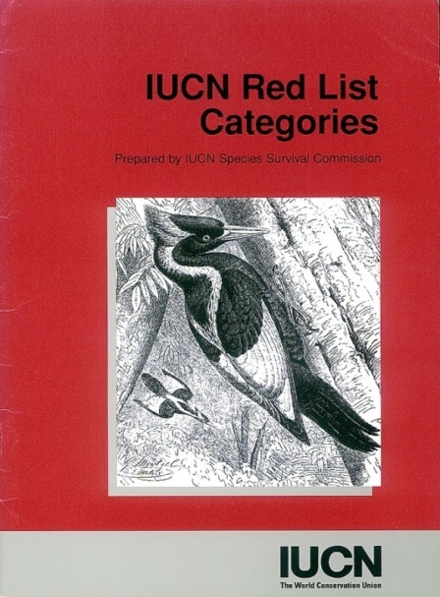
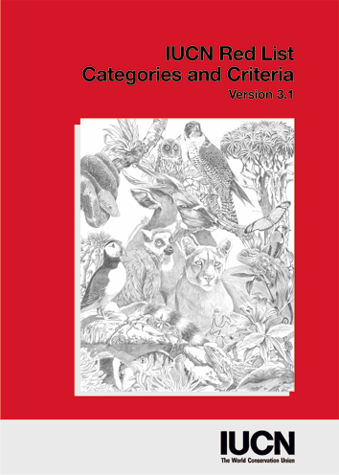
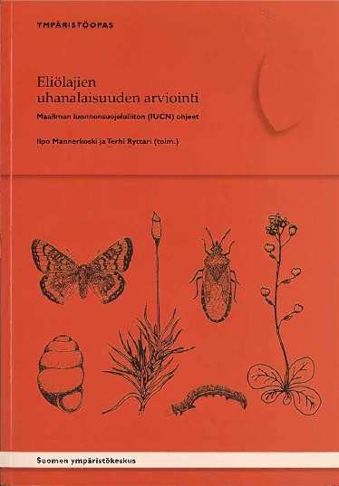
Background
The assessment followed IUCN Red List
categories and criteria
Guidelines for application at regional
levels in 2003
Finnish translation of the guidelines
with some national additions in June
2007

Slide 3
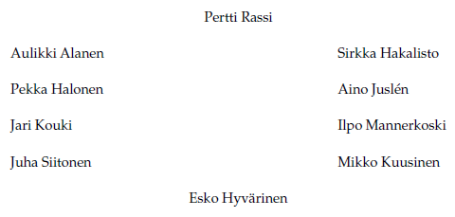
Organisation of the assessment
Steering Committee
  Expert groups (15)
Editors of red data book
Vascular plants 1990
Lichens 1991
Beetles 1991
Bryophytes 1993
Lepidoptera 1999
Hemiptera 2001
Hymenoptera 2001
Diptera 2002
Fungi 2002
Aquatic insects 2002
Molluscs 2003
Arachnida 2005
Birds 2006
Mammals 2007
Fishes 2007

Slide 4
Assessment process
The first meeting of the steering committee
6.11.2006 (20 meetings in total by 2010)
After publication of Finnish translation of
guidelines in June 2007 the assessment
work started in expert groups
Some further additions during the
assessment work based on updated IUCN
guidelines (August 2008)
Assessments were supposed to be ready by
the end of 2009, but last ones were
completed in May 2010

Slide 5
Final steps
Checking and approval of assessments January 2009 –
May 2010 (20 meetings)
Analyzing, writing, checking and editing…
Last sections of the Red Data Book ready for layout in
November 2010
Publication 1.12.2010 – after four years of work
Publication seminar (1.12.2010) with press conference and press
releases → high visibility in newspapers and
magazines and on the internet and tv-news
Seminar broadcasted live also on the internet
Continuing mediawork and press releases about threat status of
different species groups during 2011

Slide 6
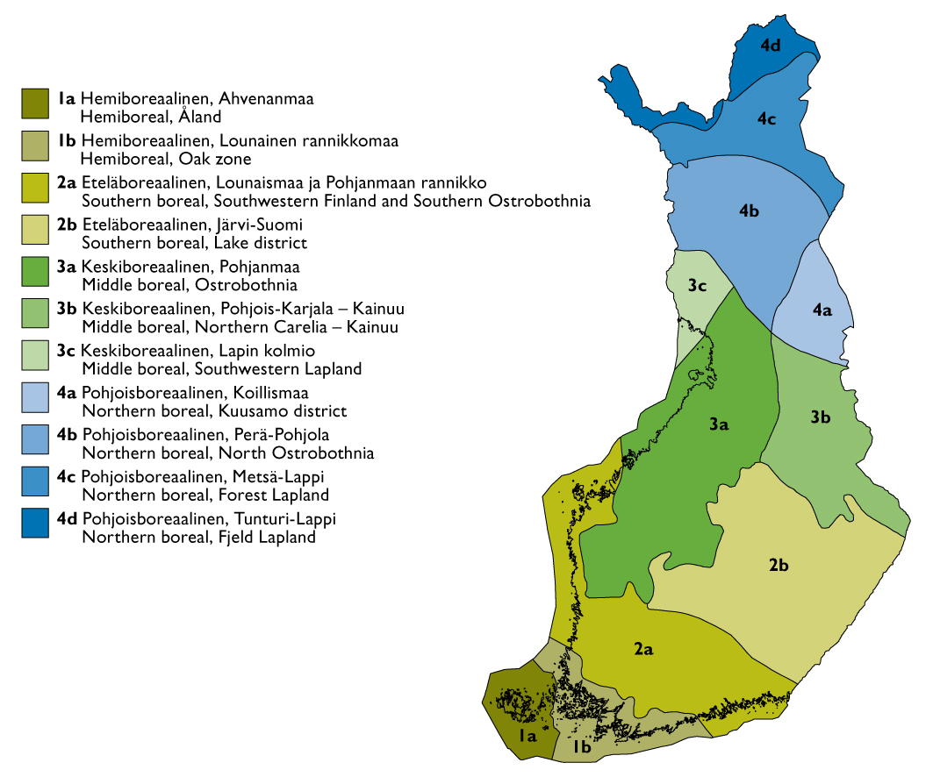
Documentation
An important part of the work that should be well
organized and instructed
Requirements set by the IUCN
National additions in Finland:
  Distribution
  Habitat (primary and other habitats)
  Causes of threat
  Threat factors
  Comment fields on occurrence, habitats,
  etc. relevant for the assessment
  Regional threat status (RT) (for some groups)
  Reasons for change of status

Slide 7
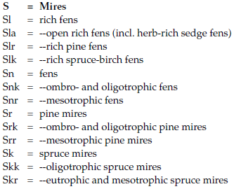
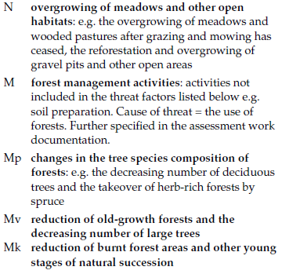
Examples of habitat classification and causes of threat

Slide 8
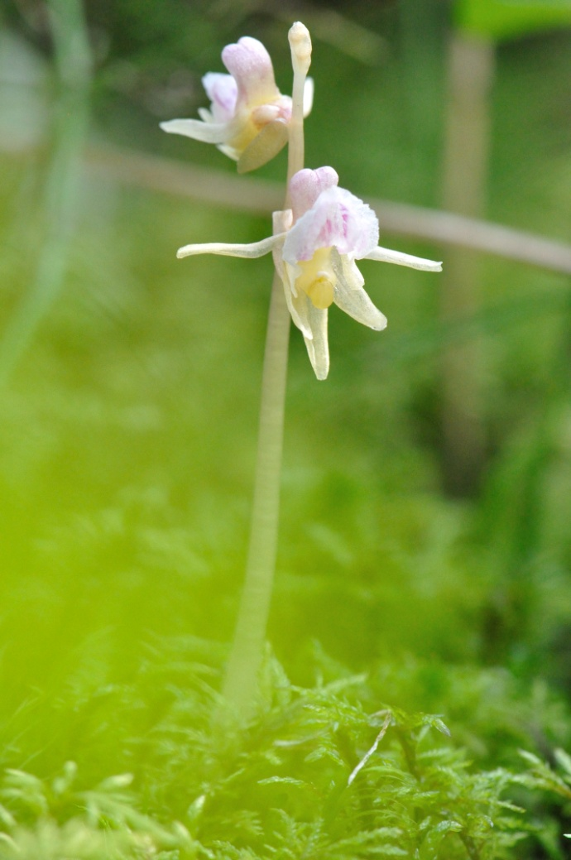
Scope of the assessment
Number of muticellular species in
Finland ca. 45 000
During the assessment work 32 218
species or lower taxa were listed
Of these, 21 398 were assessed
The rest were categorized as NE or NA
due to insufficient information for the
assessment or unestablished status in
Finland
©Esko Hyvärinen
Epipogium aphyllum - Vulnerable (VU)

Slide 9
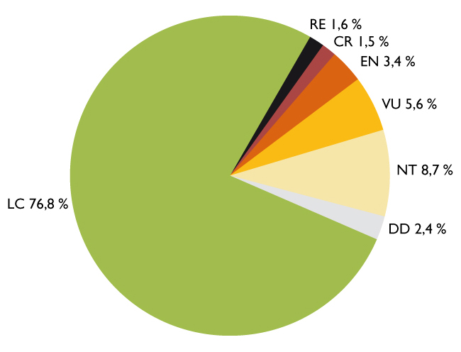
Distribution of assessed taxa (21 398) by category
2 247 threatened species
10,5 %
4 460 redlisted species
23,2 %
In the 2000 Red List
1 505 species were threatened, i.e. 10,0 % of the assessed species
RE = Regionally Extinct
CR = Critically Endangered
EN = Endangered
VU = Vulnerable
NT = Near Threatened
DD = Data Deficient
LC = Least Concern

Slide 10
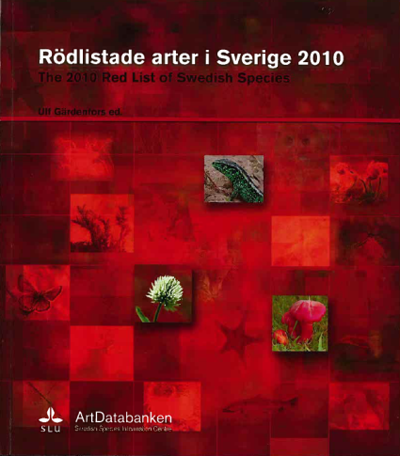
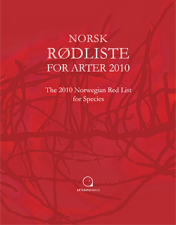
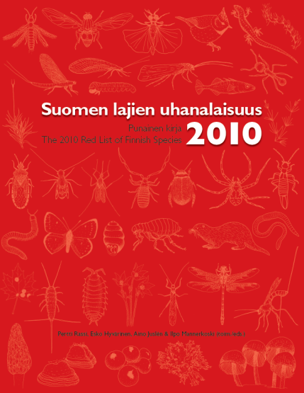
Nordic countries
Number of assessed species: Finland 21 398
Sweden 20 800
Norway 21 094

Slide 11
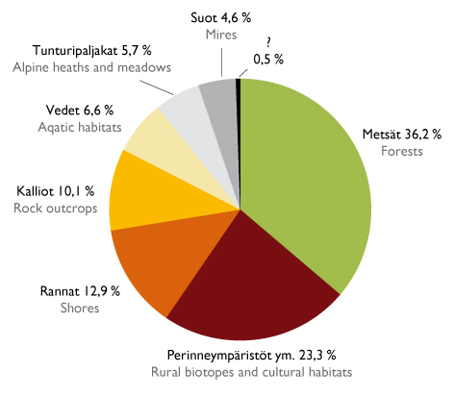
Primary habitats of threatened species

Slide 12
The most common causes of threat and threat factors of threatened species
Forest use
30,8 %
Closure of open areas
25,7 %
71 %
Stochastic factors
8,7 %
Construction
6,1 %
+ 17 other main causes
Forest use
30,1 %
Closure of open areas
26,6 %
76 %
Stochastic factors
11,1 %
Construction
8,6 %
+ 15 other main threat factors
Number of species

Slide 13
The most common causes of regional extinctions
Unknown
32,2 %
Forest use
17,8 %
Closure of open areas
15,1 %
90 %
Stochastic factors
10,5 %
Changes in arable land
8,1 %
Construction
6,6 %
+ 10 other main causes
Number of species

Slide 14
Distribution of redlisted species in Finland
Number of species

Slide 15
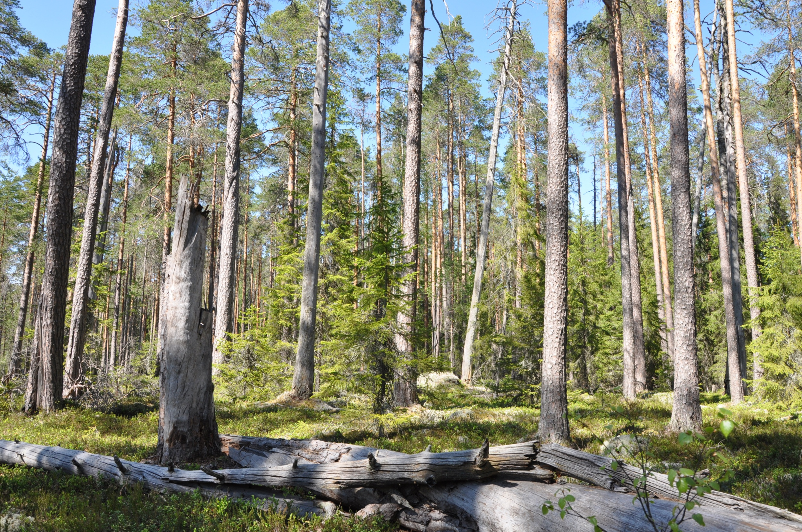
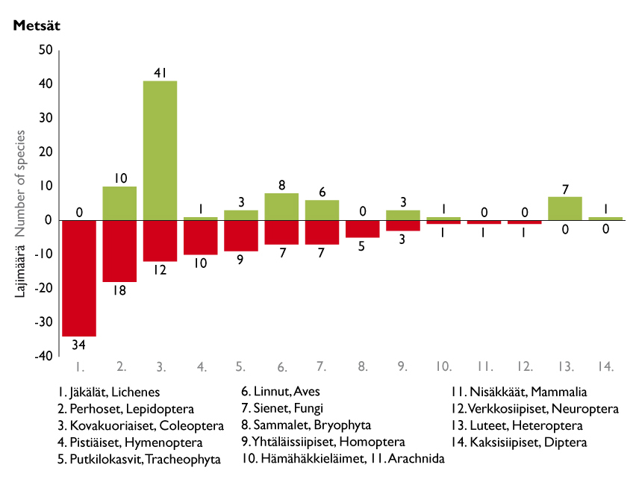
Forests
81 +
108 –

Slide 16
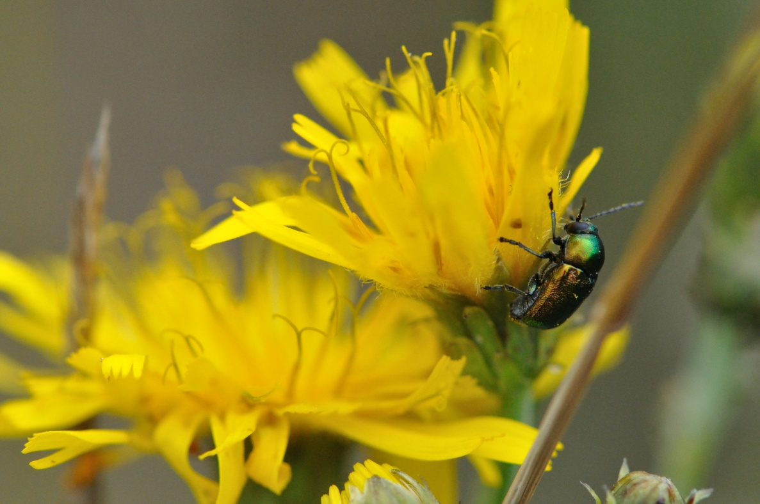
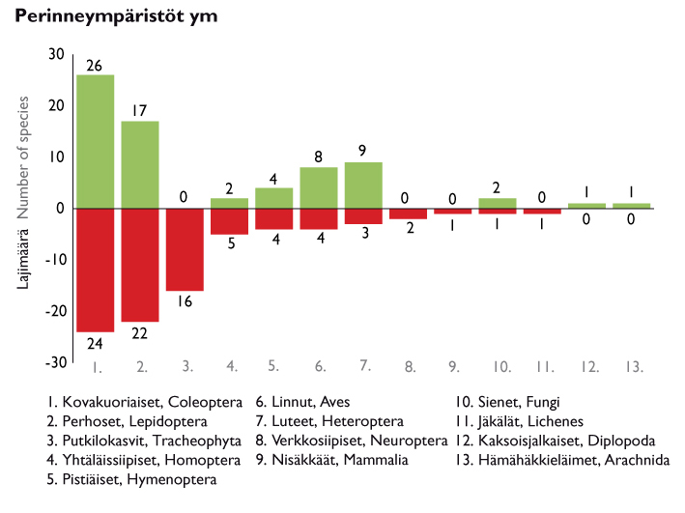
Rural biotopes and cultural habitats
70 +
83 –

Slide 17
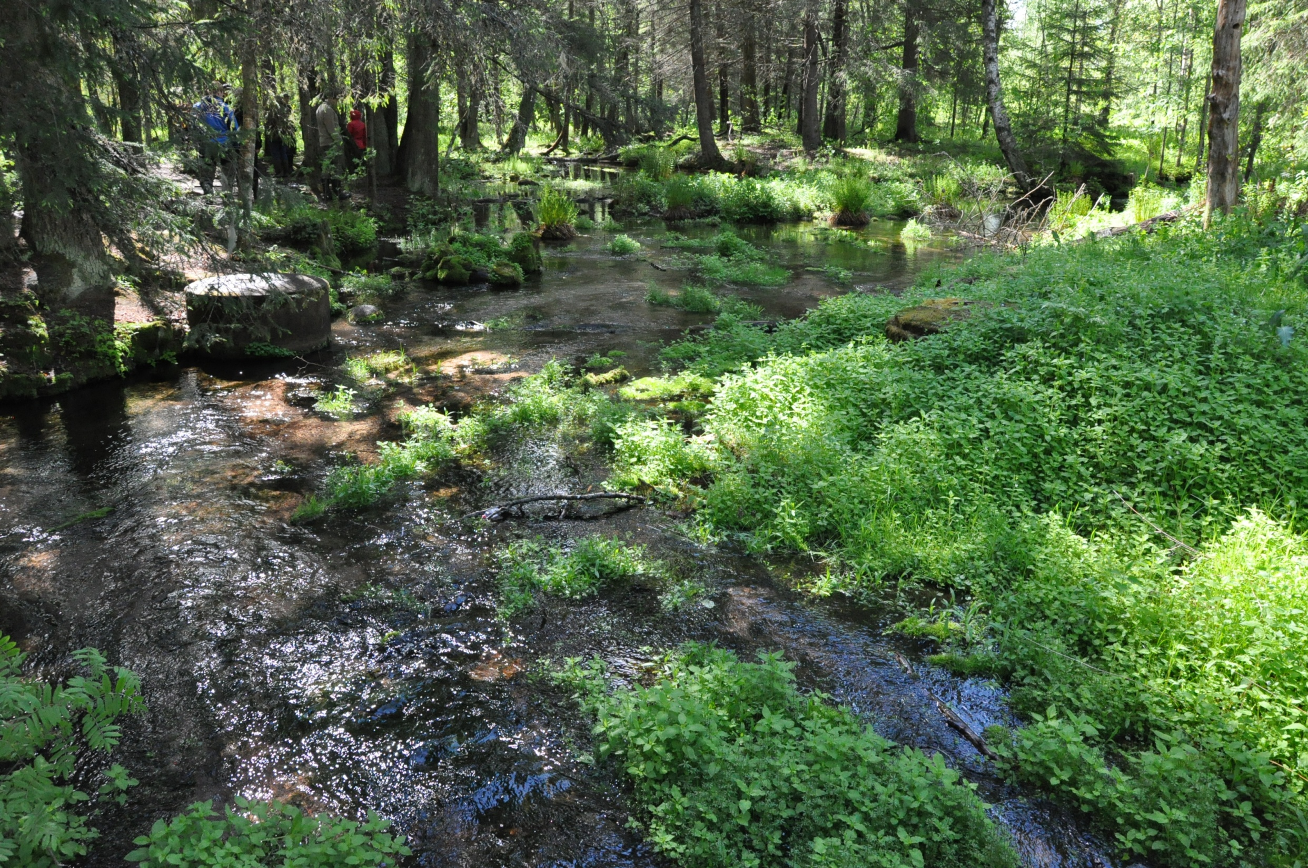
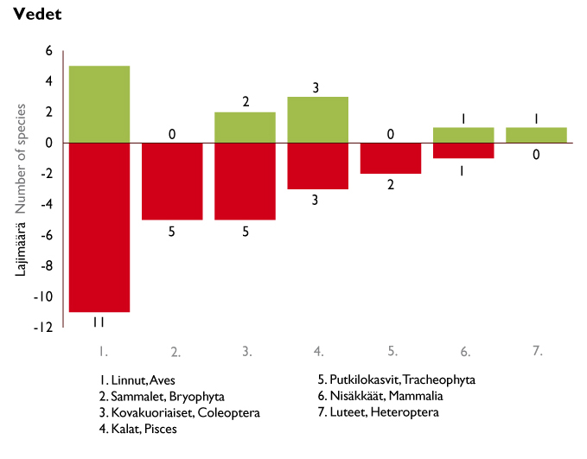
Aquatic habitats
12 +
27 –

Slide 18
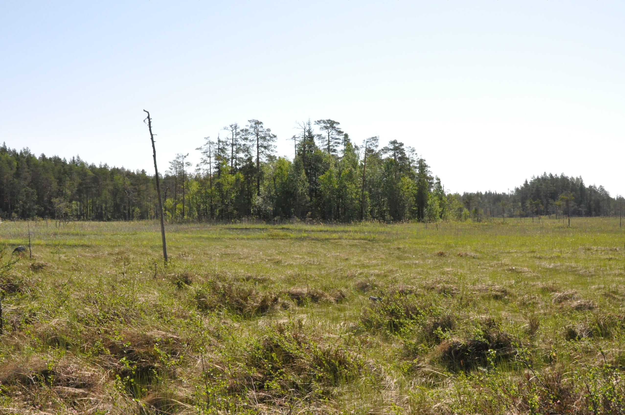
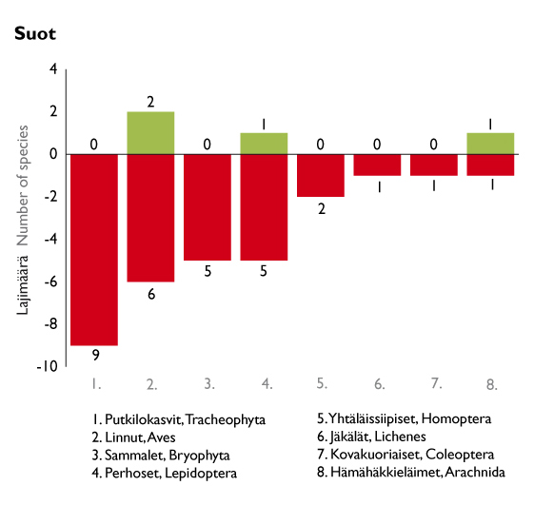
Mires
4 +
30 –

Slide 19
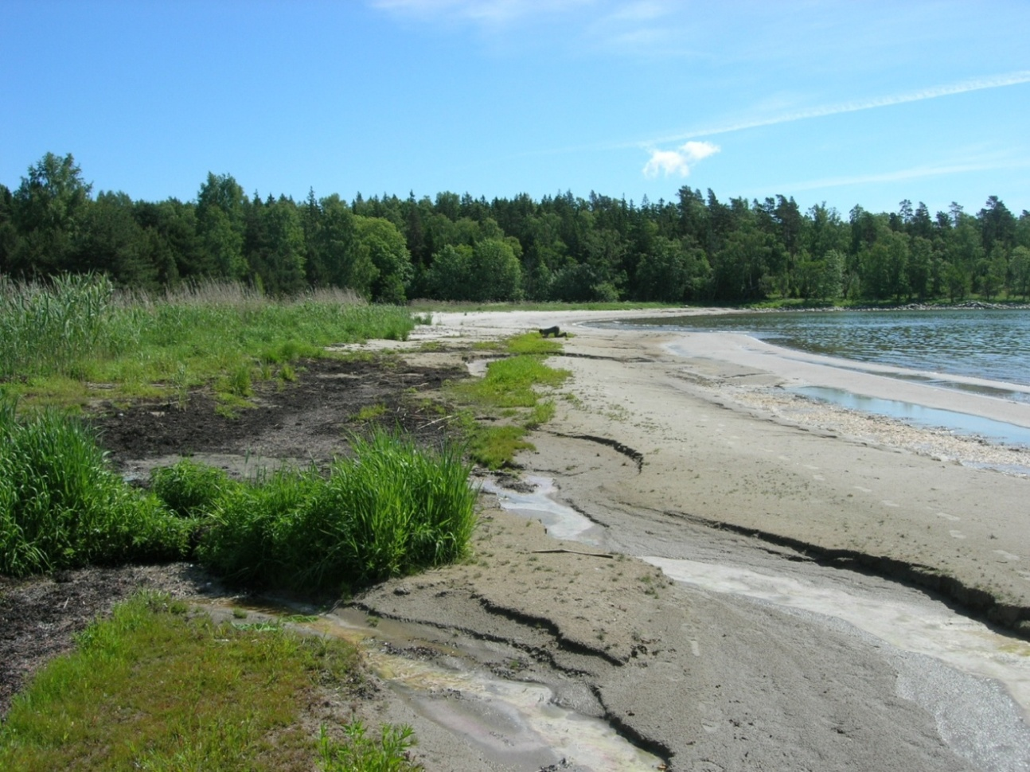
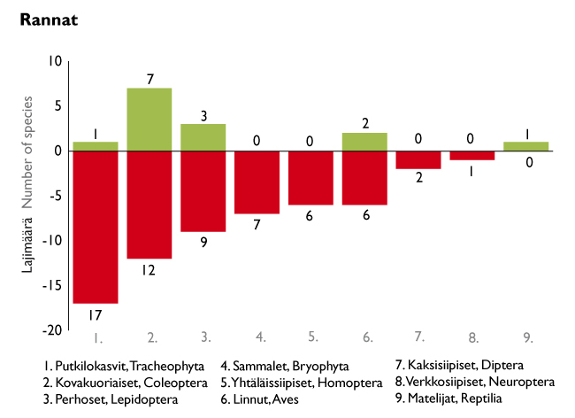
Shores
14 +
60 –

Slide 20
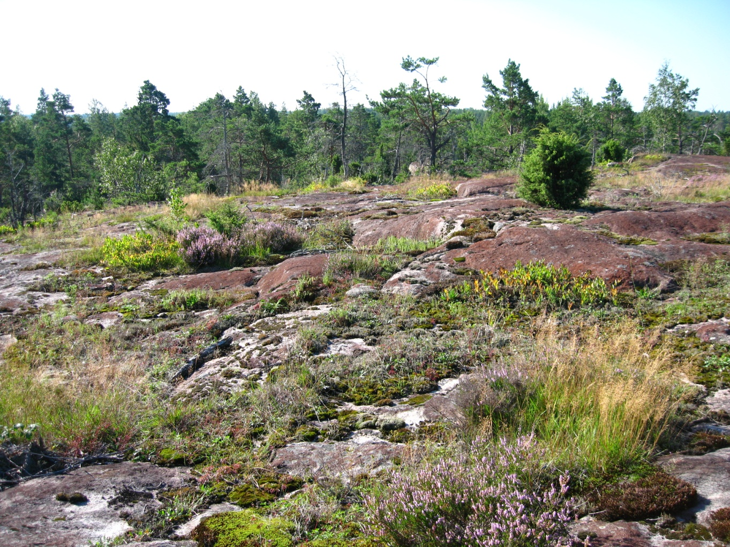
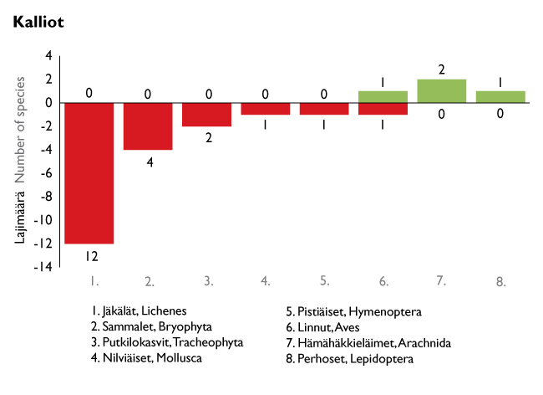
Rock outcrops
4 +
21 –

Slide 21
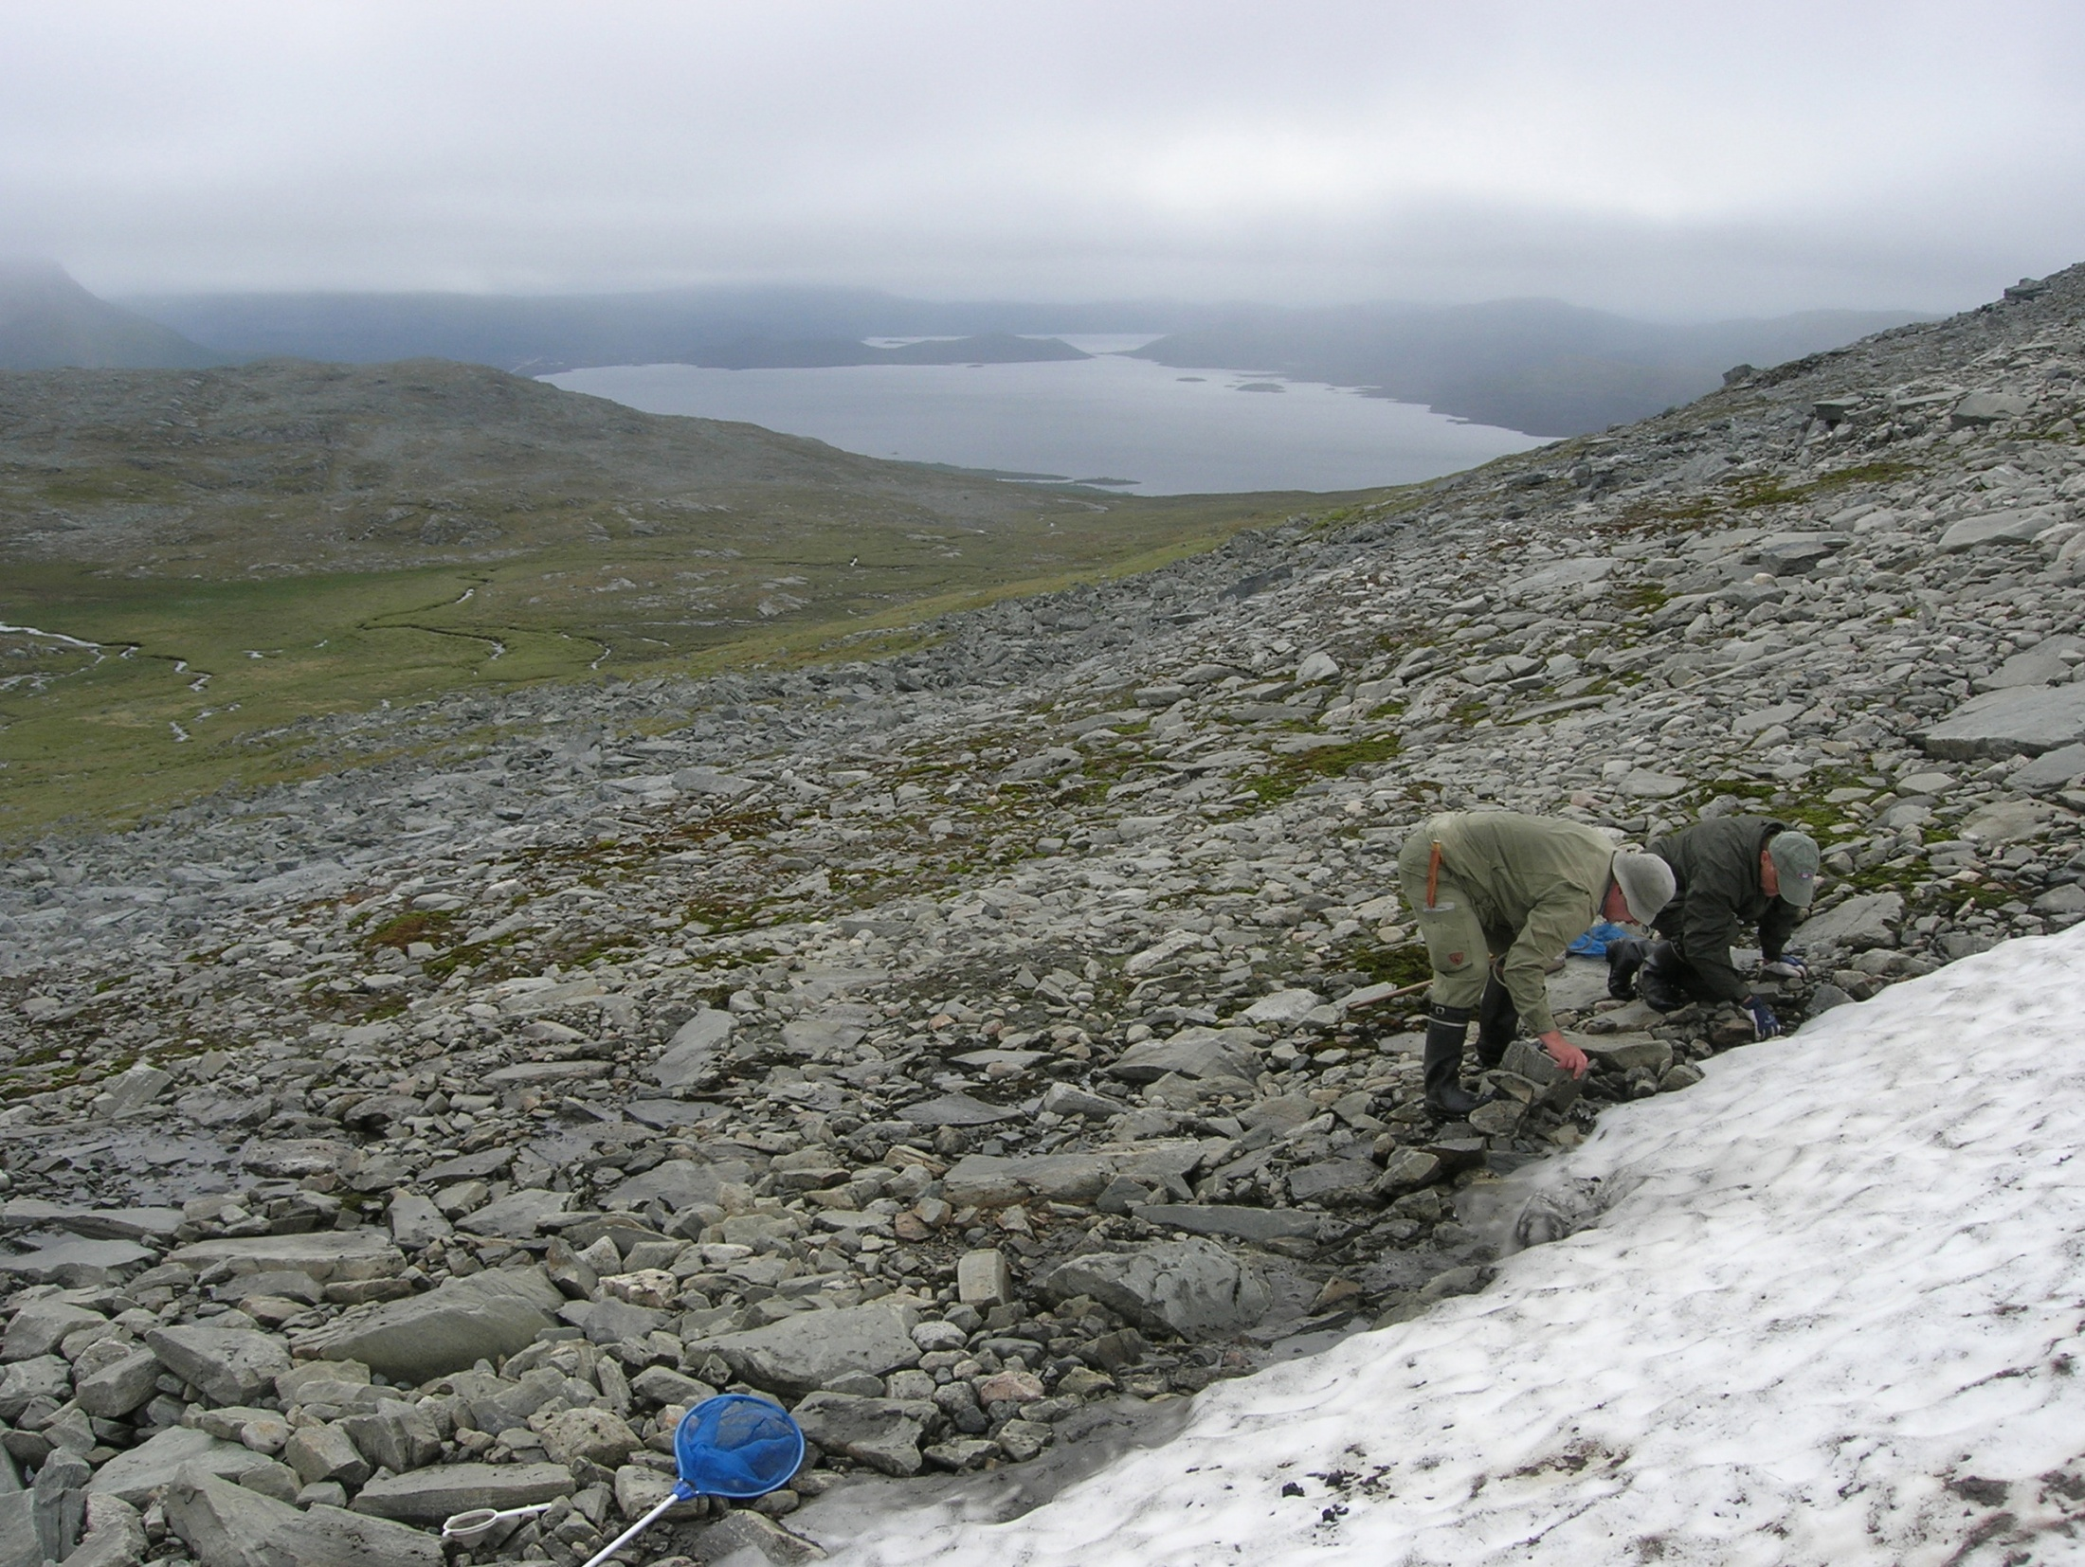
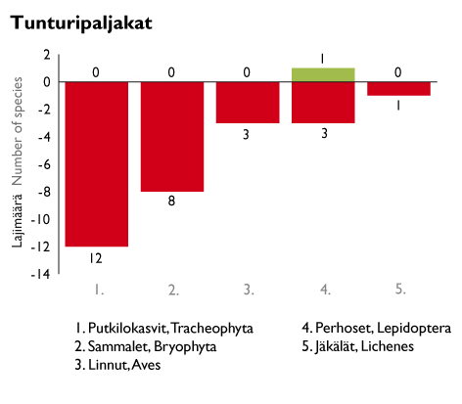
Alpine heaths and meadows
1 +
28 –

Slide 22
Genuine changes by species group

Slide 23
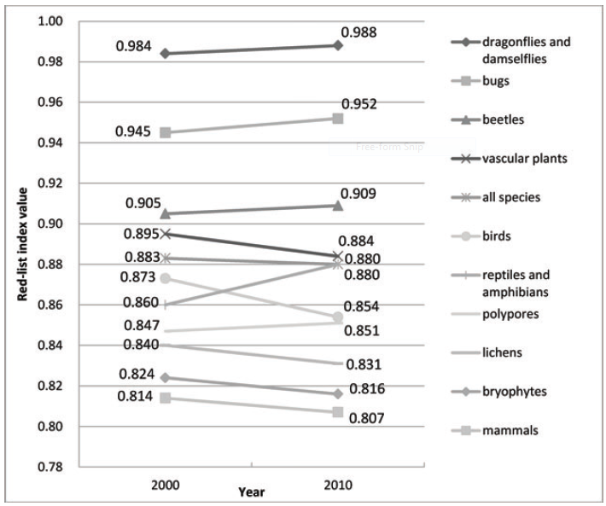
The Red List Index
Juslén, A., Hyvärinen, E. & Virtanen, L. K. 2013: Application of the Red-List Index at a National Level for Multiple Species Groups. Conservation Biology 27(2):398-406.

Slide 24
Juridical Implications of the Red List
Red List is a scientific assessment – not a juridical
document
Gives basis for annexes of the Nature Conservation Decree
  Species protected by law (136 species)
  Threatened species (2 124)
  Species under strict protection (680)
    mostly CR and EN species, also some VU
    tools for conservation in the Nature Conservation Act
  Species falling within the scope of the Hunting Act or
  the Fishing Act excluded

Slide 25
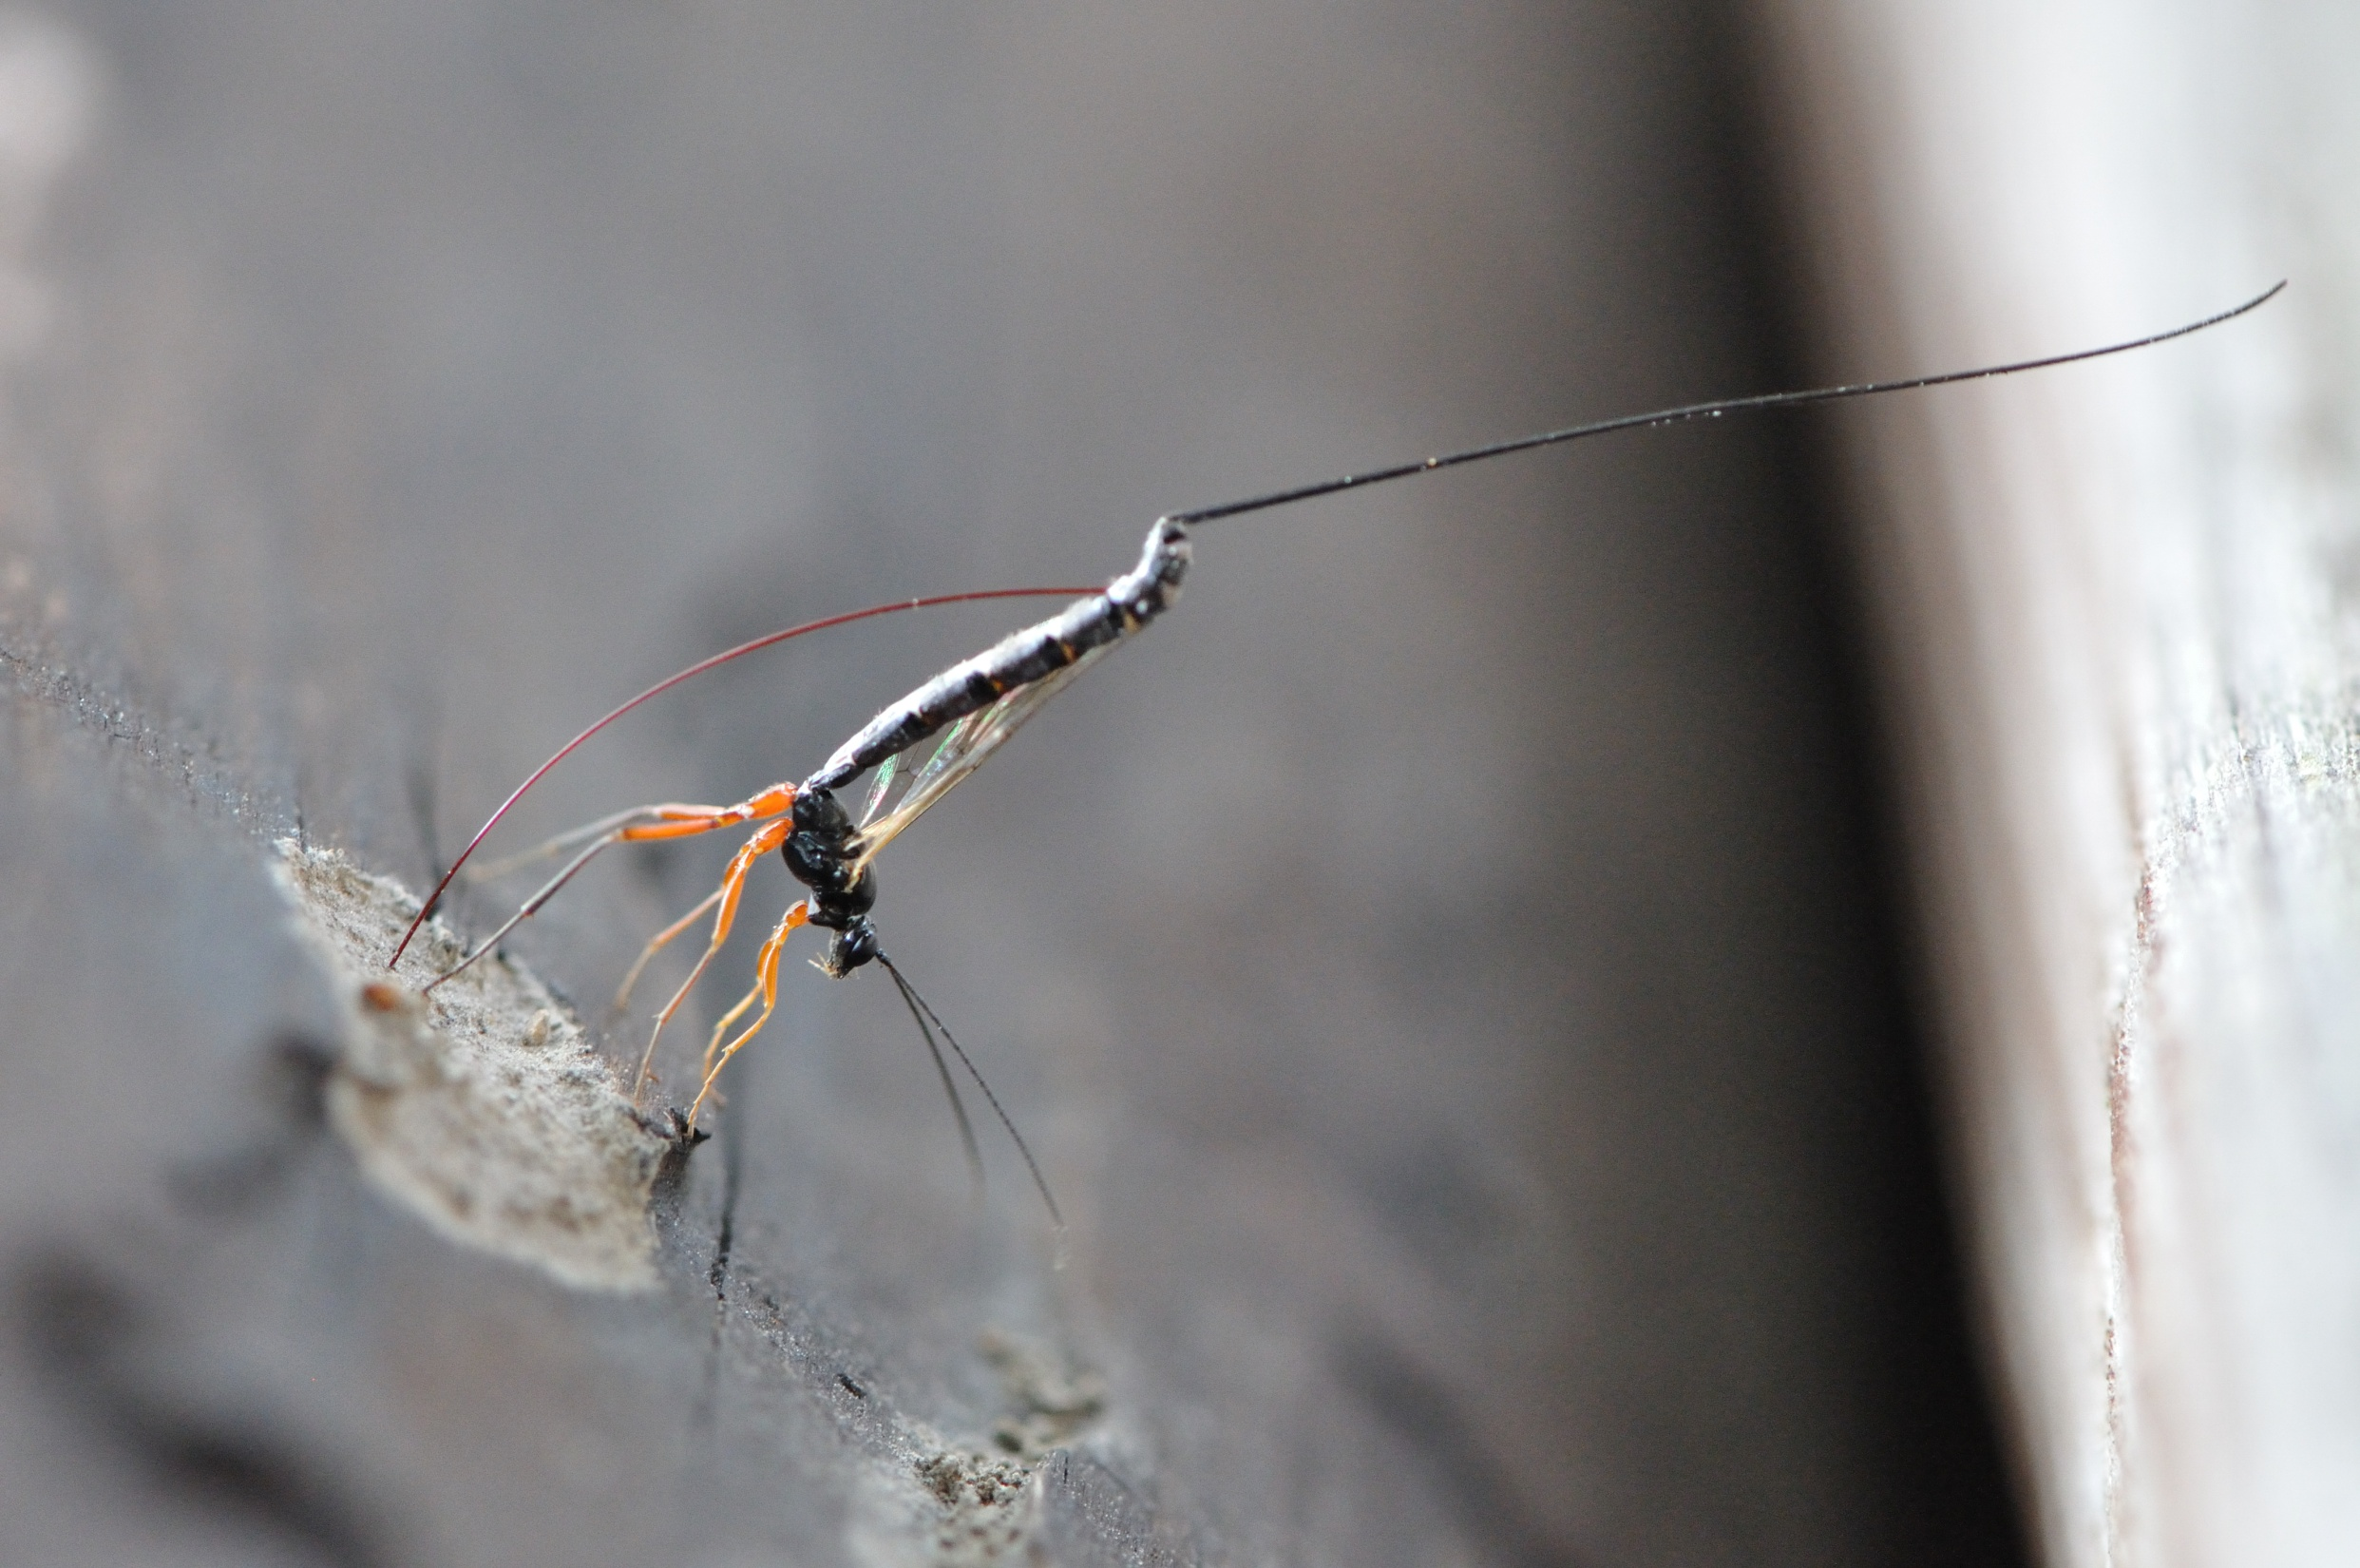
Thank you!

