Slide 1
Using the IUCN Red List Criteria at Regional Levels

Slide 2
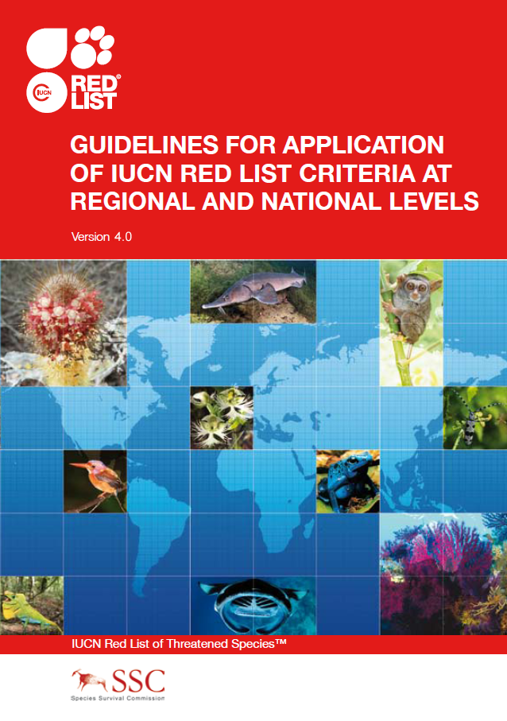
IUCN RED LIST CATEGORIES AND CRITERIA
IUCN Red List Categories and Criteria were developed for use at the global level.
Can be used at regional and national levels, with the Guidelines for Application of IUCN Red List Criteria at Regional Levels.
Free download from the IUCN Red List website (www.iucnredlist.org)
Notes:
The Red List Categories and Criteria were originally developed for use at the global level, but they can give incorrect assessments of extinction risk when used by themselves for regional assessments. Given the growing interest in using the IUCN system for national and regional red lists, IUCN developed the Guidelines for Application of IUCN Red List Criteria at Regional Levels, which adapt the Red List methodology for regional use (free to download from the Red List website).

Slide 3





Regional population may range across political borders
Region may hold a very small proportion of the global population
Taxon may be highly mobile & individuals may move between populations within & outside the region
Survival of regional population may depend on immigration from outside the region (i.e. regional population is a sink)
Taxon may be a non-breeding seasonal visitor
summer
summer
Introduced taxa?
Regionally Extinct taxa?
winter
Notes:
There are several issues that complicate regional assessments compared to global assessments. When assessing a taxon globally, every individual across the entire global range is included in the assessment, regardless of political boundaries. However, when doing a regional assessment we artificially subdivide a global population based on political borders (which are entirely irrelevant to most species!). Whereas the species may freely cross those borders as part of its greater population dynamics, we are assessing the extinction risk of only a subsection of the total population. For example:
[Click] The regional population may cross political borders. We may be assessing just the population in the ‘yellow’ country, but this is actually part of a much larger population, and the extinction risk of the part of the population within the borders of the ‘yellow’ country depends on the status of the larger population.
[Click] The taxon may be highly mobile, with individuals moving between populations both within and outside the region. Again, the part of the population within the ‘yellow’ country is not isolated, and its extinction risk will depend on dynamics between that subpopulation and the subpopulations outside the country.
[Click] The taxon may be a non-breeding seasonal visitor that only winters in our region. The extinction risk for this taxon will be heavily dependent on conditions in the breeding grounds, so we can’t realistically assess the wintering population without taking this information into consideration.
[Click] Our region may hold a very small proportion of the global population. Although the tiny population size in our region may lead us to conclude the taxon has a high extinction risk, if the global population is stable the extinction risk may actually be relatively low.
[Click] On the other hand, the survival of our regional population may depend entirely on immigration from outside the region (that is, our regional population may be a sink), so the extinction risk of the population within the region being assessed may depend heavily on the status outside the region.
[Click] We haven’t even started discussing how to deal with introduced taxa or those that are extinct in the region we are assessing but extant elsewhere.
This is why you cannot assess the extinction risk of the part of the population within those borders without considering the influence of populations outside those borders.

Slide 4
Regional versus global Red Lists
Global = LC
Regional = threatened
Global = threatened
Regional = LC
Notes:
Given these various issues, it’s not unusual for a regional assessment to differ from a global assessment:
[Click] For example, a taxon may be globally LC, but threatened within the region because the global population is large, wide-spread and stable, but within the region the population is small and declining.
[Click] A taxon may be globally threatened (typically under criterion A or C) but LC within the region because the population in the region is large and is not declining at the same rate as elsewhere.

Slide 5
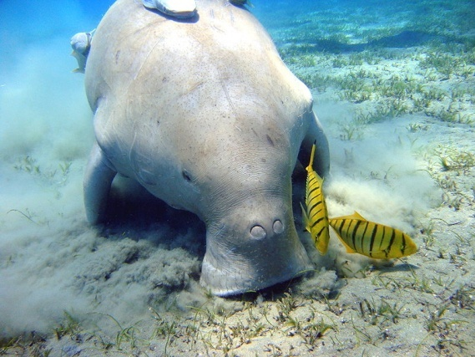
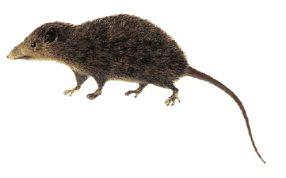
Regional versus global Red Lists
Declining or EX in at least 1/3 of global range, but stable throughout much of Australian range
  Global = VU A2bcd
  Australia = Not threatened
Photo: Julien Willem
Dugong Dugong dugon
Broad global distribution, large population, no significant threats across global range
Venezuela: many localized threats (fires, ag., cattle ranching) within very small distribution
  Global = LC
  Venezuela = VU B1ab(i,iii)
Image: Víctor Pérez
Silky Shrew Opossum Caenolestes fuliginosus
Notes:
(Note to Trainers: this slide is optional, if you’d like to give specific examples of species for which the category differs at the regional and global levels. These examples are current as of November 2011, but may change in future.).
The Dugong is an example of a species that is threatened at the global level, but not threatened regionally. The Dugong is declining or even Extinct across at least 1/3 of its global range, but is believed to be stable throughout much of its Australian range, mainly in the remote coasts of the Northern Territory and Western Australia. It is listed as VU on the IUCN Red List, but is not considered threatened in Australia.
The Silky Shrew Opossum, on the other hand, is LC globally as it has a broad distribution across Ecuador, Colombia and Venezuela, has a large global population and there are no significant threats across its global range. In Venezuela, however, the species is considered Vulnerable as it is found in only a very small area in one of the most threatened regions in the country, with much habitat loss due to forest fires, cultivation, cattle ranching, and threats associated with guerrilla presence in the area.

Slide 6
Regional assessment a three-step process:
1. Identify NA taxa
Decide which taxa are Not Applicable (NA) for the regional Red List
2. Preliminary assessment
Apply Red List criteria to the population occurring within the region only (exclude populations outside the region)
3. Final regional assessment
Evaluate potential rescue effects from populations outside the region and consider up- or down-listing accordingly.
conservation priority setting (includes other factors)
Notes:
The regional assessment process is made up of three steps:
First you must decide which taxa are Not Applicable for the regional Red List, and which taxa you will assess.
Next the regional population for each taxon is evaluated according to the IUCN Categories and Criteria, by applying the Categories and Criteria to the population within the region as if it were the only population in existence, ignoring all information from populations outside the region. A preliminary category is assigned.
Finally the effect of populations of the same taxon in neighbouring regions on the regional population is considered, and the preliminary category is up- or downlisted if appropriate.
Note that establishing conservation priorities is a completely separate process to producing a Red List, and should take other factors into consideration in addition to extinction risk (e.g. financial factors, cultural and social values, importance of the regional population, logistics, etc.). The regional Red List can feed into the conservation priority setting process, but species should never be added to or excluded from a regional Red List simply because they have some political, economic or cultural value; when conducted following the IUCN methodology, the regional Red List should be an objective evaluation of extinction risk.

Slide 7
STEP ONE – IDENTIFY NA TAXA
Taxa not eligible for regional assessments (NA)
Introduced taxa (not indigenous to the region and introduced for reasons other than conservation)
Vagrant taxa (not indigenous to the region but occurs occasionally and irregularly)
Notes:
Let’s go through the three steps in a bit more detail. In step one, we decide which taxa are Not Applicable. That is, which species are not eligible for regional assessment?
Introduced taxa – those taxa that are not native to the region and are introduced for reasons other than conservation – are not eligible for assessment. The only introduced taxa that can be assessed are those populations resulting from a benign introduction (= populations of a species not naturally found in the region that have been established in the region for conservation purposes); if the benign population is self-sustaining, it could be assessed for the regional Red List.
Vagrant taxa – those that are not native to the region but do show up in the region occasionally and irregularly – are also excluded from a regional Red List.

Slide 8
STEP ONE – IDENTIFY NA TAXA
Taxa eligible for regional assessments
Assess taxa that are native to the region
Indigenous taxa breeding within the region.
Naturally re-colonizing taxa (formerly Regionally Extinct).
Reintroduced taxa (formerly Regionally Extinct).
Marginal taxa (small proportion of global range/population within the region).
Visiting non-breeding taxa (not breeding there, but using essential resources)
See the ‘Flowchart to determine which taxa to include in a regional Red List’ in the Regional Guidelines
Notes:
The following taxa are eligible for assessment on the regional Red List. Essentially, we assess all taxa that are native to the region. This includes:
Indigenous taxa breeding within the region.
Taxa that were formerly Regionally Extinct, but have naturally re-colonized the region. These taxa may be assessed after the first year of reproduction in the region.
Reintroduced taxa may be assessed as soon as at least part of the population successfully reproduces without direct support from humans (i.e., once the offspring are shown to be viable).
Taxa that occur only marginally within the region – that is, those taxa for which only a small proportion of global range or population is found within the region (e.g. the region is at the very edge of their global range) – and visiting non-breeding taxa may also be assessed.
See also the flowchart in the Regional Guidelines document that can help you determine which taxa to include in the regional Red List.

Slide 9
STEP ONE – IDENTIFY NA TAXA
Optional filter:
Threshold to determine which taxa are included and which are Not Applicable (NA)
  e.g. <1% of the global population present/using resources in the region
Marginal taxa
Filter must be clearly stated in Red List documentation and the taxa filtered out should be assessed Not Applicable (NA).
summer
summer
winter
Visiting non-breeding taxa
Notes:
For marginal and visiting non-breeding taxa, the regional Red List authority may decide to apply a filter to determine which of these are included in the Red List and which are Not Applicable (NA).
[Click] For example, assessors may want to exclude taxa where <1% of the global population occurs within the region. This is just an example; a filter could alternatively be how regularly the taxon occurs within the region, if it is marginal/vagrant but globally threatened, etc.
[Click] Such a filter is optional. It should be determined by the regional Red List Authority at the start of the assessment process and be consistent for all taxonomic groups assessed, and should be clearly stated in the regional Red List documentation.

Slide 10

STEP TWO – PRELIMINARY ASSESSMENT
Assess species using the Red List Categories and Criteria, ignoring all data from outside the region
Endemic taxa: Regional assessment = Global assessment
Notes:
In step two, a preliminary assessment is made by applying the IUCN Red List Categories and Criteria to the total population occurring within the region only (i.e., everything occurring outside the region is ignored).
For endemic taxa, this will be the final assessment (and should be the same as the global IUCN Red List assessment). But for non-endemic taxa, this preliminary assessment may be an inaccurate indication of the true extinction risk for that taxon, because it ignores the effects of immigration. We therefore move onto step three.

Slide 11
Red List Criteria: Criterion A

Slide 12
Key terms and concepts used in Criterion A

Slide 13
Population Size
(mature individuals only)
Subpopulations
Population
Notes:
POPULATION – For the purposes of a Red List assessment, ‘POPULATION’ is defined as the total number of individuals of the taxon (including adults, juveniles, senescent individuals, etc.) across the taxon’s entire range.
POPULATION SIZE – In contrast to the general term ‘population’, the POPULATION SIZE is measured as the number of mature individuals only.
MATURE INDIVIDUALS – MATURE INDIVIDUALS are those individuals that are known, estimated or inferred to be capable of reproduction; juveniles, senescent and repressed individuals are excluded from this parameter.
The reason for population size being based on the number of mature individuals only is to allow the criteria to be applied in a consistent manner to taxa that have very different life histories. The assessment focuses on the functional part of the population only: the part that is currently able to actively contribute to the next generation.
For some taxa it can be challenging to define what a mature individual is (e.g., colonial species such as corals, fungi, lichen, etc.). The User Guidelines document provides much more information and guidance on estimating number of mature individuals appropriately for a range of different scenarios.
SUBPOPULATIONS – SUBPOPULATIONS are geographically or otherwise distinct groups within the population, between which there is little demographic exchange (typically no more than one successful migrant individual or gamete per year).

Slide 14
Generation Length
  Used to scale time-based measurements to account for different survival and reproduction rates
  e.g. ≥ 50% population decline measured over 3 generations
Notes:
GENERATION LENGTH is a concept used in red listing to scale time-based measurements (for example rate of population decline) to account for the different rates at which taxa survive and reproduce. The generation length is greater than the age at first breeding and less than age of the oldest breeding individual; for taxa that breed only once, the generation length is the age at which breeding occurs.
In the IUCN Red List Criteria, declines are measured over specific time periods, but these time periods must be appropriate for the taxon being assessed:
For a short-lived species that reproduces rapidly (for example, a dragonfly or a mouse) 10 years is a reasonable time period over which to measure a significant population decline.
For a long-lived species with a slow reproduction period (for example, a whale or a redwood tree), 10 years is an insignificant time period and population declines should be measured over a much longer time period.
Because mature individuals of different species have very different average life spans (from hours to millennia), the time period over which decline is measured is based on the generation length for the species being assessed. In this way time-based measurements are standardized appropriately across taxa.

Slide 15
Generation Length
Several definitions (all acceptable):
Average age of parents of the current cohort (“cohort” = newborn individuals in the population)
Mean age at which a cohort of newborns produce offspring
Age at which 50% total reproductive output is achieved
Mean age of parents in a population at the stable age distribution
Time required for the population to increase by the replacement rate
  Scales time-based measurements to account for different survival/reproduction rates.
  Reflects turnover rate of breeders.
  Always use natural generation length.
  See the User Guidelines for methods of calculating generation length
Notes:
Two more possible definitions of generation length include:
The mean age of the parents in a population at the stable age distribution
The time required for the population to increase by the replacement rate
The important thing to remember is that we estimate generation length to scale time-based measurements to account for the fact that different species survive and reproduce at different rates. Generation length therefore reflects the turnover rate of breeding individuals in a population. When generation length varies under threat, such as in some fish species that breed earlier when they are heavily exploited in order to boost their populations size, the more natural generation length should always be used.
Remember that the most appropriate definition for the taxon that you are assessing will depend on its specific life history characteristics. Formally, the definition of generation length requires age- and sex-specific information on survival and fecundity, and is best calculated from a life table. The User Guidelines outline other acceptable methods for calculating generation length, and IUCN also provides a spreadsheet where this can be calculated automatically.

Slide 16
Reduction
Reduction is a decline in population size (by at least the % stated in criterion A) over the specified time period.
Population Size
Time
Notes:
Reduction – A reduction is simply a decline in the population size. In the Red List Criteria, a population reduction of at least a specific percentage is measured over a specific time period, but essentially a reduction is just a population decline. The User Guidelines give more details about how to estimate a reduction from population data.
Continuing Decline – A continuing decline is a recent, current or projected future decline which is liable to continue unless remedial measures are taken. The decline may be smooth, irregular or sporadic, but the key point is that it is expected to continue unless something is done to stop or reverse the decline.

Slide 17

Past, present or future population reduction
Population Size
Time
Notes:
Criterion A is based on rate of population reduction in the past, present or future.

Slide 18
Population Size
Time
3 generations or 10 years (whichever is the longer)
To use criterion A, we first need to know:
What is the generation length? Or is it likely that a three generation time period is less than 10 years?
Notes:
All population declines in criterion A are measured over a time period of three generations or 10 years, whichever is the longer time period.
If the generation length is 2 years, three generations = 6 years. Therefore the population reduction should be measured over a 10-year time period.
If the generation length is 7 years, three generations = 21 years. You would thus measure the reduction over a 21-year period.
Therefore, to use criterion A, the first piece of information you need is: what is the generation length, or is it likely that three generations would be less than 10 years.

Slide 19

 | Critically Endangered | Endangered | Vulnerable
Geographic range
B1. Extent of occurrence (EOO) | < 100 km² | < 5,000 km² | < 20,000 km²
B2. Area of occupancy (AOO) | < 10 km² | < 500 km² | < 2,000 km²
AND at least 2 of the following 3 conditions
(a) Severely fragmented OR number of locations | =1 | ≤ 5 | ≤ 10
(b) Continuing decline observed, estimated, inferred of projected in any of: (i) EOO, (ii) AOO, (iii) area, extent and/or quality of habitat, (iv) number of locations or subpopulations, (v) number of mature individuals
(c) Extreme fluctuations in any of: (i) EOO, (ii) AOO, (iii) number of locations or subpopulations, (iv) number of mature individuals

Slide 20
Near Threatened (NT) examples:
Meets VU B1a, but:
No continuing declines not b
No extreme fluctuations not c
NT
Meets CR B2b(v), but:
>10 locations not a
No severe fragmentation not a
No extreme fluctuations not c
NT
Meets ab(iii,v):
EOO = 22,000 km² and/or AOO = 3,000 km² (highly certain estimates)
EOO = 30,000 km² and/or AOO = 3,000 km² (uncertain estimates)
NT, nearly meeting VU B1ab(iii,v)+2ab(iii,v)
Notes:
When would criterion B be used to justify listing a taxon as Near Threatened? A taxon could qualify for NT if it is close to the criterion B thresholds under the Vulnerable category. Usually this means that some of the conditions and thresholds are met, but not quite all of them. For example:
The taxon has an EOO of <20,000 km² (therefore it meets the B1 threshold for VU), and occurs in less than 10 locations (therefore it meets threshold for subcriterion a under VU); but it is not severely fragmented, there is no continuing decline, and there are no extreme fluctuations. That taxon could be listed as NT as it nearly qualifies for threatened under criterion B1. [CLICK]
The taxon has an AOO of <10 km² (therefore meeting the B2 threshold for CR), and there is continuing decline in population size (meeting the conditions for subcriterion b(v)); but, it is not severely fragmented and occurs in more than 10 locations, and there are no extreme fluctuations. The taxon could be listed as NT as it nearly qualifies as threatened under criterion B2. [CLICK]
If a taxon meets at least two of the subcriteria, but does not meet the EOO or AOO thresholds, it could be listed as NT under if:
If the EOO and/or AOO estimates are very certain, but are just above the Vulnerable values
If the EOO and/or AOO estimates are somewhat larger than the Vulnerable values, but are highly uncertain estimates (therefore these parameters might actually be much lower than current estimates suggest).
If the Assessor decides to list a species as Near Threatened, the supporting information (i.e., the species account) must explain clearly the reasons why, including which subcriteria are met, which are nearly met, and any uncertainties in the parameter estimates.

Slide 21
Points to remember:
  May use B1 or B2, or both
  Must also meet at least two of the subcriteria a, b or c
  The subcriteria will be the same for B1 and B2
        e.g. B1ab(ii,iii,v)+2ab(iii)
Notes:
Points to remember:
You may list a species under B1 or B2, or both (if it meets the thresholds values for both B1 and B2 under the same category). If the species meets the criterion B1 threshold for one category, but the threshold for B2 under a different category, then use the criterion for the most threatened category.
Along with meeting B1 and/or B2, the taxon must meet the conditions for AT LEAST TWO of the subcriteria a, b or c. To list a species in a threatened category, all of the required thresholds and conditions must be met for that category.
If the conditions for only one of the subcriteria (a, b or c) are met, then you may consider whether Near threatened can be used.
If both B1 and B2 apply to the taxon, then the final assessment will always used identical subcriteria for both B1 and B2.

Slide 22
Points to remember:
  May use B1 or B2, or both
  Must also meet at least two of the subcriteria a, b or c
  The subcriteria will be the same for B1 and B2
  B1a / B2a may be based on either severe fragmentation OR number of locations
  Remember the definitions of the terms (e.g., location)
  Be very careful with b(iii)
Notes:
Points to remember:
Subcriterion a can be based on either severe fragmentation or the number of locations; please specify in the supporting information which one you are using to list the species.
Remember the definitions of the terms used in this criterion; for example, you would define the number of locations according to the most significant threats, not the number of localities or sites where the species has been found.
Be careful when determining if there is a continuing decline in the area, extent or quality of the habitat. You should define “habitat” strictly as the specific area the species truly inhabits, considering the particular characteristics of the habitat important to the species, not a general definition like “forest” or “river”. Changes to the forest structure, for example, may or may not actually cause a decline in the quality of a particular species’ habitat and may or may not actually affect a species.

Slide 23
C
Criterion C
Small population size and continuing decline
Extinct
Notes:
Criterion C is designed to identify taxa with small populations that are currently declining or may decline in the near future.

Slide 24
C
Criterion C
Based on small population size
Population size
AND either
C1: Continuing decline in number of mature individuals at a specified rate OR
x% decline over y years
Time
C2: Continuing decline in population size at any rate AND either C2a - very small subpopulations or most mature individuals in one subpopulation; or
Notes:
[TIMED ANIMATION ON THIS SLIDE]
Criterion C is based on a small population size, and either:
[CLICK] Subcriterion C1: a continuing decline in the number of mature individuals at a specific estimated rate, OR
[CLICK] Subcriterion C2: a continuing decline in the population size at any rate, and either:
C2a: a population structure of either very small subpopulations or most of the mature individuals distributed in just one subpopulation [CLICK], OR

Slide 25
C
Criterion C
Based on small population size
AND either
C1: Continuing decline in population size at a specified rate OR
C2: Continuing decline in population size at any rate AND either C2a - very small subpopulations or most mature individuals in one subpopulation; or C2b - extreme fluctuations in population size.
Notes:
[TIMED ANIMATION ON THIS SLIDE]
…C2b – extreme fluctuations in population size [CLICK].
[NOTE TO TRAINER: The animation on this slide shows a population that is undergoing extreme fluctuation AND continuing decline in population size]

Slide 26
C
Criterion C
Small population size
C1: estimated decline in a specific time period
C2: general continuing decline
C2a(i): Small # mature individuals in each subpopulation
C2b: Extreme fluctuations in # mature individuals
C2a(ii): Most (90%+) individuals in 1 subpopulation
Notes:
Criterion C can seem a bit complex at first, but really you just have to answer a series of questions.
First estimate the population size. If this falls within the threshold for criterion C, then;
Determine whether there is a continuing decline in population size. If there is, then:
Are there data available to determine the rate of decline? If so, then consider subcriterion C1 (does the rate of decline fall within the C1 threshold).
Criterion C2 can be considered even without the rate of decline being known. For criterion C2, as
How large is each subpopulation? If all are very small, then subcriterion C2a(i) may be used.
What proportion of the population size falls within the largest subpopulation? If most of the population size is within just one subpopulation, then subcriterion C2a(ii) may be used.
Are there are extreme fluctuations in population size? If so, then criterion C2b may be used.
[NOTE TO TRAINER: Someone may ask whether a species can be listed under both subcriteria C1 and C2 (this question stems from the use of the word “OR” in the Red List Criteria). If a species qualifies for both C1 and C2, it should be listed under both. For C2, it can qualify for any or all of C2a(i), C2a(ii) and C2b.]

Slide 27
C
 | Critically Endangered | Endangered | Vulnerable
Population size
Number of mature individuals | < 250 | < 2,500 | < 10,000
AND at least 1 of C1 or C2
C1. Observed, estimated or projected continuing decline | 25% in 3 years or 1 generation | 20% in 5 years or 2 generations | 10% in 10 years or 3 generations
C2. Observed, estimated, projected or inferred continuing decline AND at least 1 of the 3 following conditions:
(ai) No. of mature individuals in each subpopulation | ≤ 50 | ≤ 250 | ≤ 1,000
(aii) % mature individuals in one subpopulation | 90-100% | 95-100% | 100%
(b) Extreme fluctuations in the number of mature individuals

Slide 28
C
Near Threatened (NT) examples:
Population size = 15,000 mature individuals Close to VU
Estimated 10% decline over last 3 generations and population continues to decline Meets C1
NT C1
Population size = 13,250 mature individuals Close to VU
Population is declining, but rate unknown Meets C2
All individuals found in 1 subpopulation Meets C2a(ii)
NT C2a(ii)
Population size < 2,500 mature individuals Meets EN
Population is declining, but rate unknown Meets C2
Largest subpop = 1,180 mature individuals Close to C2a(i)
NT C2a(i)
Notes:
As for the other criteria, to qualify for Near Threatened based on criterion C, the species should either be close to meeting the Vulnerable thresholds, or meet some but not all of the required conditions for the criterion. For example:
If the population size is 15,000 – close to the VU threshold – and the criteria are otherwise met for C1, the taxon could be listed as Near Threatened.
Again the population size is close to the VU threshold, and this time, the subcriteria for C2a(ii) are met. Since the population size is close to the VU threshold, the taxon could be listed as NT.
In this case, the population size is under 2500 and the population is declining (so far meeting the subcriteria for EN), but the largest subpopulation just exceeds the VU threshold value for the number of mature individuals in each subpopulation. This taxon could also be listed as NT.

Slide 29
C
Criterion C points to remember:
2
7
1
12
To use criterion C, an estimate of the population size is needed
3
4
8
13
6
10
5
9
11
To use criterion C1, an estimate of the generation length is needed
1, 2 or 3 generations? or
3, 5 or 10 years?
Notes:
Points to remember when using criterion C:
First of all, you must have an estimated population size in order to use C. If you don’t know how many mature individuals there are, you cannot use criterion C.
To use C1, you must know the generation length as the % declines are measured over either specific time periods or a specific number of generations, whichever is longer.

Slide 30
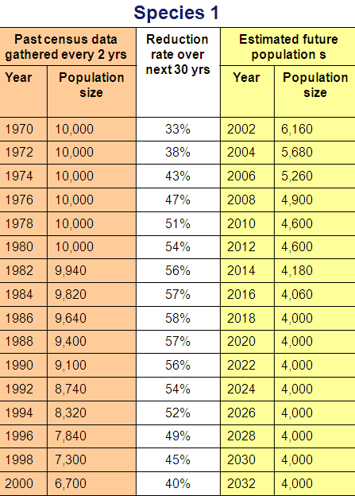
C
Criterion C points to remember:
For C1, you need some population data to be able to estimate the reduction rate.
For C2, population decline can be at an unknown rate, but population structure or fluctuations must follow the rules in C2a or C2b.
Notes:
Points to remember when using criterion C:
To use C1, you need some population data to be able to estimate the rate of decline.
For C2, the population decline can be at a general, unknown rate over an unknown time period, but the population structure must follow the rules outlined in C2a or C2b.

Slide 31
D
Criterion D
Very small or restricted population
Notes:
Criterion D identifies species with a high risk of extinction because they have extremely small or restricted populations.

Slide 32
D
Criterion D
Based on
D and D1: VERY small population size
OR
D2: VERY restricted AOO or few locations (VU only)
Notes:
A taxon can be listed under criterion D if it has a very small population size, or if it has a very restricted area of occupancy or is found in just a few locations. Remember what the IUCN definitions of AOO and location are when using this criterion.

Slide 33
D
 | Critically Endangered | Endangered | Vulnerable
D. Number of mature individuals | < 50 | < 250 | D1. < 1,000
D2. Restricted area of occupancy of number of locations + plausible threat | Only applies to Vulnerable category |  | Typically: AOO ≤ 20 km² or locations ≤ 5
D2: requires plausible future threat that could drive the taxon to CR or EX in a very short time period
CR
EN
D
VU
D1/D2

Slide 34
D
Near Threatened (NT) examples:
Population size = 1,500 mature individuals
Nearly meets VU D1
NT (nearly meets VU D1)
Best population size estimate = 2,000 mature individuals
Estimate very uncertain; population may be as low as 1,000
NT (nearly meets VU D1)
AOO = 12 km² and 3 locations
Population being harvested but not currently declining
Harvest may increase (= plausible threat) but species only likely to become VU or EN (not EX or CR) within 1-2 generations
NT (Nearly meets VU D2)
Notes:
If your taxon is close to meeting the population size threshold for Vulnerable, you could list it under Near Threatened.
If the best estimate for the population size is more than the threshold, but the estimate is very uncertain and the population might be as small as 1000 mature individuals, you could list it under NT D1.
For D2, you would most often list a taxon as Near Threatened if a plausible threat exists that could cause the taxon to decline, but not quickly enough that it would become CR or even EX within just a few generations. If the taxon could become VU or EN within 1-2 generations, you could list it as NT D2.

Slide 35
D
More examples:
Taxon lives in one lake. AOO = 22 km²
Population currently stable.
No current threats, but introduction of invasive predatory fish has occurred in other nearby lakes. If fish are introduced, population will surely plummet and could become Extinct.
VU D2
AOO = 17 km²
Population is not declining
No current threats, no plausible future threats; population likely to remain stable.
LEAST CONCERN
Notes:
To get a better idea of how VU D2 works, let’s look at 2 more examples. Say we have a taxon that is found in just one lake, with an area of occupancy of 22 km². The taxon is stable at the moment, but predatory fish have been introduced into nearby lakes and it is highly possible they could be introduced into the lake where our taxon lives. If this were to happen, the fish could easily cause the population to plummet and possibly even go extinct. Even though the AOO is slightly higher than the “typical” value, the extinction risk is very real and the taxon would be listed as VU D2.
On the other hand, even if a taxon has a very small AOO and is found in just a few locations, if there are no current or future plausible threats and the population is likely to remain stable, the extinction risk is low and taxon should be listed Least Concern.
NOTE FOR TRAINERS: the AOO figures given in this slide are not divisible by 4 (i.e., implying that the 2x2 km grid was not used for these estimates). The 2x2 km grid is strongly preferred, but sometimes a species occurs in a very distinct area that can be taken as the AOO without using the 2x2 km grid(e.g., within one lake only) . The important thing is to clearly document how AOO was estimated.

Slide 36
D
Criterion D points to remember:
2
7
1
12
To use criteria D or D1, an estimate of the population size is needed
3
4
8
13
6
10
5
9
11
D1 & D2
Vulnerable category only
Notes:
Points to remember:
To use D or D1, you must have an estimate of the population size.
D1 and D2 are only used for the Vulnerable category. For CR and EN, taxa are listed only under “D”.

Slide 37
D
Criterion D points to remember:
For D2, there must be a serious plausible threat to the population and this must be stated in the assessment.
D2. typically:
AOO <20 km² or number of locations ≤ 5
For D2, the thresholds noted in the criteria are examples only.
Notes:
Points to remember:
To use VU D2, there must be a serious plausible threat that could cause the taxa to become Critically Endangered or even Extinct within just a few generations, and this threat must be stated in the assessment.
For VU D2, the threshold values given in the criteria are given as indicators only. The most important focus of VU D2 is that the taxon is found in a very restricted area and there is a plausible threat that could cause it to become highly threatened within a very short time period.

Slide 38
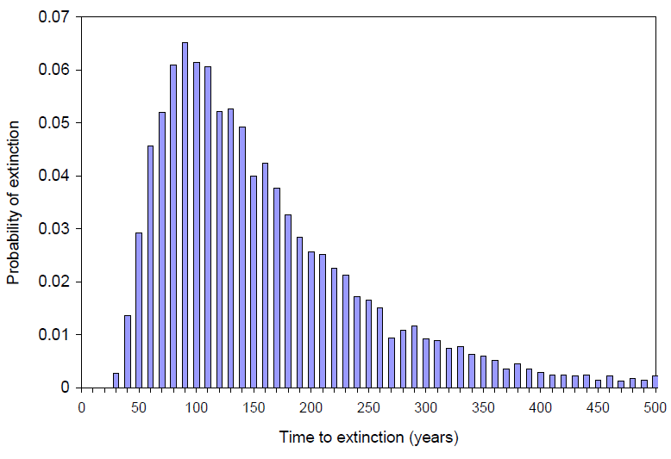
E
Criterion E
Quantitative analysis
Notes:
To qualify under criterion E, a quantitative analysis such as a Population Viability Analysis (PVA) must be conducted to determine a species’ probability of extinction over a given time period.

Slide 39
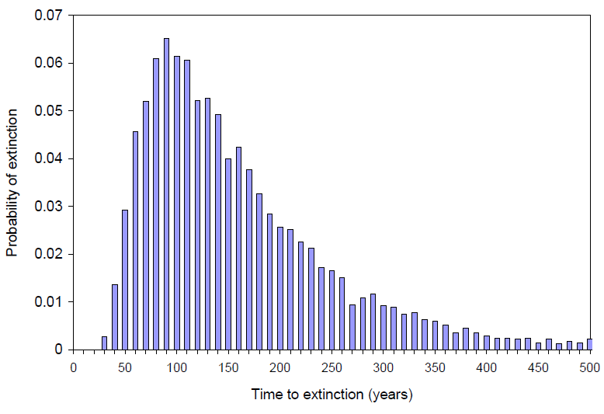
E
Quantitative Analysis
Quantitative Analysis is any form of analysis which estimates the extinction probability of a taxon based on known life history, habitat requirements, threats and any specified management options (e.g., Population Viability Analysis (PVA)).
Notes:
Quantitative analysis – A quantitative analysis any form of analysis which estimates the extinction probability of a taxon based on known life history, habitat requirements, threats and any specified management options. Population viability analysis (PVA) is one such technique. Such detailed data isn’t available for most species, but if you can run a quantitative analyses, the assumptions, the data used and the uncertainty in the data or quantitative model must be documented. Quantitative analyses are used for assessing taxa under Criterion E.

Slide 40
E
Criterion E
Based on a quantitative analysis showing a probability of extinction in the wild is at least:
50%
20%
Critically Endangered
10%
Endangered
Vulnerable
Within 10 years or 3 generations
Within 20 years or 5 generations
Within 100 years
Up to a maximum of 100 years in the future
Notes:
Criterion E has very specific thresholds for the probability and time period over which extinction is likely to take place, for each of the three threatened categories. It is measured up to a maximum of 100 years into the future. Very few species on the IUCN Red List are listed under criterion E, but if you have sufficient data to run a quantitative analysis, you can find more guidance in the User Guidelines about which methods and models can be used.

Slide 41
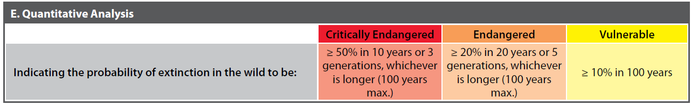
E
Notes:
The threshold values are also given on the criteria summary sheet.

Slide 42
STEP THREE – FINAL REGIONAL ASSESSMENT
Identify source-sink relationships with populations outside region
Vagrant taxa (not indigenous to the region but occurs occasionally and irregularly)
Notes:
Let’s go through the three steps in a bit more detail. In step one, we decide which taxa are Not Applicable. That is, which species are not eligible for regional assessment?
Introduced taxa – those taxa that are not native to the region and are introduced for reasons other than conservation – are not eligible for assessment. The only introduced taxa that can be assessed are those populations resulting from a benign introduction (= populations of a species not naturally found in the region that have been established in the region for conservation purposes); if the benign population is self-sustaining, it could be assessed for the regional Red List.
Vagrant taxa – those that are not native to the region but do show up in the region occasionally and irregularly – are also excluded from a regional Red List.

Slide 43
STEP THREE – REGIONAL ASSESSMENT
Step 2:
Assess the regional population according to the Red List Criteria
Breeding populations:
No
unlikely
Downlist
category from step 2
3b. Is the immigration expected to decrease?
Yes / likely
3a. Does the regional population experience any significant immigration of propagules likely to reproduce in the region?
Yes / unknown
3c. Is the regional population a sink?
Yes
likely
Uplist
category from step 2
No / unknown
No / unknown
No
change
from step 2
Visiting populations:
3d. Are the conditions outside the region deteriorating?
3e. Are the conditions within the region deteriorating?
3f. Can the breeding population rescue the regional population should it decline?
Downlist
category from step 2
No
unlikely
No
unlikely
Yes
likely
Yes / unknown
Yes / unknown
No / unknown
No
change
from step 2
Notes:
Once you have the preliminary assessment from step 2, the existence and status of populations outside the region is investigated and, if necessary, the assessment adjusted appropriately. In step 3 we use the flowchart to answer a series of questions. These questions determine whether there are populations outside the region that may “rescue” the regional population through immigration. The questions asked differ for taxa that are breeding within the region and those that are regular visitors to the region but do not breed there.
<CLICK>
First let’s look at breeding populations. In relation to the regional population, Assessors ask themselves:
3a. Does the regional population experience any significant immigration of propagules (i.e., individuals, pollen, larvae, etc.) from outside the region and are these likely to settle and reproduce within the region? If no/unknown, the population is effectively isolated (i.e., there is no known rescue effect from outside the region) and the probability of extinction within the region determined in step 2 is correct; the preliminary assessment does not change. If yes/likely then move on to question 3b.
3b. Is the immigration expected to decrease? If no/unlikely then there is a potential rescue effect from outside the region. The preliminary assessment in step 2 was an over-estimate of extinction risk, therefore it is appropriate to downlist the assessment by a category (e.g., if the taxon was EN in step 2, it would be downlisted to VU in step 3). If yes/unknown (e.g. because conditions outside the region are deteriorating and the populations there are declining) then move on to question 3c.
3c. Is the regional population a sink? (i.e. is the existence of the regional population highly dependent on the immigration of individuals from outside the region?). If yes/likely then the preliminary assessment is an underestimate of extinction risk because the regional population is unable to sustain itself without immigration and that immigration is expected to decrease. It is appropriate to uplist the assessment by a category (e.g., if the taxon was listed as EN in step 2, it would be uplisted to CR in step 3). If no/unknown, then the preliminary assessment should remain unchanged. Although there is immigration, and this is expected to decrease, the regional population is not known to rely heavily on immigration for its continued existence; immigration doesn’t act to “rescue” the regional population, therefore the preliminary assessment is a good estimate of extinction risk.

Slide 44
STEP THREE – REGIONAL ASSESSMENT
Step 2:
Assess the regional population according to the Red List Criteria
Breeding populations:
No
unlikely
Downlist
category from step 2
3b. Is the immigration expected to decrease?
Yes / likely
3a. Does the regional population experience any significant immigration of propagules likely to reproduce in the region?
Yes / unknown
3c. Is the regional population a sink?
Yes
likely
Uplist
category from step 2
No / unknown
No / unknown
No
change
from step 2
Visiting populations:
3d. Are the conditions outside the region deteriorating?
3e. Are the conditions within the region deteriorating?
3f. Can the breeding population rescue the regional population should it decline?
Downlist
category from step 2
No
unlikely
No
unlikely
Yes
likely
Yes / unknown
Yes / unknown
No / unknown
No
change
from step 2
Notes:
Visiting populations:
3d. Are the conditions outside the region deteriorating? If yes/unknown, the preliminary assessment has already taken this into account (i.e. individuals visiting the region are affected by conditions outside the region and this is reflected in the preliminary assessment), therefore the assessment should not change. If no/unlikely then move on to question 3e.
3e. Are the conditions within the region deteriorating? If yes/unknown then the preliminary assessment has already taken this into account, therefore the assessment should not change. If no/unlikely move on to question 3f.
3f. Can the breeding population rescue the regional population should it decline (e.g. if the regional population declines, can individuals from breeding populations outside the region replace the lost visiting individuals). If yes/likely then there is a potential rescue effect from populations outside the region and it is appropriate to downlist the category. If no/unknown, then there is no need to change the preliminary assessment.

Slide 45
Data Quality & Uncertainty

Slide 46
Dealing with a lack of high quality data
The threatened categories use quantitative thresholds
BUT a lack of high quality data should not deter assessors from applying the IUCN criteria.
Notes:
The Red List criteria can seem daunting to Assessors at first. Although quantitative thresholds are used to determine which threatened category a species can be listed under, the system also allows for uncertainty in the available data, and also for situations where there are very little direct data at all.
It is clear that if we were to rely only on lots of detailed research data that is 100% certain, very few species would ever be assessed beyond Data Deficient. So, a range of data quality is acceptable for use in an IUCN Red List assessment.

Slide 47
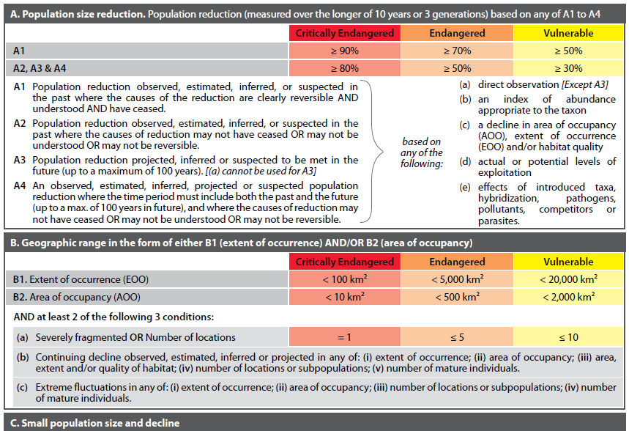
Notes:
In the Red List Categories and Criteria you will see the following terms used:
Observed
Estimated
Projected
Inferred
Suspected
These terms refer to the quality of the information used in the assessment, as defined in the Red List Categories and Criteria. The full definitions for each of these terms appears in the User Guidelines document.

Slide 48
Observed
Observed information is directly based on well-documented observations of all known individuals in the population.
For example: entire global population occurs in only one area and all individuals counted each year
Year 4 population = 8
Year 3 population = 15
Year 1 population = 19
Observed reduction of 58% over 4 years
Year 2 population = 17
Notes:
Observed data is the highest quality information we can obtain. It is directly based on well-documented observations of ALL known individuals in the population.
For example, if the entire global population of a species occurs in one small area and all mature individuals within the population are counted each year, then the Assessor would know for certain what the rate of decline for that species is. In the example shown, an observed reduction of 58% over 4 years can be calculated based on data from annual population size counts.

Slide 49
Estimated
Estimated information is based on calculations that may involve assumptions and/or interpolations in time (in the past).
For example: repeated surveys of sample sites across total range
A
Date | Site A | Site B | Site C | Site D | All | Population size estimate across total range
2005 | 105 | 110 | 210 | 59 | 484 | 2,000
2006 | 101 | 107 | 70 | 40 | 318 | 1,300
2007 | 90 | 100 | 25 | 42 | 257 | 1,000
2008 | 63 | 81 | 0 | 33 | 177 | 700
B
C
D
Sampling sites
Estimated 65% reduction between 2005 and 2008
Notes:
Estimated information is generally based on scientific studies.
For example, if regular surveys are carried out at specific sites within the range area of a species, the data gathered from these surveys can be used to estimate a rate of decline across the whole population. In the example this method results in an estimated reduction of 65% between 2005 and 2008.
Estimated information is based on calculations that involve assumptions (e.g., statistical assumptions about sampling methods used, biological assumptions about the relationship between an observed variable (e.g., an index of abundance) to the variable of interest (e.g., number of mature individuals), etc).
All of the assumptions should be stated and justified in the documentation.

Slide 50
Projected
Projected information is the same as “estimated”, but the variable of interest is extrapolated in time towards the future
For example: repeated surveys of sample sites across total range with knowledge of ongoing causes of population decline
Population size
Projected future decline based on habitat loss continuing at same rate as in the past
A
B
C
Estimated past decline based on collected data
D
10 yrs ago
now
10 yrs in future
Notes:
Projected information is the same as “estimated”, but the variable of interest is extrapolated in time towards the future.
The example shown here is the same as the one on the previous slide. If additional information is also available on the causes of decline (e.g., habitat loss) and the likelihood of the threats continuing into the future (or even increasing in future), then a population decline model can be created and extended into the future.
In the model, past decline is estimated from the collected data.
Future decline is projected based on the threat continuing as it has in the past.
For projected information, the assessment should include a discussion of the method used (e.g., justification of statistical assumptions or the population model used) and justification for extrapolating current or potential threats into the future, including their rates of change.

Slide 51
Inferred
Inferred information is based on variables that are indirectly related to the variable of interest, but in the same general type of units (e.g. number of individuals or area or number of subpopulations). Relies on more assumptions than estimated data.
For example: Past and current population sizes are not known, but trade figures for that species have declined over time.
Fresh Fish
Inferred continuing decline in population size based on decline in trade statistics for this species
Notes:
Inferred information is one of the weaker data quality types. It is based on indirect evidence, or variables that are indirectly related to the variable of interest but that are in the same general type of unit. [CLICK]
For example, we might not have any information at all on past and current population sizes. But, if the species is utilised, there may be trade data that suggest the population has declined over recent years. In this example we are looking for information about the population trend; although there are no direct data on population sizes to give a certain answer about what is happening to the population, trade information does relate to numbers of individuals of that species.
[CLICK]
The species may have been commonly sold in the past, but more recently it has become more difficult to find and buy.
This may be because the wild populations are indeed declining and it is becoming more difficult to harvest. However, it may also be due to new harvesting techniques being used that target other species and not this one, or perhaps people’s tastes are changing and so supply is shifting to meet demand.
[CLICK]
While we don’t have enough data to estimate a population decline, we could infer a continuing decline in the number of mature individuals based on the change in trade figures. We are assuming that the decline in the presence of the species in the market reflects an actual population decline, rather than a change in harvesting efforts targeting that species.
Inferred values rely on more assumptions than estimated values (e.g., inferring reduction from catch statistics requires statistical assumptions (e.g., random sampling), biological assumptions (e.g., relationship of the harvested section of the population to the total population), and assumptions about trends in effort, efficiency, and spatial and temporal distribution of the harvest in relation to the population.

Slide 52
Suspected
Suspected information is based on circumstantial evidence, or on variables in different types of units. In general, this can be based on any factor related to population abundance or distribution.
For example: Rate of habitat loss is known, but past and current population sizes are unknown.
Population size ???
Suspected population reduction of e.g., >50% based on 75% of habitat being lost
Could infer a continuing decline in habitat quality or size of AOO, but suspect a reduction in population size at a specific rate (%)
Population size ??
Notes:
Suspected information is the weakest type of data quality. It is based on circumstantial evidence (e.g. surveys of local people living within the species’ range, or who utilise the species being assessed), or on variables in units different to the kind of variable we are measuring (e.g. % population reduction based on incidence of a disease).
In the example shown here the rate of population reduction is based on the rate of habitat loss. While evidence of qualitative habitat loss can be used to infer that there is a qualitative (continuing) decline, evidence of the amount of habitat loss can be used to suspect a population reduction at a particular rate.
When translating habitat loss to rate of population reduction, you should have some information about how the species uses its habitat to justify the rate of decline you have used.
There are many more assumptions involved in suspected information and these should also be clearly outlined in the assessment documentation.

