Slide 1
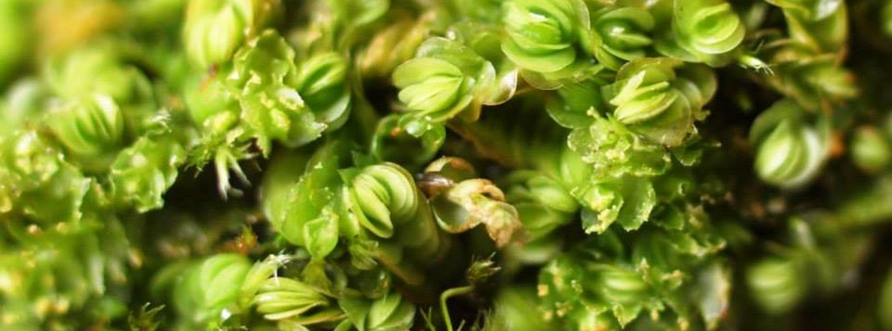
Assessment of bryophytes
in the Red List of Finland 2010
Riikka Juutinen, Finnish Bryophyte Expert Group/Metsähallitus
Kimmo Syrjänen, Finnish Bryophyte Expert Group/Finnish Environment Institute

Slide 2
Bryophyte Red Lists in Finland
Included in all Finnish Red Lists (1985, 1991, 2000, 2010)
  Assessment by IUCN criteria since 2000
Also subregional assessment: regionally threatened species (RT)
About 20 new species have been assessed after 2010
Notes:
Assessment of regionally threatened species also done by IUCN criteria since 2000. Species that fulfill either VU, EN or CR category regionally. Regions = forest vegetation zones.
Work for red listing is going on all the time: new species are discoverend and new distribution data is accumulating (field and herbaria work). Bryophyte expert group has an important role in coordinating and assisting everything related to bryophytes.

Slide 3
Backbone of Finnish assessment: the people and the data
Bryophyte Expert Group, ”Sammaltyöryhmä”
  Finnish Committee for Conservation of Bryophytes
  Started at 1980´s, officially established 1993
  15-20 expert and amateur bryologists from e.g. universities, research institutes and environmental administration
  Part time expert secretary, a lot of voluntary work
  Collecting data on Red Listed (and other) species, taking part on conservation measures, counseling
University herbaria
Database of threatened species (Hertta) and other data (access, excel, paper copies of herbarium labels...)
Check list of Bryophytes in Finland
  Updated yearly, in Finnish
Notes:
We need the people and the data to proceed with the assessment!
Our main task is to make the red list for Finnish bryophytes.
One of the oldest expert groups in Finland.
Part time expert secretary paid by the Ministry of Environment. Some of our experts can use work time for bryophyte group tasks but mostly it is voluntary, unpaid work.
In addition to redlisting we collect and digitize data on Finnish bryophytes and give advise on pretty mych everything related to bryophytes and their conservation. Most of the requests for us come from Finnish Enviromnent Institute, regional centers of environment and Metsähallitus.
Our data consists of bryophyte samples in public herbaria. Microscopical identification is often needed and samples are stored in collectons for re-identification purposes and as a proof of observation.
Mainly data on red listed bryophytes is stored in Hertta, but we also have very much non-digital data. Data management is a huge challenge for us and takes a lot of my time.
Also, we need to have up-to-date check lists.

Slide 4
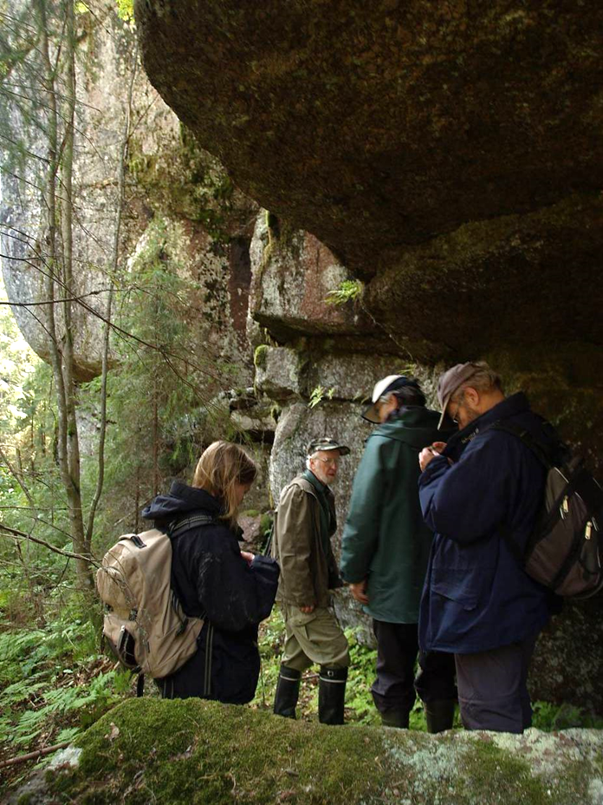
Bryophyte Expert Group working for the 2010 assessment (2008-2009)
Kimmo Syrjänen (chair), Finnish Environment Institute
Susanna Anttila (secretary), Finnish Environment Institute
Tauno Ulvinen, emeritus, University of Oulu
Sanna Laaka-Lindberg, University of Helsinki
Sanna Huttunen, University of Turku
Tiina Laitinen, Metsähallitus Ostrobottnia
Inkeri Ahonen, administration of Åland
Reino Fagerstén, emeritus
Xiaolan He, University of Helsinki
Aino Juslén, University of Helsinki
Terhi Korvenpää, Metsähallitus Southern Finland
Turkka Korvenpää
Ari Parnela, emeritus
Tapani Sallantaus, Finnish Environment Institute
Outi Vainio, Kuopio Natural History museum
Risto Virtanen, University of Oulu
Sinikka Piippo, University of Helsinki
Jouko Rikkinen, University of Helsinki
Notes:
Here is the composition of bryophyte expert group that did the 2010 red list. Since then, secretary has changed and we have also invited some younger experts to join.
Tauno Ulvinen has participated making all red lists since 1980´s. In the picture Tauno in the middle.

Slide 5
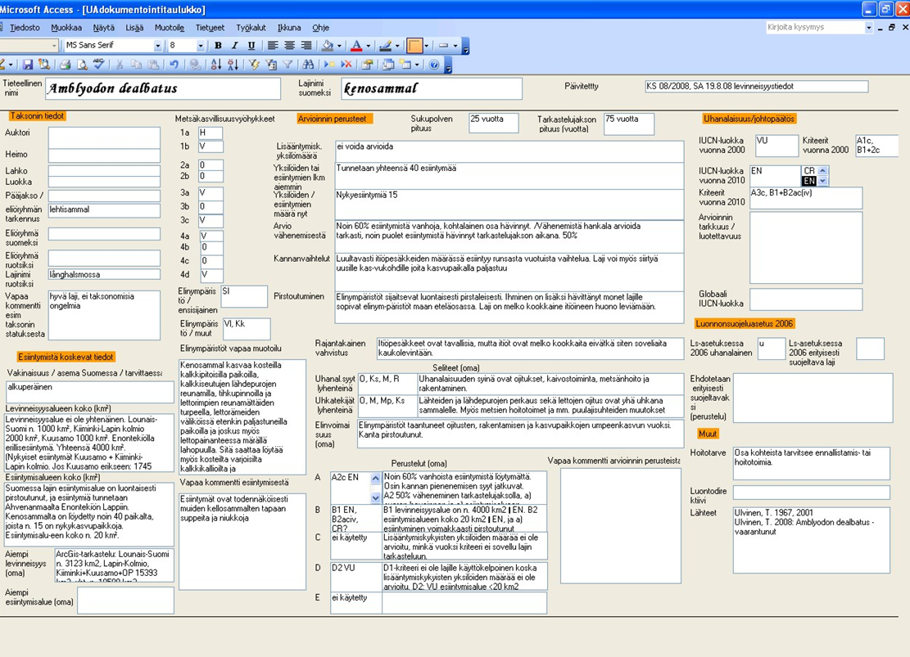
Access database for assessment
Notes:
Here is an example of the Access database our former secretary created to be used in the assessment.
Database includes the documentation the steering group LAUHA required plus something more we wanted to document.

Slide 6
Finnish Red List of Bryophytes 2010
 | Number of assessed taxa | Number of Red Listed taxa | % of Red Listed taxa
Bryophyta | 662 | 253 | 38,2 %
Marchantiophyta | 232 | 110 | 47,4 %
Anthocerophyta | 2 | 1 | 50 %
Total | 896 | 364 | 40,6 %
Some intraspesific taxa was assessed (mainly subspecies)
Taxonomy followed most recent European check lists (Hill et al. 2006, Söderström ym. 2002)
Notes:
An overview of the assessment.
40 % on all bryophytes red listed. There are more red listed species in hepatics than in mosses.
We have included intaspecific taxa quite conservatively, mainly subspecies assessed also the previous time. 14 taxa altogether.

Slide 7
Finnish Red List of Bryophytes 2010
Notes:
Evaluated taxa inside the red rectangular.
Most bryophytes are categorized as least concern.

Slide 8
Finnish Red List of Bryophytes 2010
Red Listed taxa: 40 %
Notes:
40 % of the bryoflora belong to some red list category.
4 % of species are classified as regionally extinct.

Slide 9
Finnish Red List of Bryophytes 2010
threatened bryophytes:
20 % of assessed taxa
Notes:
20 % of bryophytes are threatened.

Slide 10
Finnish Red List of Bryophytes 2010
mainly species with very few occurrences: (LC)-CR
Notes:
Data Deficient are mainly species with only few observations. They are can anything between least concern and threatened, but assessment is not possible because of insufficient data.
(e.g. Fontinalis squamosa – only one found from Finland, Fissidens bryoides s.str. not separated from F. viridulus – probably a more rare species?).

Slide 11
Finnish Red List of Bryophytes 2010
poorly known taxa, that need e.g. more work with determinations
Notes:
In Finnish bryophytes we have used Not Evaluated for example when there has been major determination problems or we have gained new information during the assessment process (and it has been too late to fix the situation).

Slide 12
Finnish Red List of Bryophytes 2010
non-indigenous
species
Notes:
Not applicable.
Two alien species: one that lives in greenhouses and an aquarium escaper.
(Lunularia cruciata, Riccia rhenana)

Slide 13
Applicating IUCN criteria on bryophytes
(co-operation with Sweden and Norway)
What is an individual (criteria A, C, D)?
  Known number of tufts, tussocks, cushions or rosettes.
  If the previous is not known, then the number of 1, 0,1 or 0,01 square meter patches in which the species occur
    Species forming extensive carpets on forest floor or in mires: 1 m2
    Small species growing on bare ground (pioneer species): 0,01 m2
  For epiphytes: number of tree/log/stump
Generation length (criteria A, C1)
  Related to life cycle strategy and substrate longevity
  Evaluation time (= three generations)
    10 years for short-lived fugitive species on e.g. bare ground or dung
    20 or 30 years for species that grow on substrates that change relatively rapidly, such as decaying wood or living tree trunks
    50 years for species that grow on more permanent substrates
Notes:
A little on applicating IUCN criteria on bryophytes. Here we have co-operated with Sweden and Norway to make our assessments more comparable.
According to IUCN guidelines well-distinquishable units should be counted as individuals. So primarily we have used the known number of tufts, tussocs, cushions or rosettes as individulas.
Often we didn´t have such accurate information, so then we used surface area as a template for individual. Grid size is related to life cycle strategy so thet pioneers get 1 square desimeter and dominat species 1 square meter as individual.
In addition, for epiphytes we calculated (if no other information was available) two individuals per tree, log or stump.
The other important definition here conserns generation length or actually evaluation time which is three generations. In bryophytes evaluation time is related to life cycle strategy so that short-living fugitive species have the shortest evaluation time and species that grow on more permanent substrates like rock have the longest evaluation time.

Slide 14
Usage of criteria in threatened bryophytes (%)
Notes:
An overview on usage of IUCN criteria . Criteria B and D were used most. Criteria E was not used in bryophyte assessment at all.
Mostly a combination of criteria and also subcriteria were used -> more reliable assesment.

Slide 15
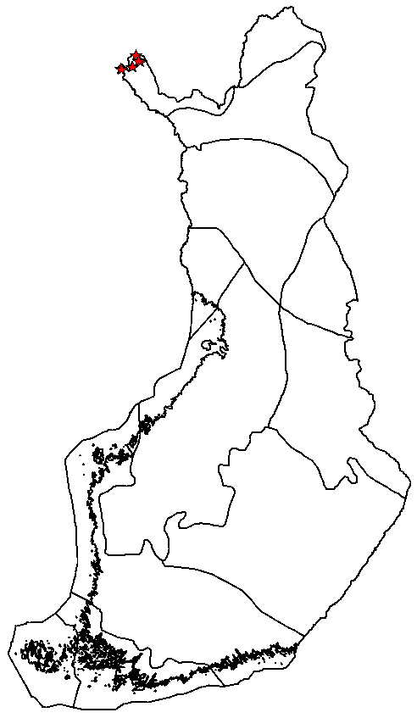
Example 1:
Brachythecium coruscum
Long-living pleurocarp moss of calcareous fell habitats, a rare habitat specialist with small populations
A2c: NT
  Suspected population size reduction less than 30 % over the last 50 years (3 generations) following the decline in quality of habitat (c). The reduction and it´s causes may not have ceased, understood or reversible.
A3c: VU
  Suspected population size reduction over 30 % in the next 50 years based on the decline in quality of habitat (c).
D2: Area of occupancy < 10 km2 and number of locations low VU
A3c;D2 -> VU
Notes:
9 known localities (but five of those discovered after the assessment), very few suitable habitats.
Calcareous fell habitats are declining according to Assessment of threatened habitat types in Finland: overgrazing by reindeers and also climate warming will change habitats in the long run.
A: Reduction in population size
A1: States that cause of reduction in population size is clearly reversible, understood and ceased. That is not true for this species.
A2: limit for VU is over 30 % reduction in population size, otherwise seems to fit. A2c: means that the reduction in population size is related to decline in quality of habitat.
A3: difference to A2 is that the reduction will happen in the future as in A2 it had happened in the past
B: Small geographic range
B: extent of occurrence and area of occupancy are small but no fragmentation or extreme fluctuations
C: Small and declining population
C: not applicable because no data on population size
D: Very small or restricted population
D1: not applicable because no data on population size
D2: Area of occupancy less than 20 square km and no more than five occurences

Slide 16
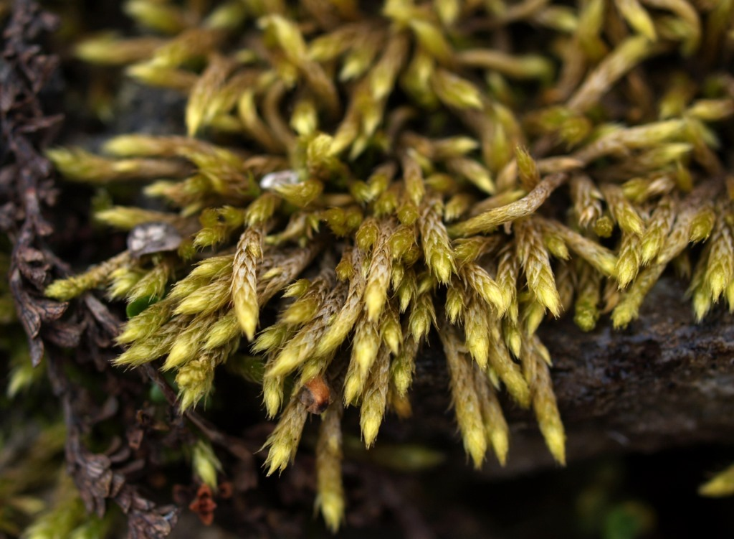
Example 1:
Brachythecium coruscum

Slide 17
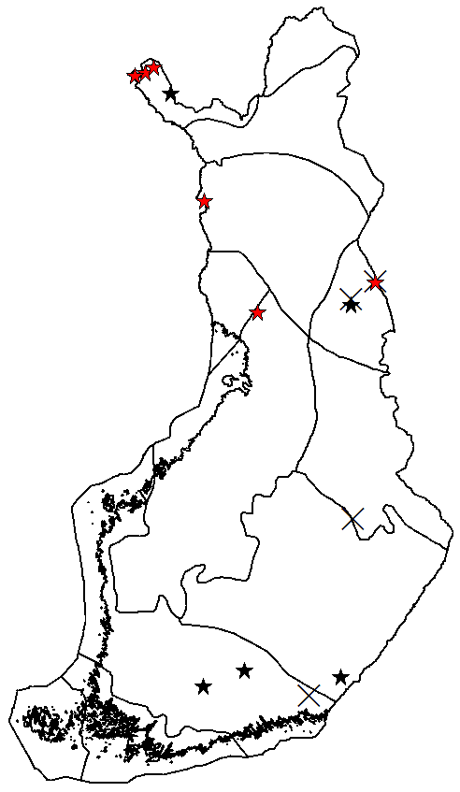
Example 2:
Aongstroemia longipes
Short-living habitat specialist of disturbed calcareous habitats
B1: Extent of occurrence 170 000 km2
B2: Area of occupancy << 500 km2 AND
  Severely fragmented (a) AND
  Continuing decline in: extent of occurrence (bi) + area of occupancy (bii) + area, extent or quality of habitat (biii) + number of locations (biv) + number of mature individuals (bv) AND
  Extreme fluctuations in population size (civ)
D1: population size less than 250 mature individuals
B2ab (i,ii,iii,iv,v) c(iv), D1 -> EN
Notes:
15 known localities in Finland. Of those 4 have been destroyed and in 6 localities the species has been seen 1990 or after. Red stars: observations 1990 and after, black stars: older observations, crosses: destroyed occurrences.
Habitats have been deteriorating due to overgrowth and changes in disturbance dynamics (for example regulation of water bodies and cessation of grazing), and the trend continues.
Criteria A and C1 not applicable because of the short generation time (evaluation time = 3 generations = 20 years): the inferred decline has for the most part happened before the 20 year evaluation time. Also, for such a short evaluation time, we have no monitoring data.
B1: Wide distribution, extent of occurrence is much more than the threshold for vulnerable (20 000 square km).
B2: area of occupancy much less than the threshold of 500 square km for endangered. Also: population is severely fragmented and the extent of occurrence, area of occupancy, quality of habitat, numper of locations and mature individuals is declining and there is also extreme fluctuations in number of mature individuals
D1: based on what we know about the size of some of the occurrences, we estimated the whole population size to be less than 250 mature individuals which is the threshold for endangered

Slide 18
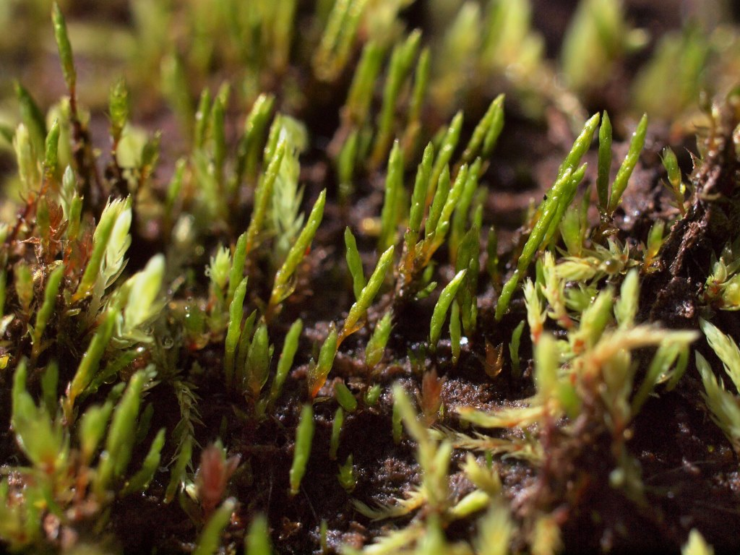

Slide 19
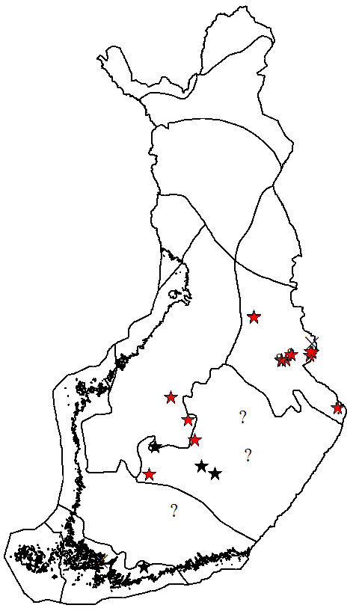
Example 3:
Cephalozia macounii
Epixylic liverwort with very poor reproductive capacity
B2ab(ii,iii,iv,v): EN
C2: polulation size less than 250 and declining AND
  Biggest subpopulation smaller than 50 individuals (a1)
C2a(i) -> CR
Notes:
Grows on logs in old growth forests. Sexual reproduction is extremely rare and current dispersal range of vegetative fragments is counted in meters. Habitats are badly fragmented and isolated due to forestry over a long period and present population is very small.
Again criteria A and C1 are not applicable because of the short evaluation time (3 generations = 20 years). Same as with Aongstroemia, the inferred decline has for the most part happened before the 20 years evaluation time.
In B criteria it is largely the same as with Aongstroemia
B1: Bryophytes are typically locally rare bur widely distributed. Here, extent of occurrence is more than the threshold for vulnerable (20 000 square km).
B2: area of occupancy much less than the threshold of 500 square km for endangered. Also: population is severely fragmented and the area of occupancy, quality of habitat, numper of locations and mature individuals is declining.
C2: Biggest subpopulations do not contain more than 10 individuals (= 5 logs) which is well under the threshold for critically endangered (50 individuals).

Slide 20
Thank you!

