Slide 1
USE OF RED DATA LIST IN SPECIES CONSERVATION: PRACTICAL EXAMPLES
International workshop on the
CONSERVATION STATUS ASSESSMENT OF ENDANGERED SPECIES IN THE BARENTS REGION,
BASED ON THE IUCN RED LIST CRITERIA
Institute of Biology, Komi Scientific Center of the Ural Branch of Russian Academy of Sciences
Syktyvkar, September 29 – October 4, 2014

Slide 2
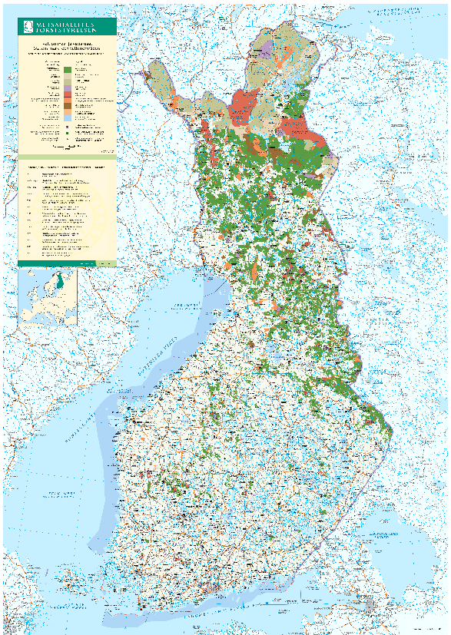
Metsähallitus
manages state-owned commercial forests and protected areas
NATURAL HERITAGE SERVICES OF METSÄHALLITUS
manages protected areas: nature conservation, recreation, hunting and fishing.
aims and budget annually set by the Ministry of the Environment

Slide 3
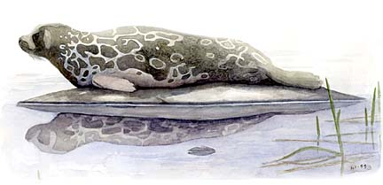
Species conservation activities in NATURAl Heritage Services
  Surveys and monitoring of species in protected areas;
  Monitoring of populations of certain Red List species on national level, e.g. Arctic fox (Alopex lagopus, CR), Saimaa ringed seal (CR, Phoca hispida saimensis, CR), Golden eagle (Aquila chrysaetos, VU) and White-backed woodpecker (Dendrocopos leucotos, EN);
  Management and restoration of habitats of threatened species;
  Protection of Red List species’ habitats on state owned land against external land use pressures (e.g. mining)
  Co-operation with the forestry sector to protect Red List species in state owned commercial forests.

Slide 4
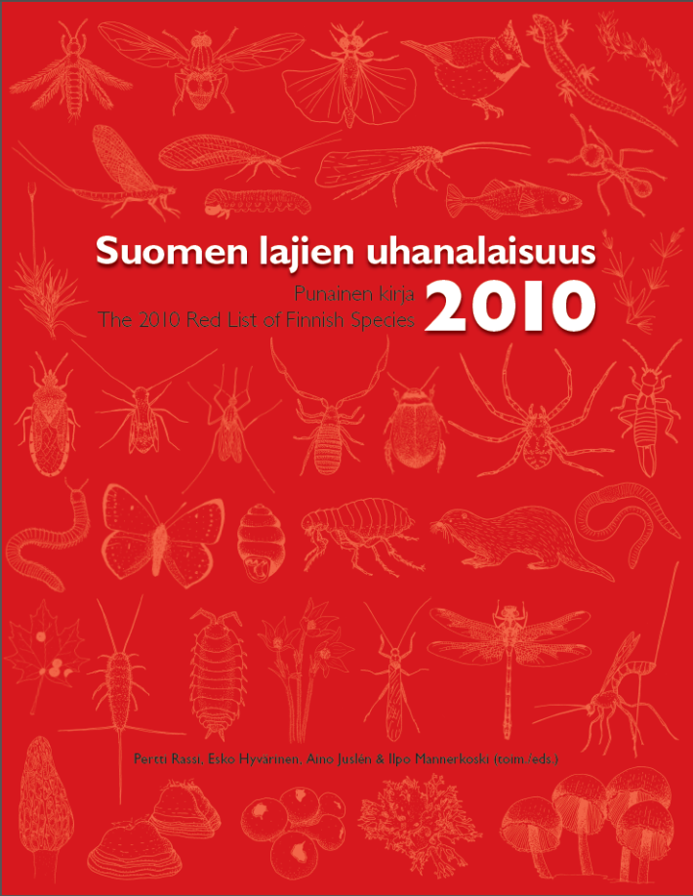
IUCN red list and natural heritage services
Species Red List is a fundamental tool
Targeting species conservation resources and activities where they are most urgently needed
An objective assessment
Wide consensus about the Red List species
Prioritization of species conservation activities
Red List enables evaluation of effectiveness and adaptive management methods in species conservation.

Slide 5
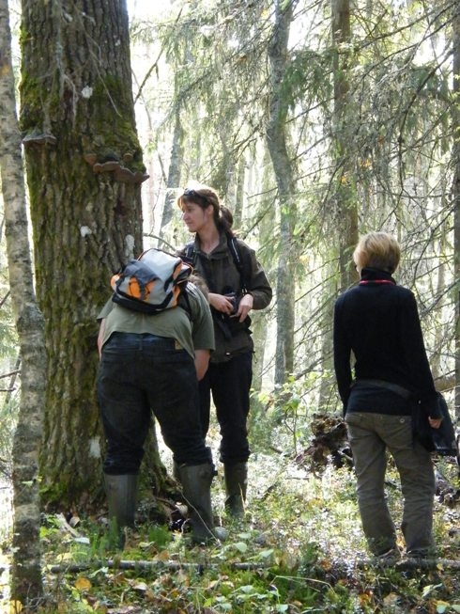
Red List species and management of Protected Areas
Species surveys and monitoring: focus on potential habitats and areas of the species in highest Red List categories (CR, EN and VU)
The data of Red List Species is stored in a national Red List species database
  New data is available in the next round of Red List Assessment
  The new locations of Red List species taken within conservation management activities, e.g.
  Habitat management and restoration often required
  Planning of recreation facilities
  Strengthening the conservation status of sites (e.g. in mine prospecting areas)
Photo: Tiina Laitinen

Slide 6
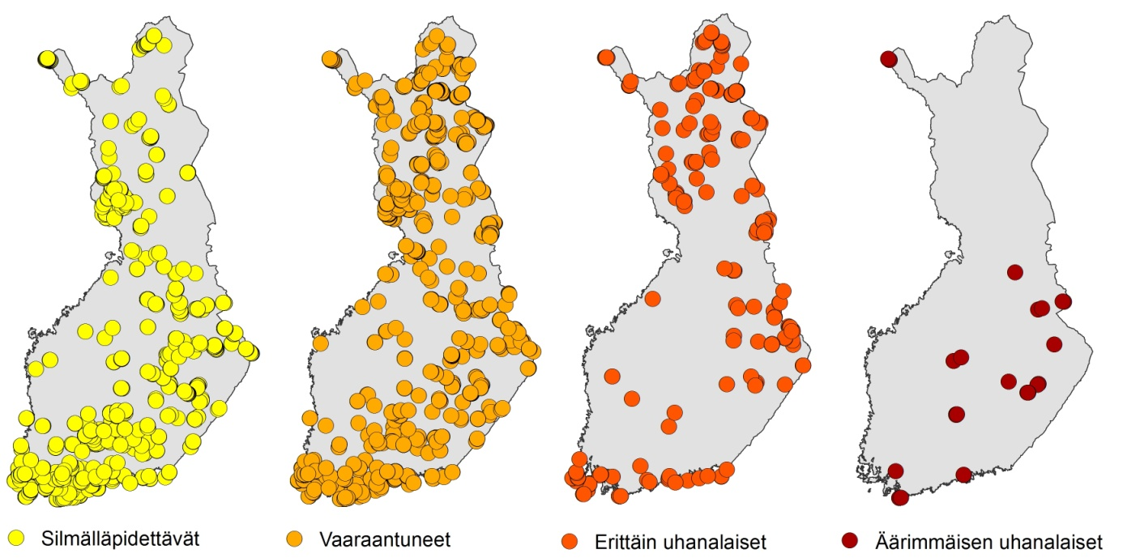
Species inventories and monitoring in protected areas
New localities of Red List species of BR, LI, CO, FU and MO found in species inventories of some protected areas by Natural Heritage Services during 2007-2013
NT
VU
EN
CR

Slide 7
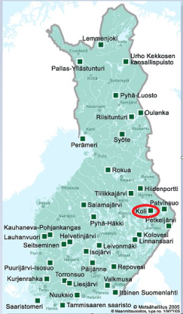
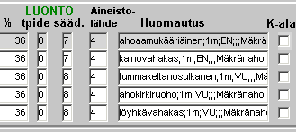
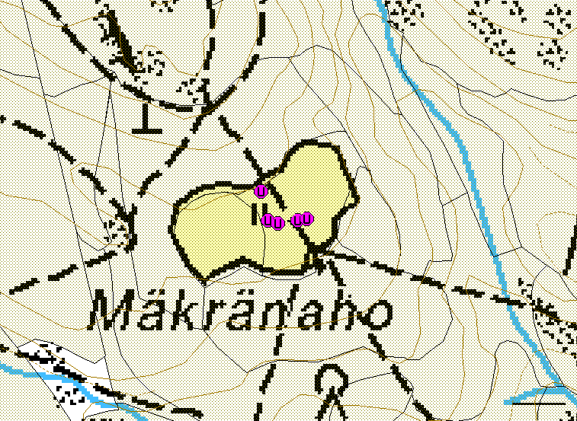
Management of species-rich meadow in koli NP
130 m

Slide 8
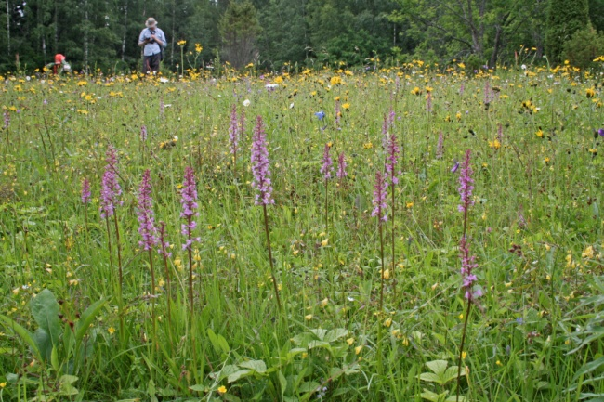
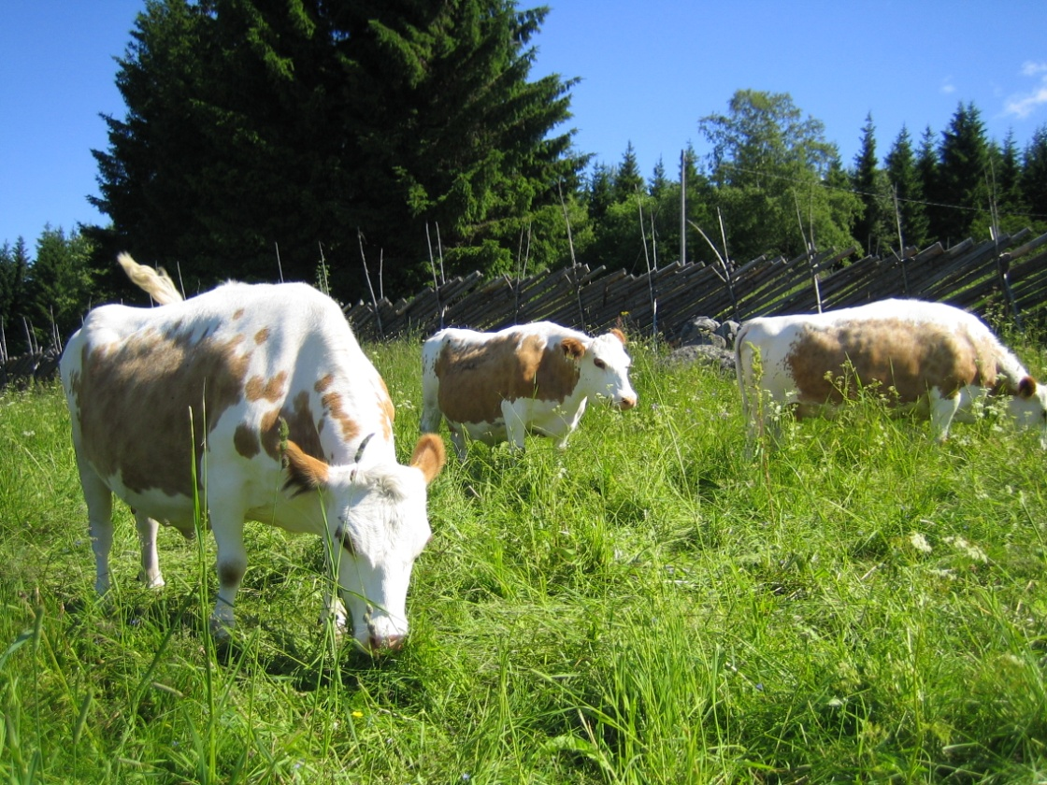
Photo: Maarit Similä
Photo: Kaija Eiisto

Slide 9
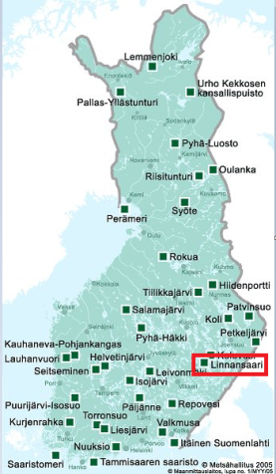
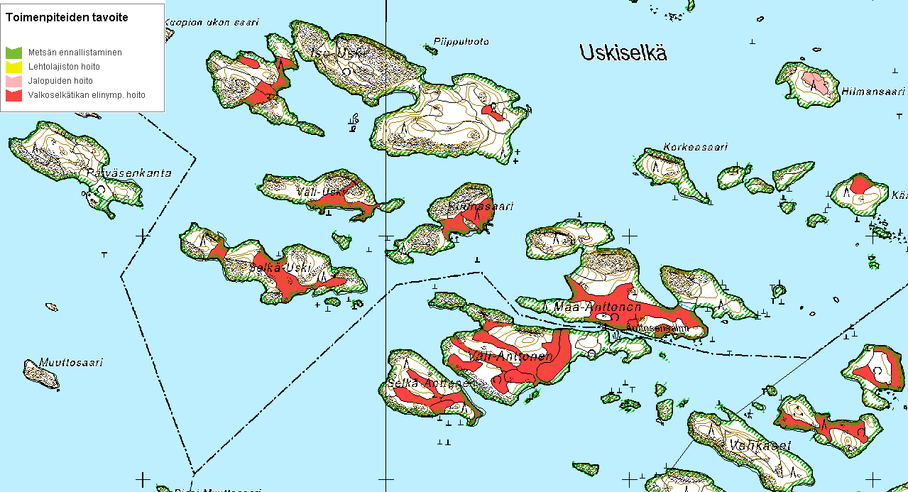
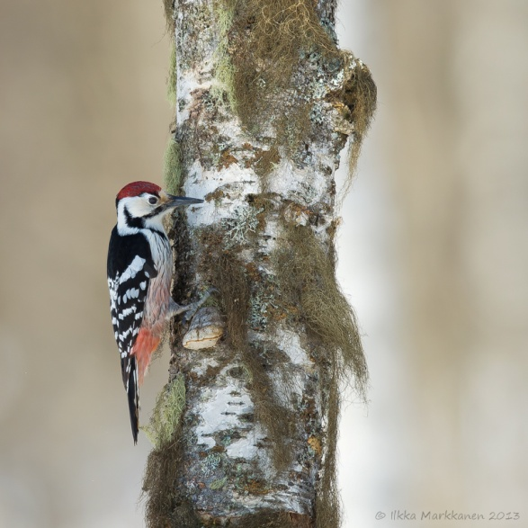
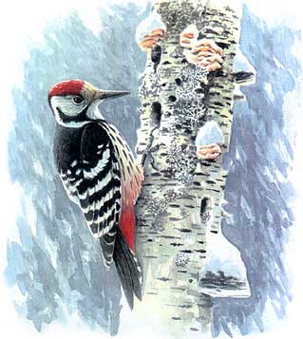
Habitat management of white-backed woodpecker (EN) in linnansaari NP
500 m

Slide 10
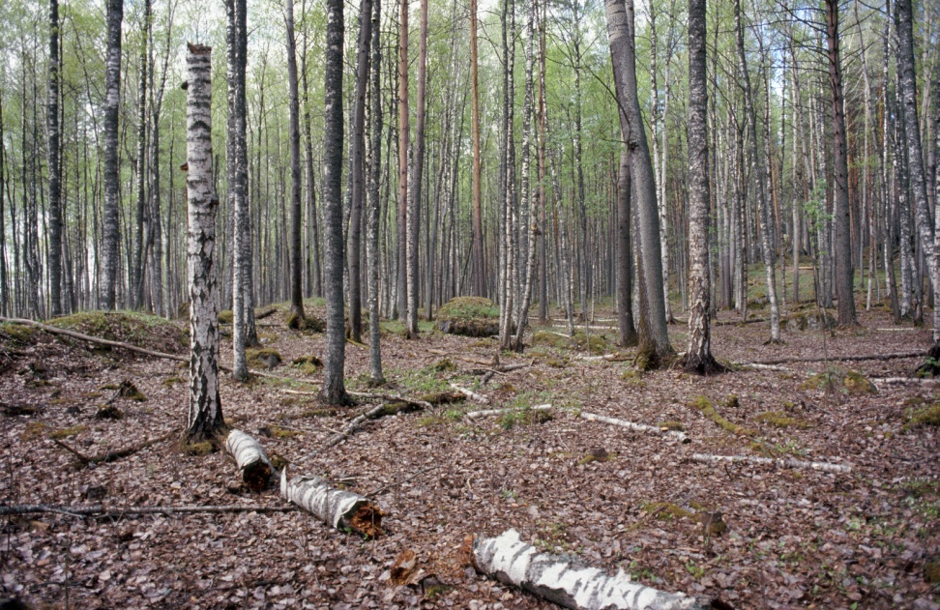
Photo: Timo Laine

Slide 11
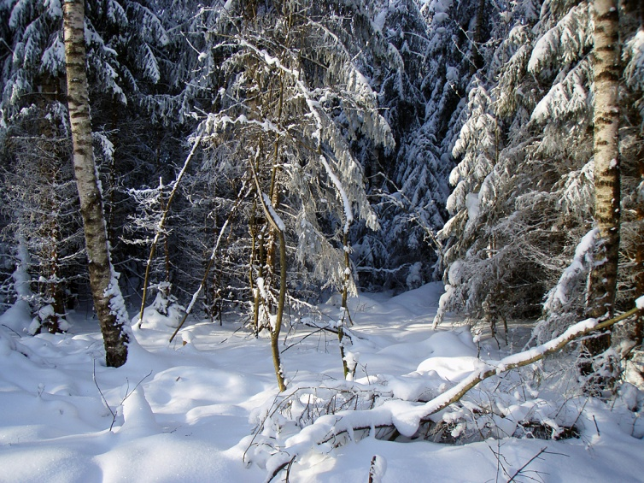
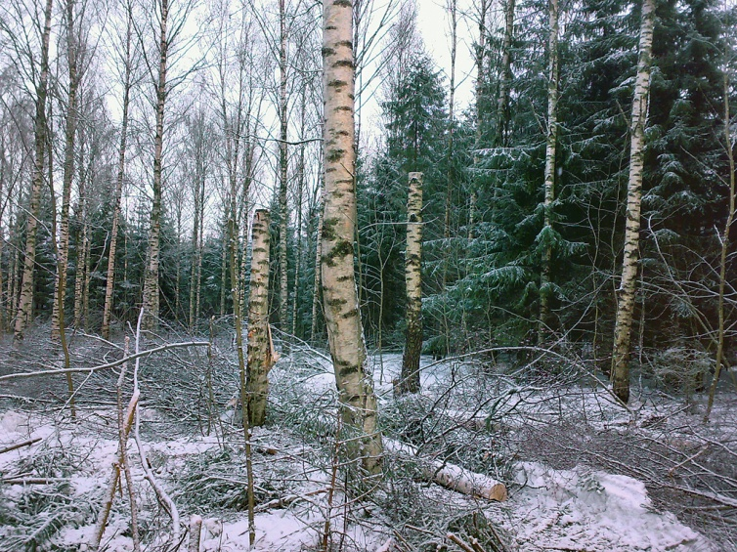
Habitat management of white-backed woodpecker (EN) in linnansaari NP
Photo:s Jouni Elonen

Slide 12
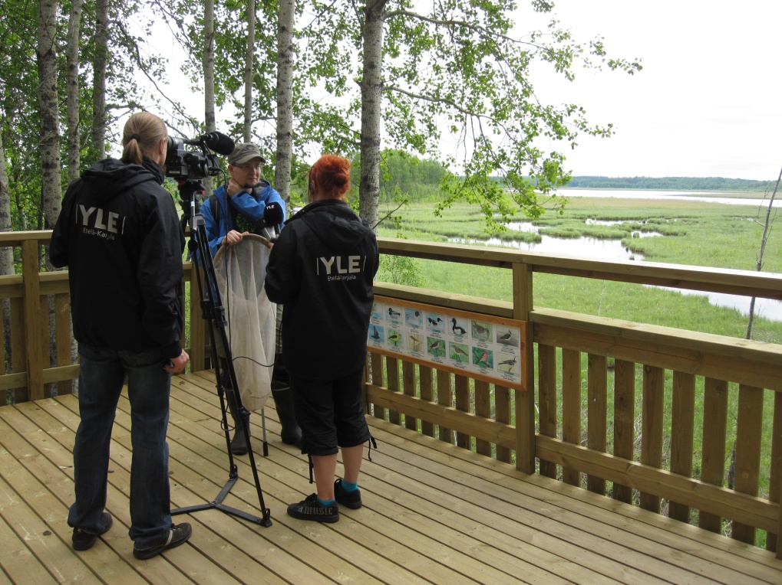
Recreational use of protected areas AND RED LIST SPECIES
Most protected areas are also used for recreation – conservation and recreation activities need to be balanced in order to avoid negative effects on protected species and habitats
Hiking trails, camping sites and other visitor facilities require good planning
Management GIS-data
Information, interpretation and environmental education are important, sometimes restrictions are needed
Photo: Tuula Kurikka

Slide 13
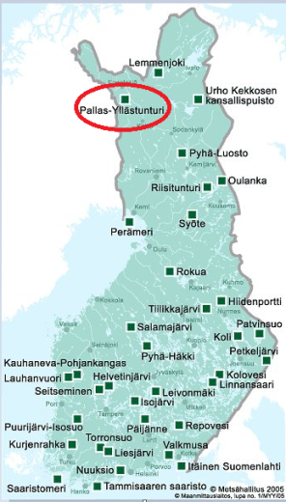
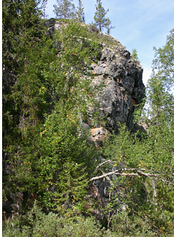
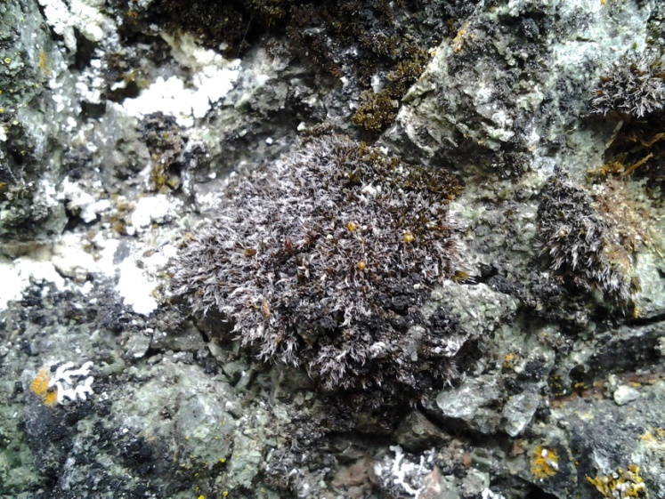
Grimmia anodon (En) and rock climbing in äkäsaivo
Photo: Riikka Juutinen
Moss Grimmia anodon (EN) and rock climbing in Äkäsaivo
Photo: Juha Paso

Slide 14
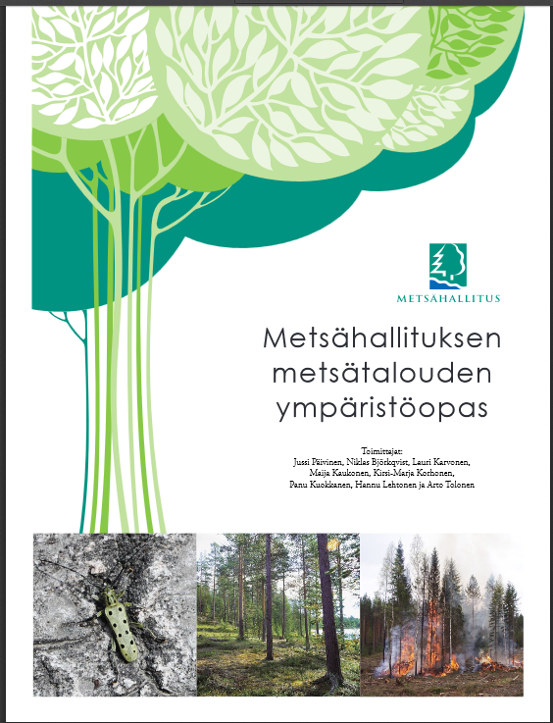
Red List Species in State Owned Commercial Forests
Nature Conservation Act gives the framework
”Metsähallitus Environmental guide for Forestry”
Concrete and comprehensive guidelines for safeguarding biodiversity and forest ecosystem services in commercial forests

Slide 15
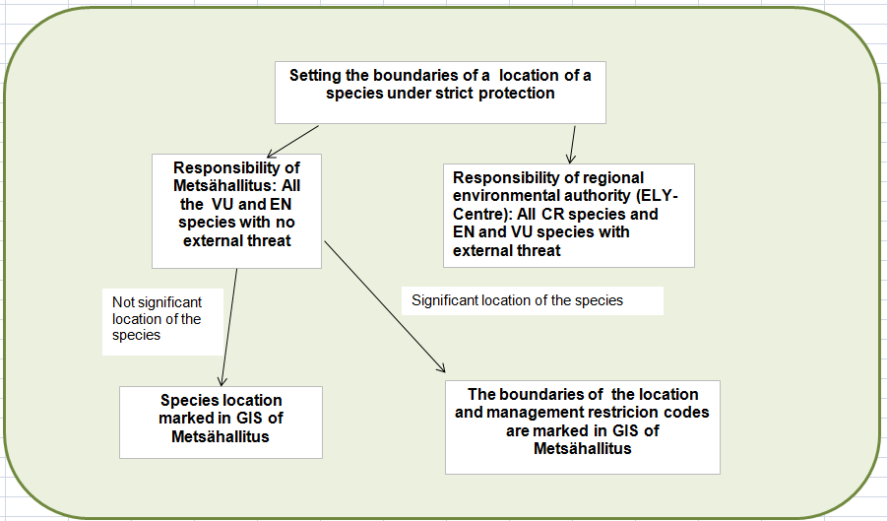
Red List species and commercial forest management in state owned forests
Source: Metsähallitus Environmental Guide for Forestry

Slide 16
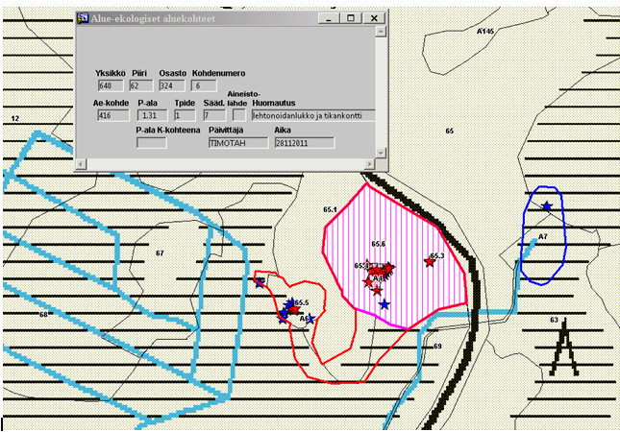
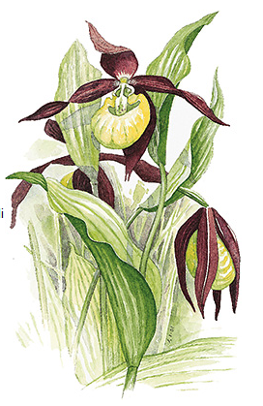
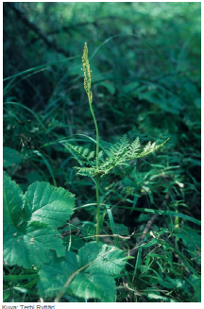
Red List species and commercial forest management in state owned forests
Habitat of Botrychium virginianum (EN) and Cypripedium calceolus (NT) in forestry-GIS

Slide 17
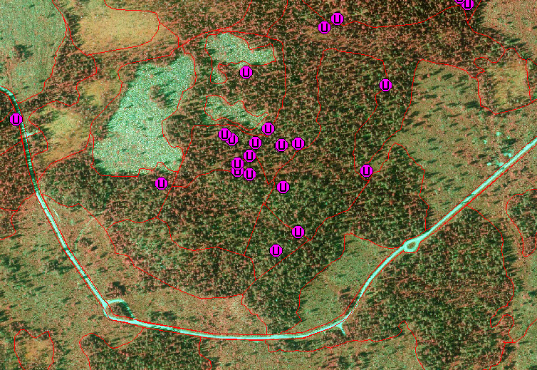
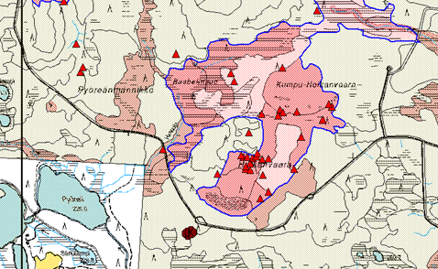
Red List species and commercial forest management in state owned forest

Slide 18
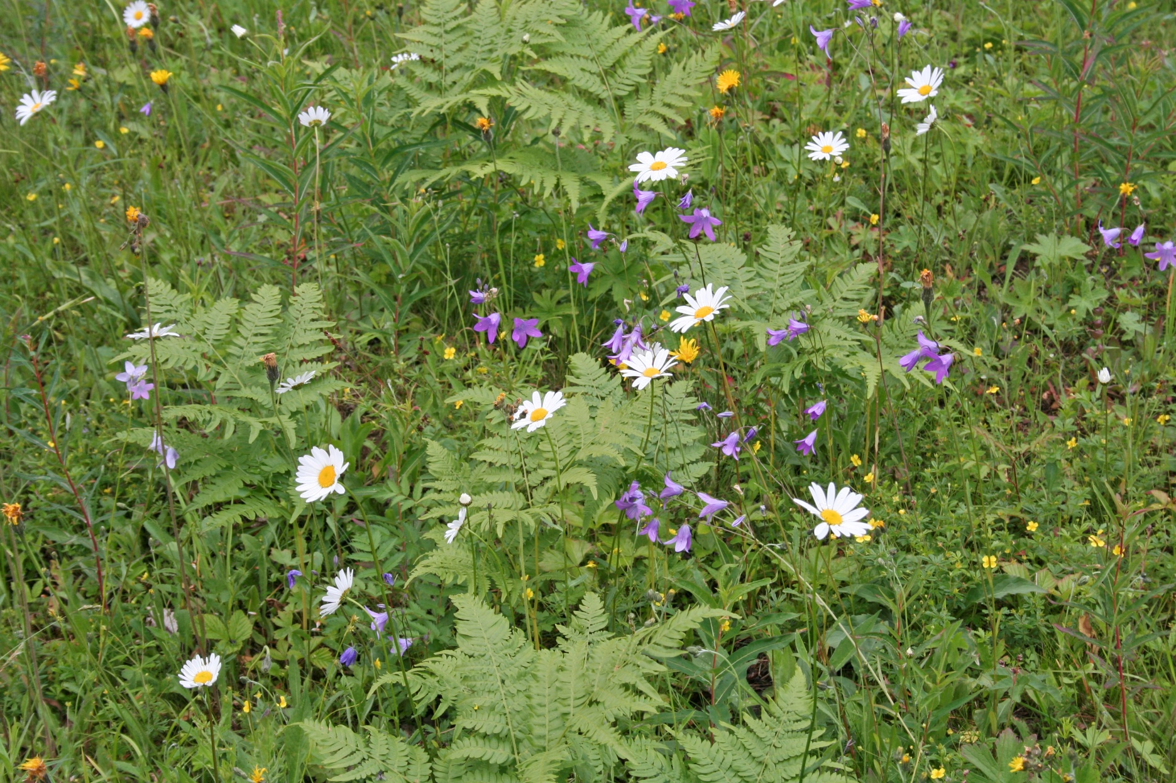
THANK YOU!

Slide 19
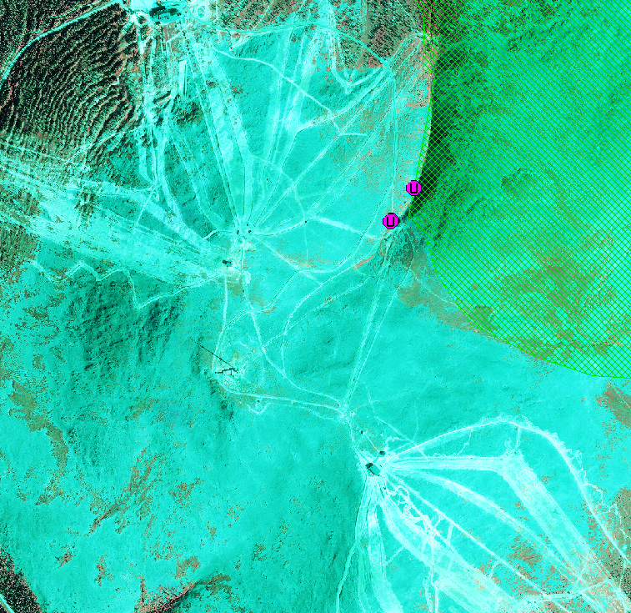
Red List Species and skiing
Habitat of e.g. mosses Grimmia mollis (EN) and Andreaea nivalis (VU) in Ylläs skiing centre beside Pallas-Yllästunturi National park

Slide 20
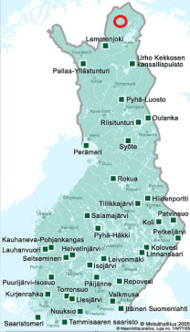
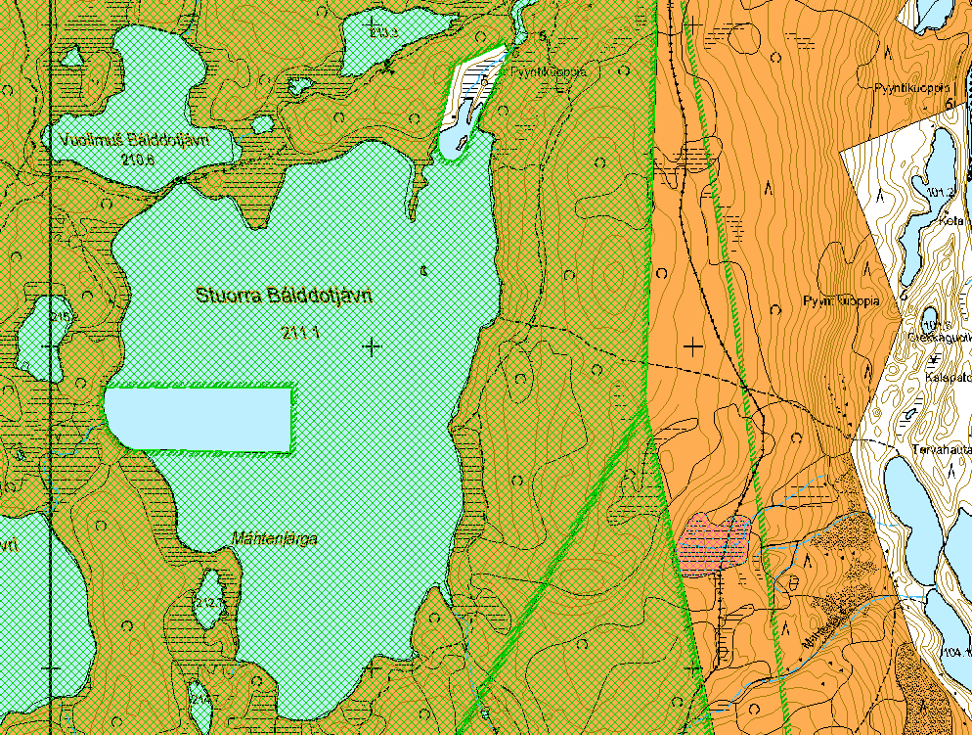
Red List species and mining
In especially northern part of Finland, mine prospecting is very active at present
Cooperation with environmental authorities in strengthening the conservation status of the localities of Red List Species
Discussions with the mining companies
E.g. the moss Rhizomnium gracile (CR) beside Kevo Strict Nature reserve

