Slide 1

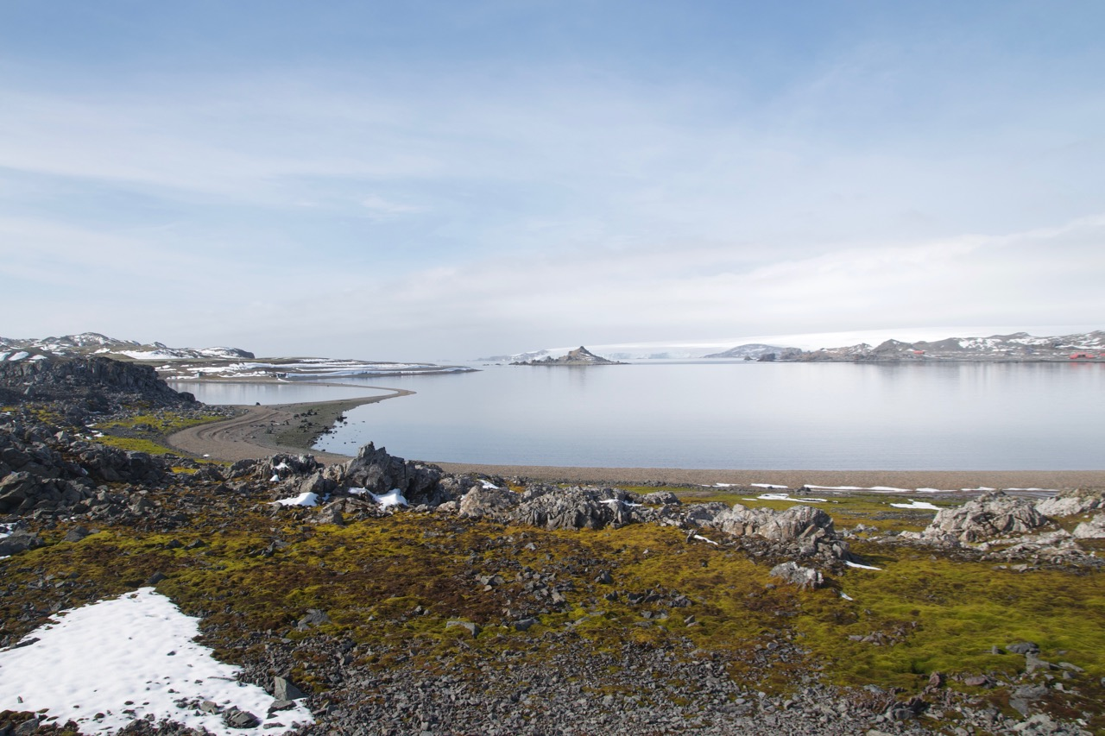
Long term passive warming effect on Antarctic lichens
Dra. Angélica Casanova Katny
Universidad Católica de Temuco

Slide 3
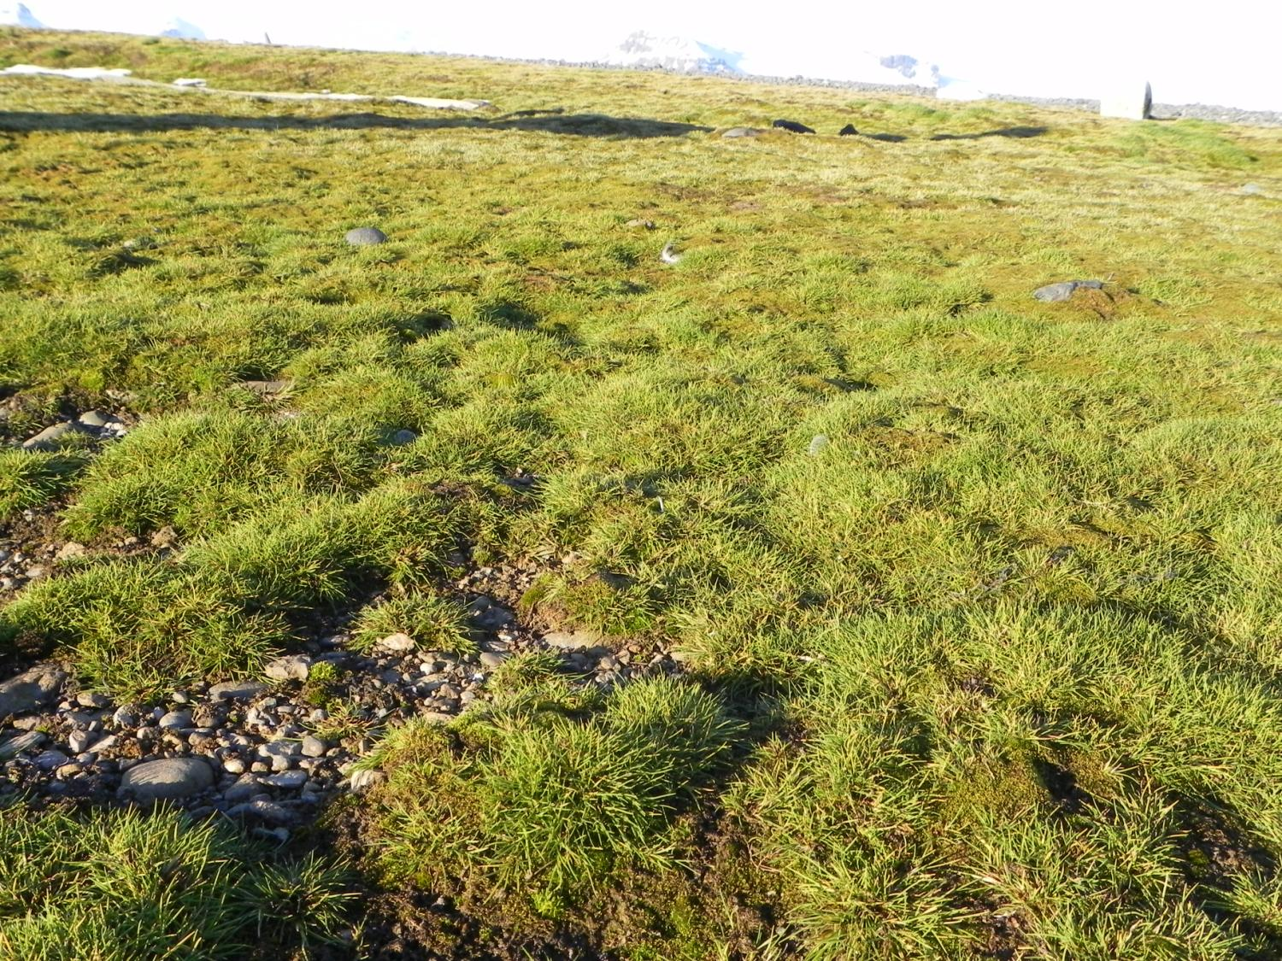
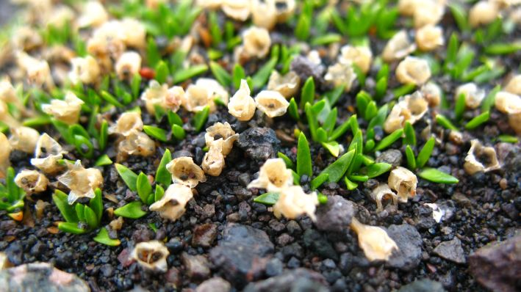
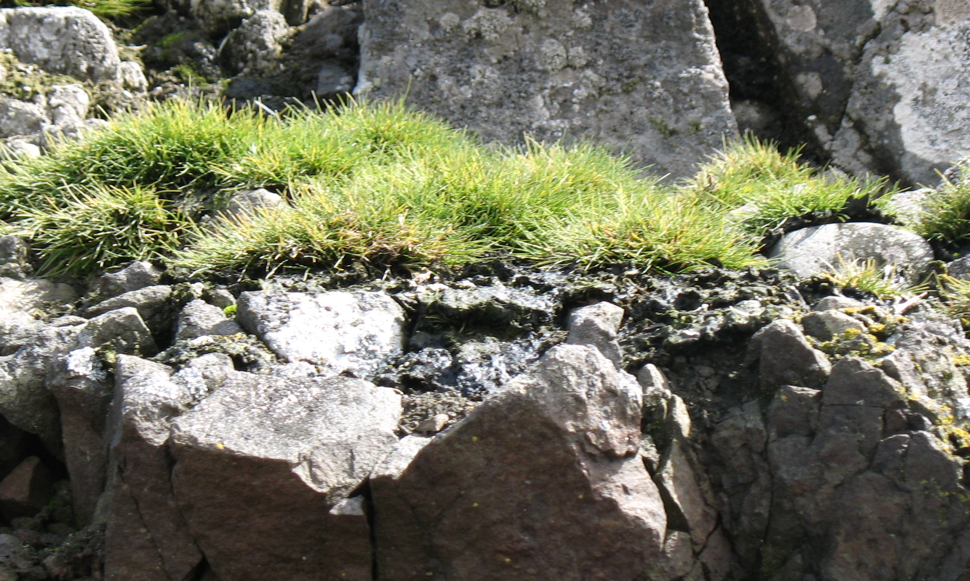
HERBACEOUS TUNDRA
Colobanthus quitensis
Arctowski Station
Deschampsia antarctica

Slide 4
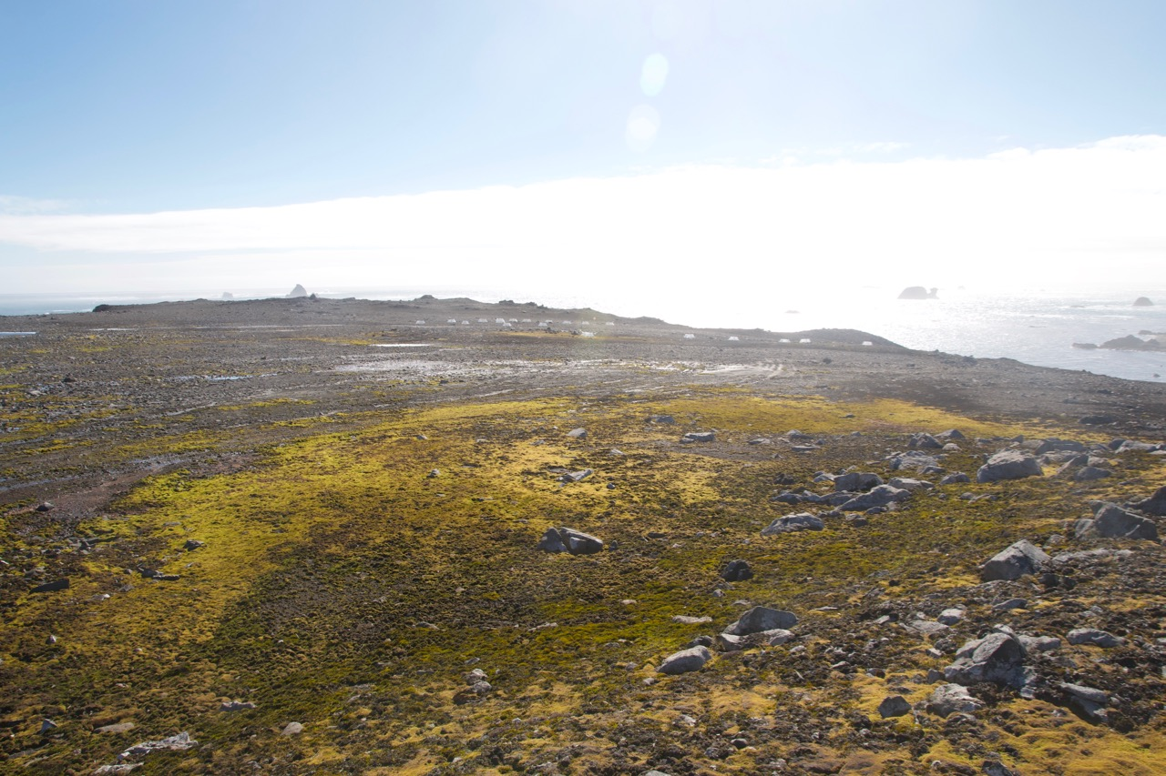
Cryptogamic tundra: Mosses

Slide 5
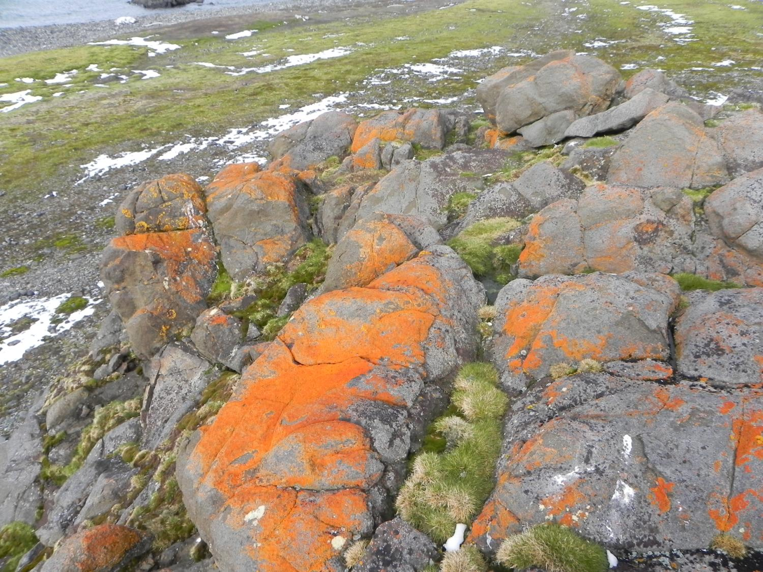
Cryptogamic tundra: Lichens
Arctowski Station

Slide 6
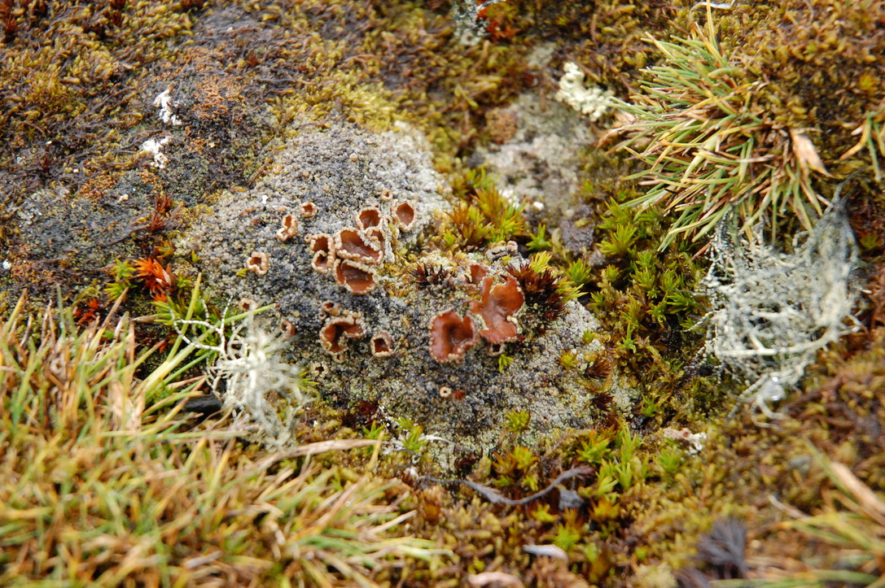

Slide 7
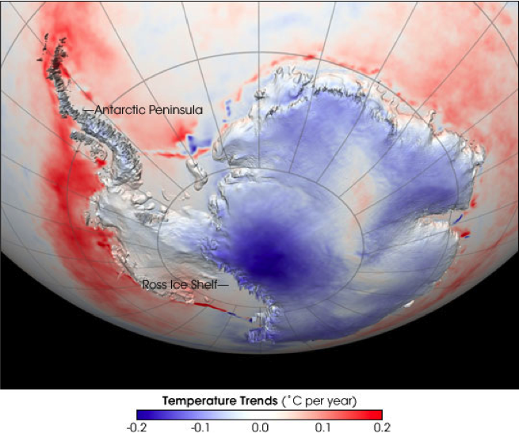
Turner et al. 2016

Slide 8
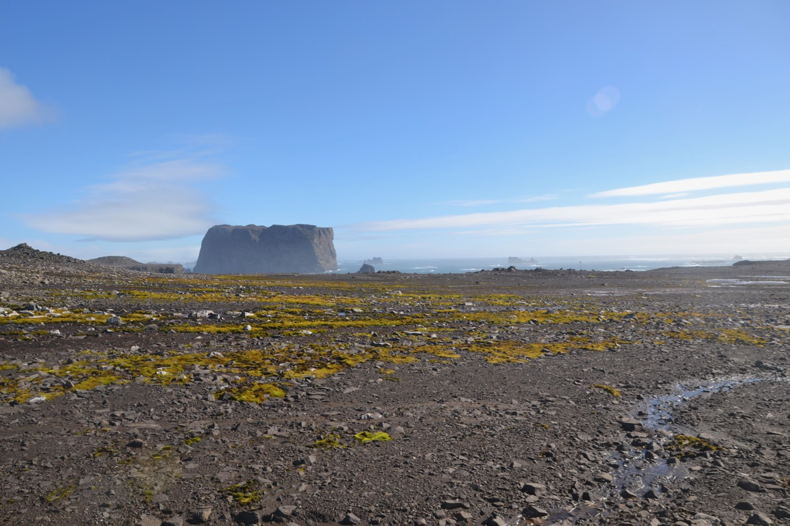
What are the effects of global warming on antarctic tundra?

Slide 9
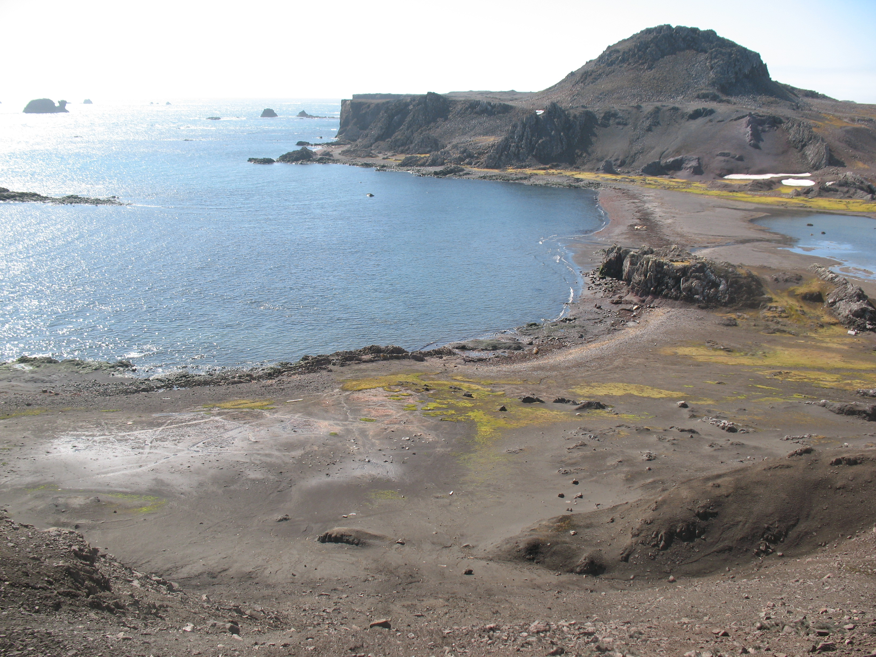
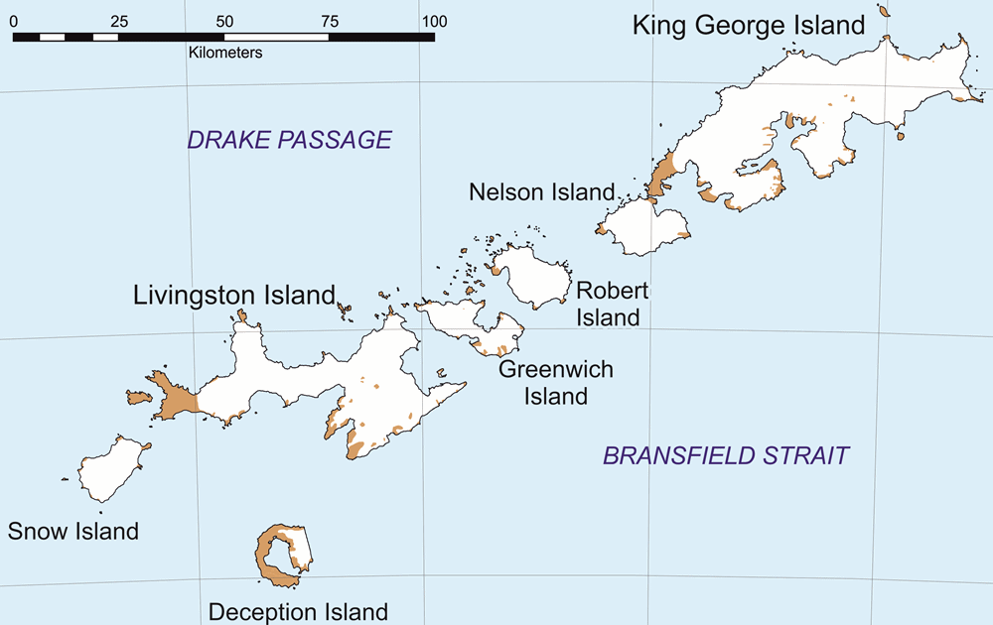
2.- Is the response to warming species-specific?
South Shetland Is. Archipelago
Fildes Peninsula

Slide 10
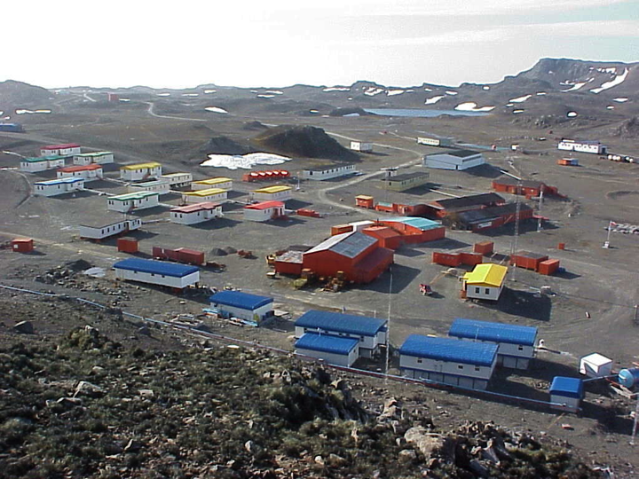
Fildes Peninsula

Slide 11
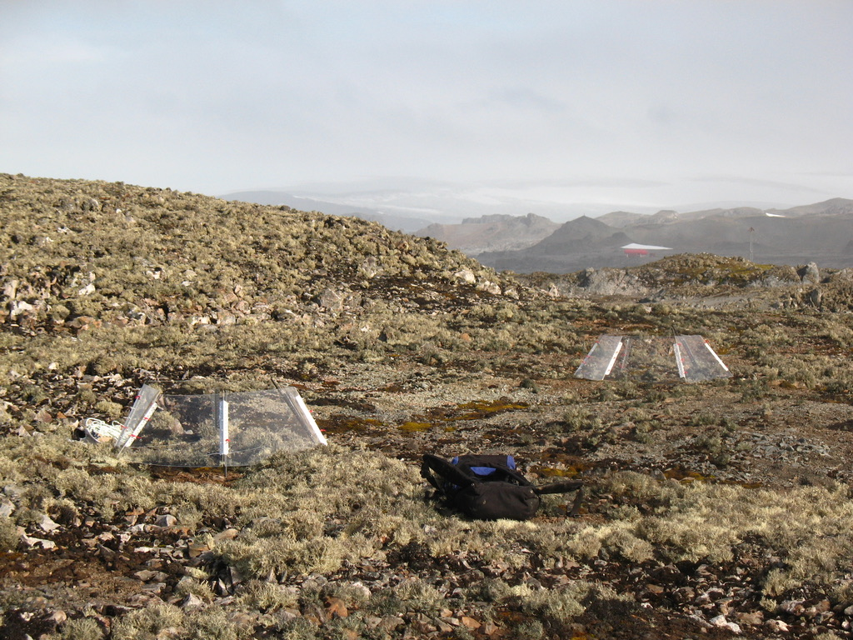
RESULTS

Slide 12
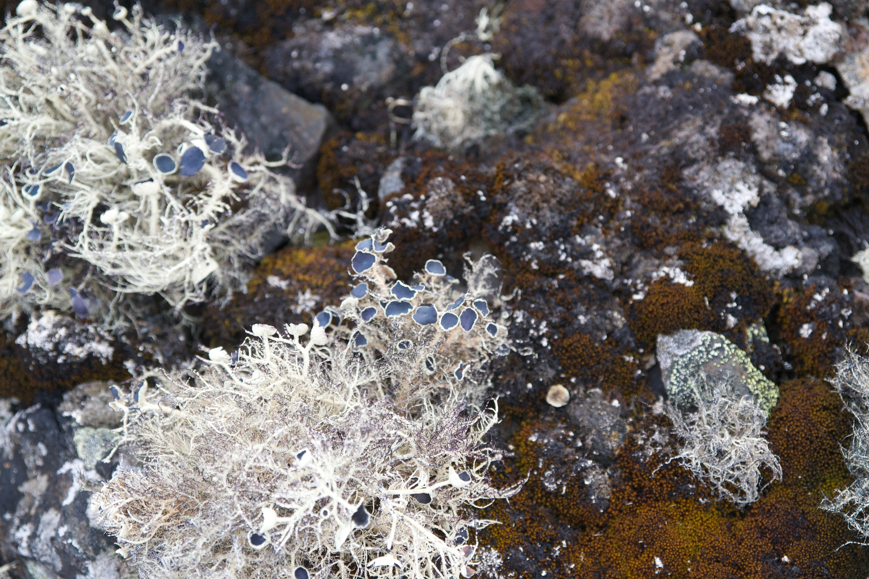
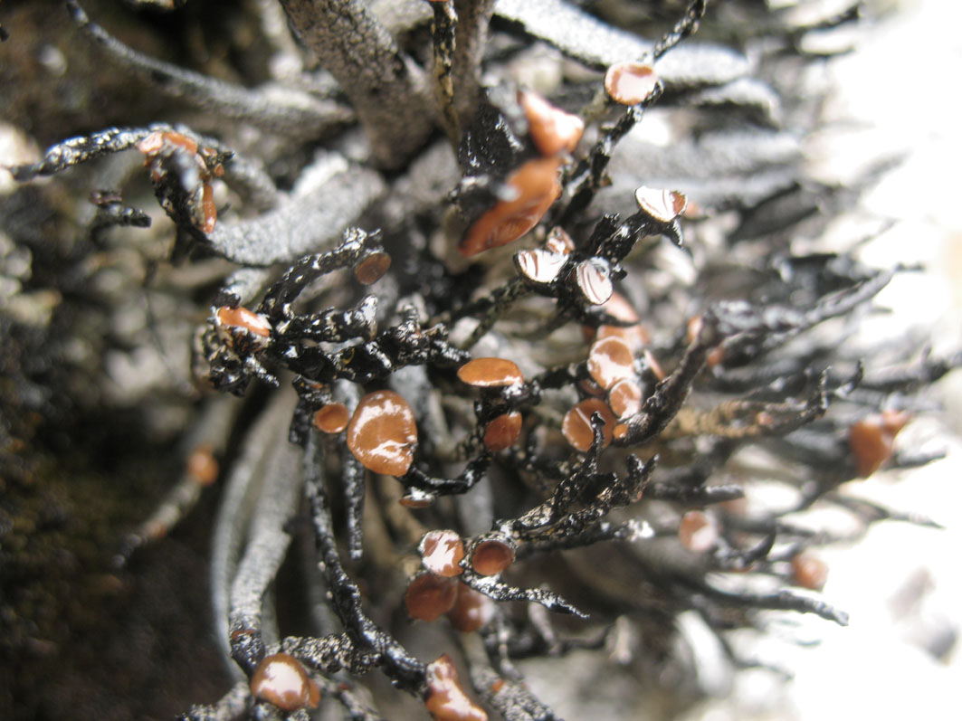
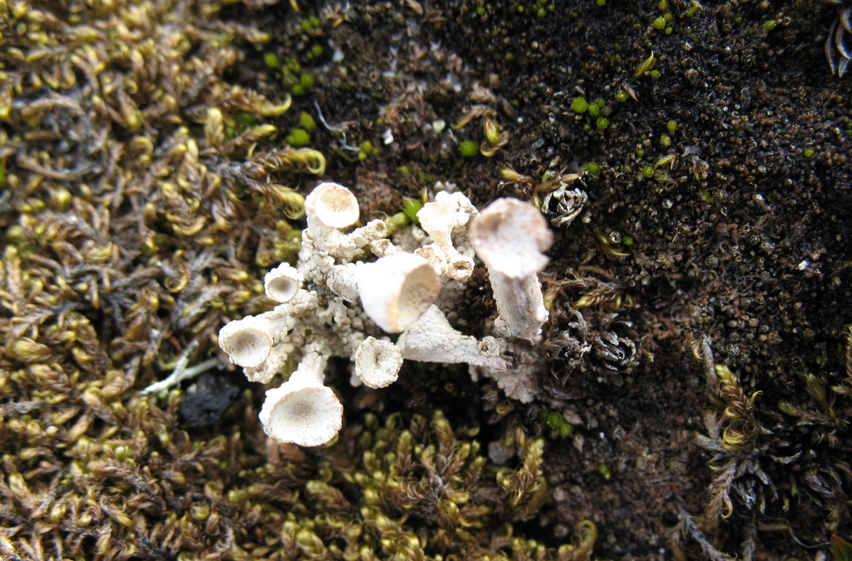
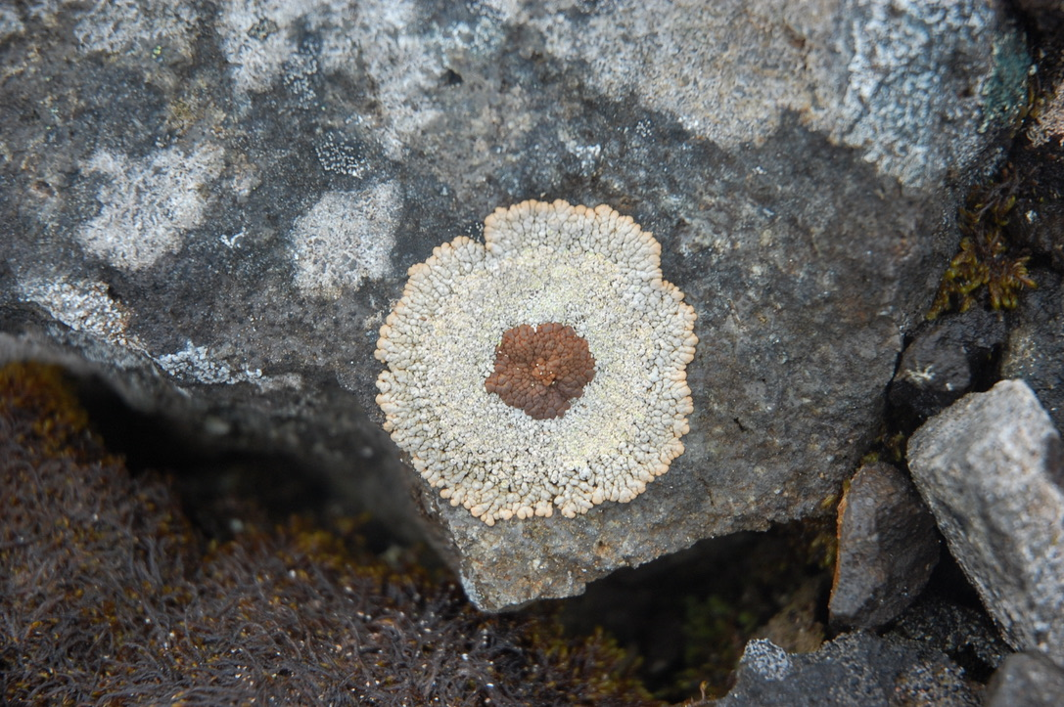
RESULTS

Slide 13
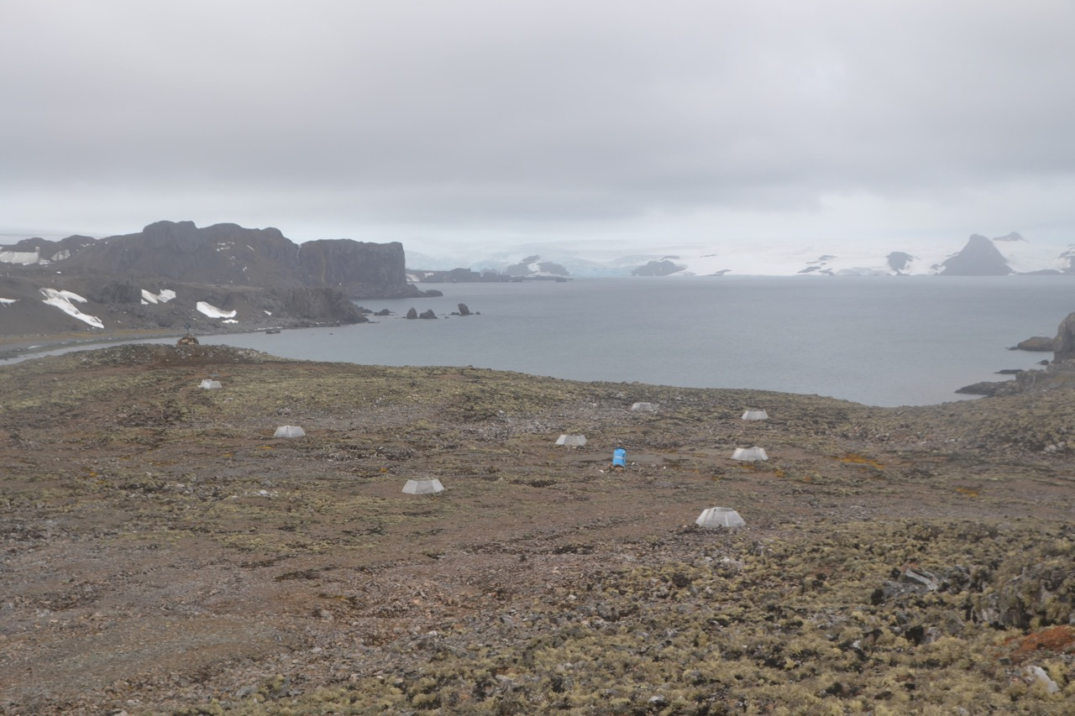
RESULTS
Microclima in OTC and control
Docku Kim et al. 2018, J of Basic Microbiology,
Shoertlidge et al. 2016, Ann of Botany

Slide 14
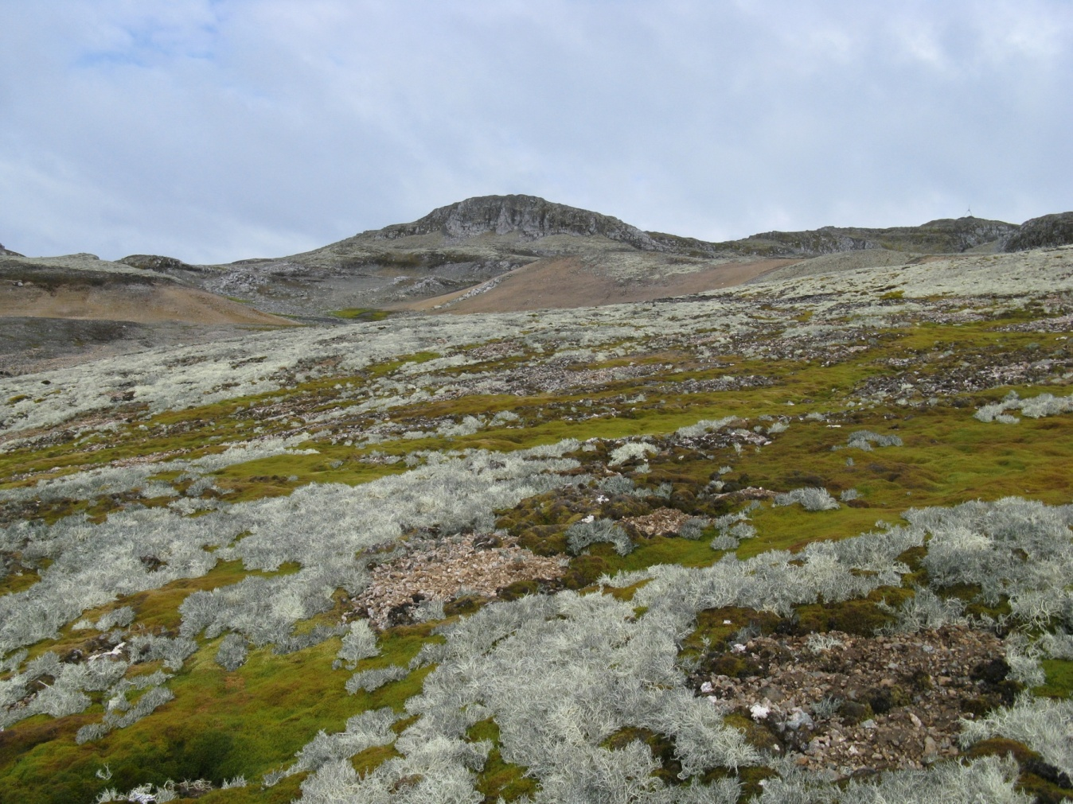
RESULTS
Notes:
AGREGAR FOTO CON MAS DETALLE

Slide 15

Open top chamber
Chlrophyll fluorescence
RESULTS

Slide 16
GLOBAL WARMING IMPACT

Slide 17
microclimate
GLOBAL WARMING IMPACT

Slide 18
GLOBAL WARMING IMPACT

Slide 19
Electron trasnport rate

Slide 20
Rehydration of Thallus
GLOBAL WARMING IMPACT

Slide 21
Rehydration of Thallus
GLOBAL WARMING IMPACT
1 hour
48 hours

Slide 22
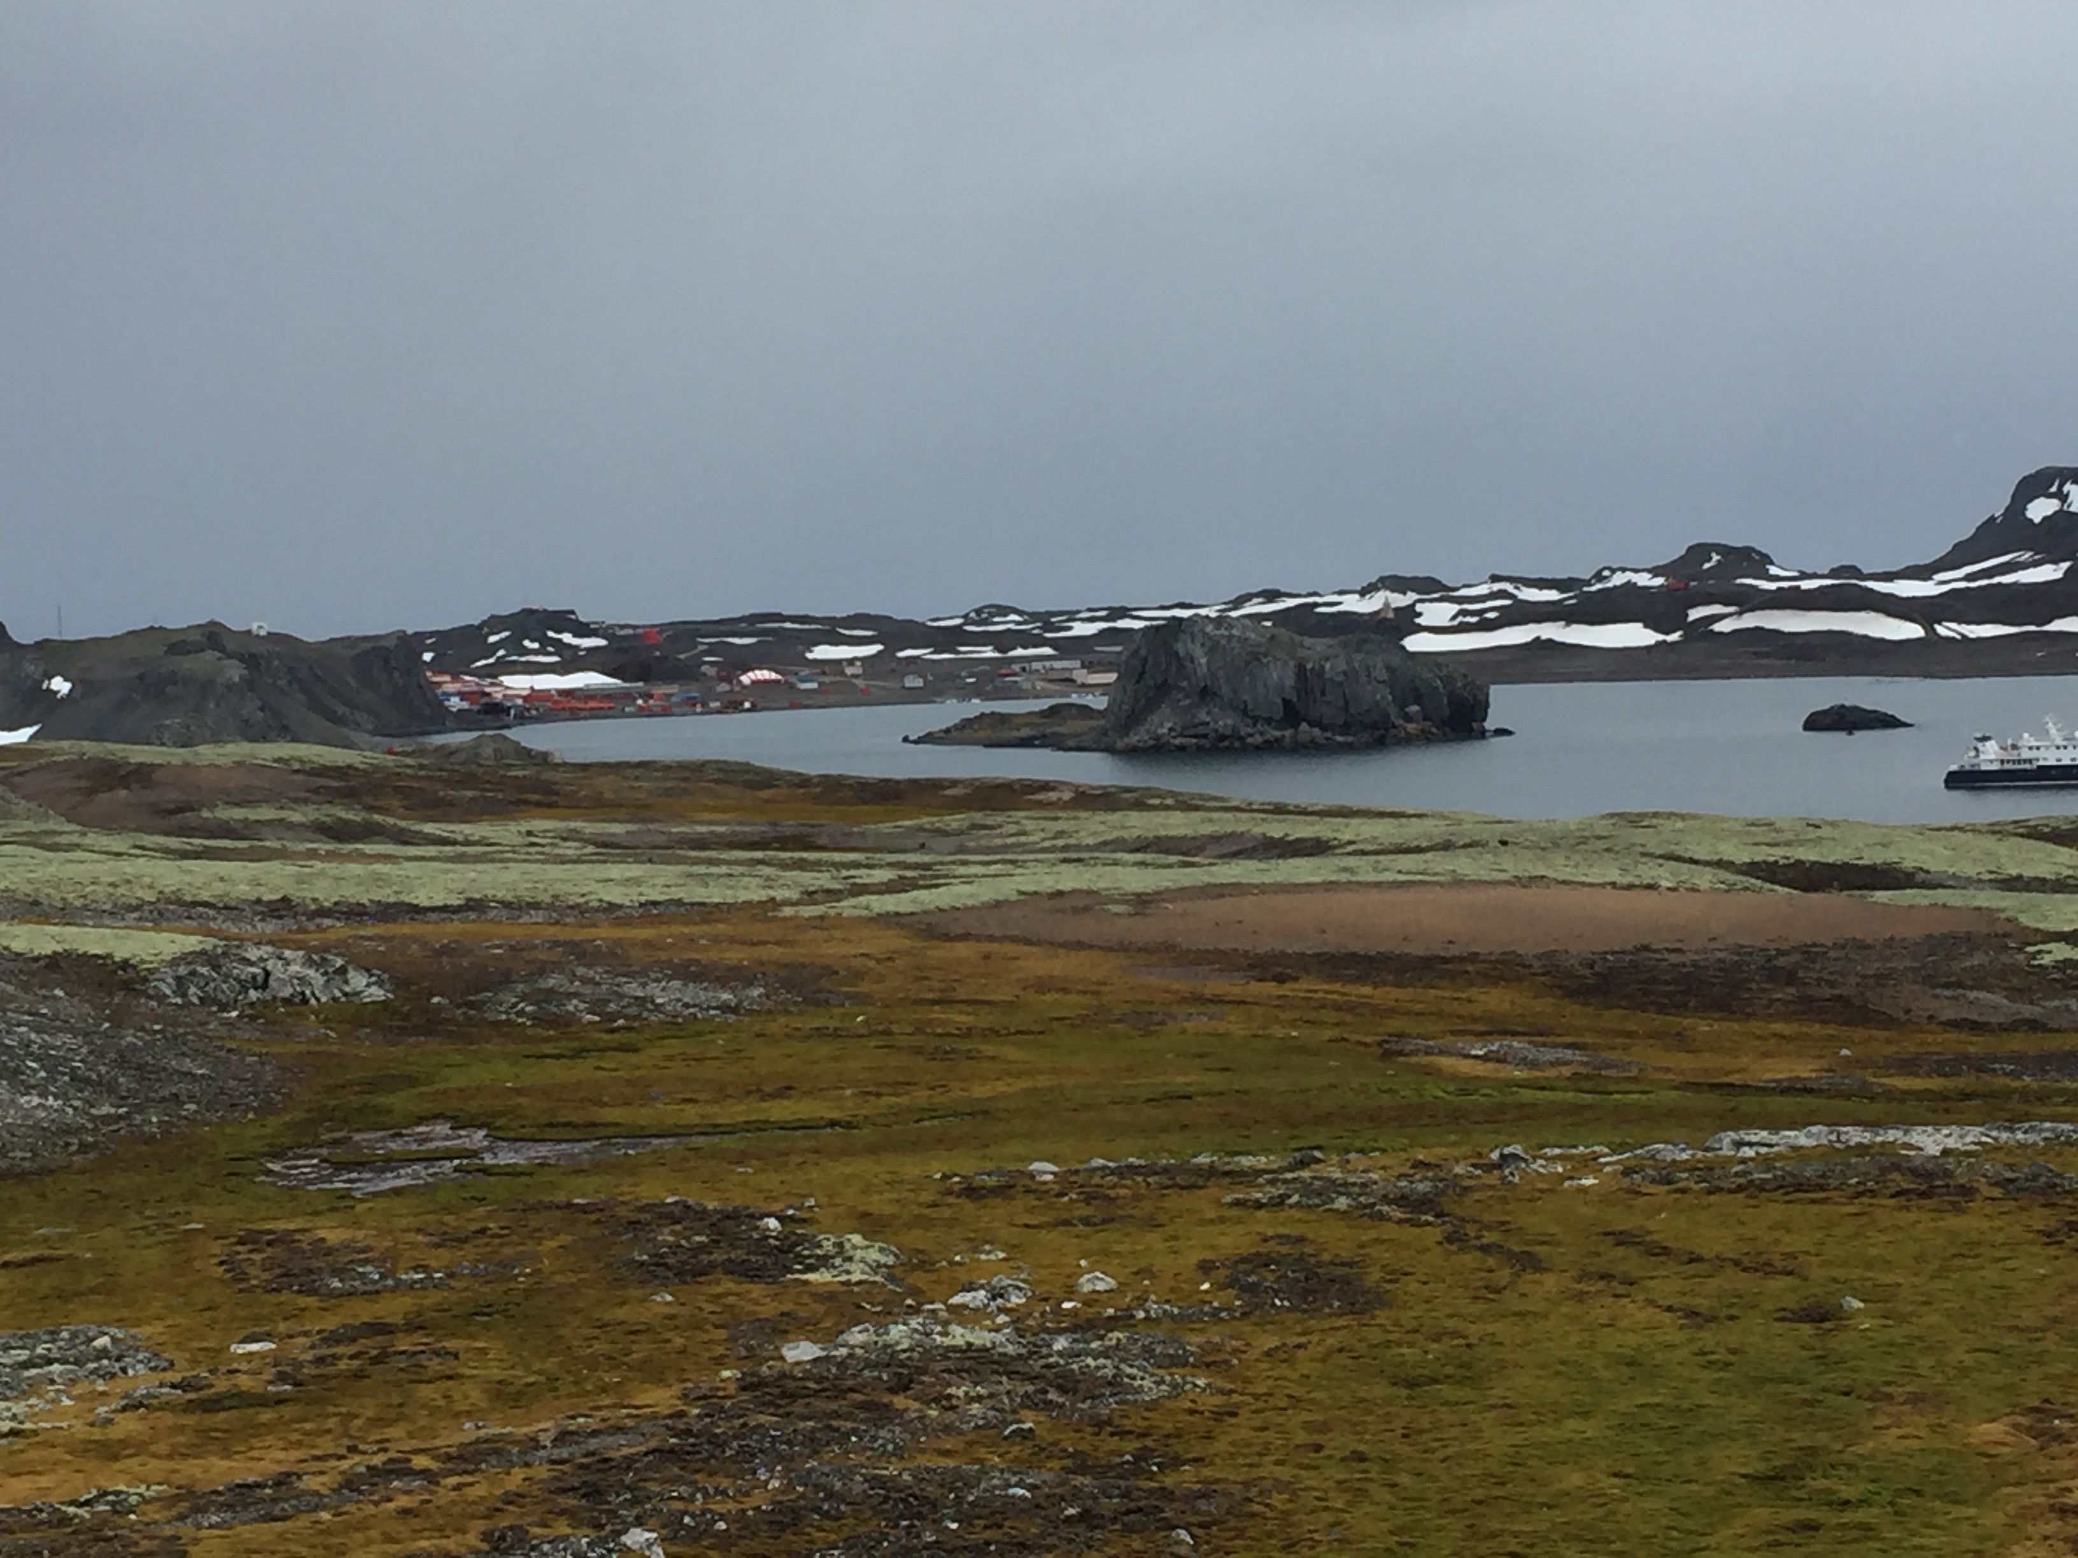
Conclusions
Warming impact on the lichen Placopsis antarctica can produce a decrease of ETR in the field
Reduced humidity during warming episode are stronger and affect prymary photochemistry
Rehydration of lichen thalli induce and increase of fluorsecence with incraesing the effective quantum yield of PSII
We found reduced C and N content in P. antarctica in OTC.

Slide 23
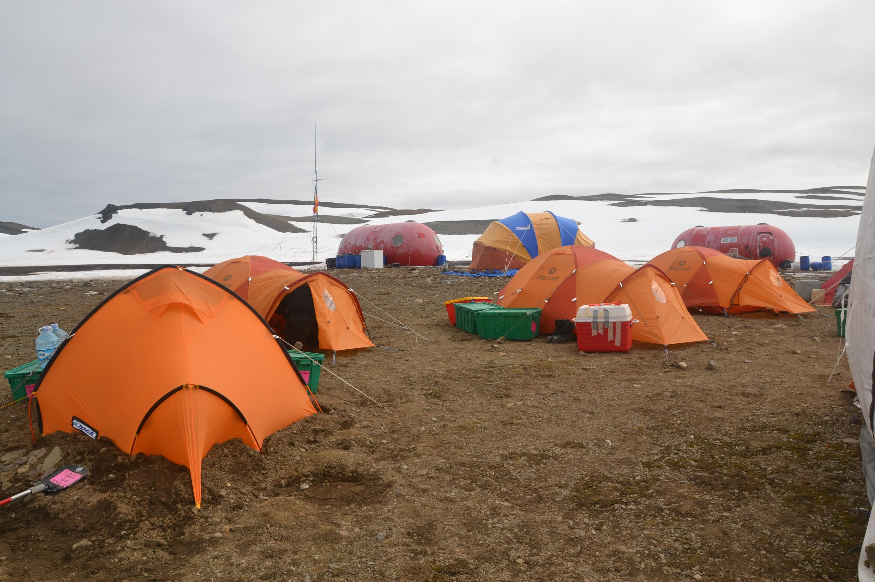
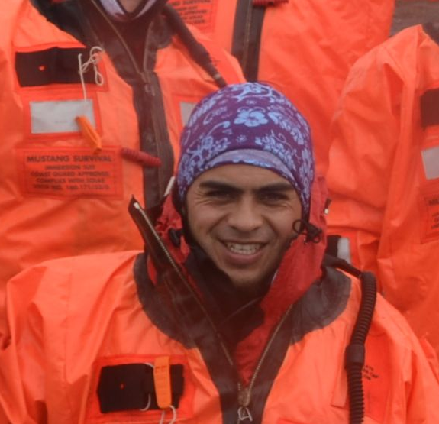
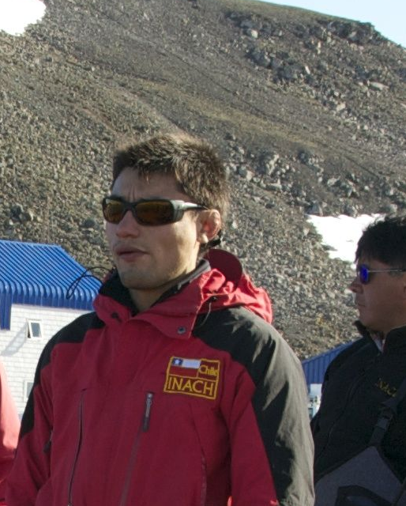


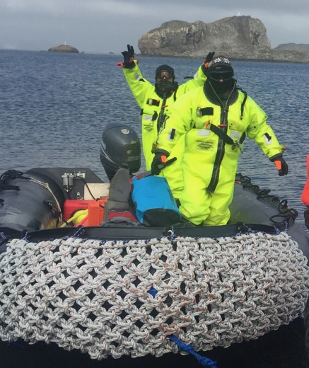
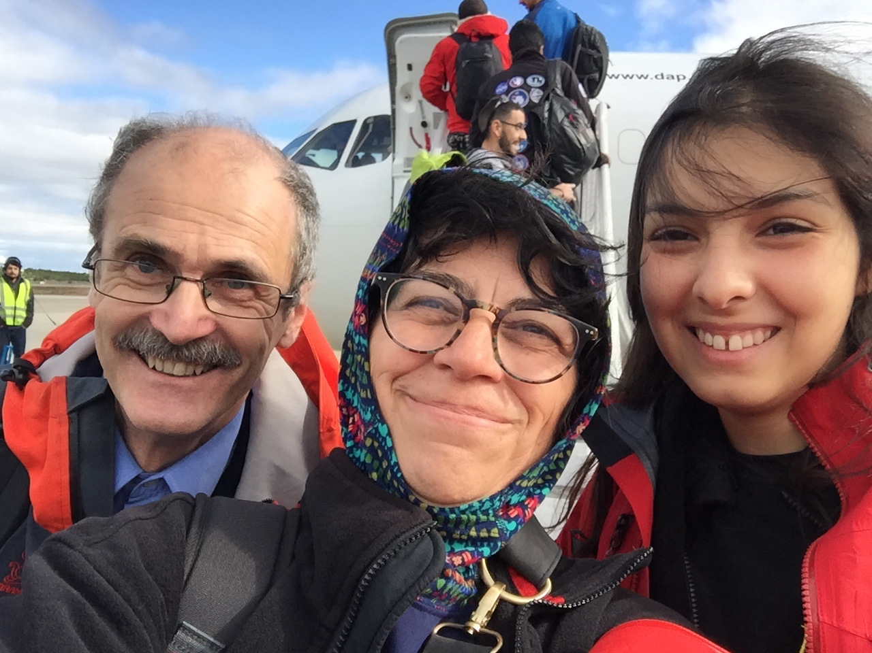
Many thanks!
FONDECYT 1120895
INACH RT0703
INACH RT2716
NFS –IN 0314
KOPRI PE16070
Hector Mancilla
Pablo espinoza
Juan Bravo

Slide 24
gracias!
thanks!
dziękuję!
спасибо тебе!

Slide 25
RESULTS
Sanionia uncinata

Slide 26
1.- Is changing plants distribution?
Deschampsia antarctica
Colobanthus quitensis
Torres et al. 2011

Slide 27
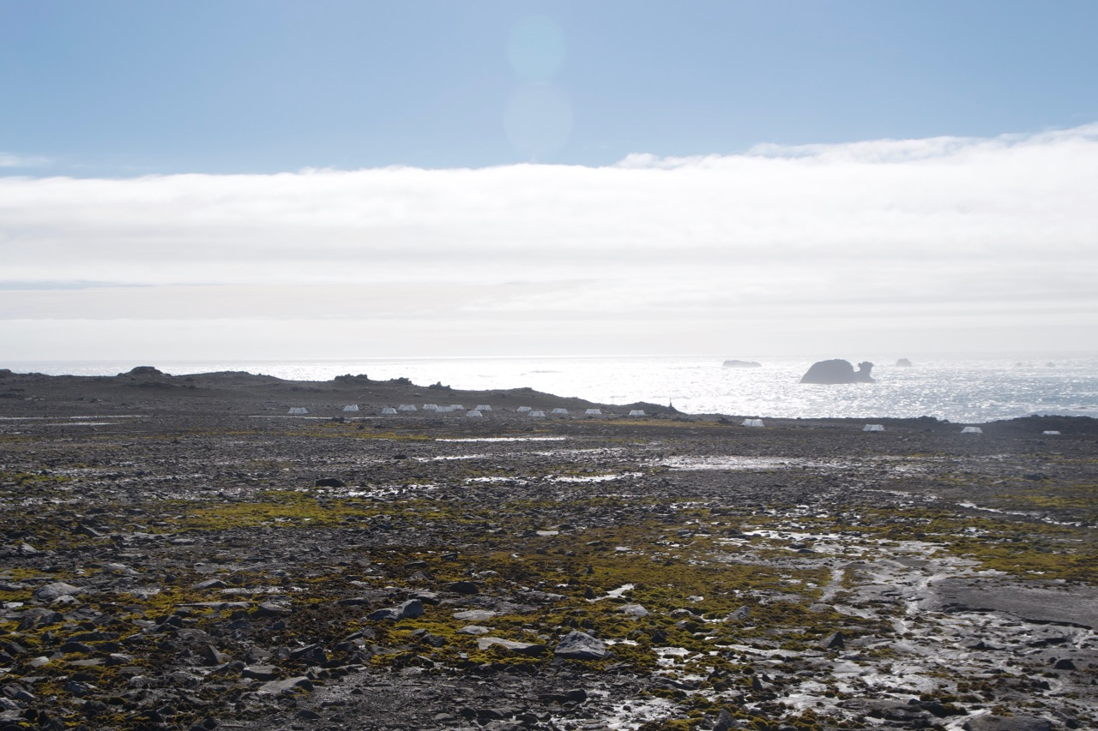
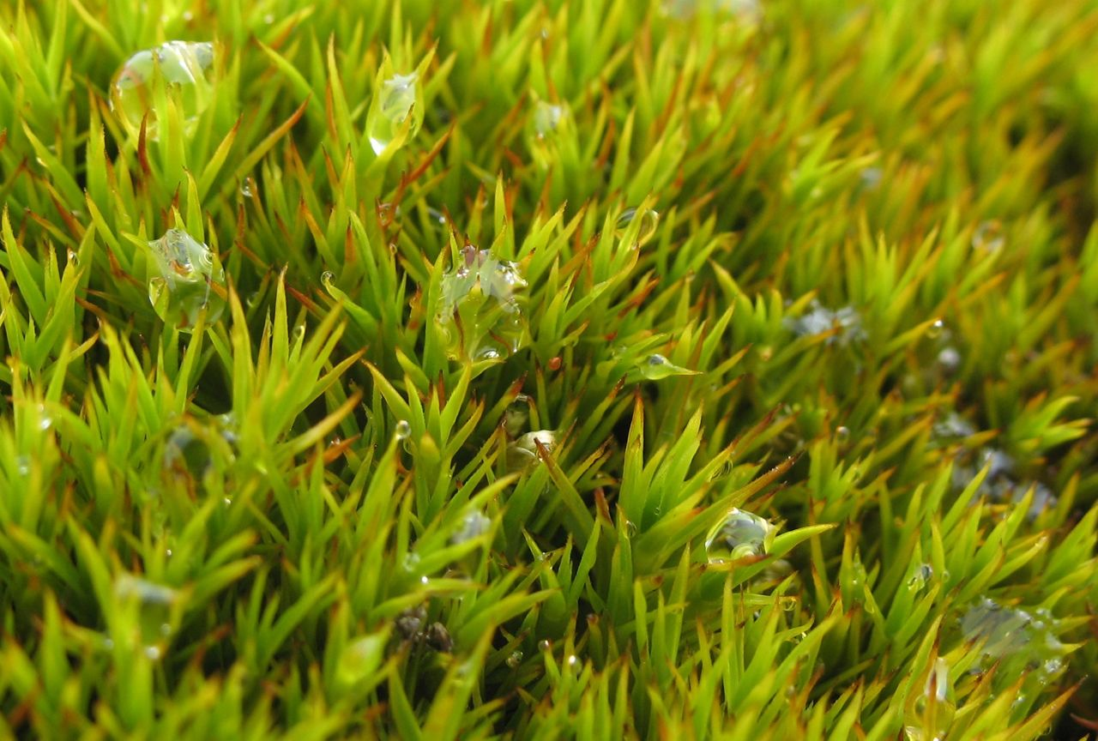
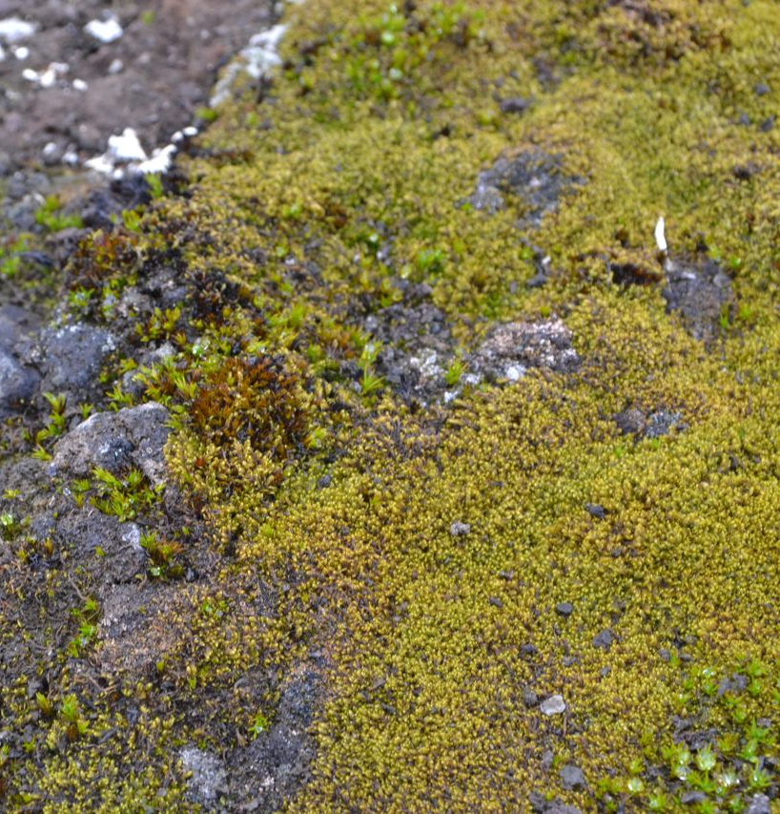
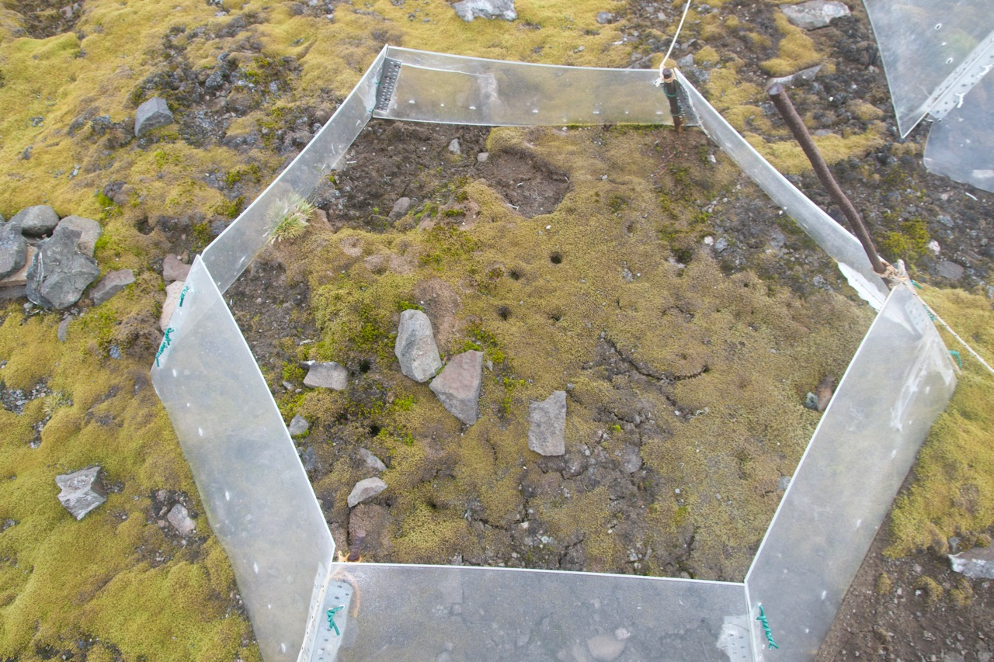
Warming experiments on Fildes, installed in 2008
Mosses, Sanionia uncinata and Polytrichsatrum alpinum
10 open top chamber
Polytrichastrum alpinum
Sanionia uncinata

Slide 28
RESULTS
Moss cover after warming, on La Cruz, Plateau, Fildes Peninsula
Shoertlidge et al. 2016, Ann of Botany

Slide 29
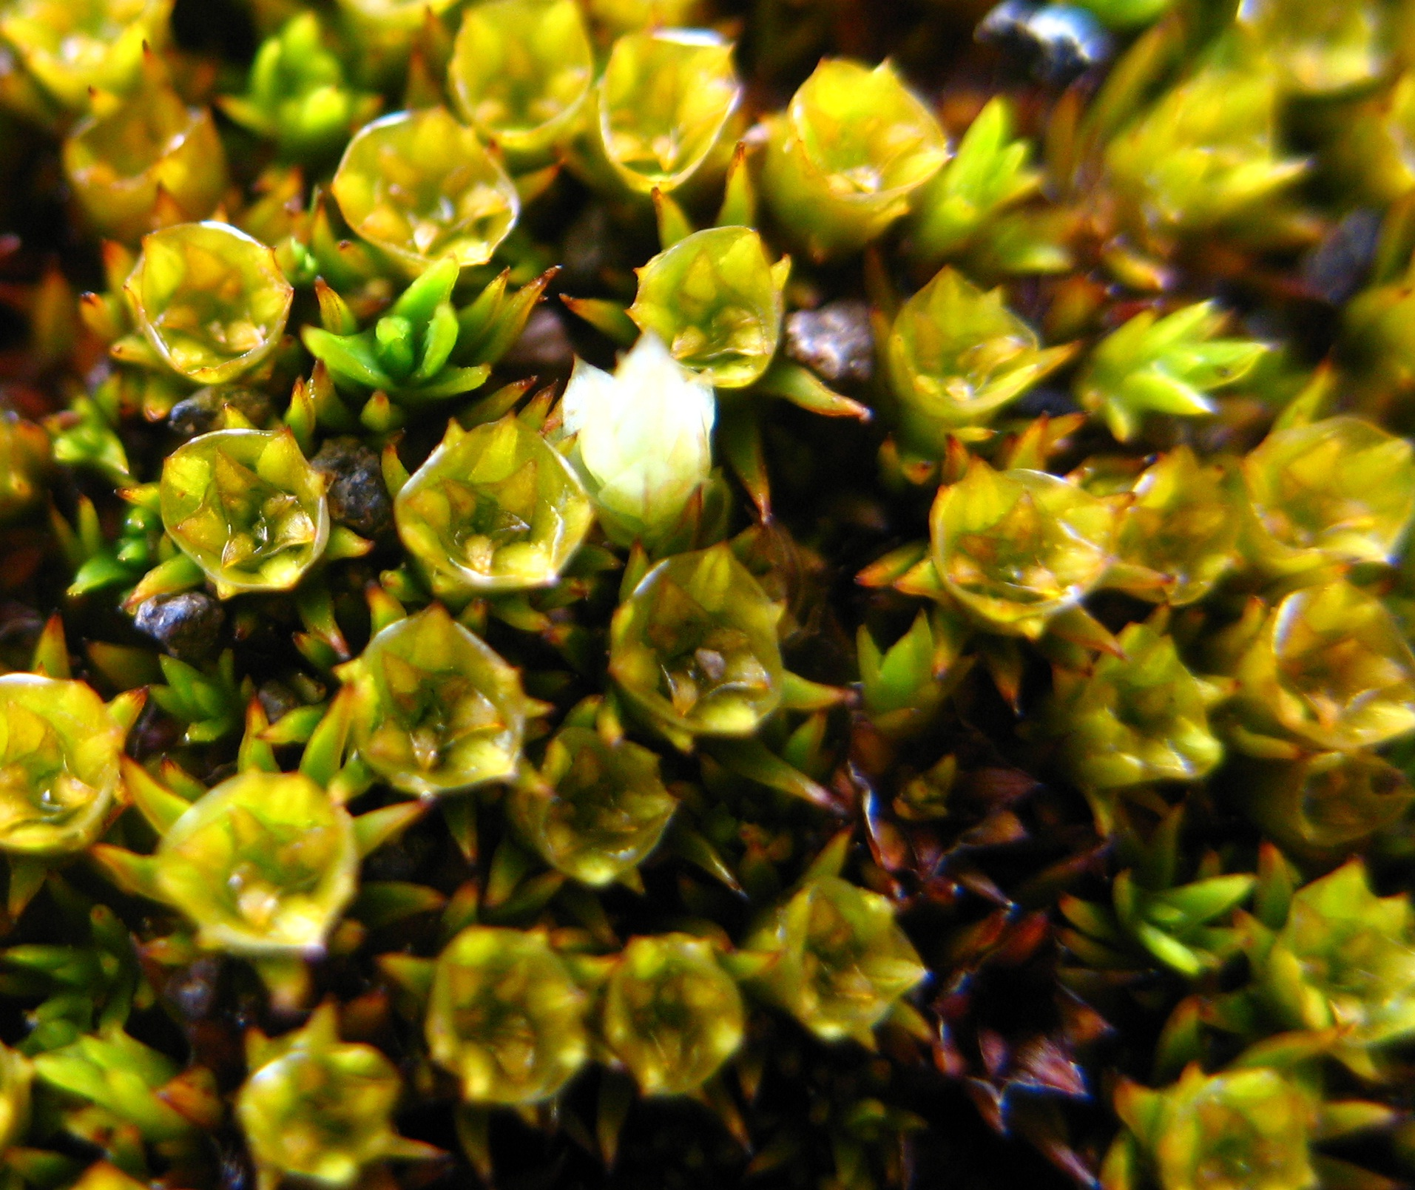
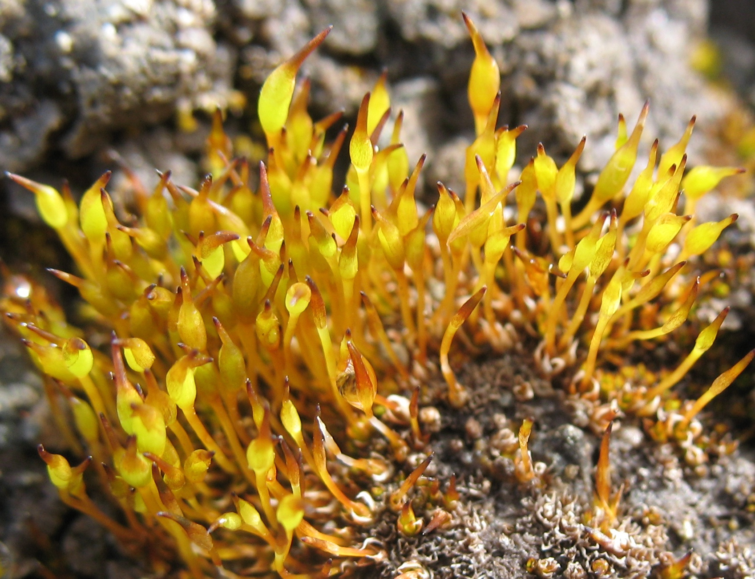
RESULTS
3.- how warming affects reproductive development in mosses?
Casanova et al. 2016, Rev. Chil. Hist. Natural

Slide 30
RESULTS
Casanova-Katny et al. 2016, Rev. Chil. Hist. Natural

Slide 31
RESULTS
Moss canopy Polytrichastrum alpinum, after 6 years of warming
Shoertlidge et al. 2016, Ann of Botany

Slide 32
Moss canopy Polytrichastrum alpinum, after 8 years of warming
Prather et a. 2019, in press Royal Society open Sc.

Slide 34
4.- how warming affects microinvertebrates associated to mosses?

Slide 36
Conclusions, moss history
Microclima is different inside the OTC, increasing temperatures
Effects on moss cover and biomass, incraesing at all, but specie-specific
Effects on moss reproduction performance, with change in moss population structure
moss microinvertebrates associated, indirectly affected

