Slide 1
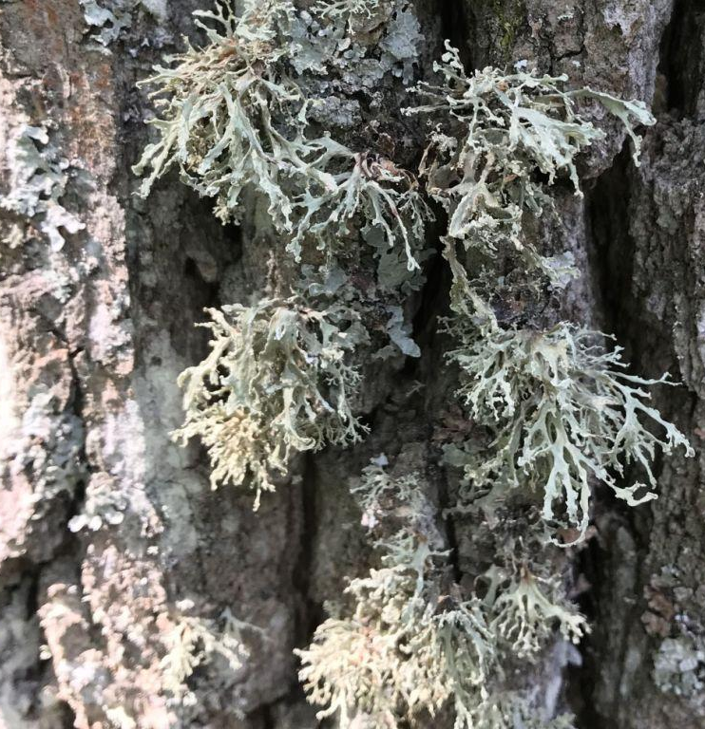
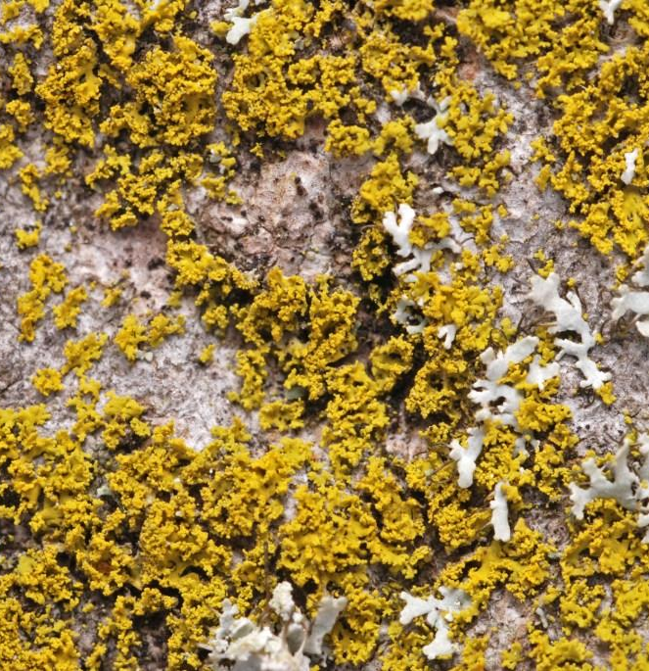
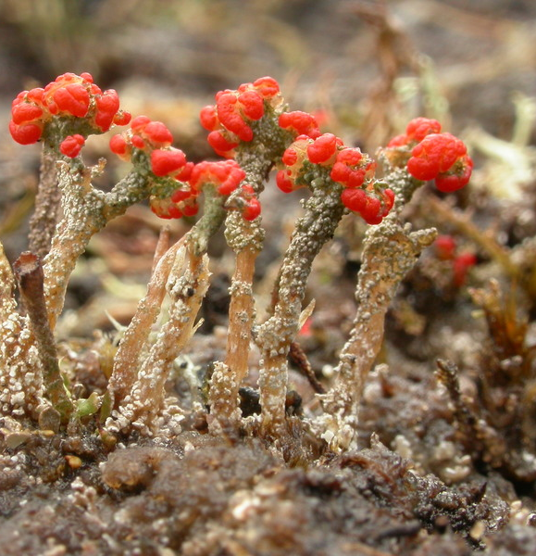
LICHENOLOGICAL RESEARCH IN CENTRAL RUSSIA: RESULTS, PROBLEMS AND SOLUTIONS
E.E. Muchnik Institute of Forest Science of RAS

Slide 2
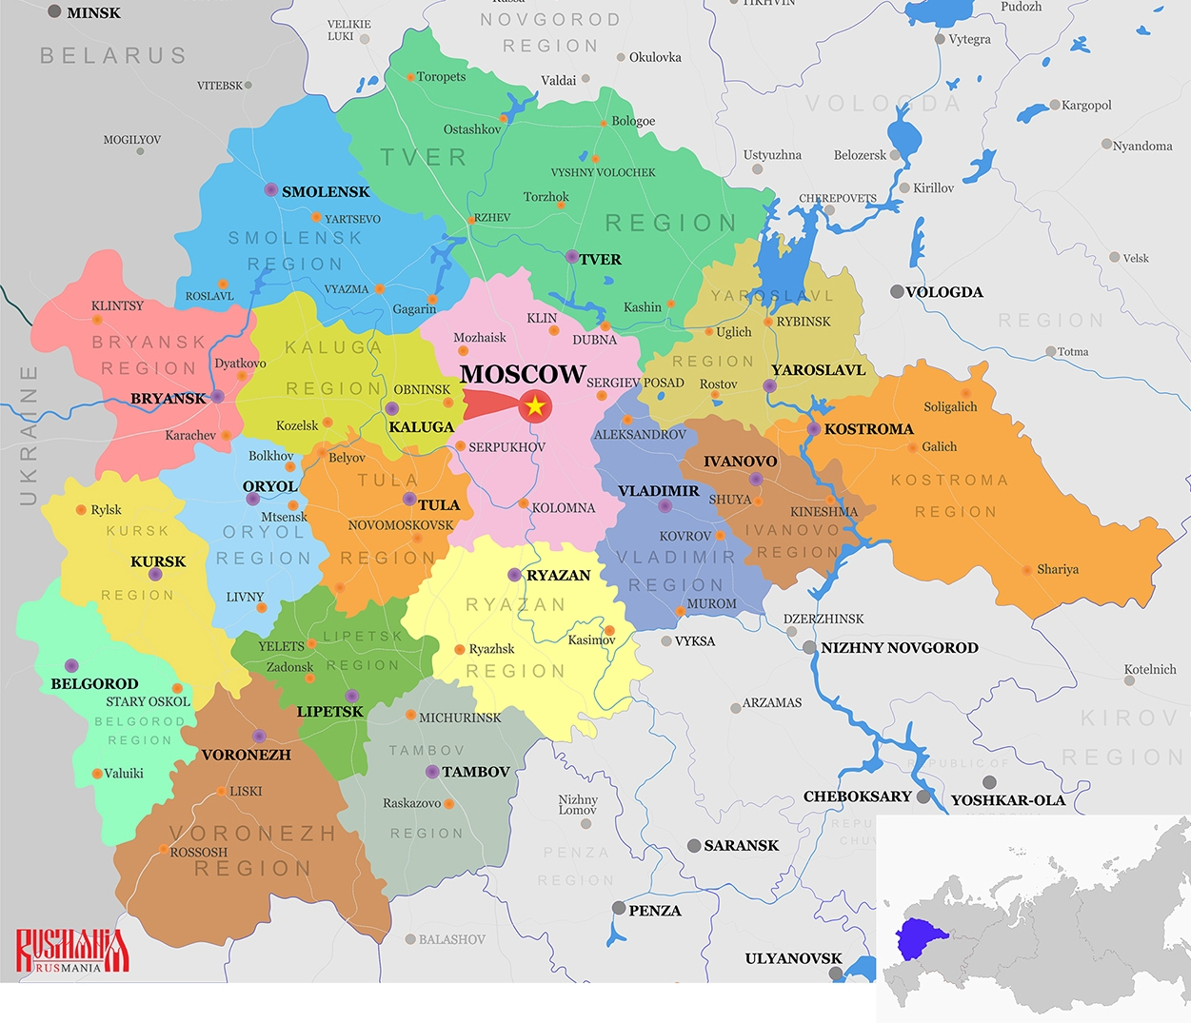
The Cenral Russia, understood within the Central Federal District, includes 18 subjects of the Federation with a total area of more than 650 thousand km²

Slide 3
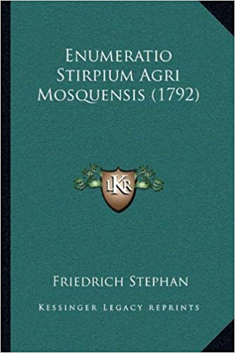
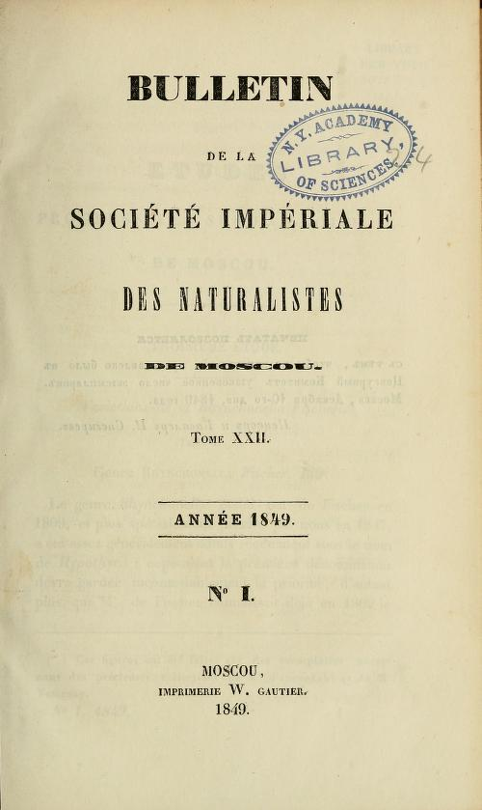
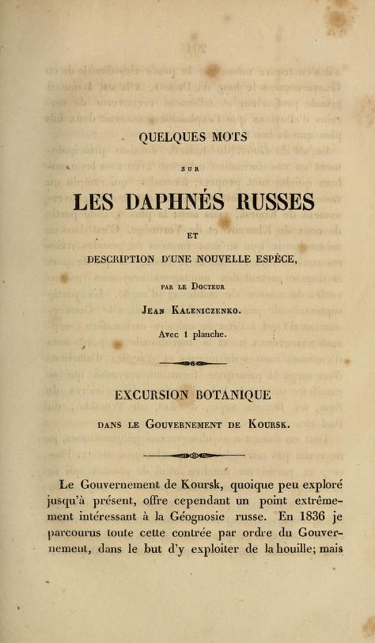
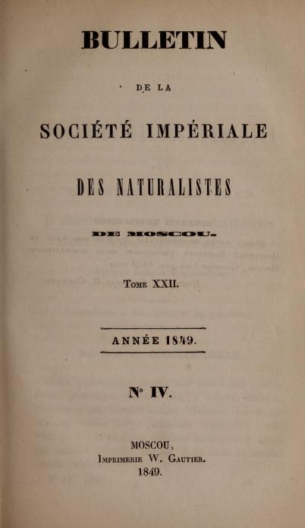
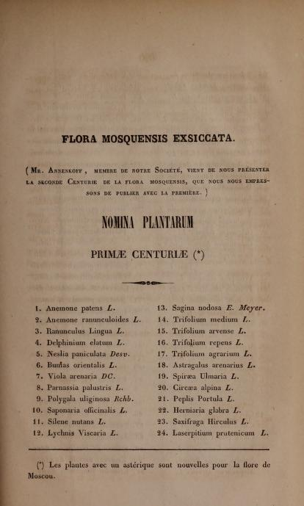
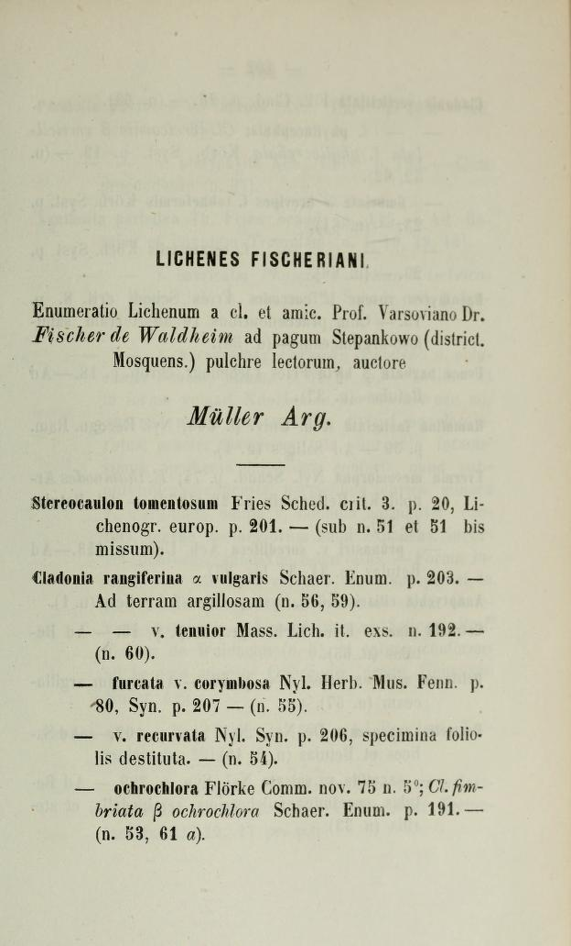
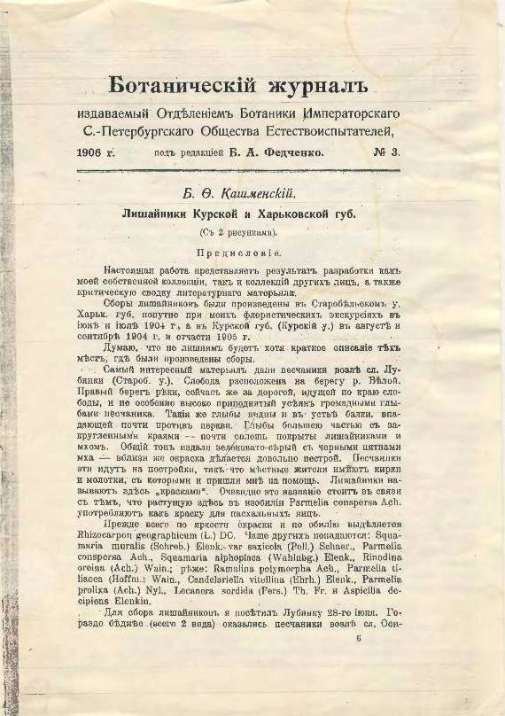
Information on the lichen biota of this territory has been accumulating for more than two hundred years, counting from the first edition of the work of F. Stephan (1792). Until almost the 70s of the XIX century, the data are very fragmented and are contained in general reports with vascular plants, for example, the works of H. Martius (1817), D. Goldbach (1820), J. Kaleniczenko (1849), N. Annenkoff (1849 , 1850, 1851), F. Pohanka (1860).
In 1878, the work of A. Müller was published, including a small list of lichens in the environs of the village of Stepankovo (Moscow province), and in 1906 an article by B.F. Kashmensky, dedicated to lichens of the Kursk and Kharkov provinces.

Slide 4
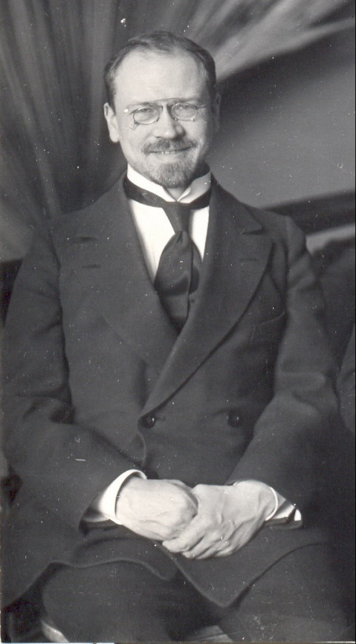
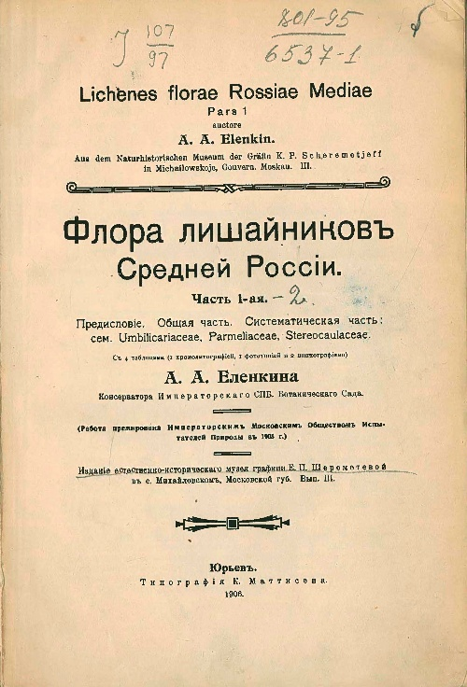
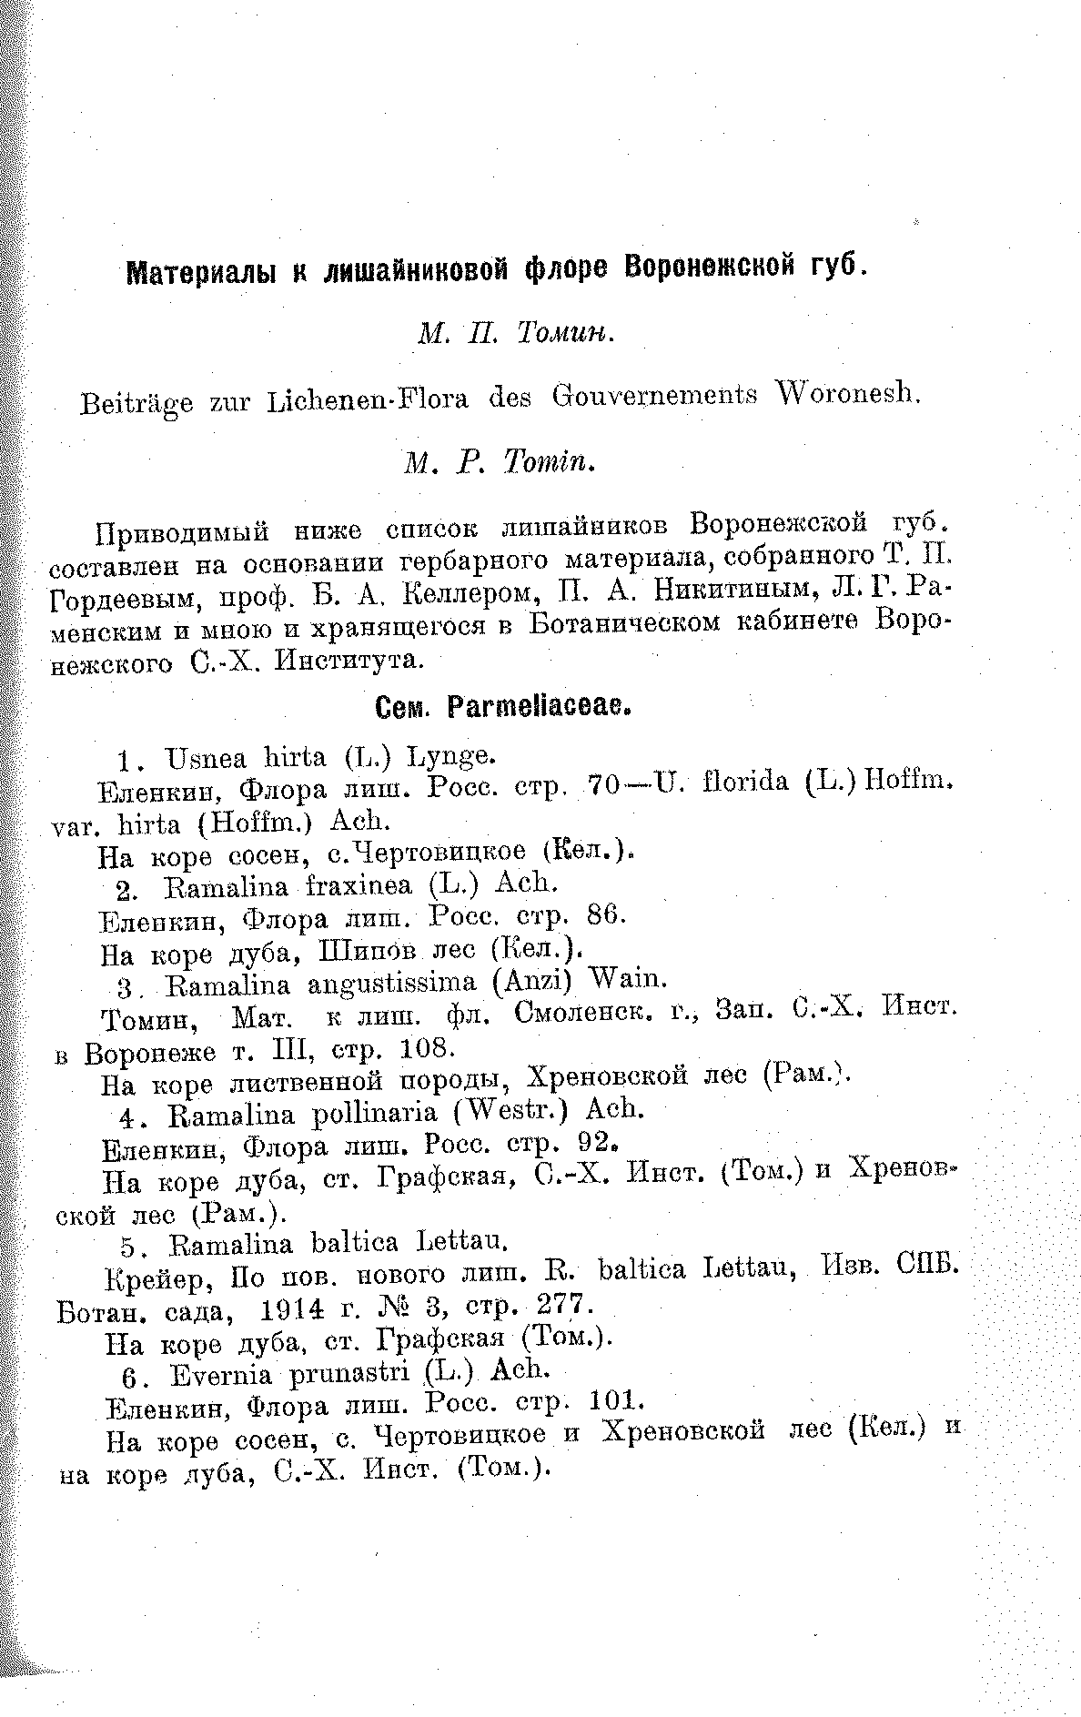
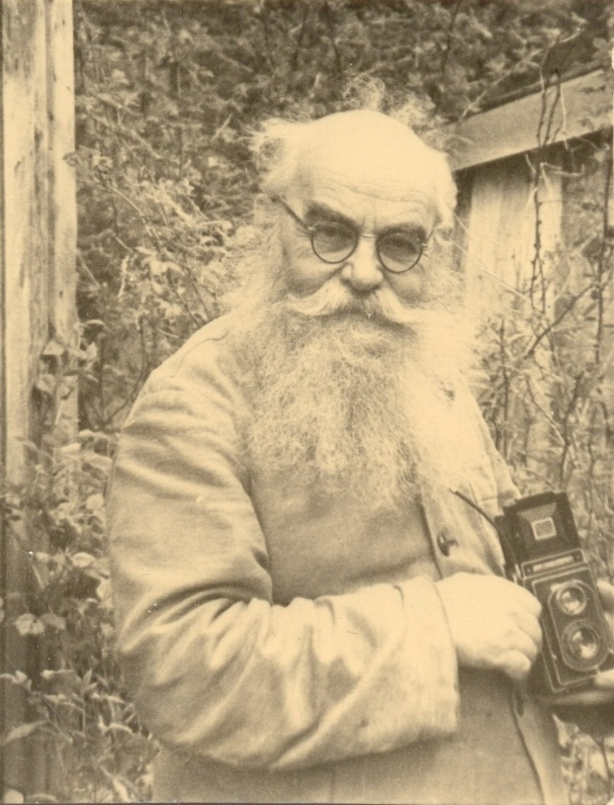
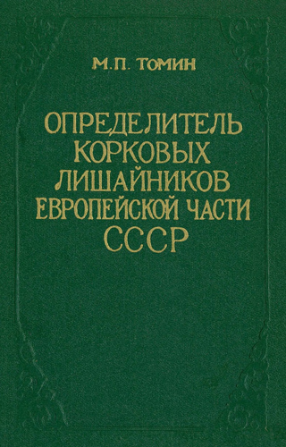
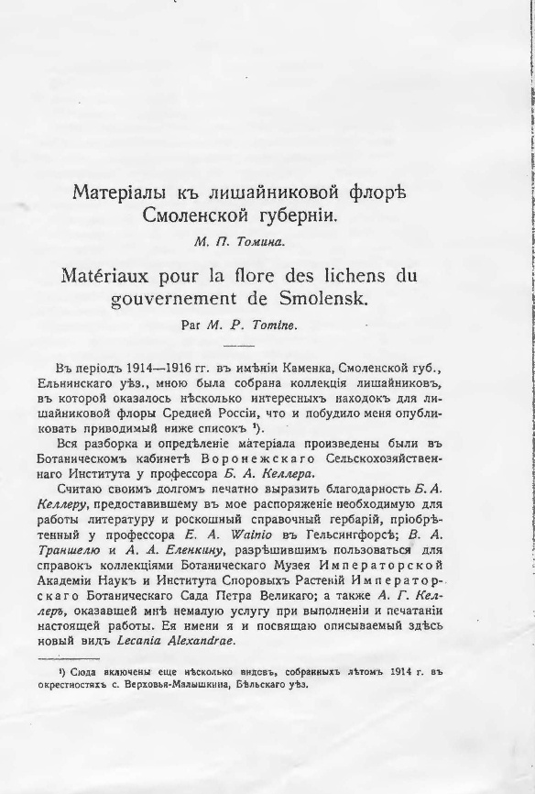
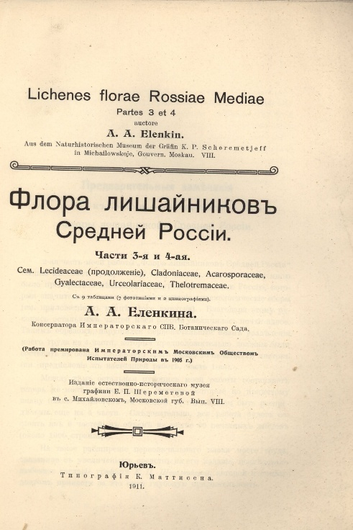
In the first half of the 20th century, the main body of data on the lichen biota of Central Russia is contained in the works of A.A. Elenkin (1904; 1906 - 1911) and M.P. Tomin (1918; 1926 - 1928; 1931; 1937; 1956); it is also worth mentioning the work of K. Ladyzhenskaya (1931) on lichens in the vicinity of Kologriv

Slide 5
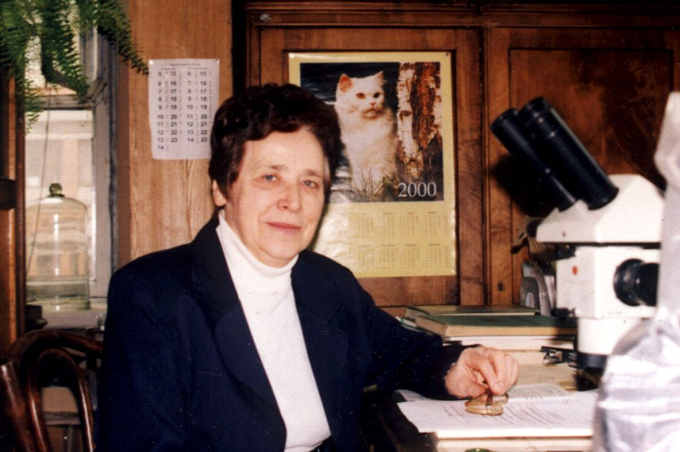
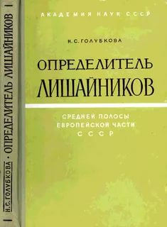
Lichenological studies of the designated territory in the second half of the twentieth century are associated with the names of N.S. Golubkova, L.G. Byazrov, I.I. Makarova, N.V. Malysheva
In addition to the above, from the 80s of the last century to the present, many researchers have studied the lichen biota of different regions of Central Russia: A.V. Pchelkin, T.Yu. Tolpysheva, A.A. Notov, L.A. Katauskayte, S.I. Chabanenko, E.E. Muchnik, L.A. Konoreva, I.N. Urbanavichene, G.P. Urbanavichus, A.A. Dobrysh, A.N. Titov, D.E. Himelbrant, E.S. Kuznetsova, M.A. Fadeeva, A.V. Gudovicheva, O.A. Kataeva I.S. Zhdanov, I.S. Stepanchikova, L.V. Gagarina, S.V. Chesnokov and others.

Slide 6
As a result, according to current taxonomic and nomenclature sources, 928 lichen and allied fungi species from 258 genera integrated in 109 families are known.
Range of Leading Families
Percentage of all Leading Families

Slide 7
Range of Leading Genera
Genus | Number of species | Genus | Number of species | Genus | Number of species
Сladonia | 66 | Calicium | 10 | Cetraria | 5
Verrucaria | 41 | Pertusaria | 10 | Circinaria | 5
Lecanora | 39 | Usnea | 10 | Melanohalea | 5
Arthonia | 21 | Myriolecis | 9 | Physconia | 5
Rinodina | 19 | Candelariella | 7 | Placynthiella | 5
Lecania | 17 | Flavoplaca | 7 | Absconditella | 4
Bacidia | 17 | Gyalecta | 7 | Lepra | 4
Chaenotheca | 16 | Lecidella | 7 | Melanelixia | 4
Peltigera | 16 | Scytinium | 7 | Nephroma | 4
Caloplaca | 15 | Xanthoparmelia | 7 | Parmelina | 4
Lecidea | 14 | Collema | 6 | Pospidia | 4
Micarea | 14 | Hypogymnia | 6 | Sclerophora | 4
Rhizocarpon | 14 | Mycobilimbia | 6 | Scoliciosporum | 4
Chaenothecopsis | 13 | Phaeophyscia | 6 | Strangospora | 4
Ramalina | 13 | Stereocaulon | 6 | Trapelia | 4
Acarospora | 12 | Aspicilia | 5 | Trapeliopsis | 4
Bryoria | 12 | Athallia | 5 | Xanthocarpia | 4
Lepraria | 11 | Buellia | 5 | Xanthoria | 4
Biatora | 10 | Calogaya | 5 | In total: 56 | 589

Slide 8
Despite a long period of research and many publications, a significant part of the territory of the CR is insufficiently and unevenly studied lichenologically
Some regions are more or less fully covered by lichenological studies (Tver, Yaroslavl, Moscow and Moscow city, Ryazan, Oryol, Kaluga, Tula, Bryansk, all Central Black Soil regions),
for others there is fragmentary and / or partially outdated information (Kostroma, Smolensk, Vladimir, Ivanovo regions)

Slide 9
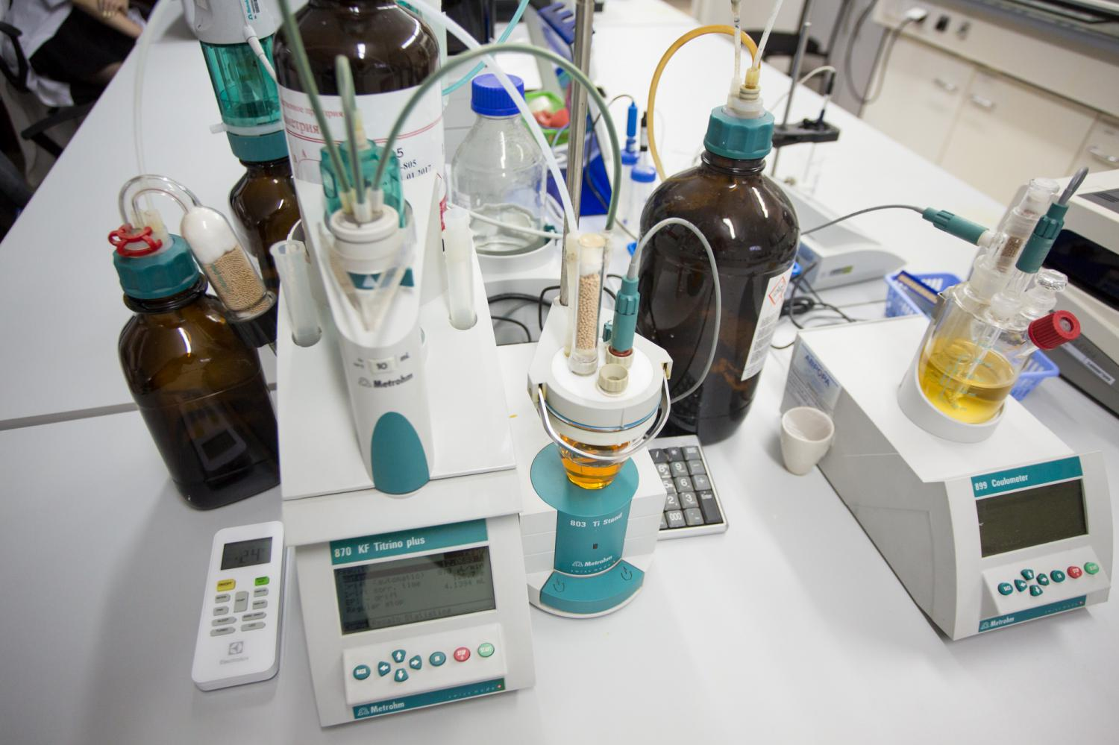
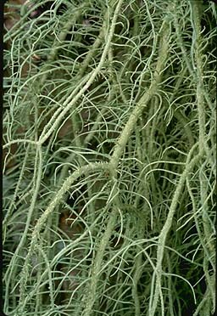
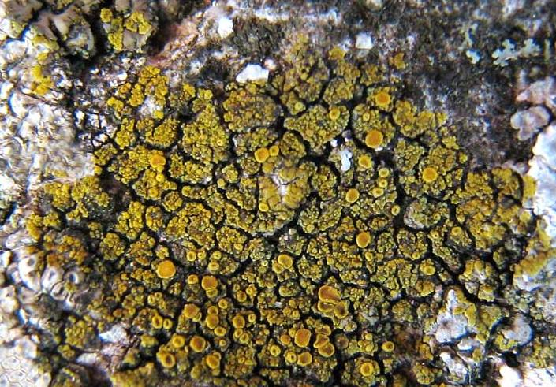
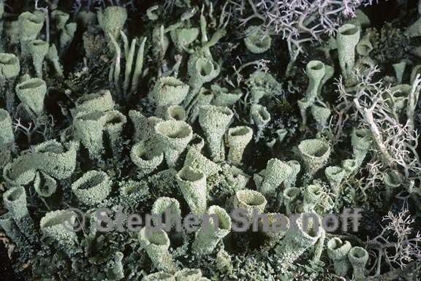
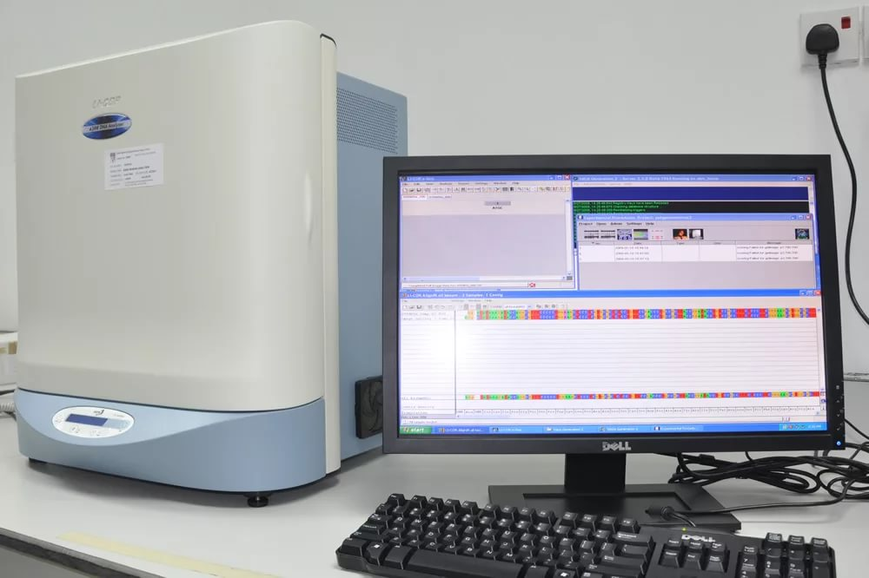
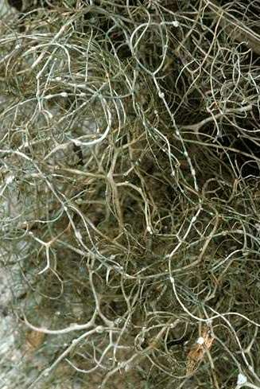
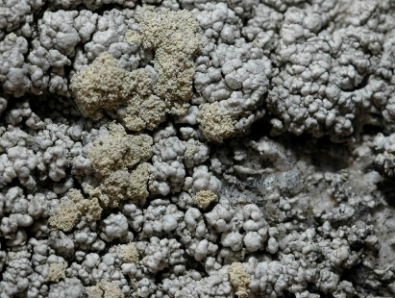
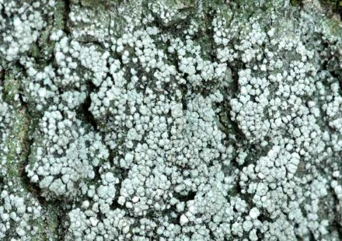
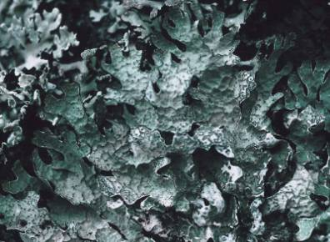
Absence or inaccessibility for revision of herbarium specimens of many species noted in publications
Modern identification techniques
Changes in understanding the volumes of many species
The need for a complete revision of herbarium materials of Bryoria s.l., Caloplaca s.l., Candelaria, Cladonia s.l., Lecanora s.l., Ochrolechia, Parmelia s.l., Pertusaria s.l., Usnea and others.

Slide 10
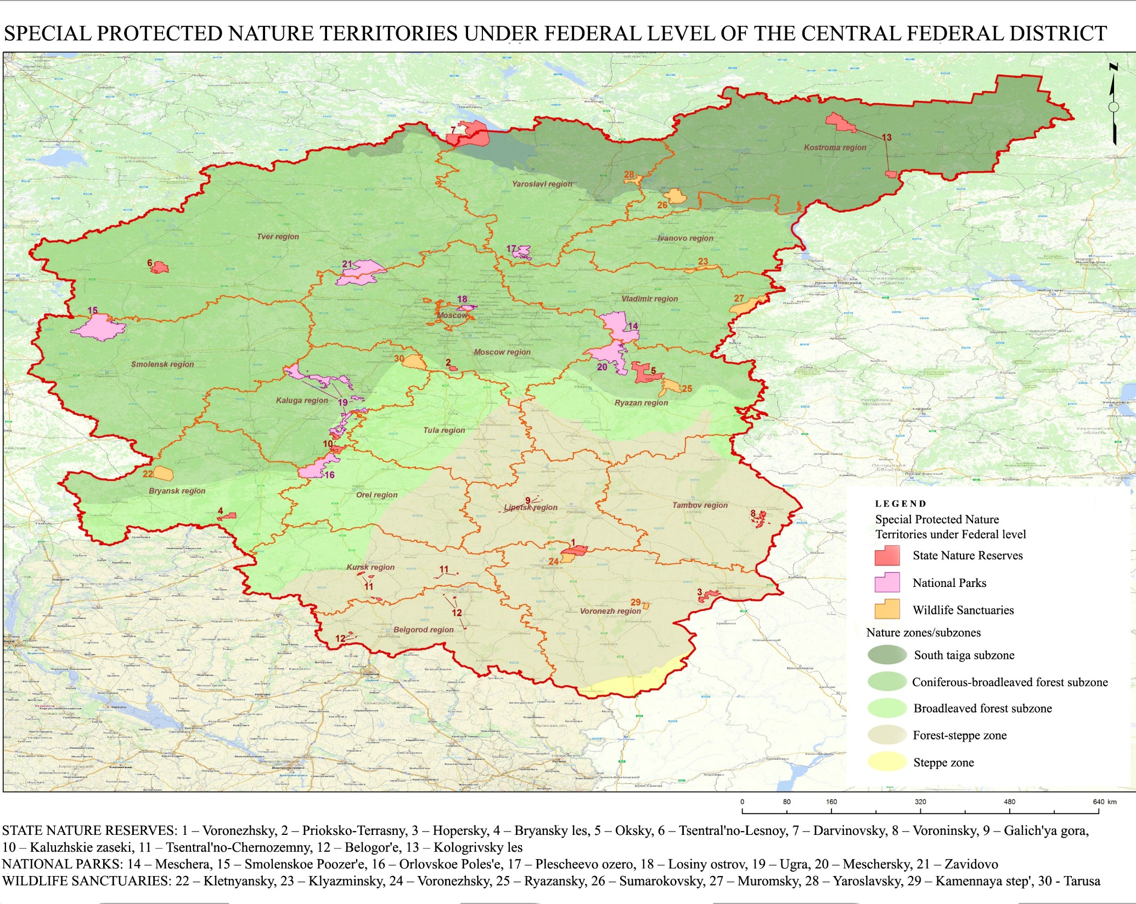
Serious difficulties arise in the development of measures to protect of lichen biota richness in the Central Russia in general and on regional
(or zonal, depending on the approach) level in particular.
Total area of Special Protected Territories under Federal level is 13,26 th. km² . Total richness of lichen biota is 719 species (77.5 %)

Slide 11
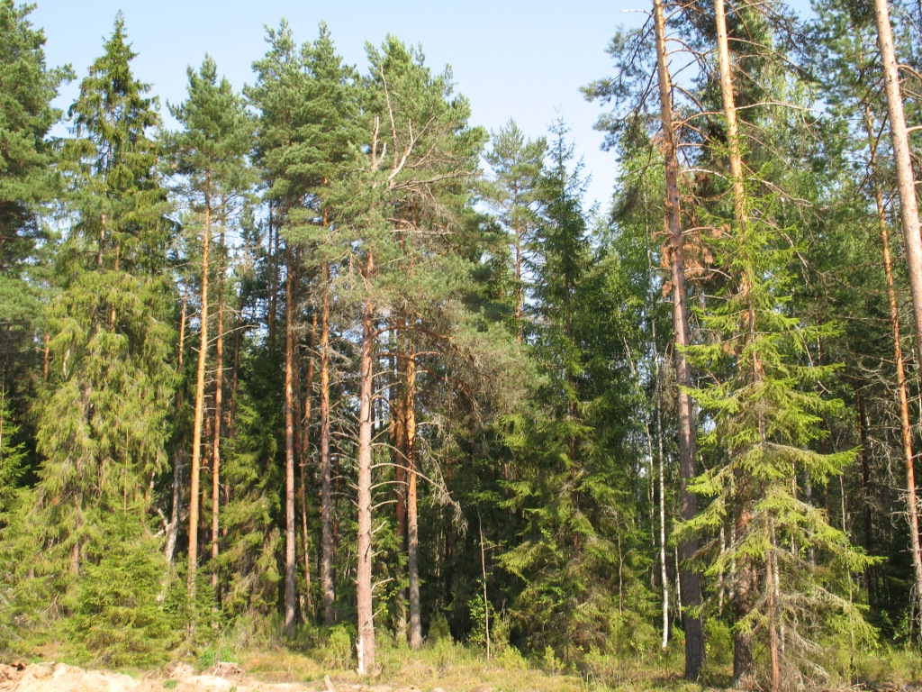
South Taiga forest subzone
Total area in Central Russia (S1)
– 80.9 th. km²
Total area of Specially Protected Territories (S2) – 2.12 th. km² (2.6 % of S1)
Lichen biota’s richness – 354 species
Lichen biota’s richness – 308 species
(R1 = 87 %)
Protected lichens – 12 species,
including 2 – on Federal level
Protected lichens in Specially Protected Territories
– 11 species (R2 = 91.6 %)
Davinsky State Reserve – 178 species
Kologrivsky Les State Reserve– 235 species
Yaroslavsky Wildlife Sanctuary - ??
Sumarokovsky Wildlife Sanctuary - ??

Slide 12
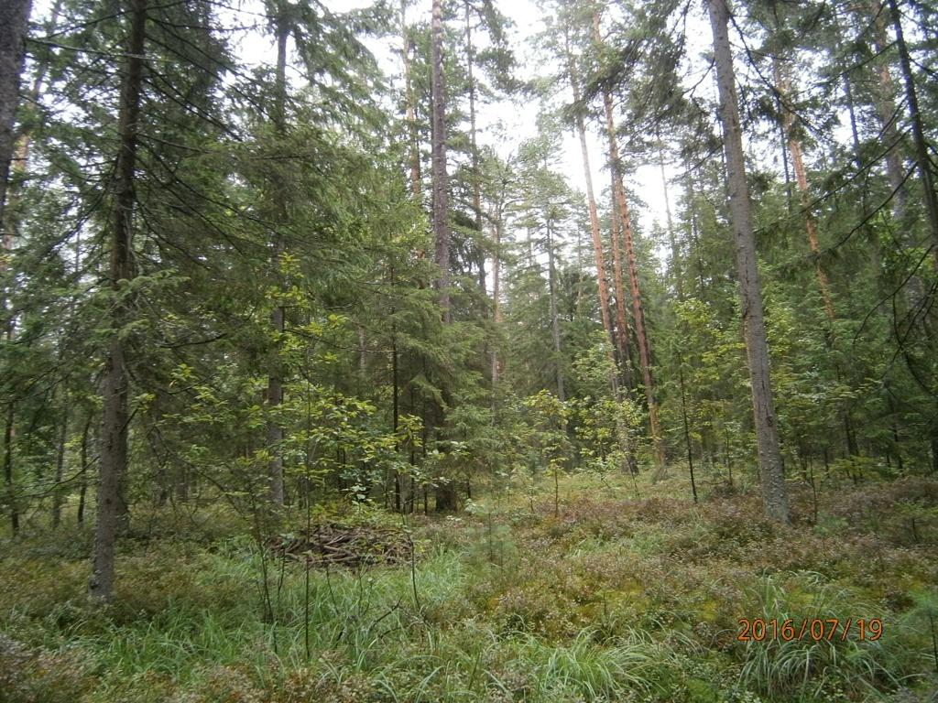
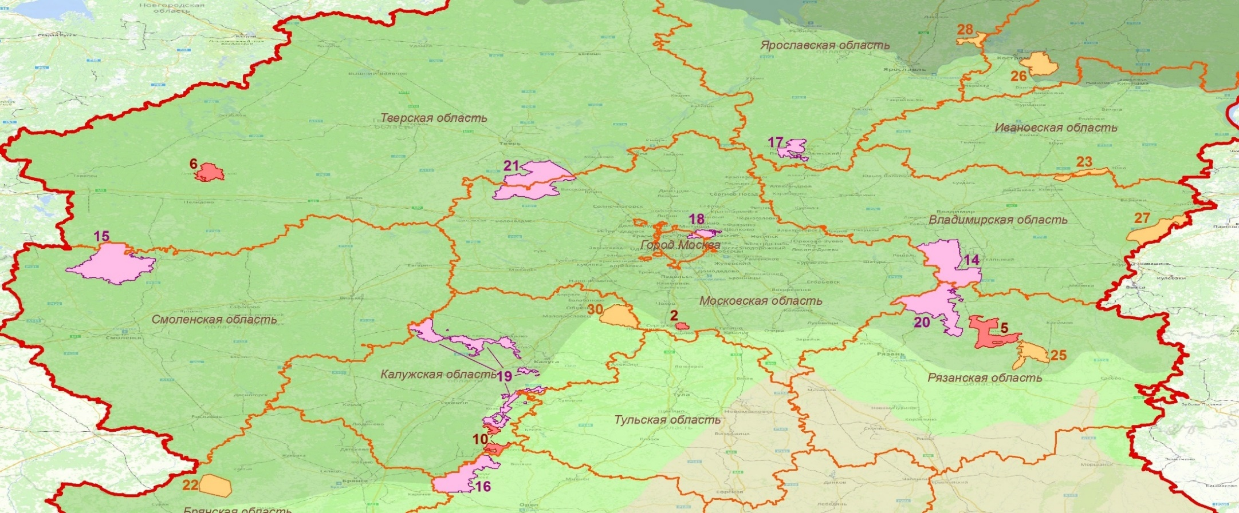
Сoniferous-broadleaved forest subzone
Total area in Central Russia (S1)
– 304.9 th. km²
Total area of Specially Protected Territories (S2) – 9.12 th. km² (3 % of S1)
Lichen biota’s richness – 730 species
Lichen biota’s richness – 525 species
(R1 = 71.9 %)
Protected lichens – 110 species,
including 4 – on Federal level
Protected lichens in Specially Protected Territories
– 77 species (R2 = 70 %)

Slide 13
Type of Specially Protected Territoria | Name of Specially Protected Territoria | Known number of lichen species | Research level
State Nature Reserves | Tsentralno-Lesnoy | 381 | High
 | Prioksko-Terrasny | 108 | Poor
 | Oksky | 217 | High
National parks | Pleshcheevo Ozero | 105 | Poor
 | Zavidovo | 321 | High
 | Smolenskoye Poozerie | 160 | Poor
 | Losiny Ostrov | 85 | Poor
 | Meshchera | 167 | High
 | Meshchersky | 136 | Poor
 | Orlovskoye Polesie | 178 | High
 | Ugra (Ugorsky cluster) | 143 | Poor
Wildlife Sanctuaries of Federal level | Klyazminsky | - | Not investigated
 | Muromsky | - | Not investigated
 | Ryazansky | 87 | Poor
 | Kletnyansky | 114 | Poor

Slide 14
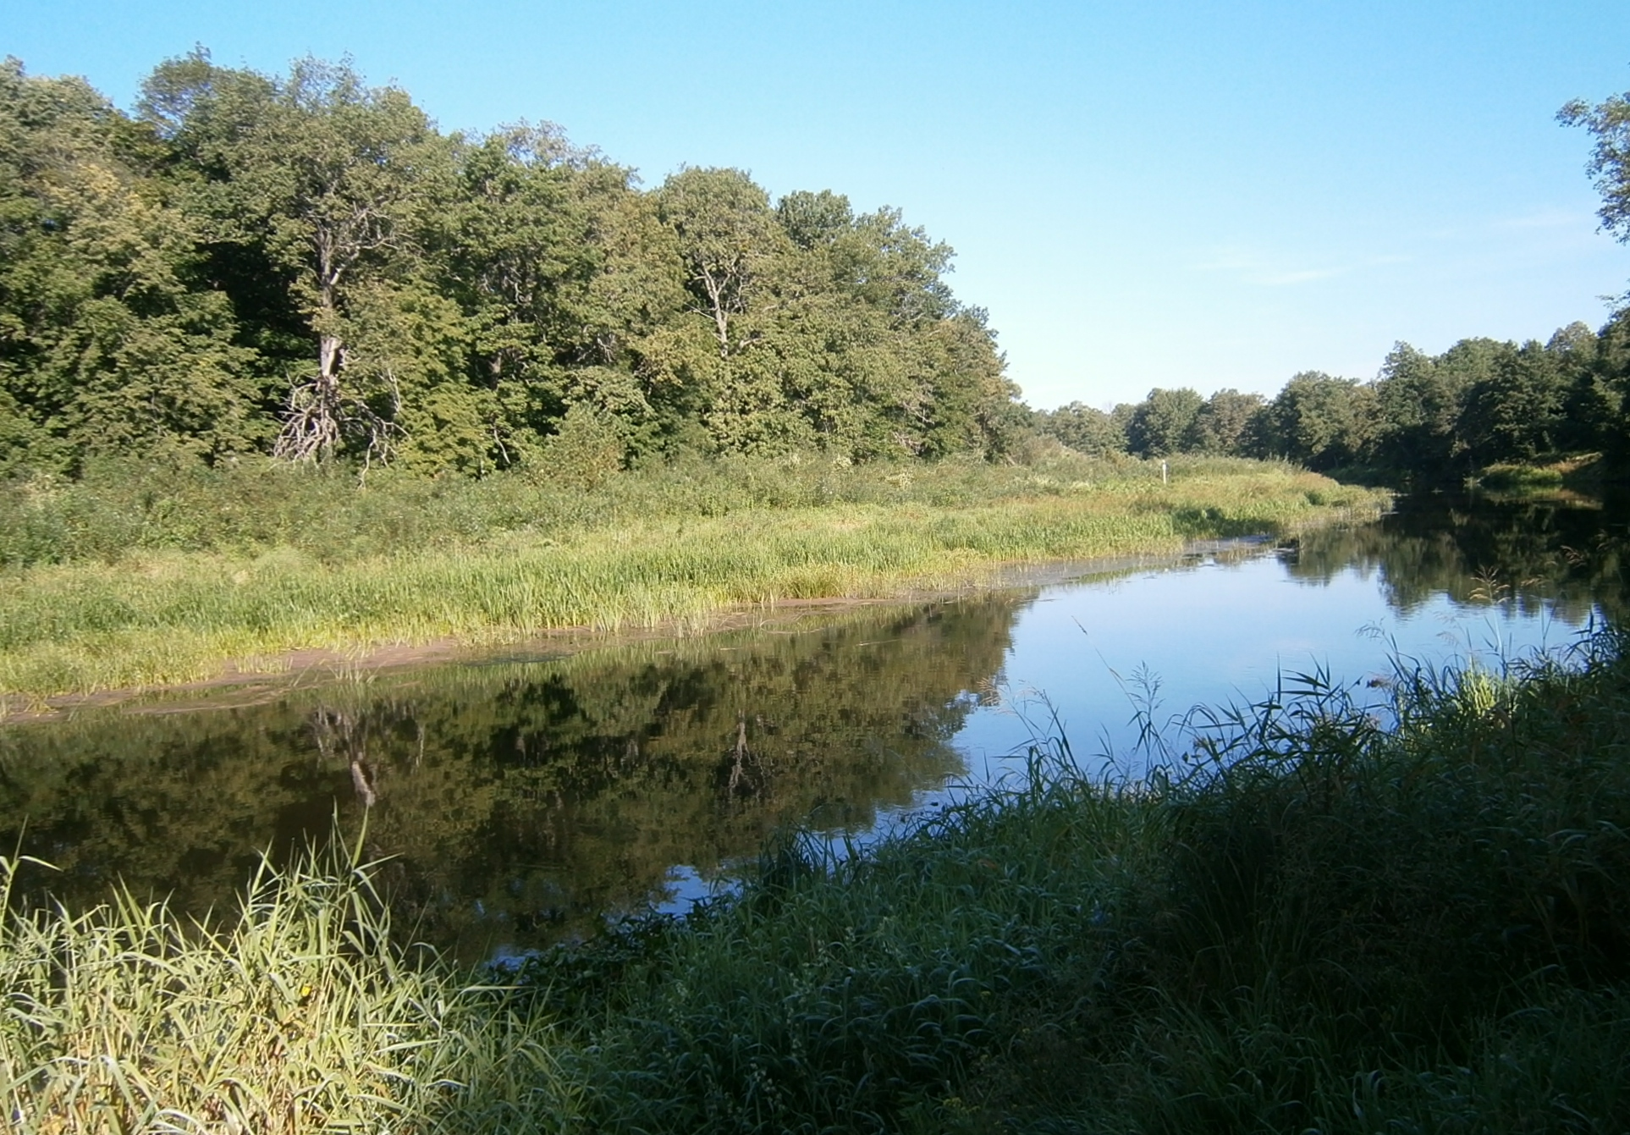
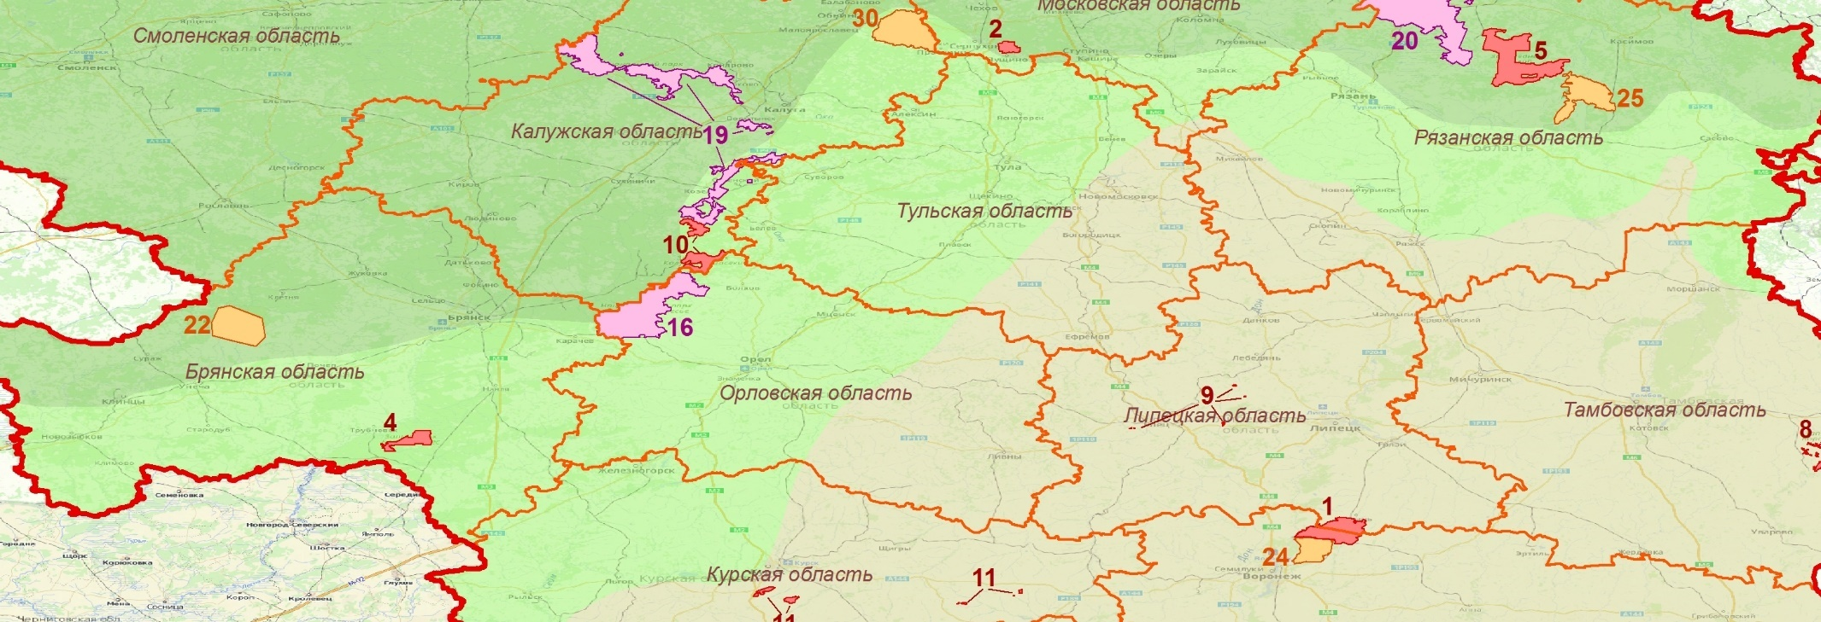
Broadleaved forest subzone
Total area in Central Russia (S1)
– 89.8 th. km²
Total area of Specially Protected Territories (S2) – 1.09 th. km²
(1.2 % of S1)
Lichen biota’s richness – 387 species
Lichen biota’s richness – 279 species
(R1 = 72.1 %)
Protected lichens – 56 species
Protected lichens in Specially Protected Territories
– 49 species (R2 = 87.5 %)
State Complex “Tarusa”– 197 species
NP Ugra (Vorotynsky and Zhizdrinsky clusters) – 121 species
SNR Kaluzhskie zaseki – 151 species
SNR Bryansky les– 177 species

Slide 15
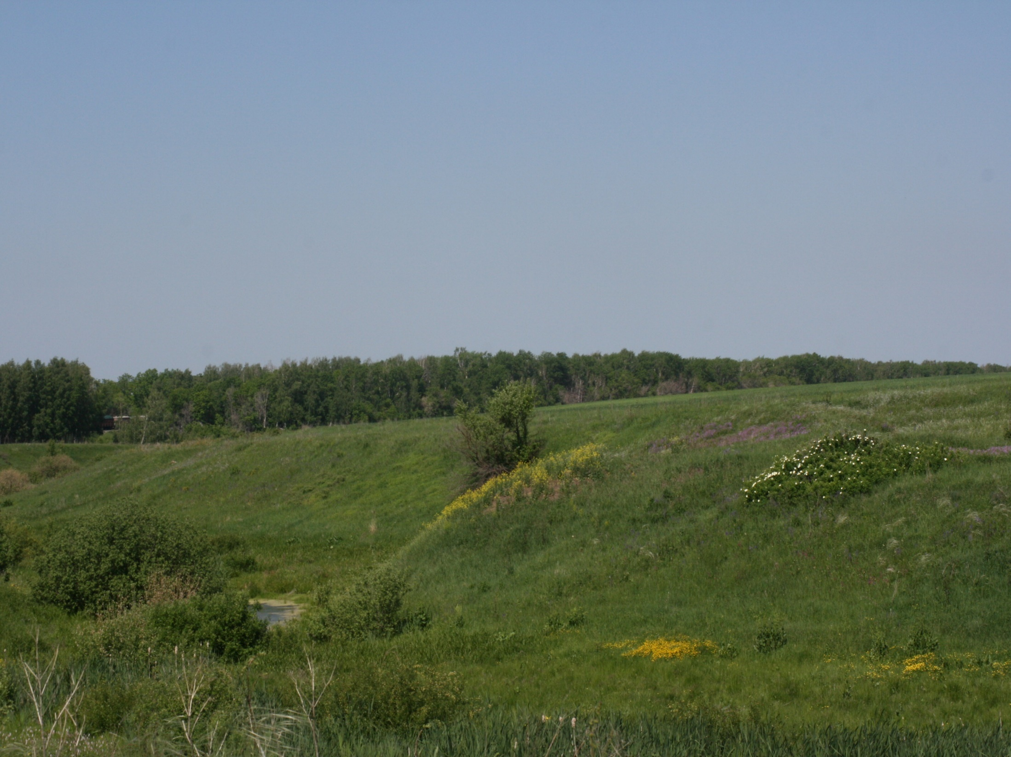
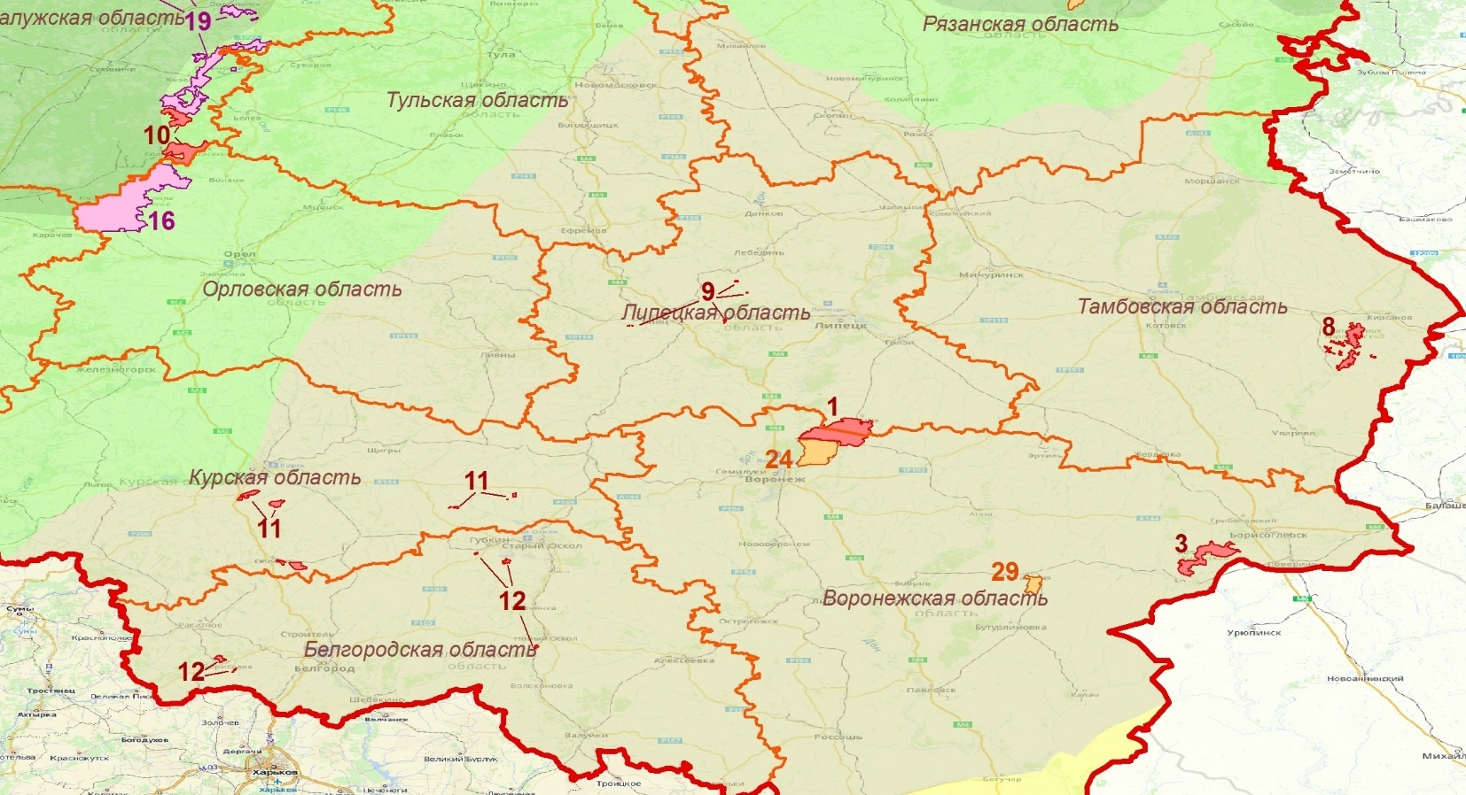
Forest-steppae zone
Total area in Central Russia (S1)
– 185.6 th. km²
Total area of Specially Protected Territories (S2) – 0.93 th. km² (0.5 % of S1)
Lichen biota’s richness – 544 species
Lichen biota’s richness – 379 species
(R1 = 69.7 %)
Protected lichens –101 species
Protected lichens in Specially Protected Territories
– 82 species (R2 = 81.2 %)

Slide 16
Type of Specially Protected Territoria | Name of Specially Protected Territoria | Known number of lichen species | Research level
State Nature Reserves | Galichya Gora | 154 | High
 | Voroninsky | 64 | Poor
 | Voronezhsky | 173 | High
 | Khopersky | 113 | High
 | Centralno-Chernozemny | 168 | High
 | Belogorie | 189 | High
Wildlife Sanctuaries of Federal level | Voronezhsky | 74 | Poor
 | Kamennaya step’ | - | Not investigated

Slide 17
Conclusion
The following measures are needed to obtain objective data on the lichen biota of Central Russia:
organization of additional lichenological studies in poorly studied regions (Vladimir, Smolensk, Kostroma, Ivanovo regions) and in some protected natural territories;
revision of available herbarium materials, exclusion from the regional lists of unconfirmed and doubtful species;
compiling lists of the most vulnerable and in need of protection of species for all zonal divisions of Central Russia; development and implementation of relevant changes to the existing regional lists of protected lichen species.

Slide 18
Acknowledgments:
The administrations of State nature reserves (Voroninsky, Voronezhsky, Galichya Gora, Centralno-Chernozemny Black Earth, Khopersky, Belogorye, Darvinsky, Oksky, Bryansky Les) and National parks (Pleshcheevo Ozero, Meshchera, Meshchersky, Orlovskoye Polesie) for their assistance in research;
M.V. Kazakova, N.A. Sobolev (Ryazan State University named S.A. Esenin), G.V. Kondakova (Yaroslavl State University named P.A. Demidov), L.F. Volosnova (Oksky State Reserve), N.N. Popova (Voronezh Institute of Physical Culture), S.V. Volobuev (V.L. Komarov Botanical Institute RAS), L.L. Kiseleva and T.A. Tsutsupa (Oryol State University), Garin E.V. (I.D. Papanin Institute of Inland Water Biology RAS), A.V. Shcherbakov and E.Yu. Blagoveshchenskaya (MV Lomonosov Moscow State University) for organizing regional studies and collecting lichenological collections;
L.A. Konoreva, I.N. Urbanavichene (Botanical Institute named after VL Komarov RAS), G.P. Urbanavichus (Institute of Industrial Ecology of the North, KSC RAS), A.G. Paukov (Ural Federal University named after B.N. Yeltsin), A.A. Notov (Tver’ State University), A.G. Tsurikov (Gomel University named F. Skorina) for many years of cooperation in lichenological research in Central Russia;
Conference Organizing Committee – for the opportunity to make a report!

Slide 19
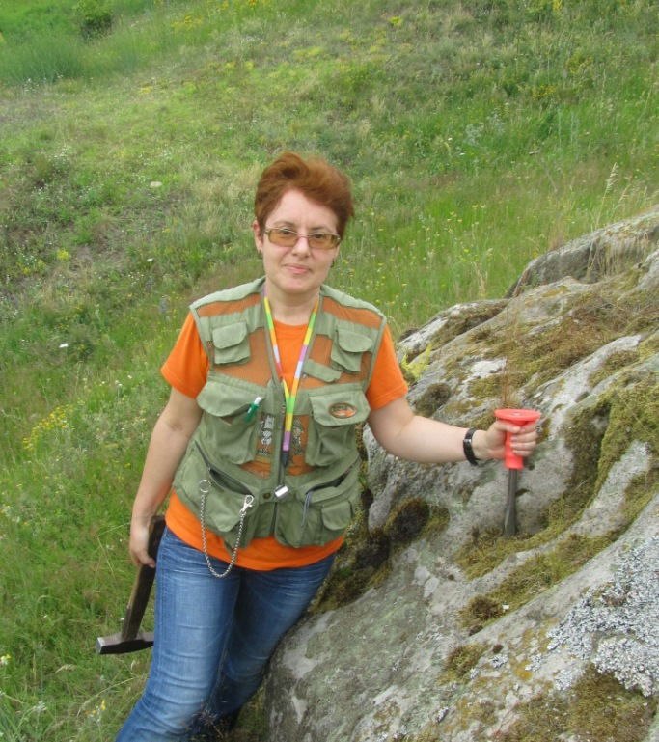
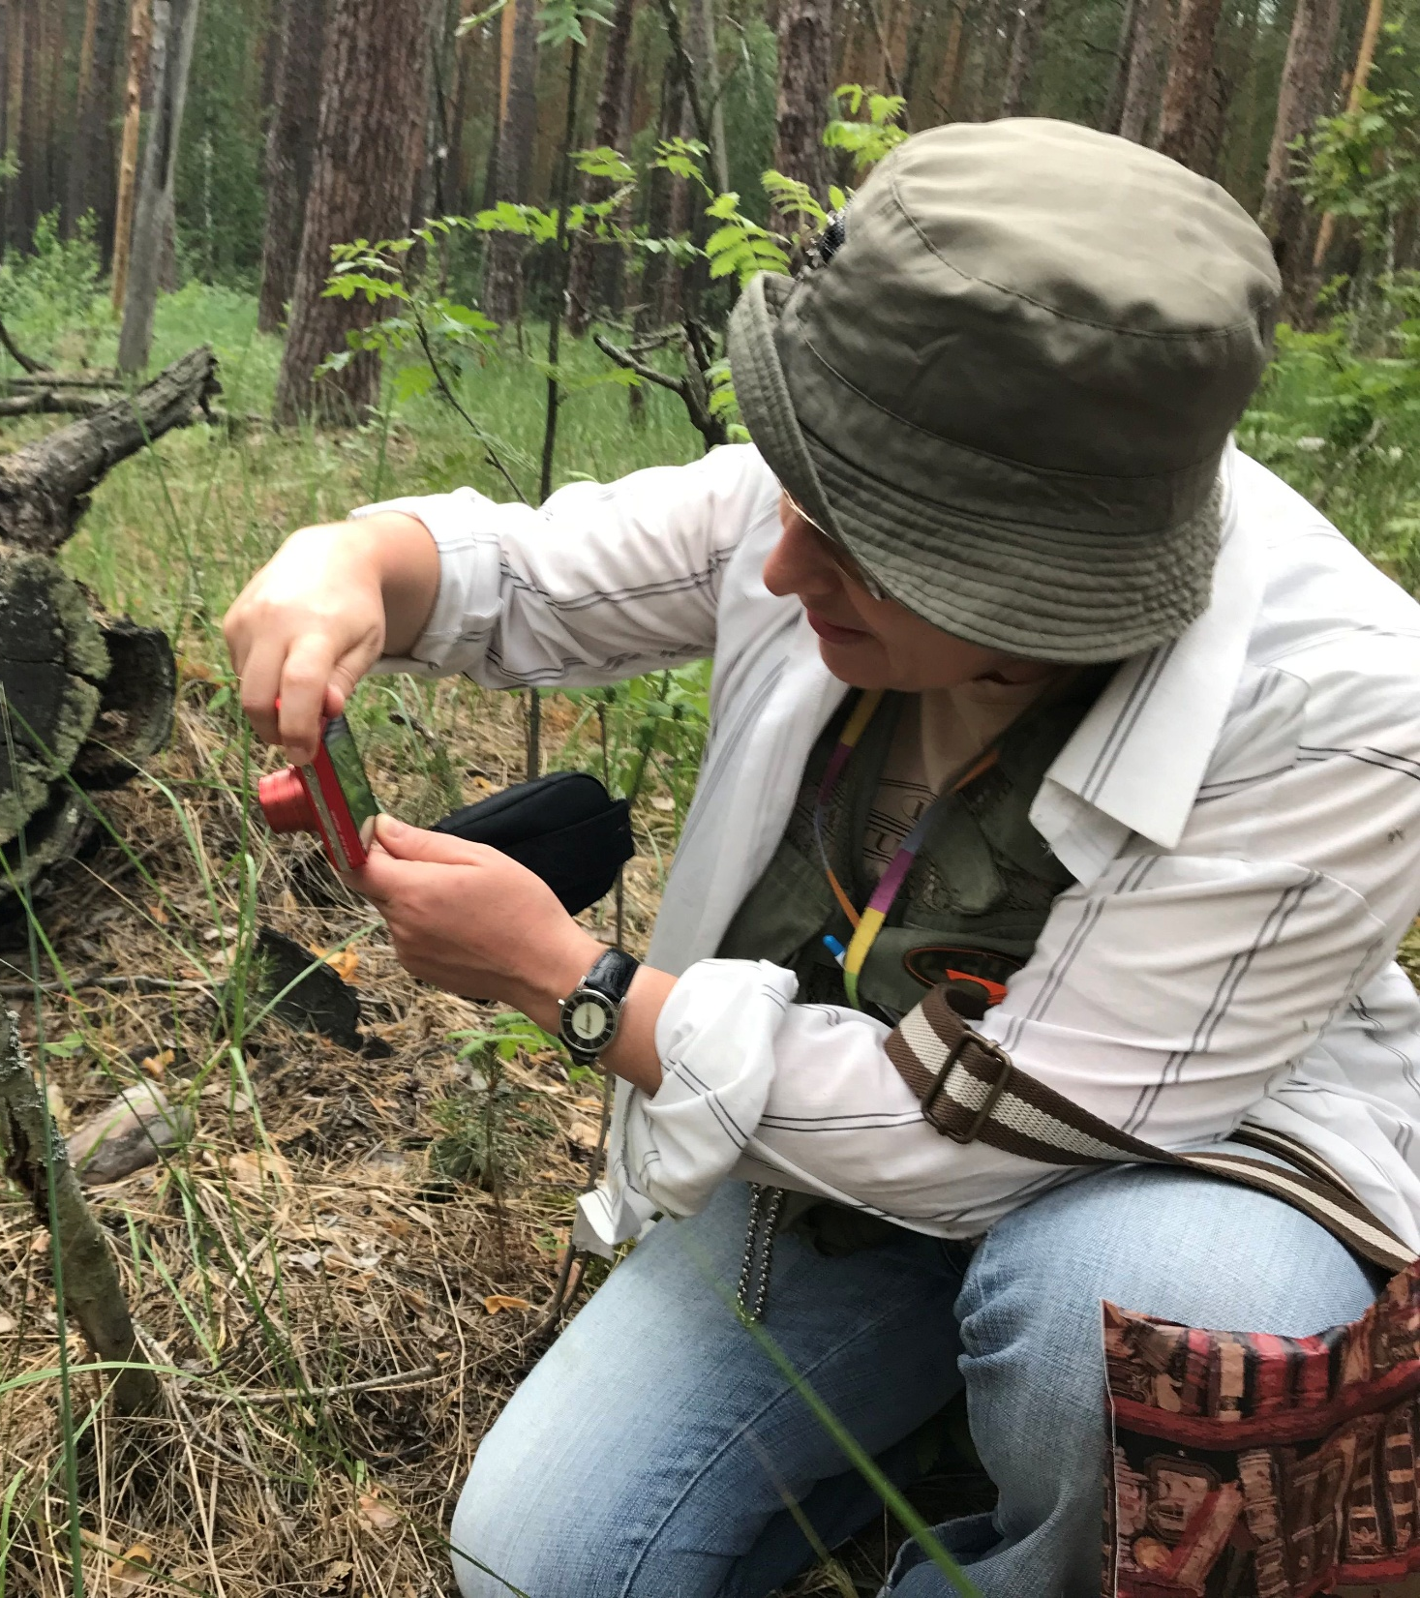
Thanks for your attention!

