Slide 1
REFORESTATION OF LICHEN PINE FORESTS AT THE OPEN PITS IN THE MIDDLE TAIGA OF THE EUROPEAN NORTHEAST
I.A. LIKHANOVA¹, T.N. PYSTINA¹, G.S. SHUSHPANNIKOVA², G.V. ZHELEZNOVA¹
¹Institute of biology Komi SC UrB RAS 167982, Syktyvkar, Kommunisticheskaya, 28.
²P. Sorokin Syktyvkar State University 167001, Syktyvkar, Oktyabrskiy pr., 55.

Slide 2
Study area
1- Open pits location

Slide 3
Methods
At least 10 releves were made at each stage of succession (20, 40, 60, 100, and 160 years). The area of plots was 100 m². 55 releves were analyzed.
For each stage of succession, we determined age of trees at 3-5 plots.
Ordination of the releves was made by NMS method using ExcelToR software (Novakovskiy, 2016).
Classification of vegetation was made by Braun-Blanquet approach (Braun-Blanquet, 1964; Weber et al., 2005; Mirkin, Naumova, 2012).

Slide 4
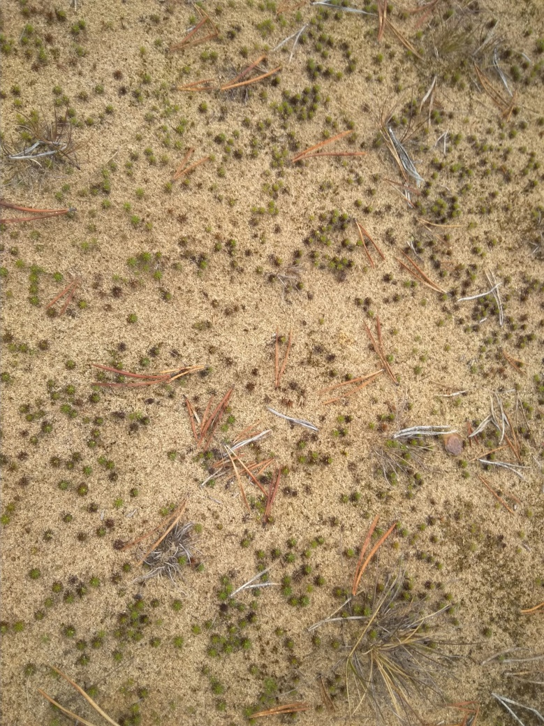
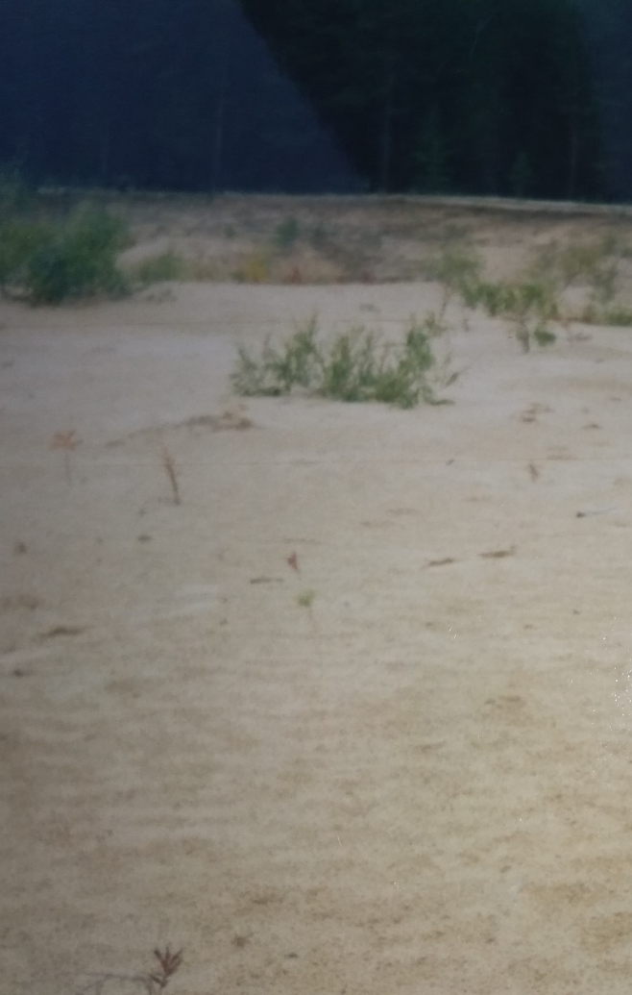
Succession stage Polytrichum piliferum (20 years)

Slide 5
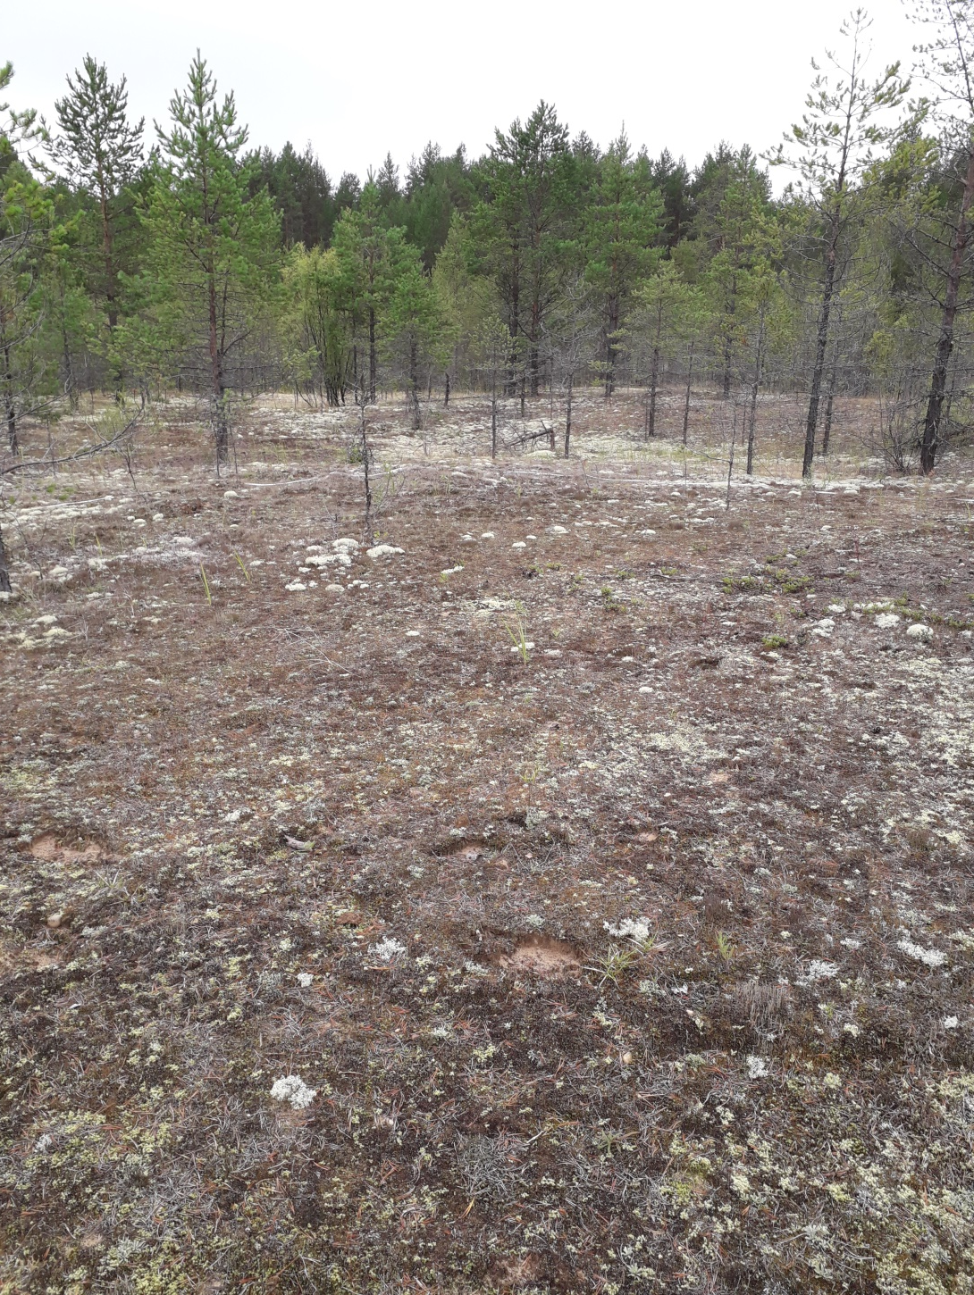
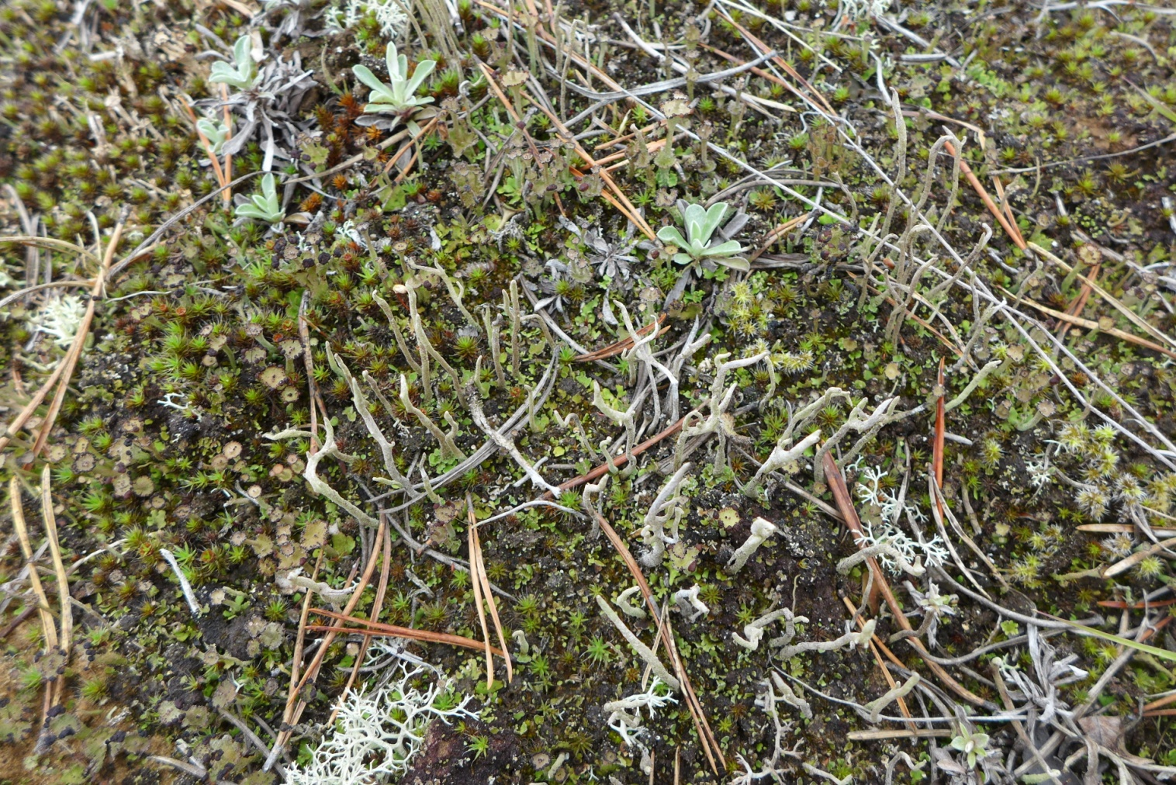
Succession stage Cladonia verticillata and Cladonia subulata (40 years)

Slide 6
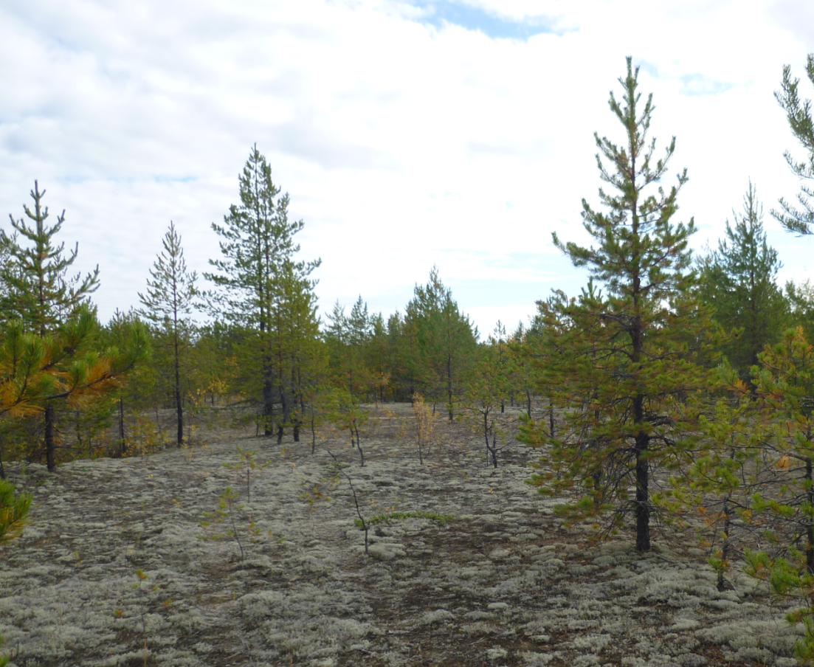
Succession stage Cladonia mitis (55 years)

Slide 7
Succession stage Cladonia arbuscula, Cladonia rangiferina (100 years)

Slide 8
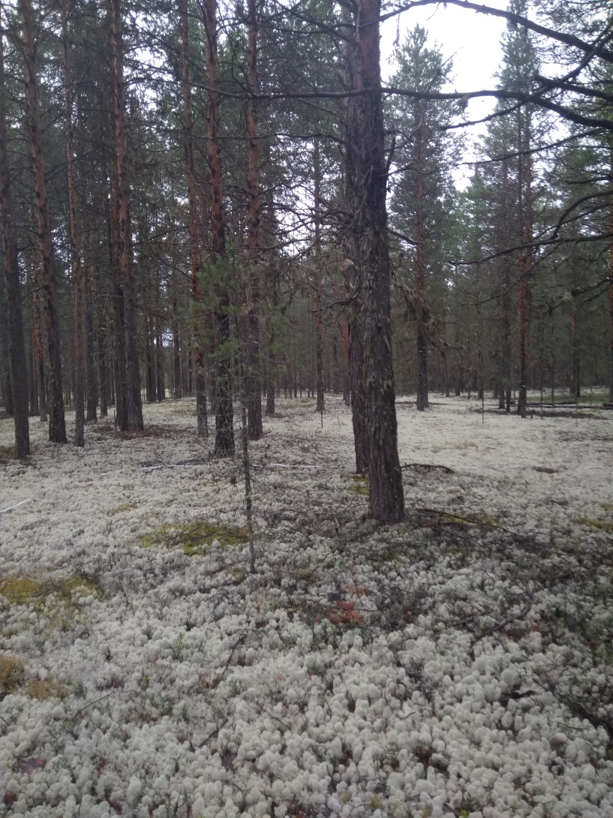
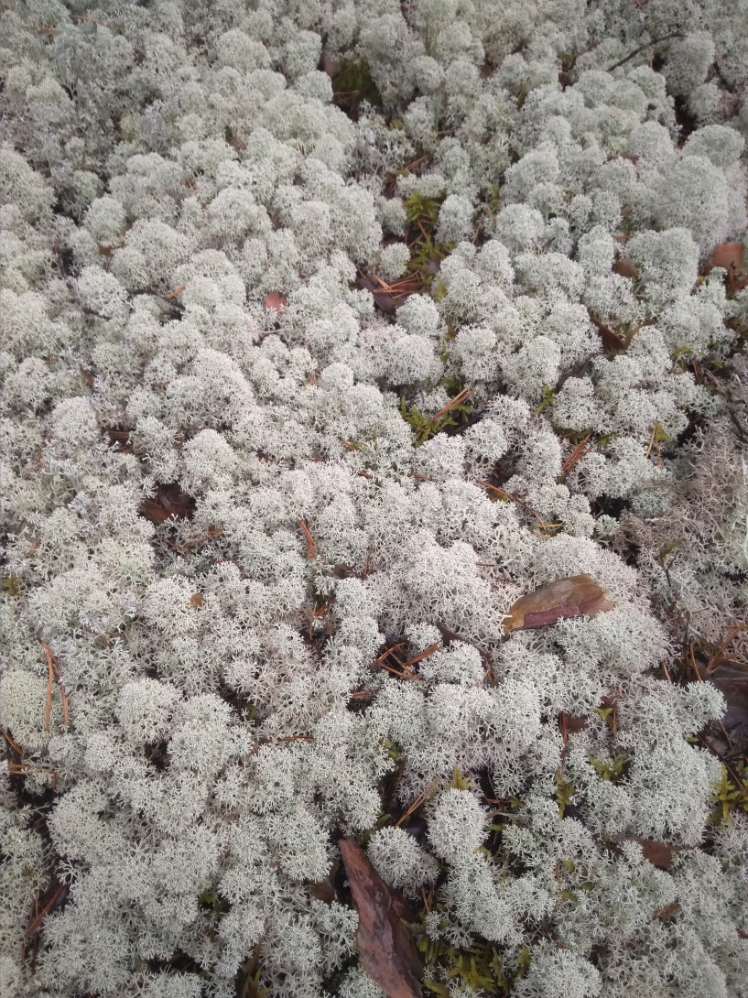
Succession stage Cladonia stellaris (160 years)

Slide 9
Changes in the number of trees and undergrowth during the succession of lichen pine forests
tree stand and undergrowth higher than 1,3 m
undergrowth lower than 1,3 m

Slide 10
Age structure of tree stands
Succession age 40 years
Succession age 160 years

Slide 11
Changes in the tree height and diameters during succession of lichen pine forests
height, m
diameter, cm

Slide 12
Species with increased frequency of occurrence during the succession
Frequency of occurrence, %
Succession age, years

Slide 13
Species with decreased frequency of occurrence during the succession
Frequency of occurrence, %
Succession age, years

Slide 14
Species that increased frequency of occurrence during the initial stages of succession and decreased frequency of occurrence during the final stages of succession
Vascular plants
Frequency of occurrence, %
Succession age, years
Mosses and lichens
Frequency of occurrence, %
Succession age, years

Slide 15
Species diversity during the succession

Slide 16
Prodromus
Class Vaccinio–Piceetea Br.-Bl. in Br.-Bl.et al. 1939
Order Pinetalia sylvestris Oberdorfer 1957
Alliance Cladonio stellaris–Pinion sylvestris Kielland-Lund ex Ermakov et Morozova 2011
Ass. Cladonio arbusculae–Pinetum sylvestris (Kielland-Lund 1967) Ermakov et Morozova 2011
Subass. C. a.–P. s. typicum (Kielland-Lund 1967) Ermakov et Morozova 2011
Subass. C. a.–P. s. cladonietosum mitis subass. nov. hoc loco

Slide 17
NMS ordination of releves
20-year communities at the pits
55-year communities at the pits
160-year forests
100-year forests
40-year communities at the pits

Slide 18
Association Cladonio arbusculae–Pinetum sylvestris (Kielland-Lund 1967) Ermakov et Morozova 2011
Diagnostic species ass. Cladonio arbusculae–Pinetum sylvestris и субасс. C. a.–P. s. tupicum | subass. C. a.–P. s. typicum | subass. C. a.–P. s. cladonietosum mitis
Cladonia stellaris | V | II
Cladonia cornuta | V | IV
Cladonia uncialis | V | V
Cladonia deformis | V | II
Cladonia coccifera group. | II | II
Cladonia crispata | IV | II
Empetrum hermaphroditum/nigrum | I | I
Dicranum fuscescens | I | .
Diagnostic species subass. C. a.–P. s. cladonietosum mitis
Cladonia mitis | I | V
Polytrichum piliferum | III | V
Ceratodon purpureus | I | V
Cladonia verticillata | I | V
Niphotrichum canescens | . | IV
Cladonia subulata | . | IV
Salix acutifolia | . | IV
Cladonia gracilis ssp. turbinata | III | V

Slide 19
Conclusions
Slow formation of pine stands during the primary anthropogenic succession in the European northeast middle taiga is due to the adverse properties of sandy substrate and leads to a different age of stands.
We revealed five stages of succession: Stage 1 Polytrichum piliferum (20 years); Stage 2 Cladonia verticillata and Cladonia subulata (40 years); Stage 3 Cladonia mitis (55 years); Stage 4 Cladonia arbuscula, Cladonia rangiferina (100 years); Stage 5 Cladonia stellaris (160 years).
Two subassociations of Cladonio arbusculae–Pinetum sylvestris were revealed. Subass. typicum includes lichen pine forests. Subass. C. a.–P. s. cladonietosum mitis includes open communities of young pine stands with the prevalence of pioneer mosses and lichens in the lower layers of vegetation.

Slide 20
Thanks for your attention!

Slide 21
 | Abundance
Cladonio arbusculae–Pinetum sylvestris and C. a.–P. s. tupicum | C. a.–P. s. tupicum | C. a.–P. s. cladonietosum mitis
Cladonia stellaris | V | II
Cladonia cornuta | V | IV
Cladonia uncialis | V | V
Cladonia deformis | V | II
Cladonia coccifera group. | II | II
Cladonia crispata | IV | II
Empetrum hermaphroditum/nigrum | I | I
Dicranum fuscescens | I | .
C. a.–P. s. cladonietosum mitis
Cladonia mitis | I | V
Polytrichum piliferum | III | V
Ceratodon purpureus | I | V
Cladonia verticillata | I | V
Niphotrichum canescens | . | IV
Cladonia subulata | . | IV
Salix acutifolia | . | IV
Cladonia gracilis ssp. turbinata | III | V
Pinetalia sylvestris and Vaccinio–Piceetea sylvestris
Pinus sylvestris | V | V
Cladonia rangiferina | V | V
Cladonia arbuscula | V | II
Cetraria islandica | V | I
Carex ericetorum | III | V
Arctostaphylos uva-ursi | II | V
Antennaria dioica | II | V
Pilosella officinarum | I | III
Calluna vulgaris | I | I
Vaccinium vitis-idaea | V | II
Vaccinium myrtillus | II | I
Dicranum polysetum | V | II
Pleurozium schreberi | V | I
Dicranum scoparium | III | I
Other species
Festuca ovina | III | IV
Cladonia fimbriata | II | IV
Cladonia phyllophora | IV | III
Cladonia sulphurina | III | III
Chamaenerion angustifolium | I | III
Hieracium umbellatum | . | V
Erigeron acris | . | III
Agrostis tenuis | I | III
Calamagrostis epigeios | II | V

