Slide 1

Irina N. Mikhailova
RECOVERY OF EPIPHYTIC LICHEN COMMUNITIES AFTER REDUCTION OF EMISSIONS FROM
A COPPER SMELTER
Institute of Plant and Animal Ecology UD RAS
Ekaterinburg, Russia

Slide 2
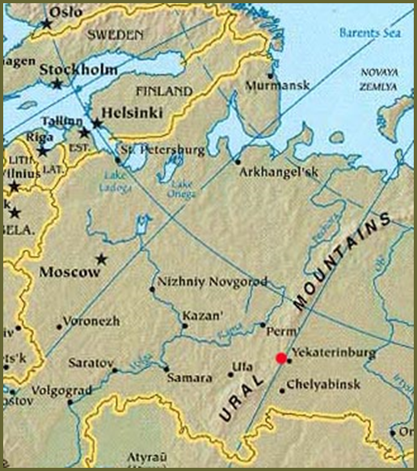
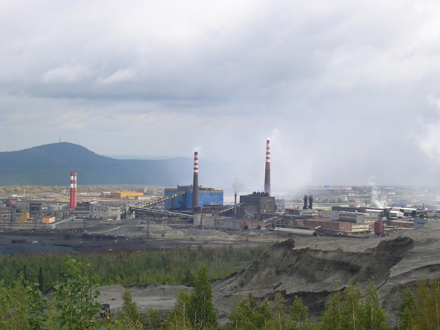


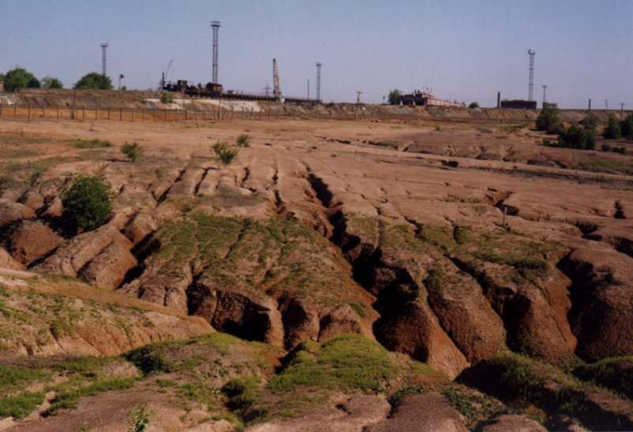
Copper smelter in the Middle Urals
SO_{2,} Cu, Fe Pb, Zn, Cd, As, etc.
since 1940
I
II

Slide 3
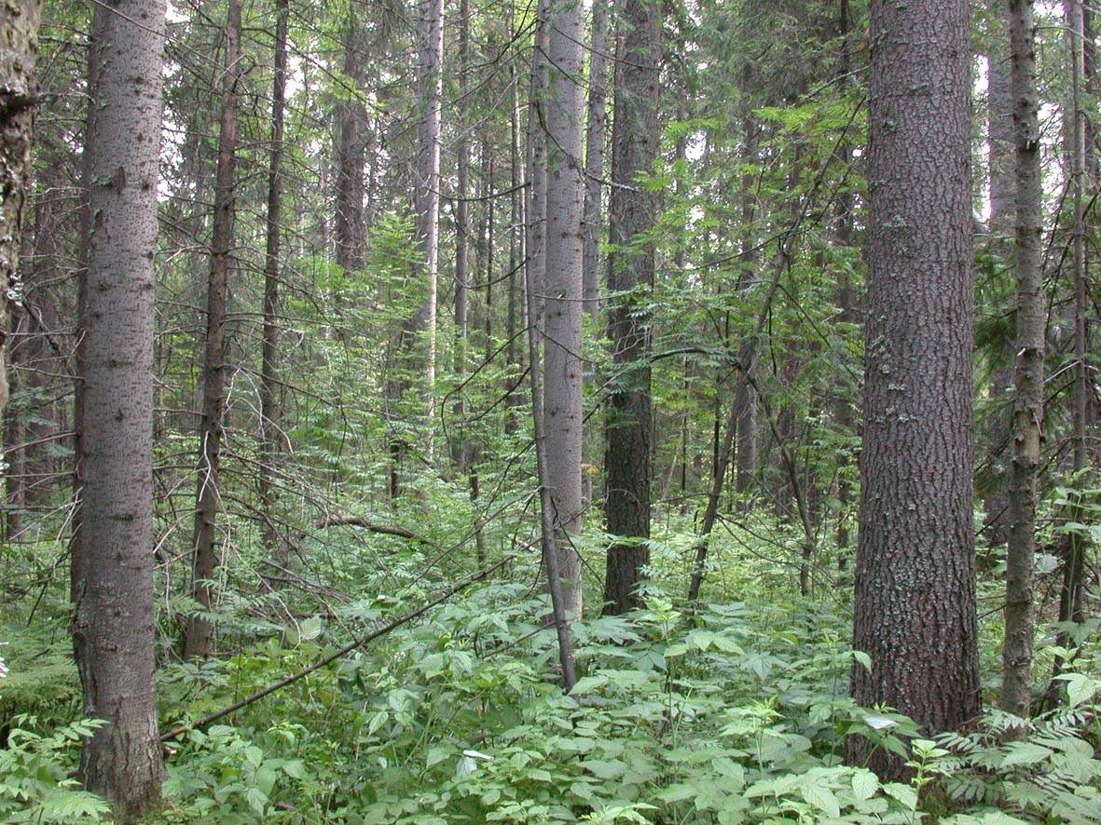
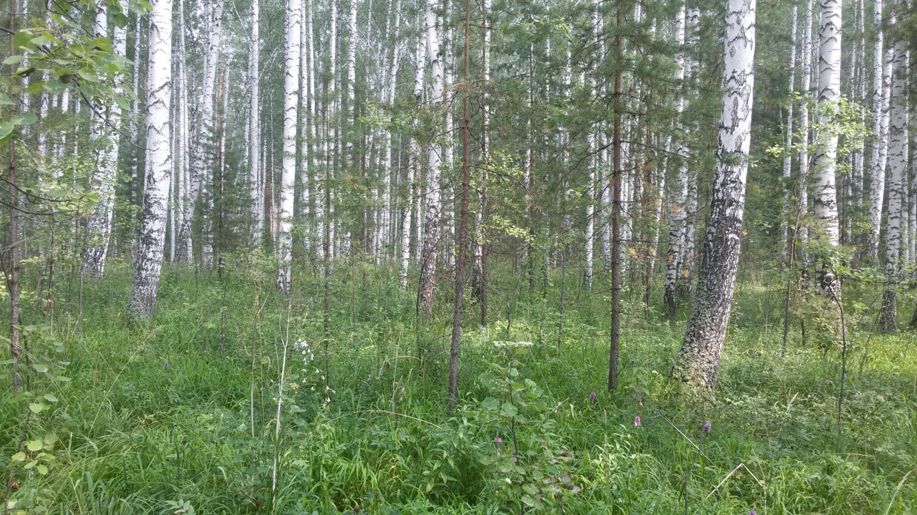
Background forests
Fir and spruce forest
Secondary birch forest

Slide 4
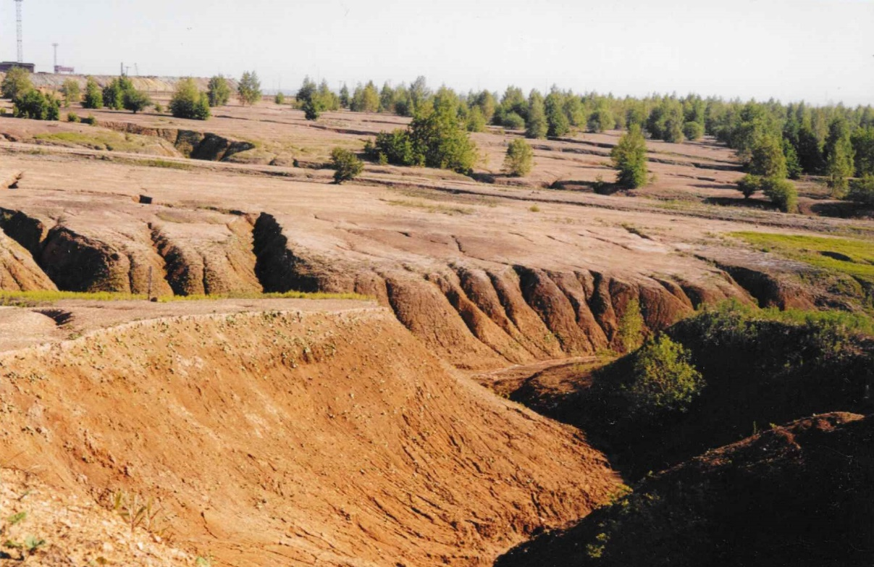
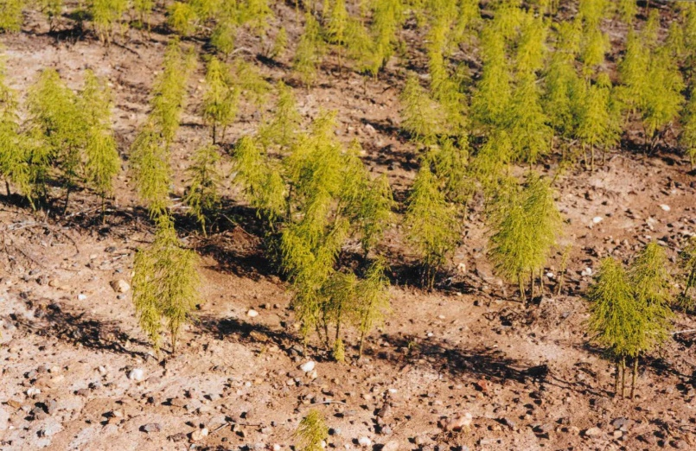
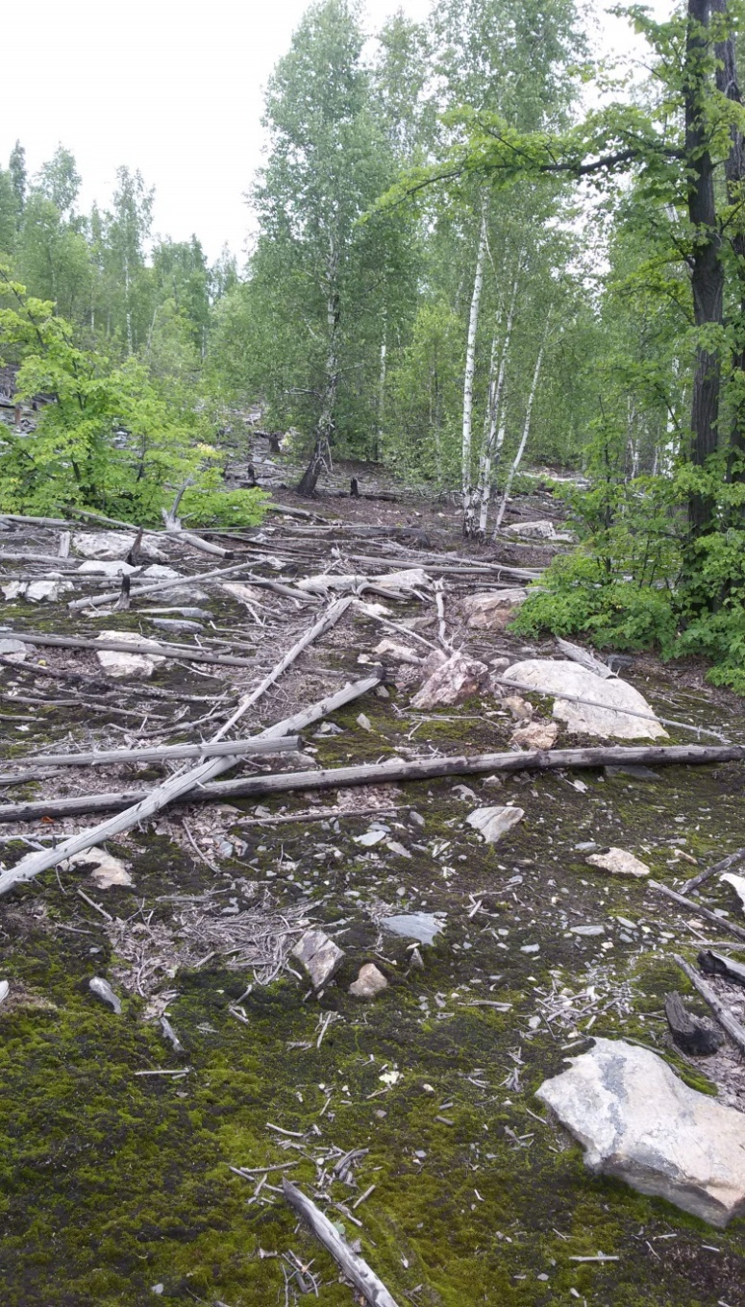
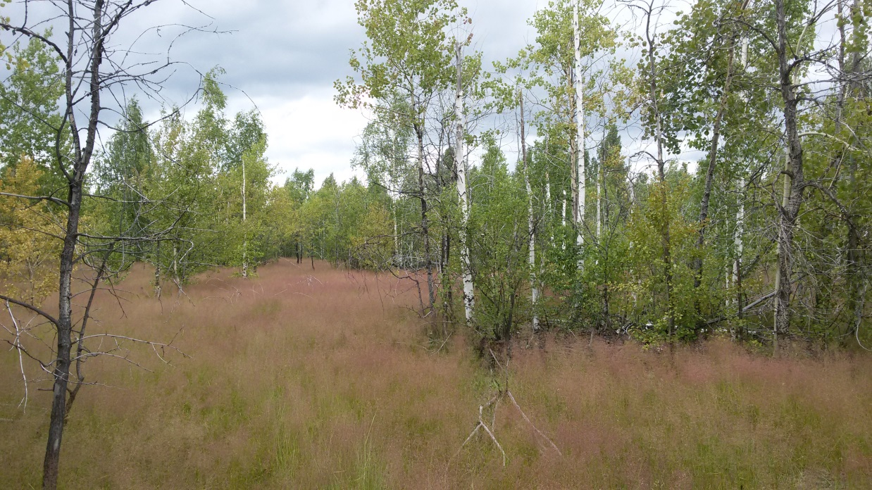
Industrial barren
1 km from the smelter, 1990
1-2 km from the smelter, 2015
1 km from the smelter, 2015

Slide 5
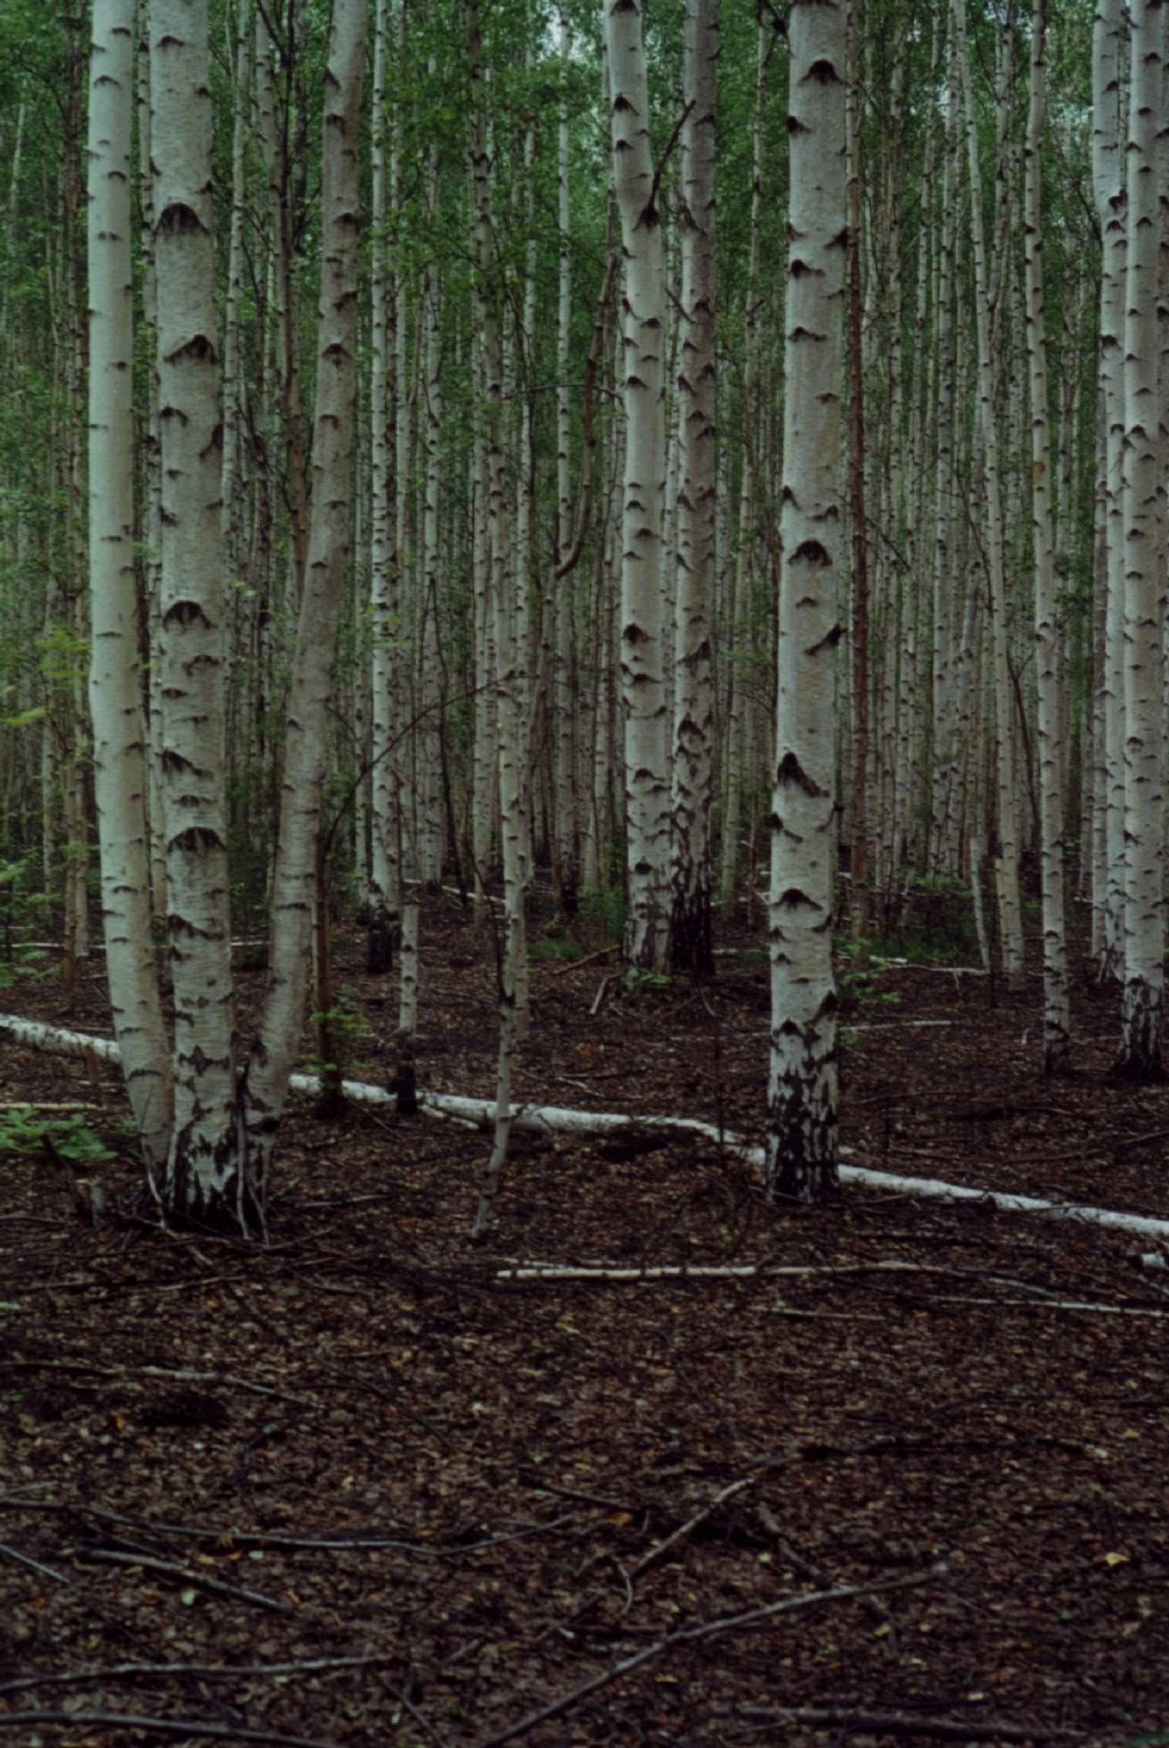
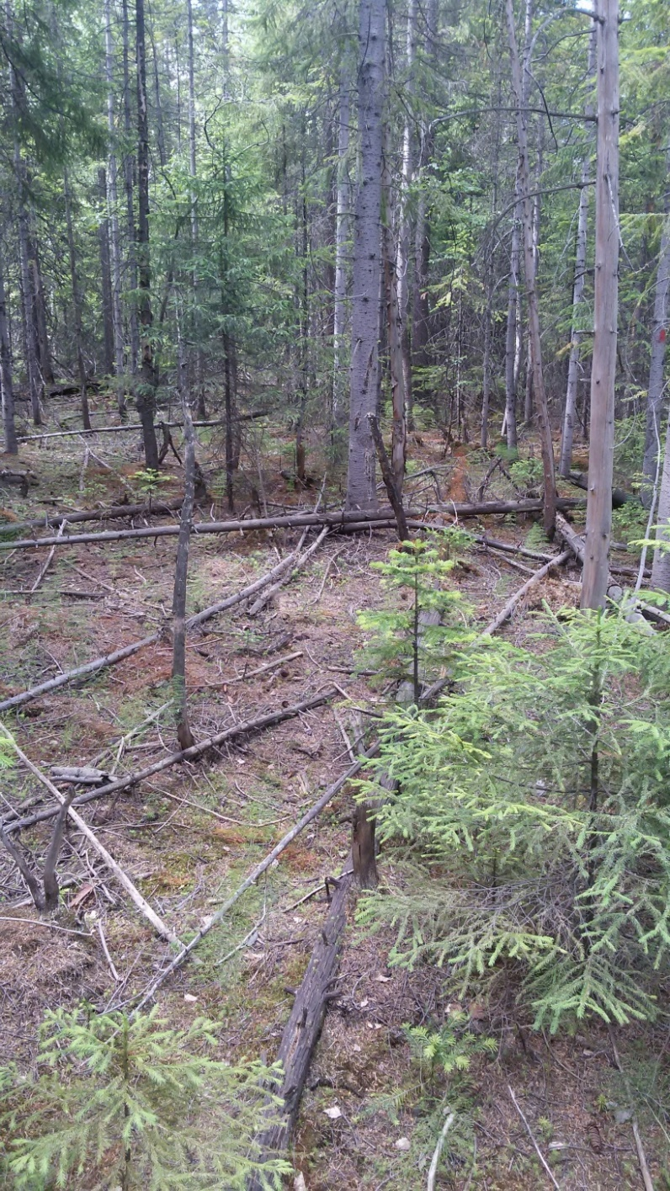
2-4 km from the smelter
Betuletum nudum, 1995
Abieto-Piceetum nudum, 2015

Slide 6
Hypothesis
Epiphytic lichens are not connected directly with pool of toxic substances in the forest litter and upper soil; so they will recover much faster than grass stand do.
Epiphytic lichens grow and develop very slow. Besides, they have no diaspores bank like vascular plants have; so they will recover even more slow than grass stand do.
???

Slide 7

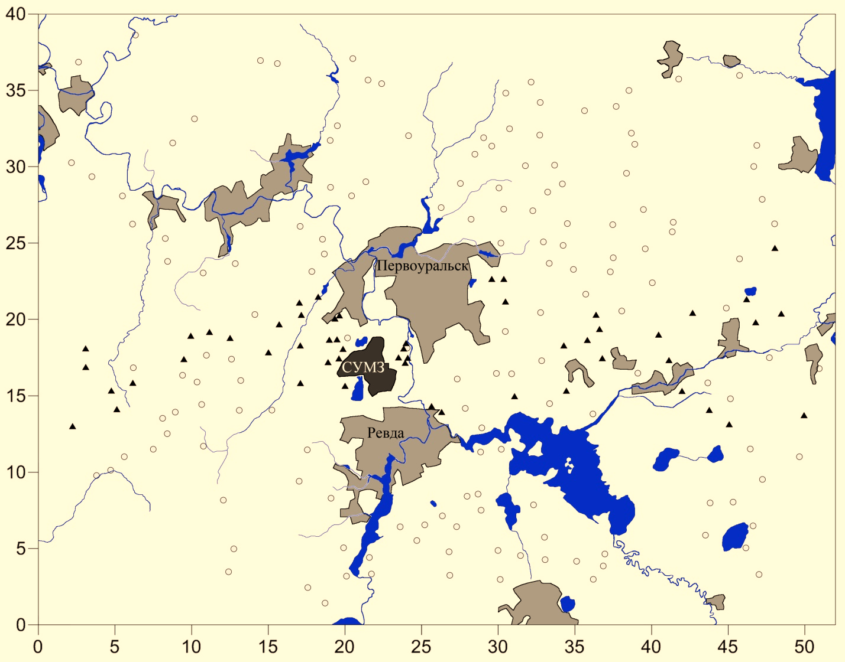
Part I. Re-mapping, or ‘20 years after’
1995-1997
220 plots,
INTAS project
2015-2016
110 plots,
RFBR project
10 birch trees per plot
(Betula pubescens/pendula)
2 sample grids per tree
(Liebendȍrfer e.a., 1988)
N
Distance, km

Slide 8

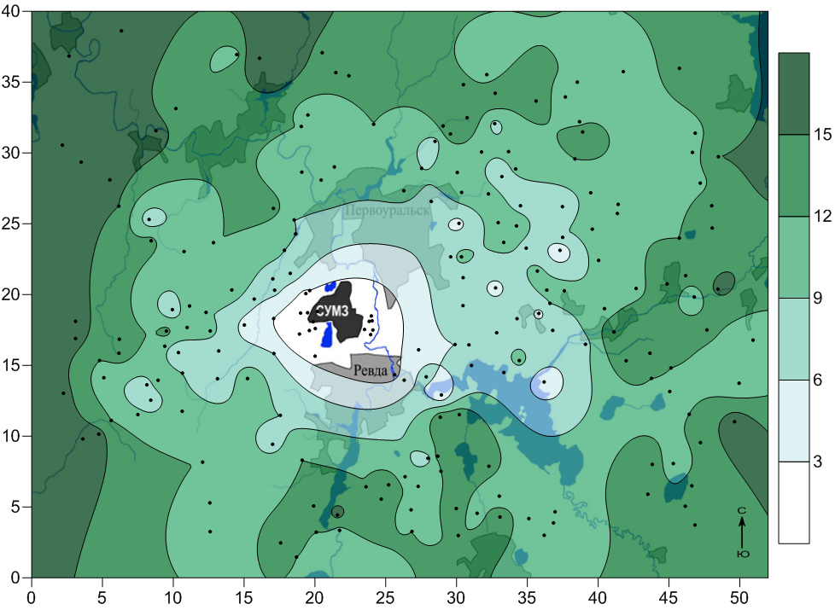
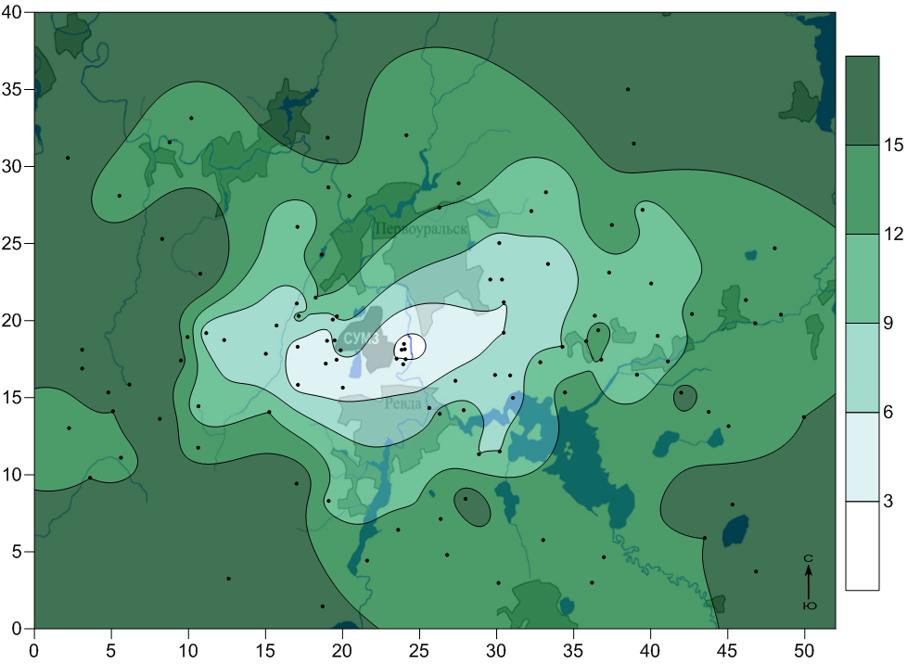
Number of lichen species
Surfer 10 Software
1995
Area: 52x40 km (2080 sq.km)
2015

Slide 9
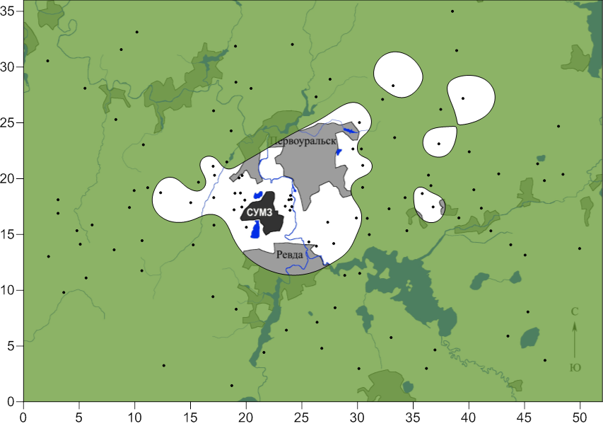
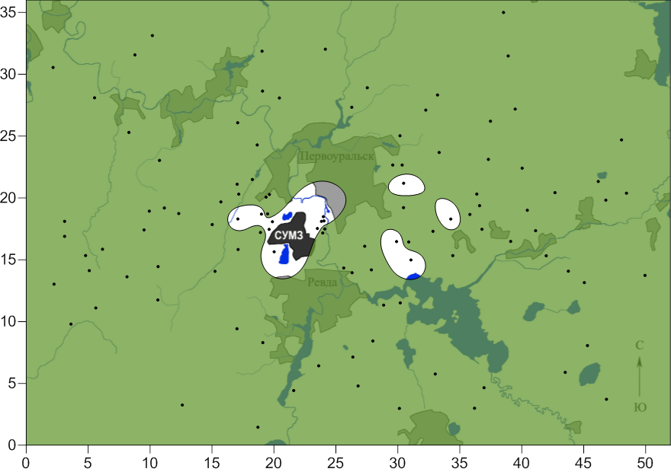
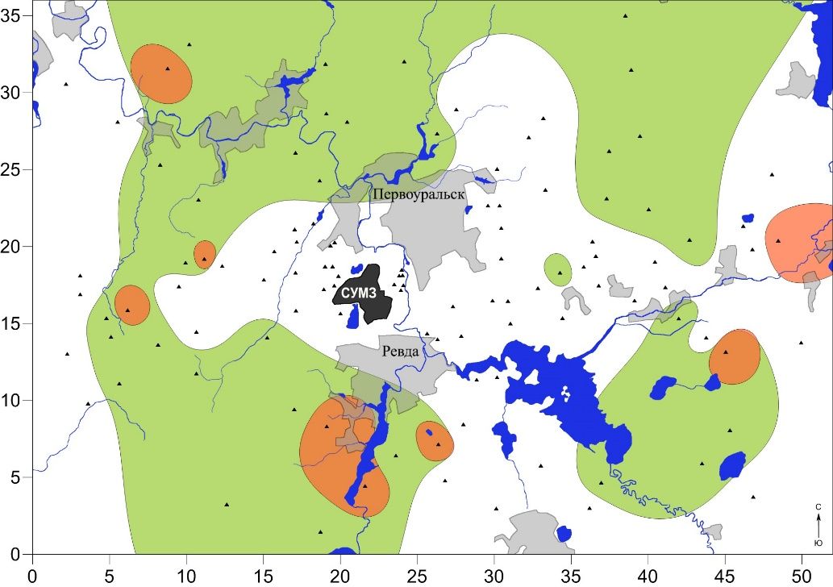
Species distribution
Hypogymnia physodes, 1995
Hypogymnia physodes, 2015
1666.8 km²
1819.6 km²
Сhaenotheca ferruginea
1995
2015

Slide 10
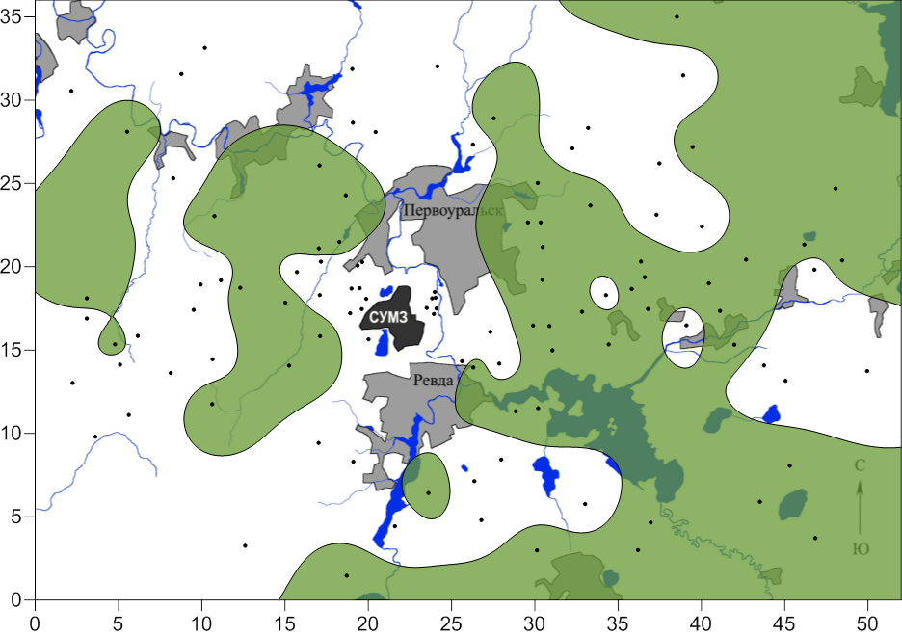
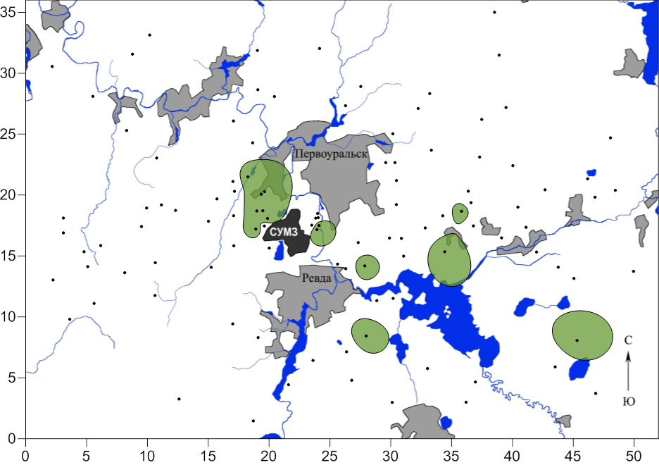
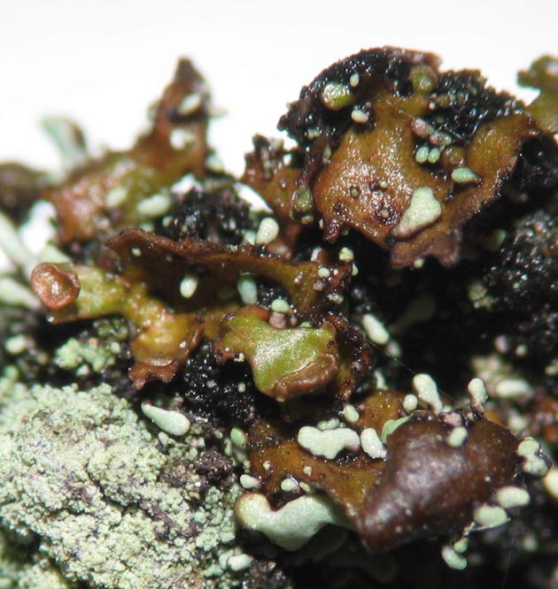
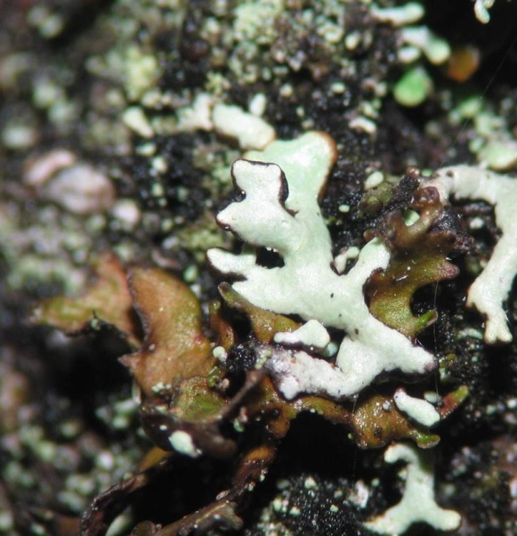
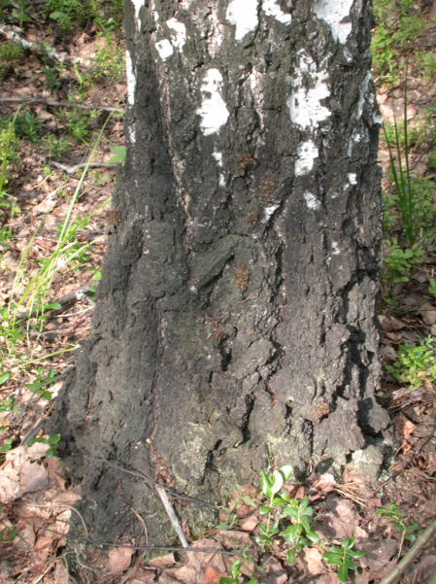
Species distribution
Tuckermanopsis sepincola, 1995
Tuckermanopsis sepincola, 2015
884.5 km²
62.3 km²
Interspecific competition

Slide 11
Part II. Annual monitoring since 2014
Permanent plots in fir and spruce forests
Distance from the smelter:
1 km – 2 plots
2 km – 5 plots
4 km – 5 plots
7 km – 5 plots
30 km – 5 plots
5 spruce (Abies sibirica) trees
per plot (110 trees in total)
4 permanent quadrates 20x20 cm per trunk
22 plots
20 cm
20 cm
130 cm
N
S

Slide 12
Number of lichen species

Slide 13
Species distribution

Slide 14
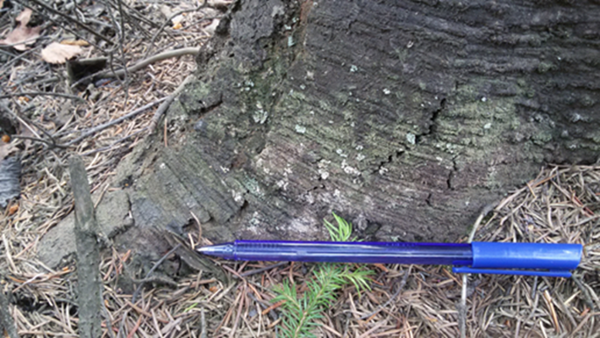
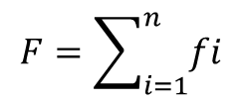
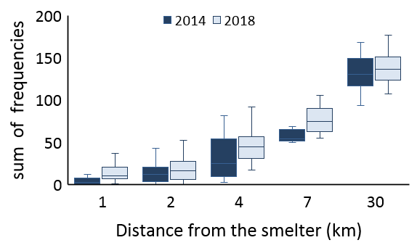
Sum of species frequencies
$$F=\sum_{i=1}^{n}{fi}$$
n – number of species
f – frequency of the i-th species
1 km, 2017

Slide 15
Structure of lichen communities

Slide 16
Conclusions
In spite of obvious improvement of the situation, lichen richness is still shown to decrease with proximity to the smelter.
For the moment, recovery rates of epiphytic lichens exceed that of grass stand. However, this can be a feature of the initial stages of recovery.
To move to the background state, lichen communities will likely need not only complete elimination of pollution but also recovery of microclimate typical of undisturbed forests.
Some sensitive species recolonize formerly polluted areas much faster than this could be expected; this means that toxitolerance is not of high importance for successful recolonization.

Slide 17
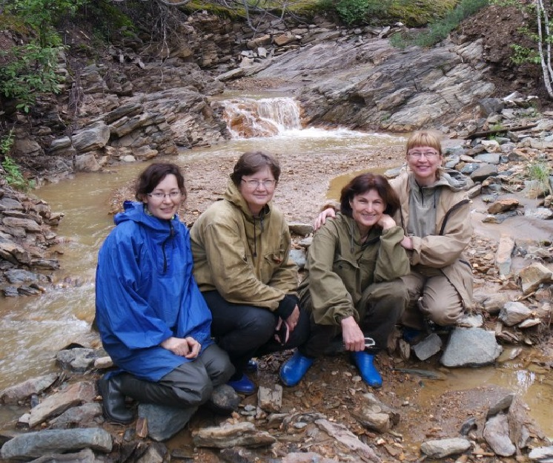
Acknowledgments
Dr. Marina Trubina
Dr. Svetlana Kaigorodova
Dr. Dina Nesterkova
Dr. Eugene Vorobeichik
Dr. Jurga Motiejunaite
The study was supported by RFBR (project 15-04-06828)

