Slide 1
The latest information about changes in the systematics of calicioid lichens
and some speculation of new taxon in Sweden
Janolof Hermansson
Nature preserver

Slide 2
News
Maria Prieto and Mats Wedin 2016
“Although the high degree of non-monophyly and parallel evolution has long been acknowledged within the mazaediate Caliciaceae (Lecanoromycetes, Ascomycota), a natural re-classification of the group has not yet been accomplished. Here we constructed a multigene phylogeny of the Caliciaceae-Physciaceae clade in order to resolve the detailed relationships within the group, to propose a revised classification, and to perform a dating study. The few characters present in the available fossil and the complex character evolution of the group affects the interpretation of morphological traits and thus influences the assignment of the fossil to specific nodes in the phylogeny, when divergence time analyses are carried out. Alternative fossil assignments resulted in very different time estimates and the comparison with the analysis based on a secondary calibration demonstrates that the most likely placement of the fossil is close to a terminal node rather than a basal placement in the Calicium clade. Our dating analysis show two successive events giving rise to main clades of mazaediate taxa within the Caliciaceae, in the Upper-Lower Cretaceous boundary and in the Paleocene. As a result of this study, Cyphelium is synonymized with Calicium, Acolium is resurrected, and the new genera Allocalicium and Pseudothelomma are described. Twelve new combinations are proposed: Acolium karelicum, Acolium marcianum, Allocalicium adaequatum, Calicium carolinianum, Calicium lecideinum, Calicium lucidum, Calicium notarisii, Calicium pinicola, Calicium trachyliodes, Pseudothelomma occidentale, Pseudothelomma ocellatum and Thelomma brunneum. A key for the mazaedium-producing Caliciaceae is included.”

Slide 3
Result of phylogentic
Result of phylogentic
They did total of 227 sequences were generated for this study.
The two families Physciaceae and Caliciaceae in the sense of Gaya et al. (2012 ) are recovered as monophyletic.
Among the non-mazaediate Caliciaceae, relationships are not fully resolved, probably due to the fact that Buellia s. lat. is a heterogeneous.
Traditionally, Calicium and Cyphelium have been distinguished mainly by the presence of stalked apothecia in Calicium and sessile or immersed apothecia in Cyphelium.

Slide 4
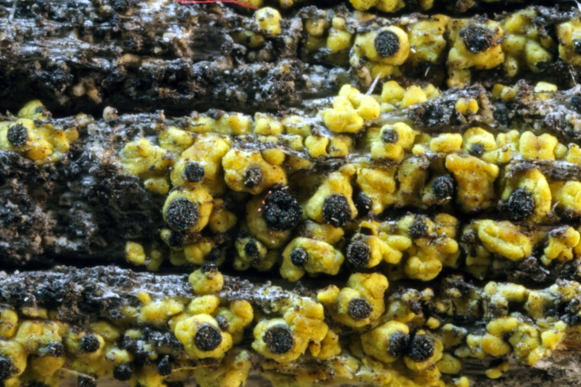
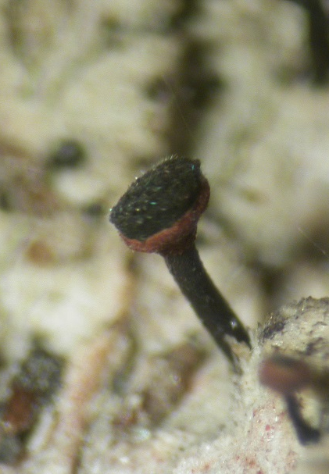
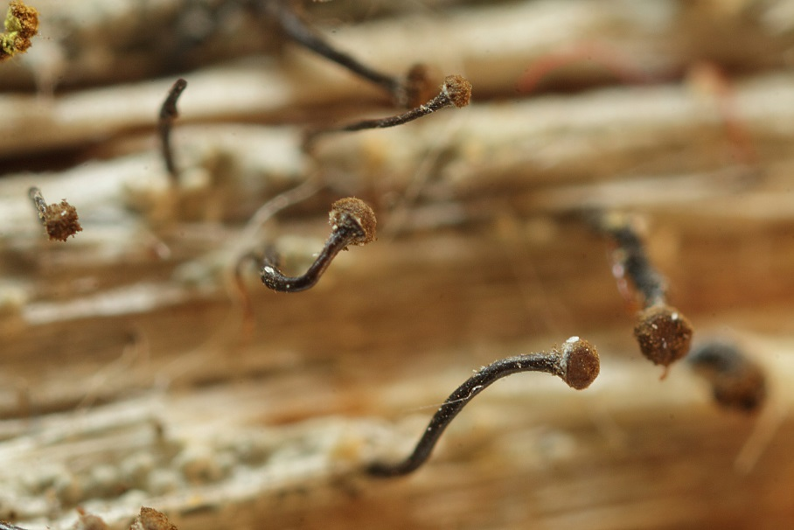
Allocalicium
Calicium
Calicium
Acolium
Chaenotheca

Slide 5
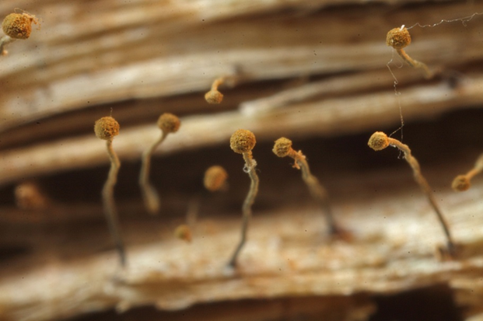
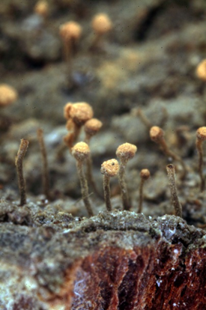
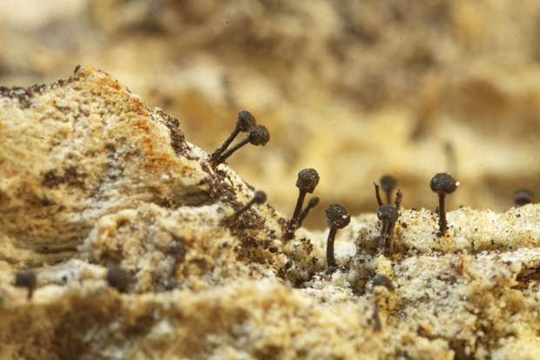
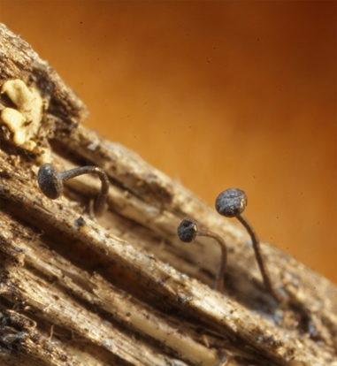
Chaenotheca
Sclerophora
Chaenothecopsis
Mycocalicium

Slide 6
They find it useful to denominate the three clades with mazaediate representatives as clade A, B and C.
B2 includes Cyphelium s. str. (type C. tigillare) which is morphologically well-characterized, having immersed apothecia with a very thin excipulum, comparatively small, obovate to pyriform asci, smooth spores, and by growing on dry wood in comparatively exposed situations.
Clade C includes the Acolium-clade and the Tholurna-clade of Tibell (2003), and the rather odd Calicium adaequatum.
New Genera
Allocalicium
Pricto, M. & Wedin, M. 2016. Phylogeny, taxonomy and diversification events in the Caliciacaea. Fungal Diversity. Springer.

Slide 7
But - there are more to find out about Caliciales.
New species and genera.
Example from Sweden of new species
A new species Calicium episcalaris Tibell & Knutsson
On thallus of Hypocenomyce scalaris
It is close to Calicium pinastri and Calicium montana.
Tibell, L. & Knutsson, T. 2016. Calicium episcalaris, a new species from Sweden – Symbolae Botanicea Upsaliensis 38:49-52. Uppsala.

Slide 8
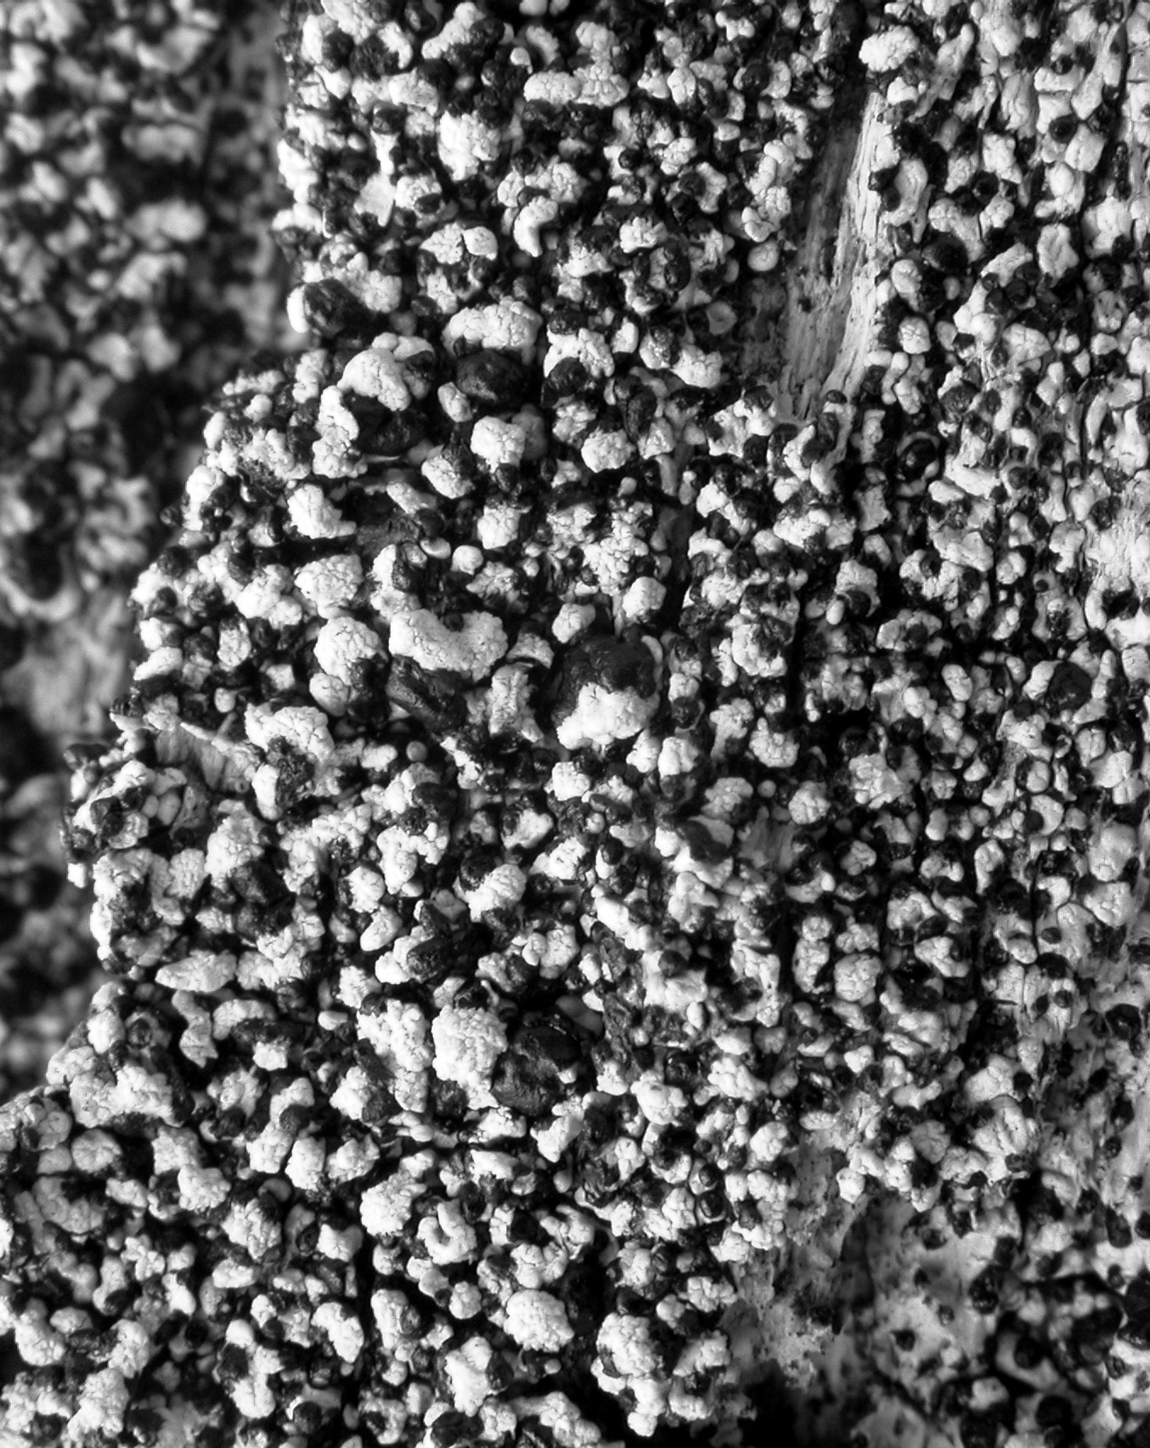
On Ramboldia elabens – a new not describe species
Rather common
Short stalked
”Jugendparasite”

Slide 9
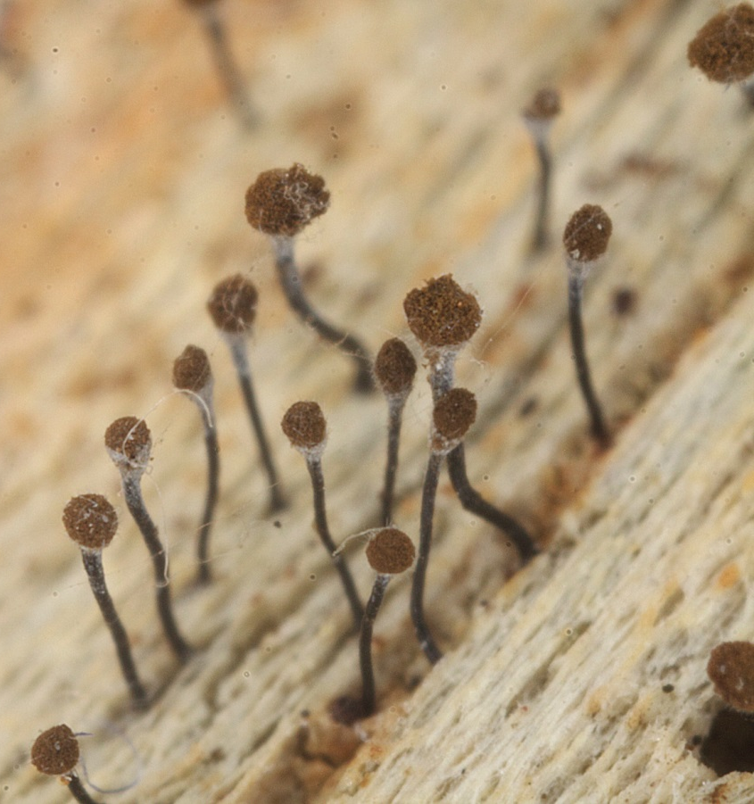
On different Polypore species of Genera Trichaptum.
Very similair of Chaenotheca brunneola
Probably specific on the different Trichaptum-species.

Slide 10
Trichaptum laricinum

Slide 11
A new species and a new Genus
Recorded one time
Very typical
Living as ”Jugendparasite” on Trichaptum abietinum.

Slide 12
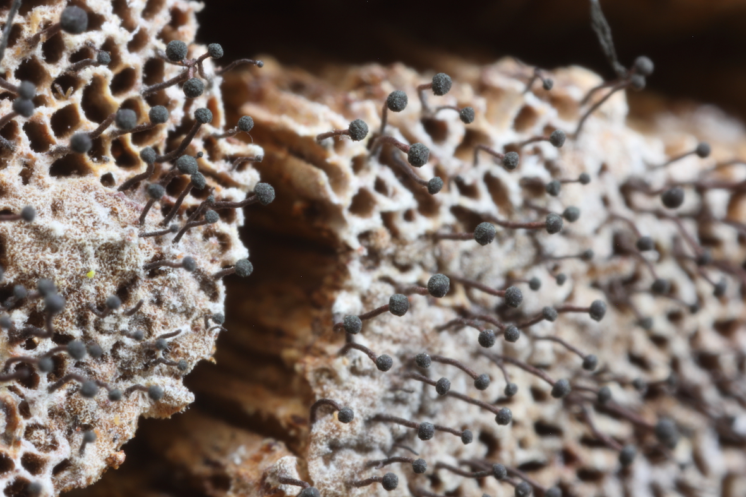
One more note!
Chaenothecopsis haematopus – a very rare lichenicolous fungi.
Look at Polypores!

