Slide 1
The prelimary 2020 Red List of Swedish Species - Lichens
Janolof Hermansson
Nature preserver

Slide 2
Background
In the Red List assessment, available data on the species are evaluated, among other things from environmental monitoring, amateur biologists' reports to the “Art Portal”, research and museums against the international, formalized criteria.
ArtDatabanken's organism group managers together with expert committees prepare Sweden's red list for their respective organism group. New Red List every 5th Year.
On the basis of completed values, the program generates the most likely red list category, based on the IUCN criteria.

Slide 3
Assessments of the threat situation
Collected by amateur experts
The public can comment on the preliminary Red List under a few month
Data from inventories and public statistics on changes in their habitats (For example, the assessment of species associated with the tree elm is affected by the forecast for alms disease)
The Red Listing Assessment is done by compare a species' population size, population change, area of occurrence, degree of fragmentation against a set of criteria (thresholds).

Slide 4
Here is an overview of the criteria that apply for a species to be red listed in Sweden
A. At least 15% population reduction over 10 years or three generations (whichever is longer)
B. Small area of distribution (<40,000 km2) or small area of occurrence (<4,000 km2) and at least 2 of 3 sub-criteria:
Heavy fragmentation or few localities
Continuous reduction
Extreme fluctuations
C. Small population (<20,000 individuals) and continuous decline

Slide 5
D. Very small population (<2000 individuals) or very limited incidence area (<40) km2 which makes the species susceptible to impact or random factors. Not necessarily any ongoing reduction
E. Quantitative analysis of extinction risk, Population Viability Analysis (PVA), indicates at least 5% risk that the species will die within 100 years
The species that meet the criteria for any of the categories National Extinction (RE), Acutely Endangered (CR), Strongly Endangered (EN), Vulnerable (VU), Nearly Endangered (NT) or Knowledge Deficiency (DD) are referred to as Red Listed. The red-listed species categorized as CR, EN or VU are termed threatened.

Slide 6
Lichens
50 % of lichen species (a 1350) have been assessed according to the Red List criteria.
The lichenicolous fungi included
Very few changing – very little resources in between the Red Lists
About 285 lichen species in the preliminary 2020 Red List.

Slide 7
The Result
The prelimanary results presented in the Red List 2020 do not show any noticeable improvement for biodiversity in Sweden on an overall level. Rather, it seems that the negative impact of Swedish species has been constant for the last 15 years.
The rate at which Sweden loses species diversity has neither increased nor decreased since 2015. In Red List 2015, 4,273 of 21,600 assessed species were classified as red listed (NT, VU, EN, CR, RE or DD), of which 2,029 species were threatened (VU , EN or CR). The fact that the number of red-listed and the number of threatened species has increased since 2010. The number of red listed species corresponds to 19.8% of the total number of assessed species and is at the same level as in previous red lists (2000, 2005 and 2010).

Slide 8
There are five important points (here four – the fifth is marine):
1. The forest and agricultural landscape are the richest types of landscapes - they are important for about 1,800 and 1,400 species, and are utilized by several hundred more species. Forest felling and overgrowth are the two factors that affect most red-listed species in Sweden, both of which pose threats to about 30% of the red-listed species. Harvesting of old forest or previously extensively used forests is one of the main reasons why forest living species are red listed. In order to reverse the trends with continued declining populations, unprotected forest environments with red listed species need to be preserved long term. Overgrowth occurs in several types of environments; in meadows, meadows and pastures as well as forest and marshland. The causes of overgrowth are several, mainly ceased (grazing and mowing) and lack of recurring disturbances (eg fire and flood), but also tree planting, fertilization, nitrogen loss, ditching and a warmer / drier climate.
2. For many red-listed species, so-called mosaic landscapes significant, environments that contain more than two different landscape elements, e.g. forest environments containing both forest and open land. In order to manage the landscape in a sustainable way and to benefit these species, different industries must work together (especially agriculture and forestry).
3. Extinction occurs not only at the national level - the species categorized as RE (National Extinction) - but extinction also occurs locally and regionally for all species whose area of occurrence and area of distribution is decrease.
4. ArtDatabanken's assessments of the state of Sweden's species are based on both expert knowledge and data from various sources - in particular from the Art Portal. The public's involvement and the reports in the Art Portal are an invaluable source of knowledge about species distribution and status.

Slide 9
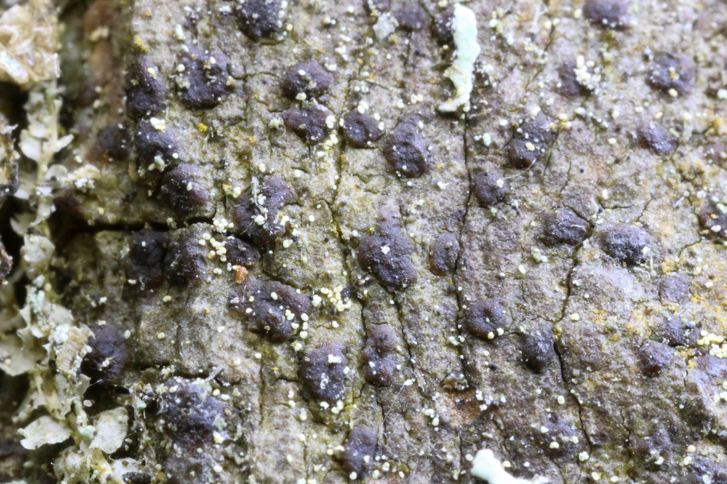
Some example
Arthonia incarnata (VU)
The species was known from a few localities in northern Sweden from the end of the 19th century, but then no finds were made until the 1990s. There are now about 60 current localities.

Slide 10
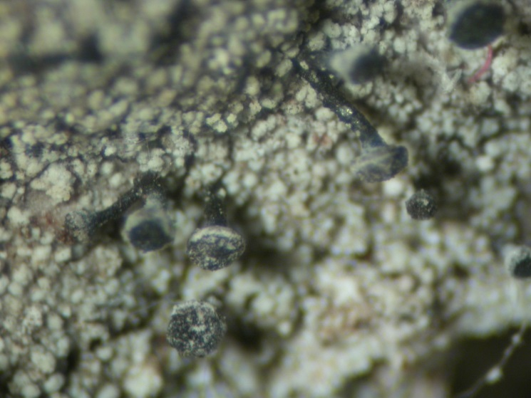
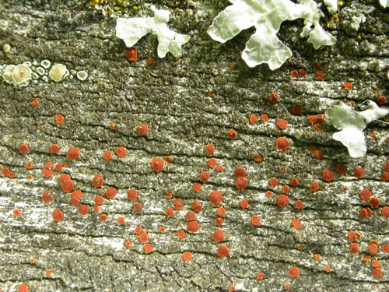
Calicium lenticulare (CR)
The species was only known from a local in Sweden for 138 years (1864). In 1991, the species was discovered again. Since a large number of people have been looking for this species for a long time, it is certainly an extremely rare species.
Blastenia furfuracea (EN)
The species are only known from five regions. Some occurrences are from the beginning of the 20th century. Today there are about ten current finds from two regions. The species is only found on old timber barns.

Slide 11
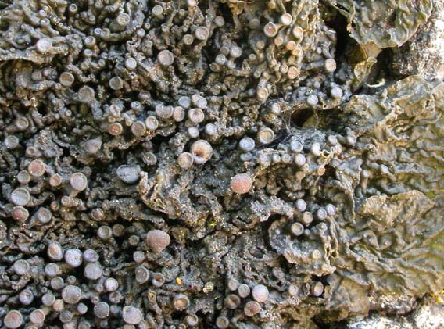
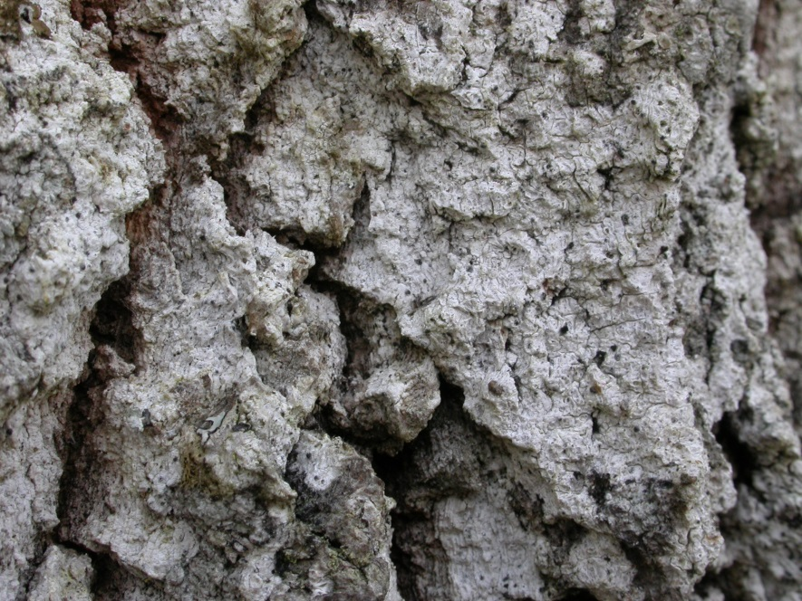
Collema subnigrescens (NT)
The species is widely distributed in Central Sweden and the northern coastal landscapes. In total there are more than 1000 known localities. It is reported that it is in decline in Southwestern Sweden and in the forest land in the northern part of the distribution area.
Eopyrenula leucoplaca (LC)
The species is known from some 80 current localities, but very overlooked. 20 years ago, the species was considered extinct (RE).

Slide 12
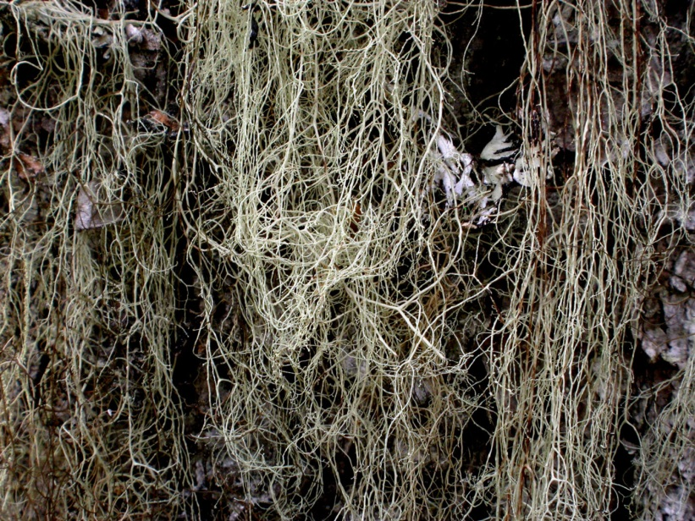
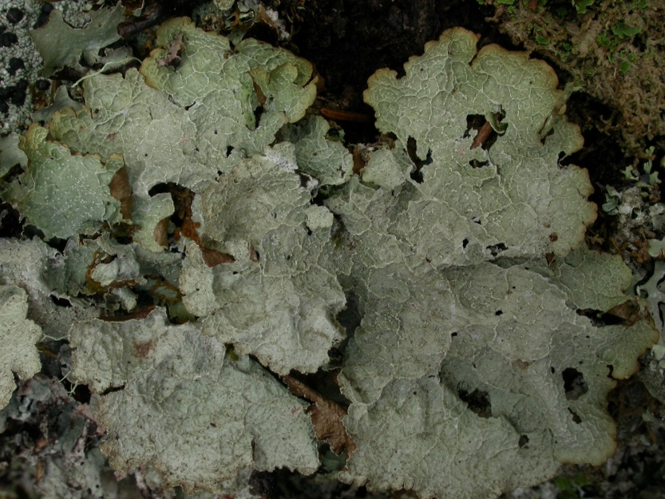
Ramalina thrausta (EN)
The species has previously occurred in virtually all of Sweden, but has declined very sharply and has now disappeared from large parts of the country.
Platismatia norvegica (VU)
he species has a western distribution. Occurs in old forest. Data indicate that it has decreased in several areas. It is approaching category EN.

Slide 13
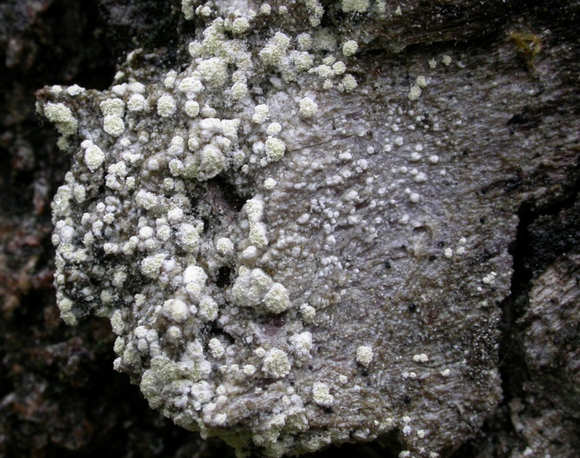
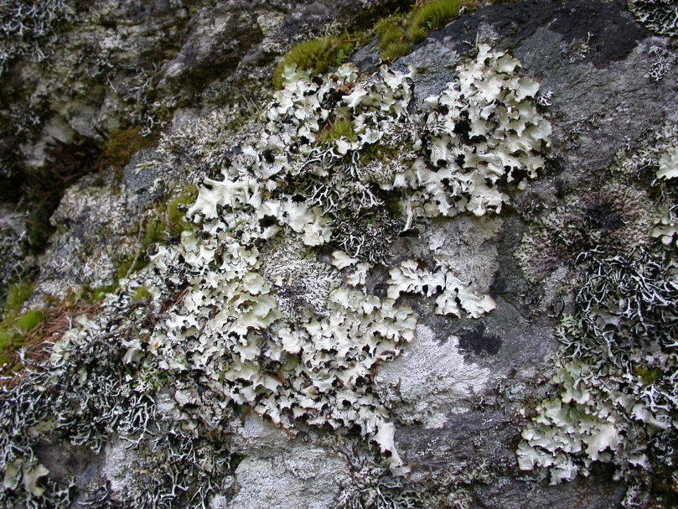
Lecanora impudens (VU)
The species has an eastern distribution and is known from about 50 localities. The species has long been reported from southern Sweden on broad-leaves trees. Since the beginning of the 1990s, finds have also been made in northern Sweden, on aspen. Taxonomic problems.
Cetrelia olivetorum (CR)
The species is known from four current localities and in 2004 there were a total of c. 30 dm2. Previously, there were three more localities.

Slide 14
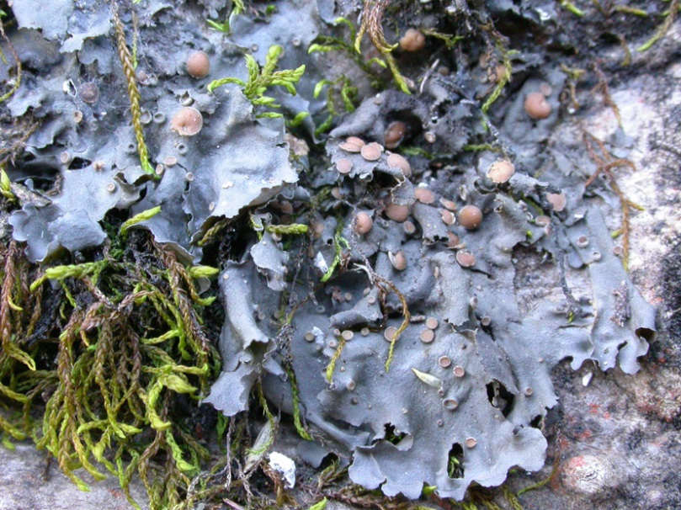
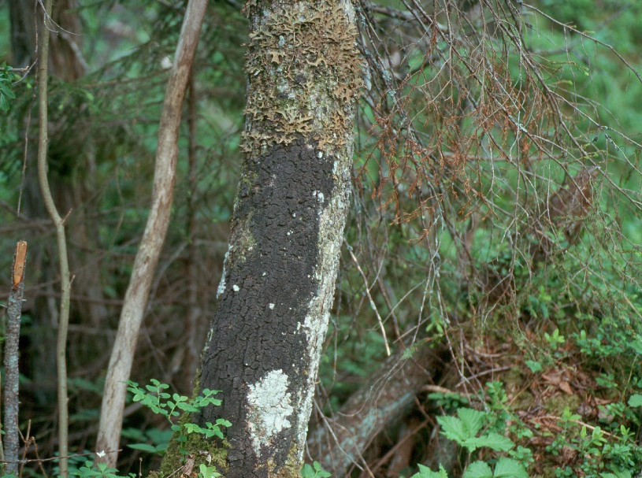
Leptogium rivulare (EN)
The species is only known from five regions. There are 12 current localities and it has disappeared from 6. The species may have naturally large variations in population size.
Parmeliella triptophylla (LC)
The species has been common on old deciduous trees in different habitat. Has decreased significantly in the cultural landscape and probably also in the forest landscape. Poor awareness of the reduction rate and yet the population is too large.

