Slide 1
ПОТОКИ СО₂ И СН₄ В ЛИШАЙНИКОВЫХ СООБЩЕСТВАХ КРУПНОБУГРИСТОГО БОЛОТА СУБАРКТИКИ
CO₂ AND CH₄ FLUXES IN LICHEN COMMUNITIES OF PALSA MIRE IN SUBARCTIC REGION
Zagirova S.V., Miglovets Mikhail
Институт биологии Коми НЦ УрО РAH, г. Сыктывкар

Slide 2
The aim is to compare the fluxes of carbon dioxide and methane from the surface of a palsa mire in sites with lichen cover and peat spots during the warm season.
Palsa mire of northern Europe are common in regions with an average annual air temperature of about -1 ° C and a total precipitation of <500 mm per year (Mires and peatlands of Europe,2017);
The southern border of the distribution of palsa mires in the European part of Russia is confined to the transition of the forest-tundra to the northern taiga (Растительность европейской части СССР,1980) at the southern bound of permafrost zone (Геокриологическая карта…,1998);
Palsa mires are a convenient model for studying the response of terrestrial ecosystems to climate change;
In the study of microbiological activity and the emission of CH4 and CO2, the authors often ignore the differences between the various structural elements of permafrost mounds (palsas). The study of the differences between areas of cryogenic peat soils covered with and without vegetation is rare in the works (Marushchak,2011;Каверин,Пастухов,2013;Огнева и др,2016)

Slide 3
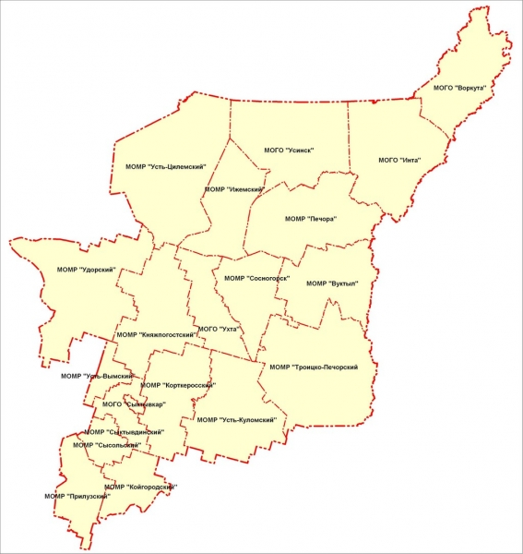
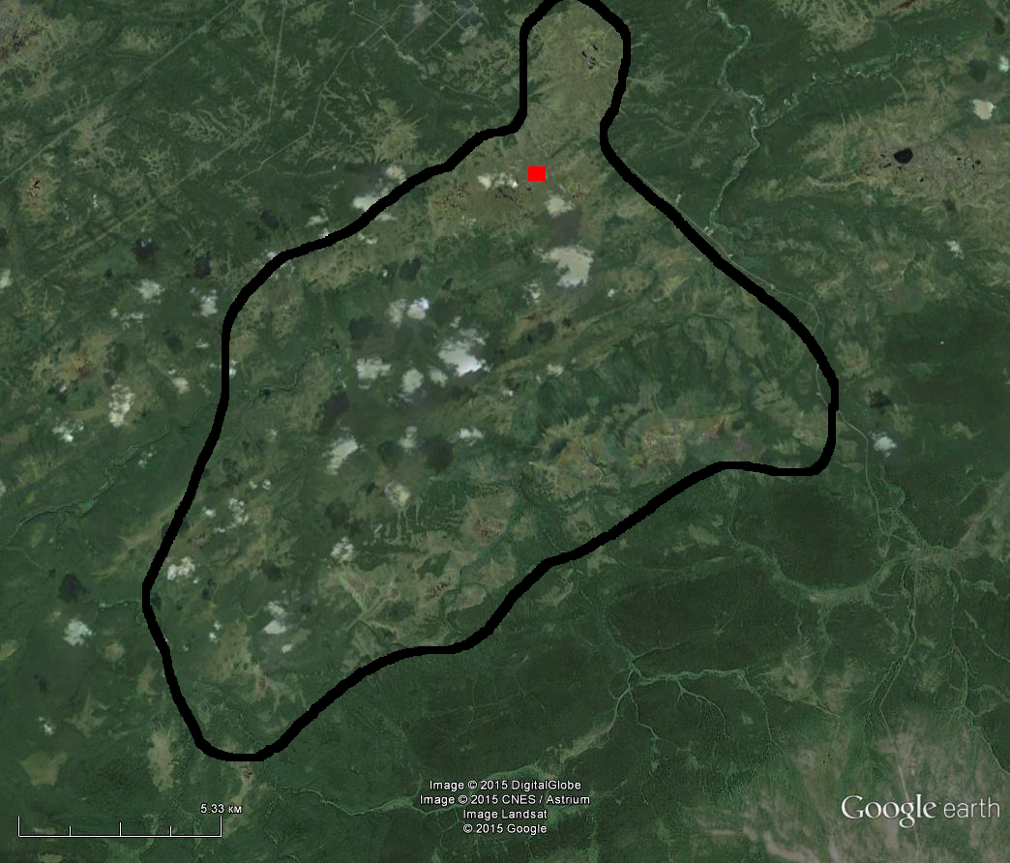
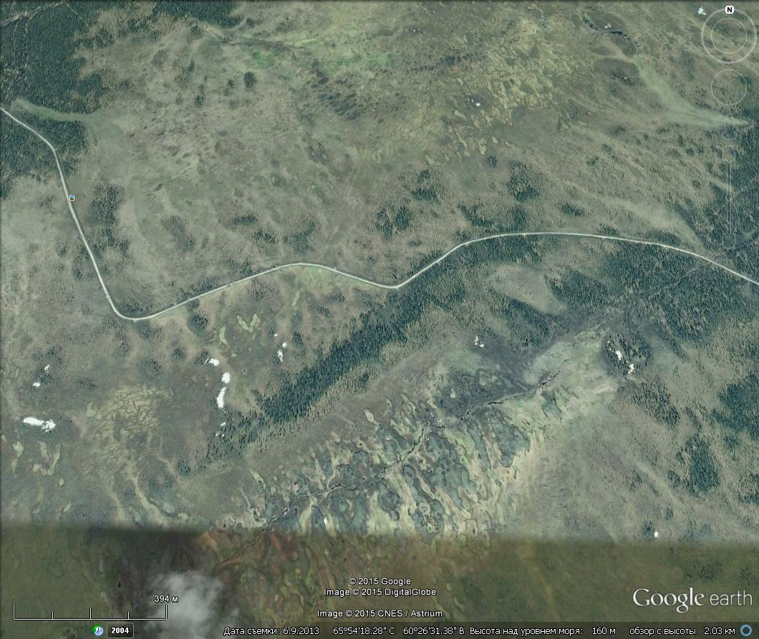
I- Inta district. Foothill region;
II A – Mire system;
IIB – Study palsa mire site
I
A
II
B
Observations started in 2013 as part of the UNDP / GEF ”Nothern Peatlands ClimaEast Project”

Slide 4
Sketch map of the distribution of key microbiotopes at studied palsa mire

Slide 6
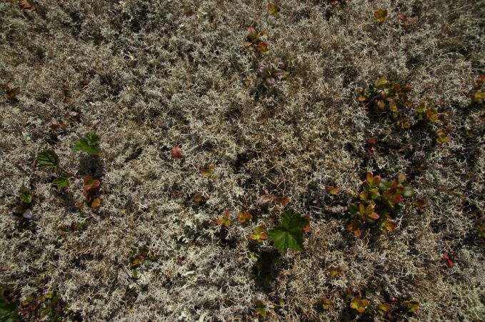
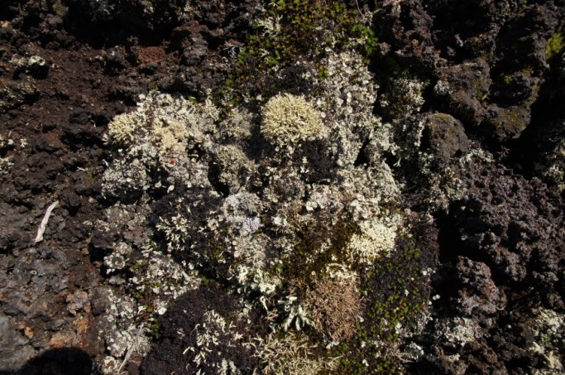
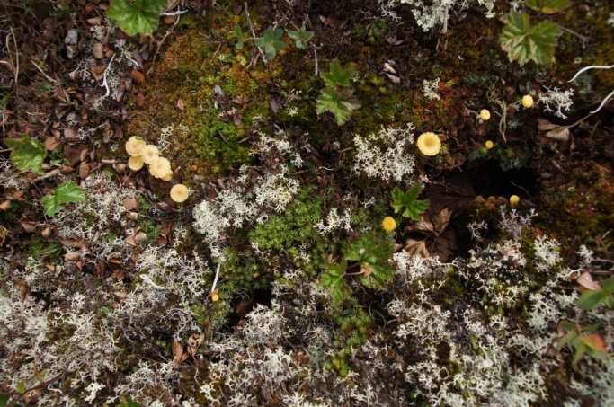
Peat mound/Palsa
Peat spot (non covered)
erosive nature
Lichen communities (frequent Cladonia arbuscula, C. сoccifera, C. gracilis, C. rangiferina)
Srubs-lichen
(Ledum palustre, Vaccinium uliginosum, Betula nana, Empetrum hermaphroditum, lichen)
On the Palsa there are: Flavocetraria cucullata, F. nivalis, Cetraria nigricans, Anzina carneonivea, Ochrolechia frigida, Pertusaria dactilina, Dibaeis baeomyces, Placynthiella icmalea. And one species protected in the Republic of Komi and the Russian Federation: Lichenomphalina hudsoniana (photo 3). Lichen phytomass ranged from 0.9 (palsa slope) to 1.5 (top) kg/m²
Description of species and photo by Pystina T.N.

Slide 7
Dynamics of Palsa soil temperature under peat spots (PS) and lichen cover (depth-15 cm) in 2016

Slide 8
Dynamics of water content in the upper layers of palsas peat spots and under lichens in 2016

Slide 9
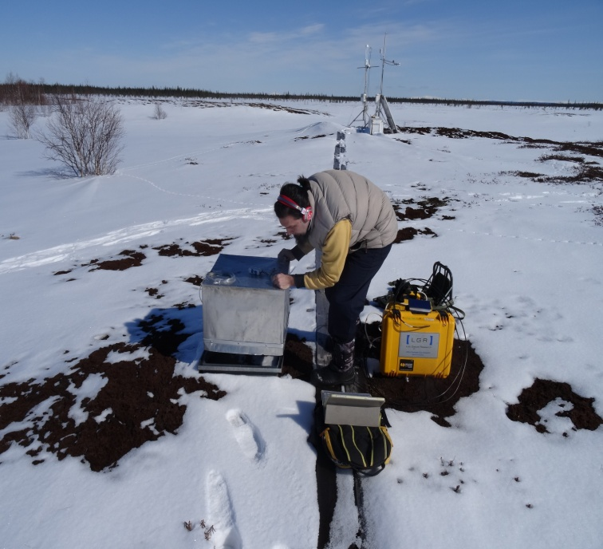
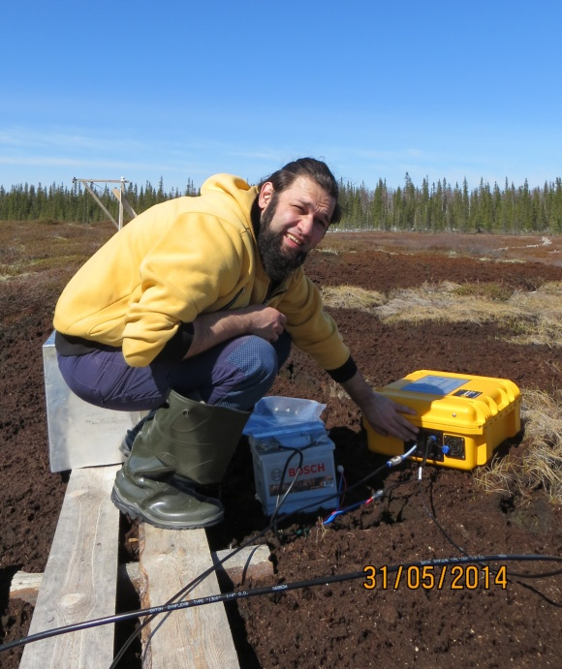
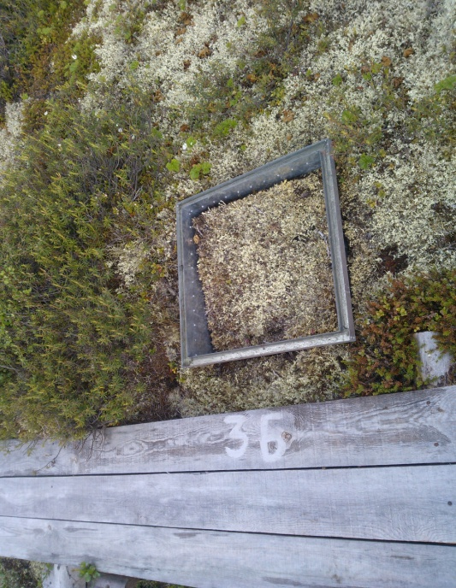
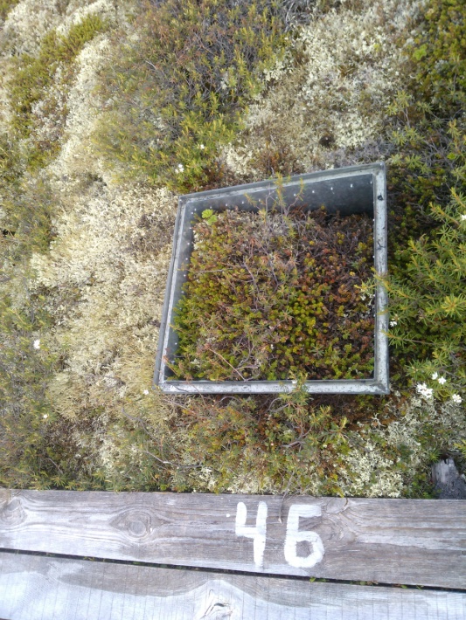
Observations are obtained by static dark chambers method. The CO2 / CH4 flux was determined with an area limited by a frame (0.25 m²) with a aqualock. The volume of the chamber is 0.1 m³. Chambers exposure time - 20 min. The concentration of CO2 / CH4 in air was determined by a UGGA-30p portable dynamic infrared gas analyzer (Los Gatos Research inc., USA). The CO2 / CH4 flux was calculated using the modified ideal gas equation.

Slide 10
Dynamics of average daily rates of CH4 flux from the surface of studied peat spot plots (PS) and lichen plots (n = 3) in 2015-2016

Slide 11
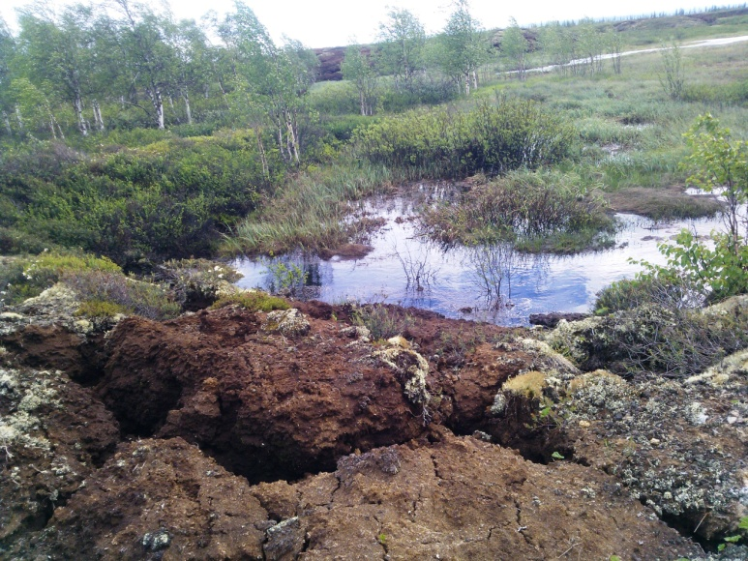
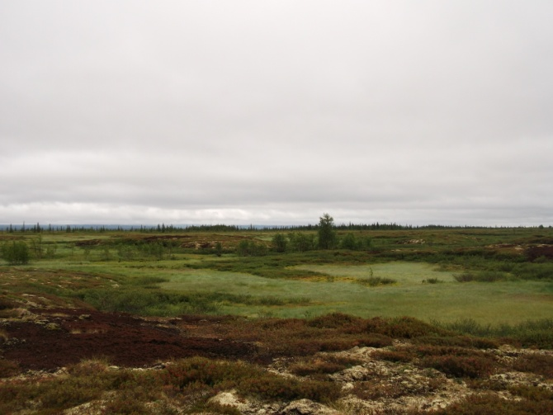
Daily dynamics of methane flux from the surface of peat spots and from lichen covered plots at the permafrost palsa 16/07/2015 (A) and 19/07/2016 (B)
A
B

Slide 12
Dynamics of average daily rates of CO2 flux from the surface of studied peat spot plots (PS) and lichen plots (n = 3) in 2015-2016

Slide 13

Total calculated values of CH4 and CO2 emissions from June 1 to September 12 (2015-2016) from the surface of studied microbiotopes of the Palsa mire
Microbiotopes | Area, м² | Total emission, kgСН₄
 |  | 2015 | 2016
Peat spot | 6613 | 0.2 | 2.3
Lichen communities | 27383 | -4.4 | -7.8
Flark+creek | 38285 | 618.5 | 455
Ridge | 39358 | 63 | 67
Total | 111639 | 677 | 517
Microbiotopes | Area, м² | Total emission, MgСO₂
 |  | 2015 | 2016
Peat spot | 6613 | 1.7 | 2.5
Lichen communities | 27383 | 10.5 | 14.8
Flark+creek | 38285 | 12.7 | 20.5
Ridge | 39358 | 28 | 46
Total | 111639 | 53 | 84

Slide 14
Lichen communities developing on permafrost peat mounds, covered in winter with thick snow cover, contribute to maintaining optimal hydrothermal conditions for microbiota, in contrast to uncovered peat spots.
Under the lichen thallus, the moisture content in the upper layer of peat is higher than at PS at half the growing season at comparable temperatures. In autumn, with intensive freezing of the upper horizons, near-zero temperature remains under lichens, which can also support partial biota metabolism.
Other authors have noted that the carbon content of microbial biomass under lichens areas is 3 times higher than on peat spots (Ogneva et al.,2016).
We noted that lichen areas are the only microbiotopes in which methane uptake is observed. In total, methanotrophs under lichens absorb 4.4 - 7.8 kg in the studied area.
CO2 emission from the surface of lichen areas in the warm period is well higher than on peat spots. In total, 6 times more CO2 is emitted from lichen plots.

Slide 15
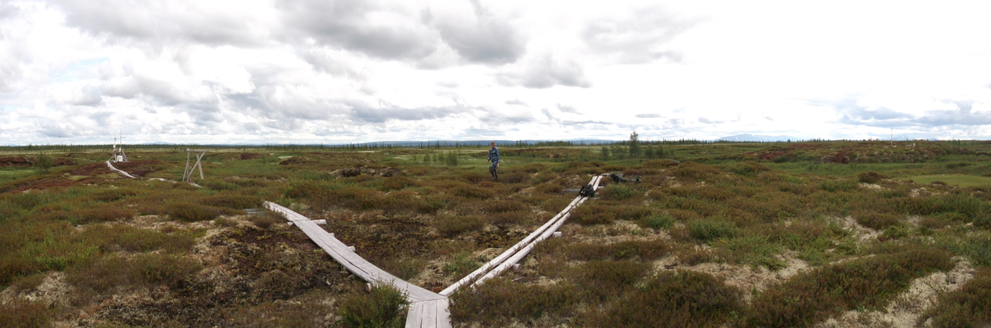
Thanks for attention
The undisturbed lichen areas of palsa play a significant role in the carbon balance of mires and the regulation of greenhouse gases, as the greenhouse potential of methane is 20 times higher than that of CO2.

