Slide 1
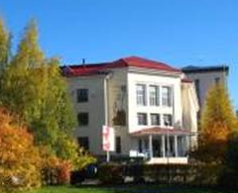
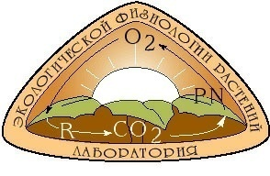
Institute of Biology Komi SC UB RAS,
Komi Republic, Syktyvkar
THE RESPONSE OF CYTOCHROME AND ALTERNATIVE RESPIRATION RATE OF BOREAL AND ANTARCTIC LICHENS TO TEMPERATURE
Mikhail A. Shelyakin
E-mail: shelyakin@ib.komisc.ru
Syktyvkar 2019

Slide 2
Lichens - ancient and complex objects of wildlife
Form Lichen Biology / Nash T.H. Ed., 2008
Collema nigrescens
Anaptychia ciliaris
Nephroma resupinatum
Cetraria islandica
Consist of two or more components
Up to 90% of biomass is heterotrophic mycobiont
Inhabit around the globe
Able to survive and exist in very extreme conditions

Slide 3
EFFECT OF TEMPERATURE ON LICHEN RESPIRATION (LITERATURE ANALYSIS)

Slide 4
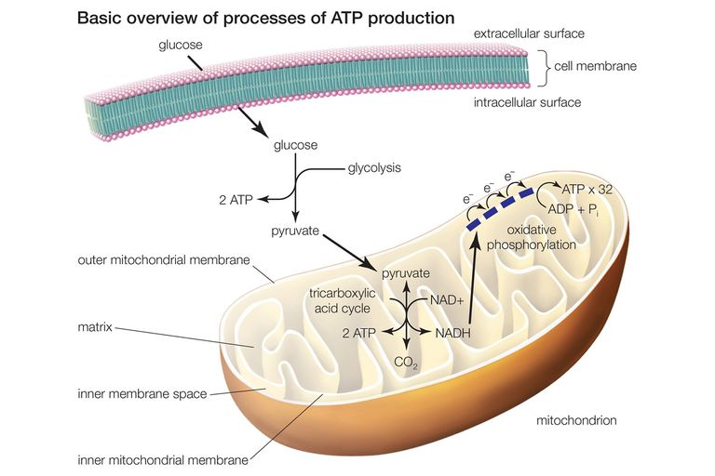
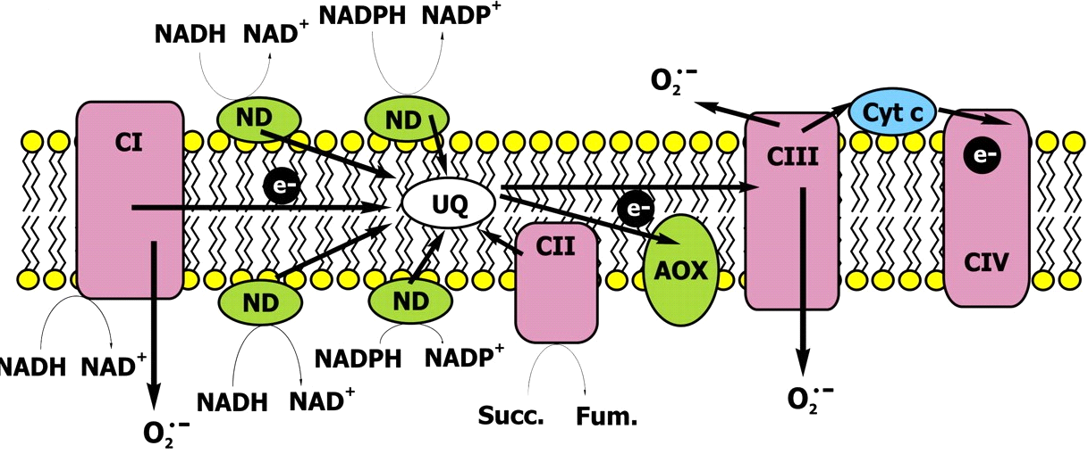
CELLULAR RESPIRATION IS A COMPLEX AND MULTI-STAGE PROCESS
C₆H₁₂O₆ + 6O₂ → 6CO₂ + 6H₂O + 36 ATP
V total = V alt + V cyt + V res
V total – total respiration
V alt – alternative (energy dissipating) respiratory pathway
V cyt - cytochrome respiratory pathway
V res – non mitochondrial (residual) respiration

Slide 5
TEMPERATURE DEPENDENCE OF RESPIRATION
At optimal temperatures
Q₁₀ - Temperature quotient of respiration (at optimal temperatures Q₁₀=2-4)
Respiratory enzymes inactivation
Disturbance in respiratory and energy cells’ metabolism
Superoptimal temperatures
Сell membranes disturbance
AIM
To investigate the effects of short-term temperature changes on the respiration rate and the respiratory pathways capacities and relative contribution in lichen species collected from their natural habitats in boreal zone and Antarctica.

Slide 6
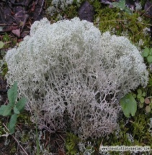
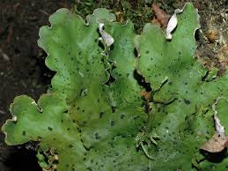
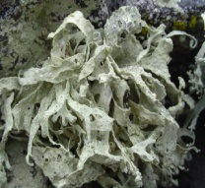
OBJECTS
Lichens from the middle taiga subzone
Species | Life-form | Ecological group | Photobion
Cladonia stellaris | fruticose | epigeic | green algae
Peltigera aphtosa | foliose | epigeic | green algae and cyanobacteria
Peltigera rufesсens | foliose | epigeic | cyanobacteria
Cladonia stellaris
Peltigera aphthosa
Peltigera rufescens
Lichens from Antarctica
Species | Life-form | Ecological group | Photobiont
Ramalina terebrata | fruticose | epilithic | green algae
Umbilicaria decussata | foliose | epilithic | green algae
Usnea aurantiaco-atra | fruticose | epilithic | green algae
Usnea sphacelata | fruticose | epilithic | green algae
Ramalina terebrata
Umbilicaria decussata
Usnea aurantiaco-atra
Usnea sphacelata

Slide 7
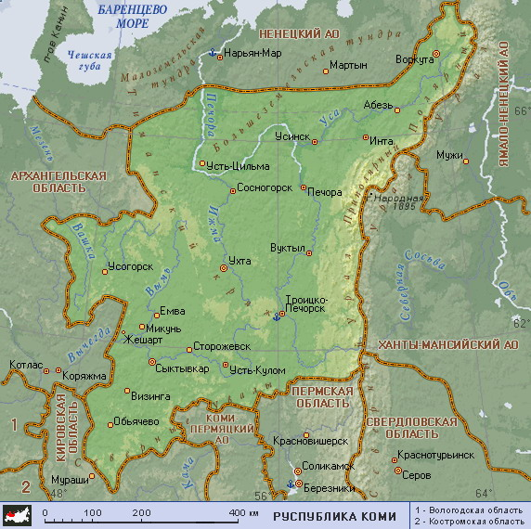
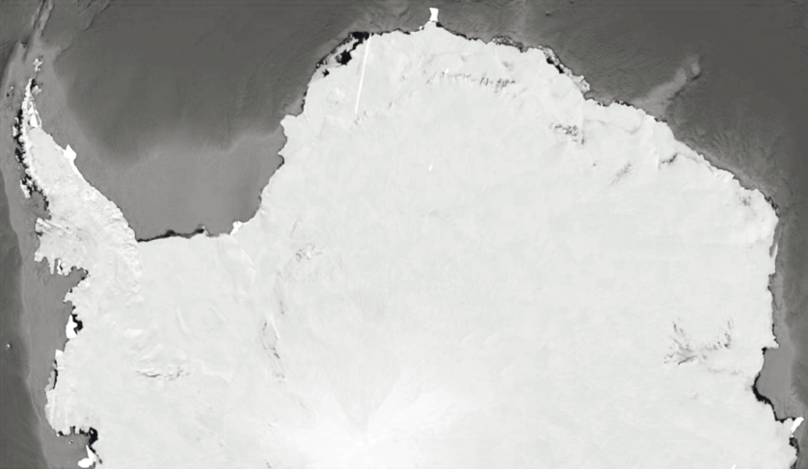
LICHEN SAMPLING SITES
Middle taiga subzone
Samples were collected in July 2019
Times of day | T air, °C |  | RH, %
 | Meadow | Forest | Meadow | Forest
Morning (6-7 h) | 22.2±0.4 | 15.2±0.1 | 61.5±0.7 | 69.7±0.8
Day (12-14 h) | 31.1±0.3 | 21.2±0.4 | 35.7±2.3 | 40.3±1.4
Evening (21-22 h) | 17.8±0.3 | 11.7±0.2 | 77.1±0.9 | 64.8±2.3
Antarctica
0
Samples were collected in in the summer period in 2015, 2016 and 2018
100 км
1 - islands adjacent to the Antarctic Peninsula
2 - eastern continental Antarctica
1
2
Site | Mean surface air temperature*, ⁰С
 | Summer | Winter
1 | 0.5 | -5.6
2 | -3.3 | -17.6
Antarctica
* - data from http://www.aari.aq/
Sadowsky, Ott // Polar Biol (2016)

Slide 8
METHODS
Oxygen uptake rate was measured with a polarographic Oxytherm system.
The respiratory pathways capacity was estimated with the method of the specific respiratory inhibitors. Inhibitor of the alternative respiratory pathway was 6 mM benzhydroxamic acid. Cytochrome respiratory pathway was inhibited by 2 mM KCN.
The respiration rate of Antarctic and boreal lichens was measured in the temperature range of 5-35 and 5-40ºС, respectively.
Before determining the respiratory activity, the Antarctic lichens thalli were hydrated to full saturation with periodic drip irrigation and acclimated for a week in a Binder KWVF-720 chamber (Germany) at a temperature of 15°C and a relative humidity of about 60%.
Boreal lichens respiration was measured immediately after selection and hydration of thalli for several hours.

Slide 9
TEMPERATURE DEPENDENCE OF LICHEN TOTAL RESPIRATION
Boreal lichens
Antarctic lichens
4000
P. rufescens
3000
P. aphthosa
nmol О₂ / (g DW min)
Um. decussata
2000
U. sphacelata
C. stellaris
U. aurantiaco-atra
1000
R. terebrata
0
5
15
25
35
40
5
15
25
35
Temperature, ○C

Slide 10
INFLUENCE OF THE TEMPERATURE ON RESPIRATORY PATHWAYS CAPACITY AND RATIO IN THE BOREAL LICHENS THALLI
C. stellaris
600
100
80
Valt
400
60
Vres
200
40
Vcyt
20
0
P. aphthosa
0
3000
100
80
Valt
2000
60
Vres
nmol О₂ / (g DW min)
% from total respiration
40
Vcyt
1000
20
0
0
P. rufescens
3000
100
80
2000
60
Valt
40
Vres
1000
Vcyt
20
0
0
5
15
25
35
Temperature, ○C
40
5
15
25
35
40

Slide 11
INFLUENCE OF THE TEMPERATURE ON RESPIRATORY PATHWAYS CAPACITY AND RATIO IN THE ANTARCTIC LICHENS THALLI
(From Eastern Continental Antarctica)
1000
Um. decussata
100
800
80
600
60
Valt
400
Vres
40
Vcyt
200
20
0
0
nmol О₂ / (g DW min)
% from total respiration
1000
U. sphacelata
100
800
80
600
60
Valt
Vres
400
40
Vcyt
200
20
0
0
5
15
25
35
5
15
25
35
Temperature, ○C

Slide 12
EFFECT OF THE TEMPERATURE ON RESPIRATORY PATHWAYS CAPACITY AND RATIO IN THE ANTARCTIC LICHENS THALLI
(From Islands Adjacent To The Antarctic Peninsula)
R. terebrata
600
100
80
400
Valt
60
Vres
200
40
Vcyt
20
0
0
nmol О₂ / (g DW min)
% from total respiration
U. aurantiaco-atra
600
100
80
400
60
Valt
Vres
40
Vcyt
200
20
0
0
5
15
25
35
5
15
25
35
Temperature, ○C

Slide 13
EFFECT OF THE TEMPERATURE ON THE Q₁₀ RESPIRATORY QUOTIENT
Cladonia stellaris
3.5
5.0
3.0
4.0
Valt
2.5
Vtotal
2.0
3.0
Vcyt
Q₁₀
Q₁₀
1.5
2.0
1.0
1.0
0.5
0
0
5-15
15-25
25-35
35-40
5-15
15-25
25-35
35-40
Temperature range, ○C
Umbilicaria decussata
3.5
5.0
3.0
4.0
Valt
2.5
Vtotal
2.0
3.0
Vcyt
Q₁₀
Q₁₀
1.5
2.0
1.0
0.5
1.0
0
0
5-15
15-25
25-35
5-15
15-25
25-35
Temperature range, ○C

Slide 14
CONCLUSION
Thus, a short-term temperature increase can significantly activate the respiration rate and cause changes in the respiratory pathways ratio in the thalli of boreal and Antarctic lichen species.
It was shown that with an temperature increase in the range of 5–35 and 5–40 ° C, the intensity of O₂ consumption increased on average by 4–5 and 5–7 times in lichens selected in the middle taiga subzone and in Antarctica, respectively.
It was revealed that an increase in the total respiration intensity due to the cytochrome pathway in the thalli of Antarctic lichens occurred in the temperature range of 5-15 ° C. In the boreal lichens, the cytochrome respiratory pathway activity increased with an increase in temperature from 5 to 35 ° C. Changes in the alternative pathway and / or the residual non-mitochondrial respiratory component capasity in the Antarctic lichens were observed with increasing temperature to 25 ° C and above. In the boreal lichens such respiratory changes were observed only at 40 ° C.
Calculations of the temperature respiratory quotient showed that the total and cytochrome lichens respiration is most sensitive to an increase in temperature from 5 to 15 °C (Q₁₀ was 2.5-3.5). In the temperature range 25–35 and 35–40 ° C, the sensitivity of the alternative respiratory pathway increased in Antarctic and boreal lichen species (Q₁₀ values were about 4 and 2, respectively). The Q₁₀ values for total respiration and cytochrome respiratory pathway were about 1.

Slide 15
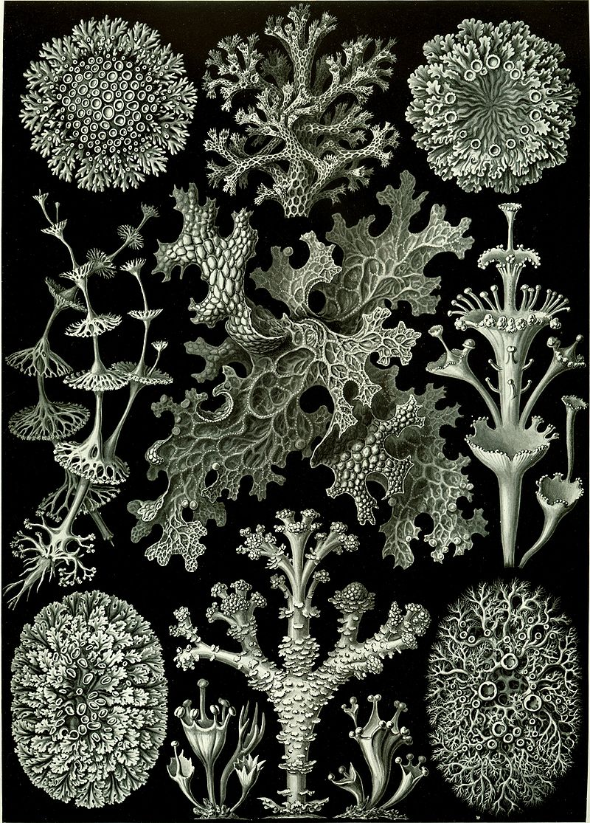
Acknowledgements: Mikhail P. Andreev (Komarov Botanical Institute, Russian Academy of Sciences) for the opportunity to collect the Antarctic lichens samples used in this study.
This work was partly funded by RFBR
(research project No. 18-34-00346 mol_a).
THANKS FOR ATTANTION!
Lichens from «Artforms of Nature»
(Ernst Haeckel)

