Slide 1
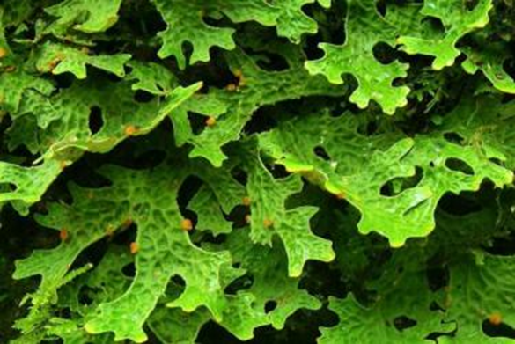
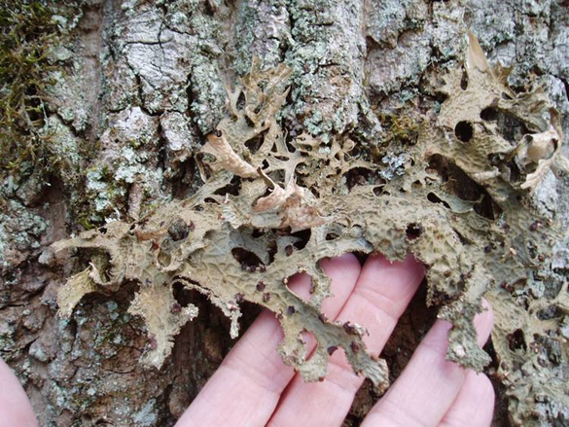

Photoprotection in lichens
R.P. Beckett^{1,2}, F.V. Minibayeva^{2,3}, K.A. Solhaug⁴
¹School of Life Sciences, University of KwaZulu-Natal, South Africa
²Kazan Federal University, Kazan, Russia;
³Kazan Institute of Biochemistry and Biophysics, Russian Academy of Sciences, Kazan, Russia;
⁴Department of Ecology and Natural Resource Management, Norwegian University of Life Sciences, Ås, Norway.

Slide 2

Extreme Stress Tolerance
Example: Lichens in space, exposed to vacuum, extreme temperatures and ultraviolet radiation for two weeks. Lichens survived with minimal damage.

Slide 3
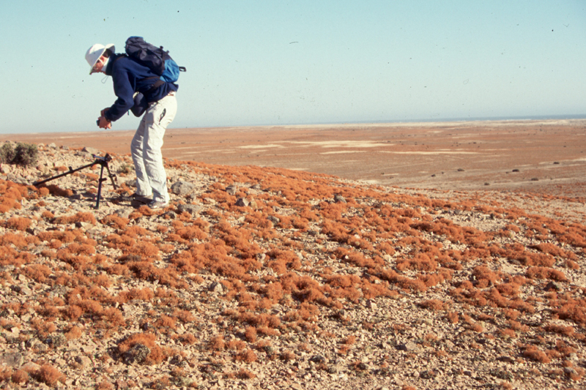
Example: Teloschistes in Namibia

Slide 4
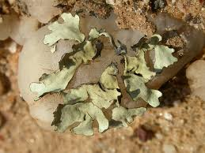
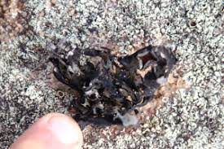

Xanthoparmelia hottenttota
Wet
Dry

Slide 5
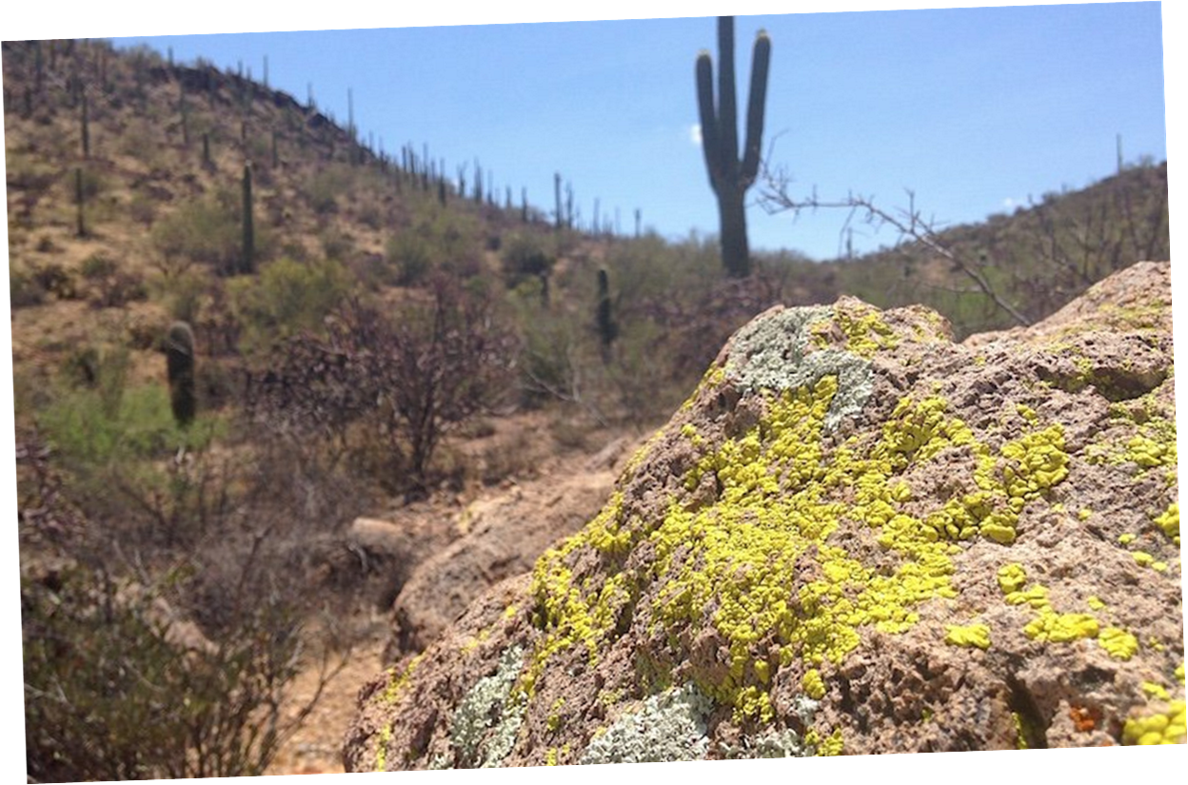

Slide 6
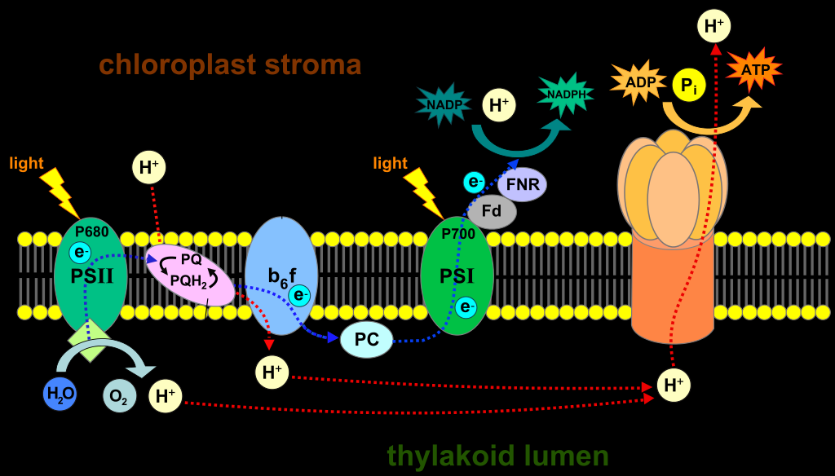
Why is high light harmful?
Light excites chlorophylls, but if energy absorbed is not used in photochemistry (e.g. no CO₂ fixation) then they react with O₂, producing singlet oxygen (¹O₂*) and other ROS such as superoxide (O₂^{.-} )
The main sites of ROS generation are in and around PSII - net result - photoinhibition

Slide 7
Light particularly harmful for DT organisms
As they dry they still absorb light even though no CO₂ fixation
Result: “a decreases in NADP⁺ regeneration by the Calvin cycle causes a reduction of photosynthetic electron transport chain and increased accumulation of ROS” (Challabathula et al., 2018)

Slide 8
Photoinhibition even occurs in the dry state
Mechanism not entirely clear, but…..
Even in desiccated bryophytes excitation energy can be transferred from chlorophyll to the reaction centers (Heber et al. 2006)
Water is not necessary for the formation of singlet oxygen from a chlorophyll triplet (Pospíšil 2016)
Desiccation inhibits normal repair processes (Buffoni-Hall et al. 2003)
Does most photoinhibition occur wet or dry state?

Slide 9
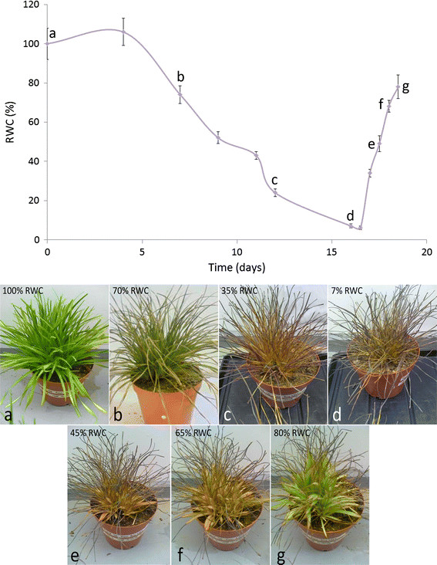
Some higher plants break down chlorophyll - Poikilochlorophylly in South African monocot Xerophyta
….. But lichens seem to like to retain their chlorophyll

Slide 10
High Light Stress - overview of talk
Repair of damage
Scavenging of ROS once formed
  SOD
  POX
  CAT etc.
Prevention of ROS formation
  Non-Photchemical Quenching (NPQ)
  Light screening compounds

Slide 11
Talk themes
Effects of UV not considered here
Some adaptations known in higher plants not or poorly studied in lichens
However, there are some specific “lichen specific” adaptations
All adaptations have a “cost”
Recent discoveries make it possible to re-investigate some earlier observations e.g. how can tolerance to high light be induced

Slide 12
Repair

Slide 13
PSII Repair cycle
Most damaged - D1 protein, part of PSII
“Repair in cyanobacteria, algae, and plants shares a central feature: the replacement of the photodamaged D1 subunit with a newly synthesized copy”
Not studied in lichens!

Slide 14
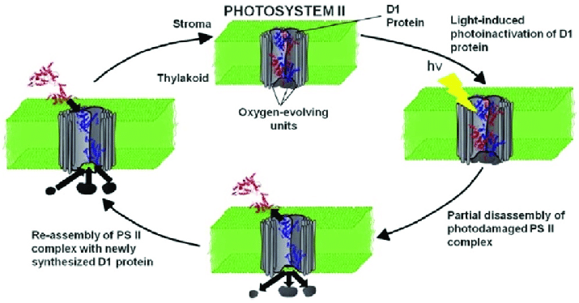
PSII Repair cycle

Slide 15
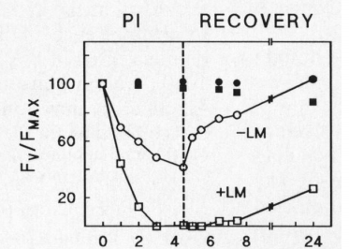
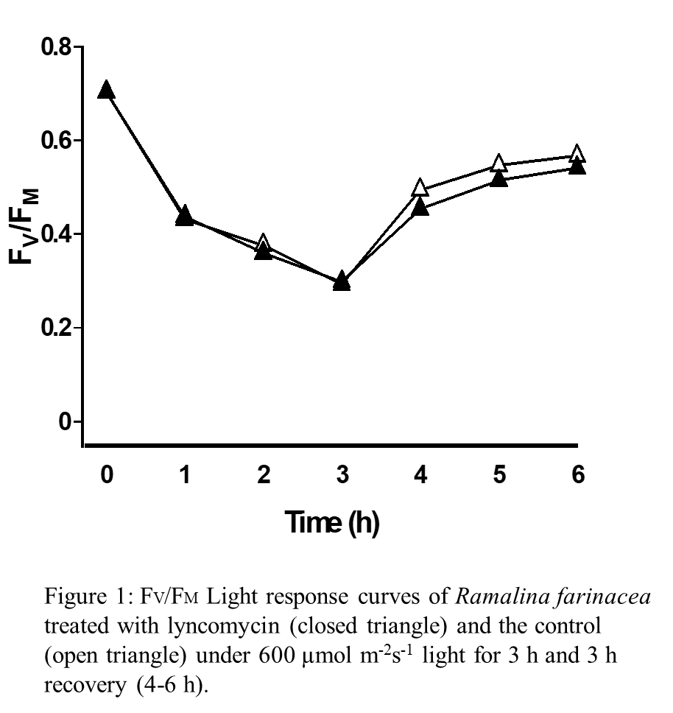
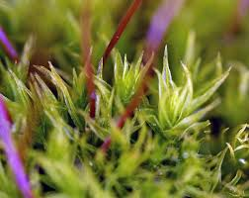
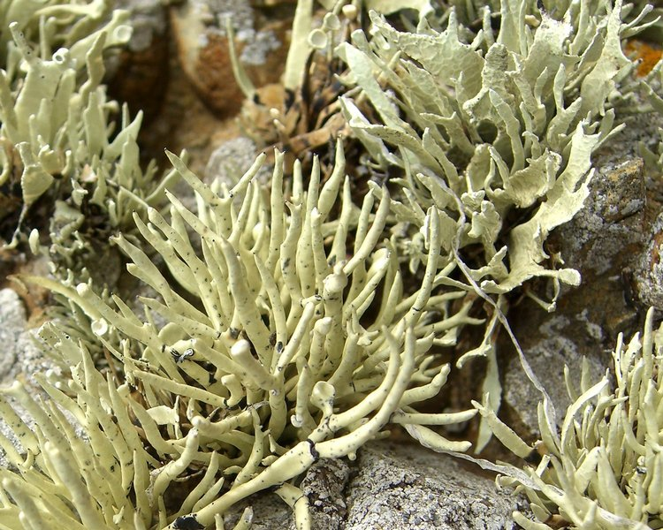
PSII repair cycle studied with lincomycin (blocks D1 protein repair), not yet studied in lichens
Example from the moss Ceratodon, photoinhibiton with and without lincomycin
But so far we have not found an effect in lichens

Slide 16
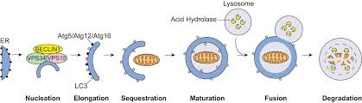
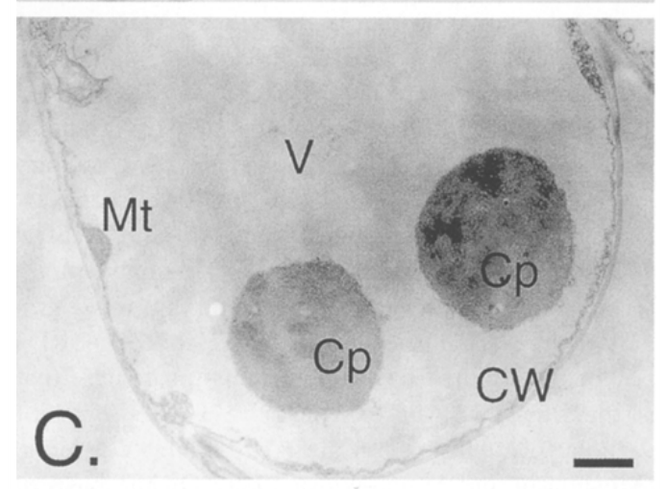
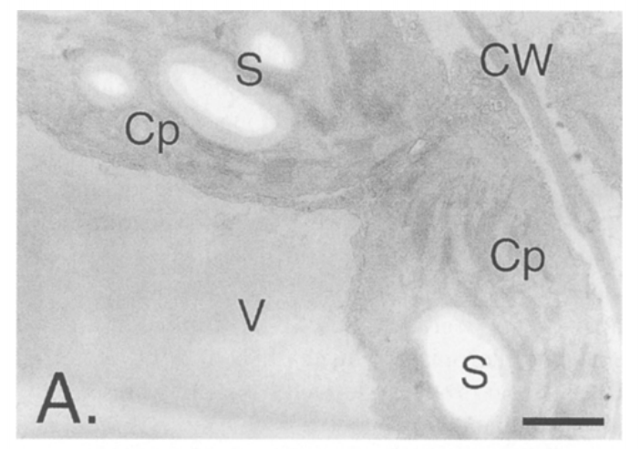
“Chlorophagy” - not studied in lichens, but in higher plants, whole plastids degraded
High Light

Slide 17
Scavenging

Slide 18
ROS are scavenged by the antioxidants
Enzymes: Superoxide dismutase, catalase, ascorbate peroxidase, guaiacol peroxidase, glutathione reductase, monodehydroascorbate reductase, dehydroascorbate reductase
Non-enzymatic antioxidants: Ascorbic acid, reduced glutathione, tocopherol and carotenoids
Effect of desiccation on antioxidants well known, but high light not studied, but in green photobionts Halliwell – Asada pathway assumed to operate

Slide 19
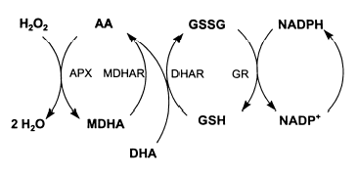
The Halliwell-Asada Pathway (after Blokhina et al. 2003)

Slide 20
ROS and signalling
Attempts to upregulate antioxidant enzymes to improve tolerance in higher plants mostly unsuccessful
“There appears to be a level of coordination between ROS producing- and ROS metabolizing processes that allows a pool of ROS to persist in the cellular environment. This coordinate regulation allows increases in the available ROS pool to occur during stress, presumably for signaling purposes” Foyer (2011)

Slide 21
Avoidance
Non-Photochemical Quenching (NPQ)
Classic lichen secondary metabolites
Melanins

Slide 22
Non-Photochemical Quenching
NPQ is the dissipation of excited states of chlorophyll (¹Chl*) into heat
Occurs when thylakoid luminal pH drops below 5.2 e.g. when CO₂ fixation inhibited
Major component qE, which in algae depends on the Light-Harvesting Complex Stress-Related (LHCSR) proteins
LHCSR transfers energy from Chl to carotenoids. Also, a Zea-independent quenching mechanism that involves formation of Car radical cations.

Slide 23
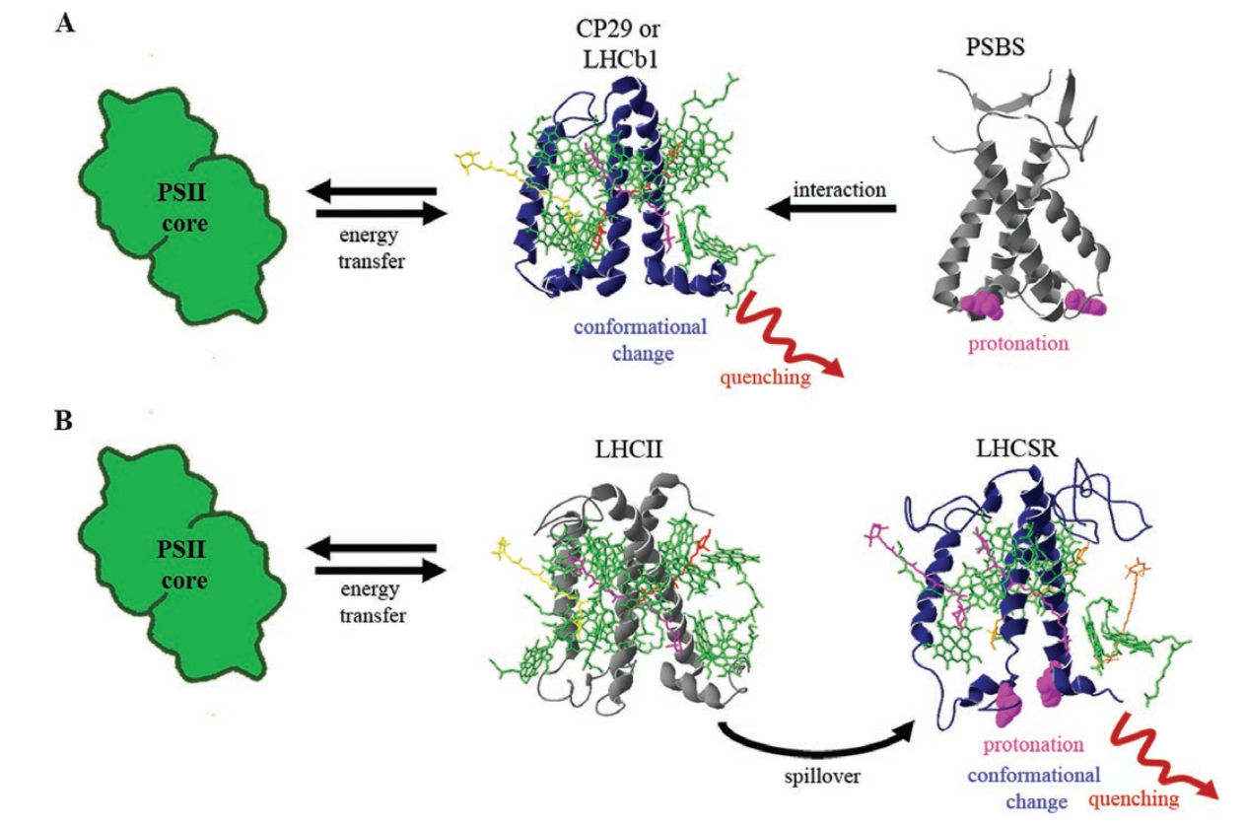
Higher Plants
Algae
Pinnola (2019) J Exp Bot

Slide 24
Other components of NPQ
In algae:
qI - a consequence of photoinhibitory damage
qZ – a strictly zeaxanthin dependent quenching
Other forms of quenching (qM, qH etc.) probably only occur in higher plants

Slide 25
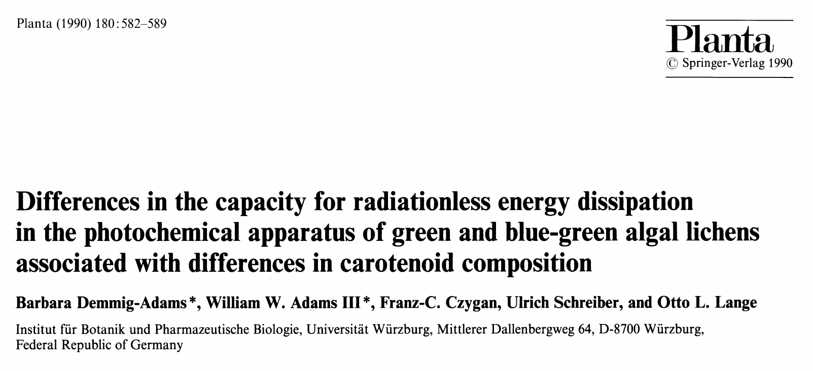
NPQ in lichens
“Natural variation in NPQ capacity is commonly observed in cyanobacteria to flowering plants, and even between different populations or accessions of the same species grown in the same conditions” Hamdani et al. (2019)
NPQ (qE) studied in lichens for many years (1990), ecophysiology still poorly understood

Slide 26
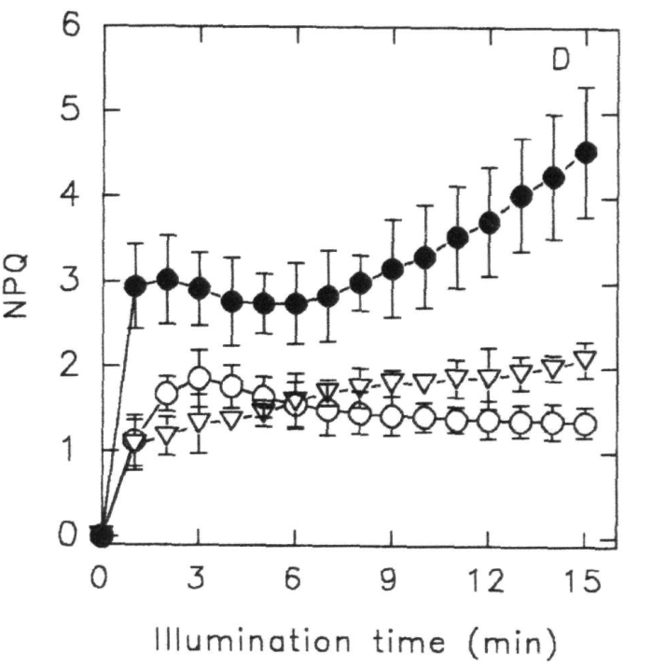
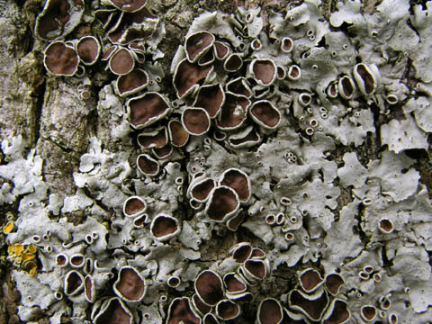
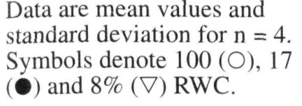
… but NPQ increases as thallus dried and risk of ROS formation increases
Parmelina quercina (Calatayud et al. 1997)

Slide 27
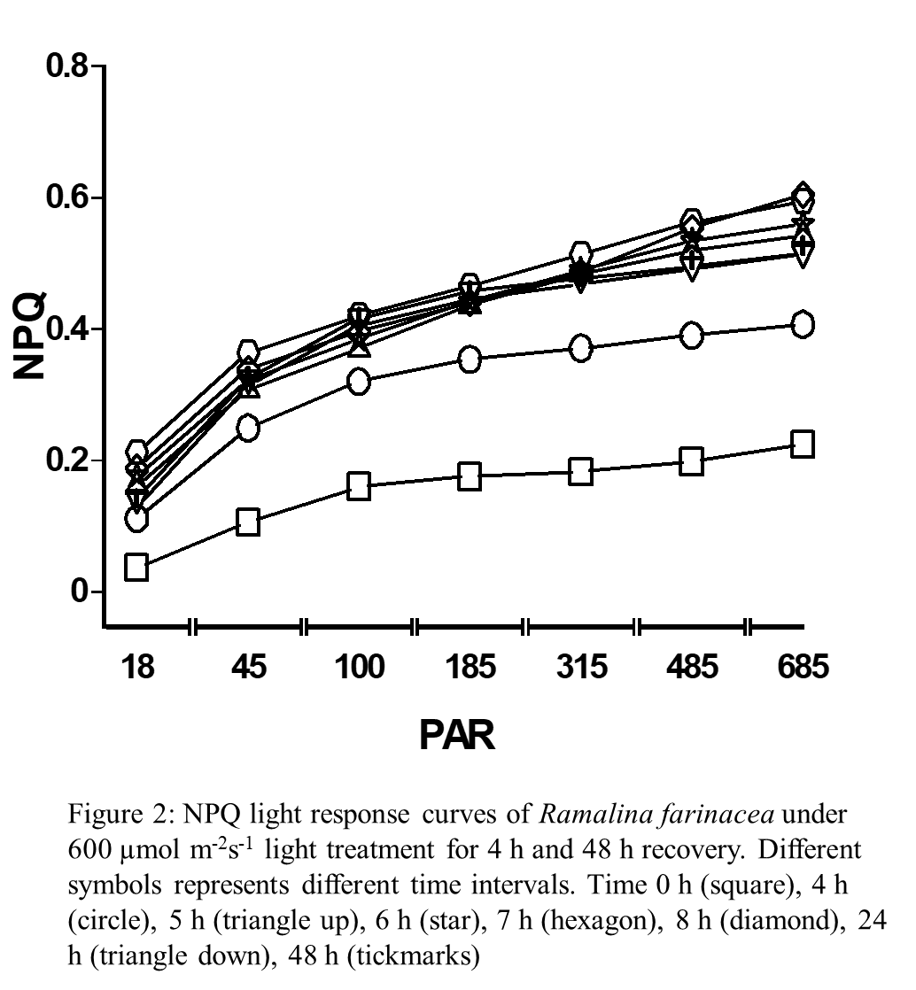

Recently we have shown that NPQ displays a sustained increased (qI?) following exposure to high light (4 h at 600 µmol m⁻² s⁻¹)
Beckett et al. (unpublished)

Slide 28
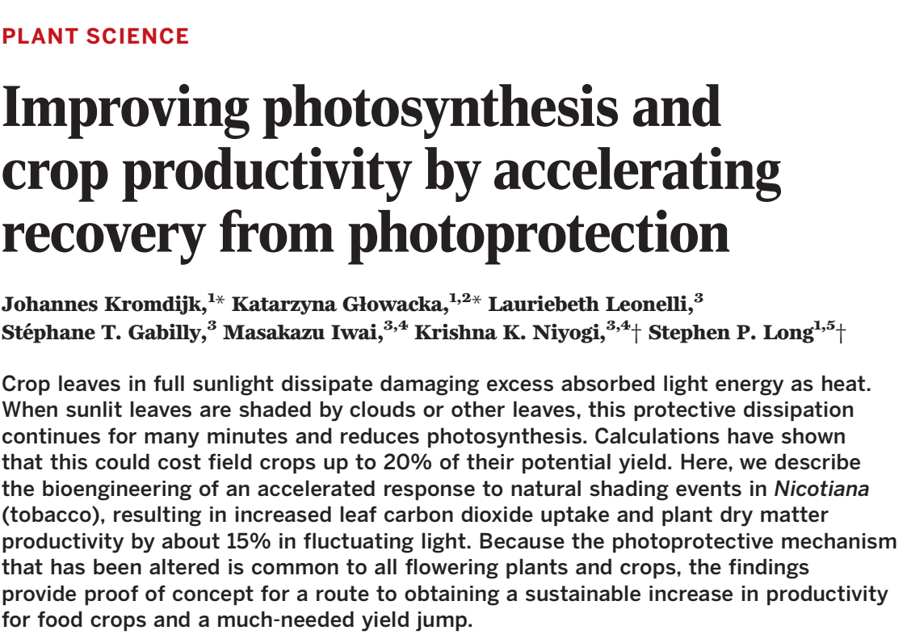
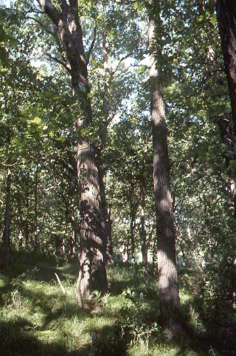
Cost: increased NPQ can reduce photosynthesis!
Exact cost hard to define, but in crops attempts to speed up “switching off” of NPQ e.g. after high light stress may increase yields by up to 20%
Do lichens that derive most energy from sunflecks switch it on / off more quickly?
Manipulating three genes allows faster recovery (accelerating the
xanthophyll cycle and increasing PsbS)

Slide 29
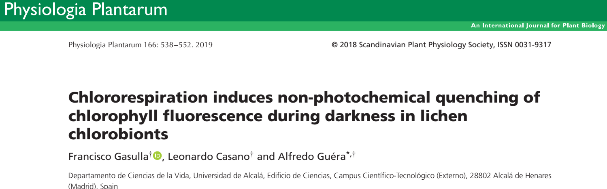
Other Forms of Quenching
State transitions
Chlororespiration
“There are other desiccation-induced, nuclear-encoded chloroplast proteins have been identified in resurrection plants like C. plantagineum and X. viscosa. The mode of protection afforded by these proteins to the chloroplasts during desiccation is not clear yet e.g. ELIP, lipocalins” ” (Challabathula et al., 2018)

Slide 30
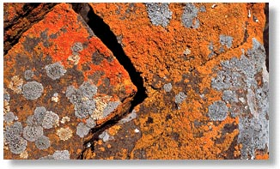
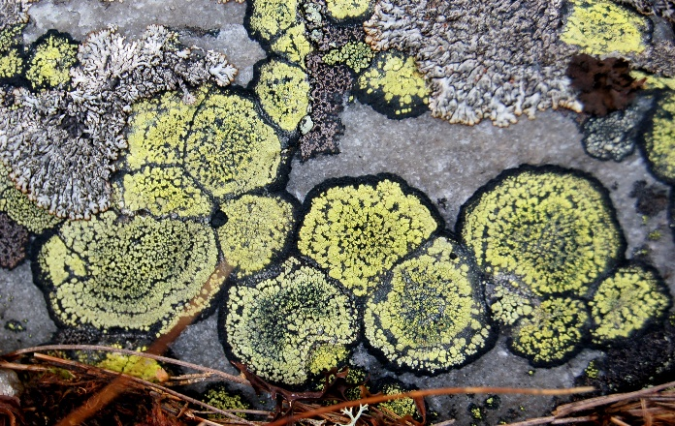
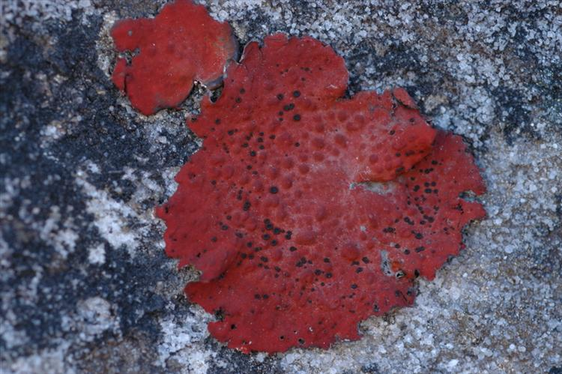
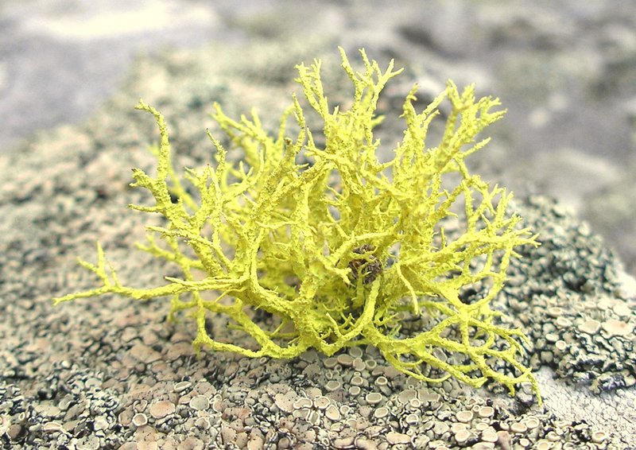
Avoidance by Light Screening

Slide 31
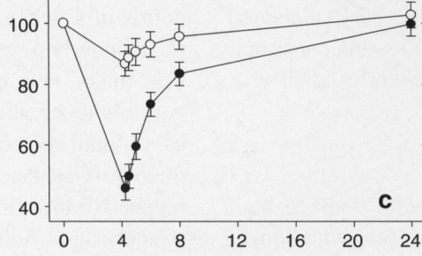
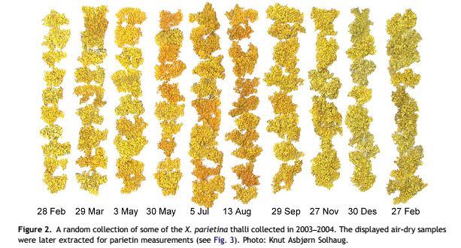
Parietin is a classic cortical pigment

Slide 32
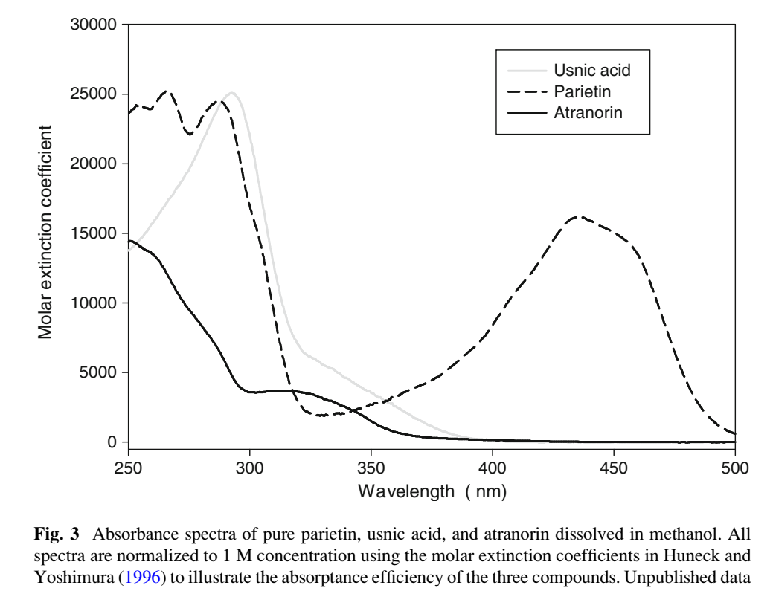
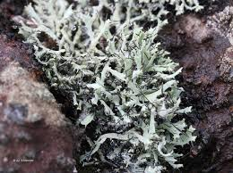
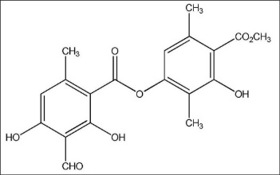
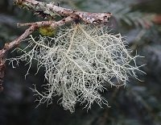
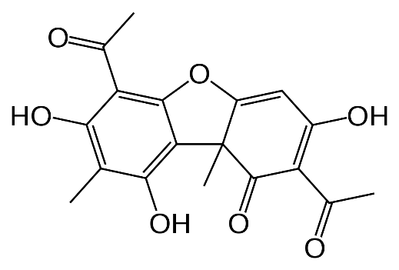
… but also “colorless” compounds e.g. usnic acid, atranorin – photoprotection?
Heterodermia
Atranorin
Usnea
Usnic acid

Slide 33
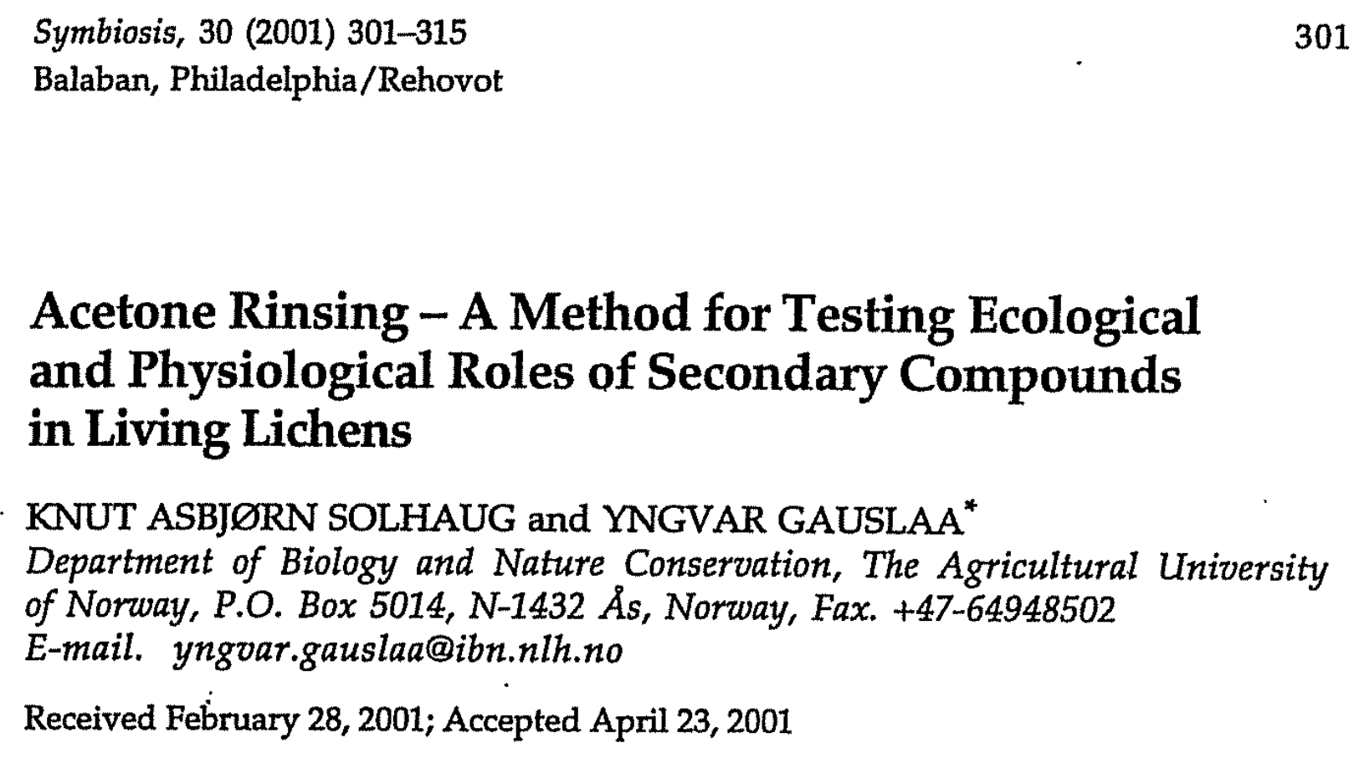


Slide 34
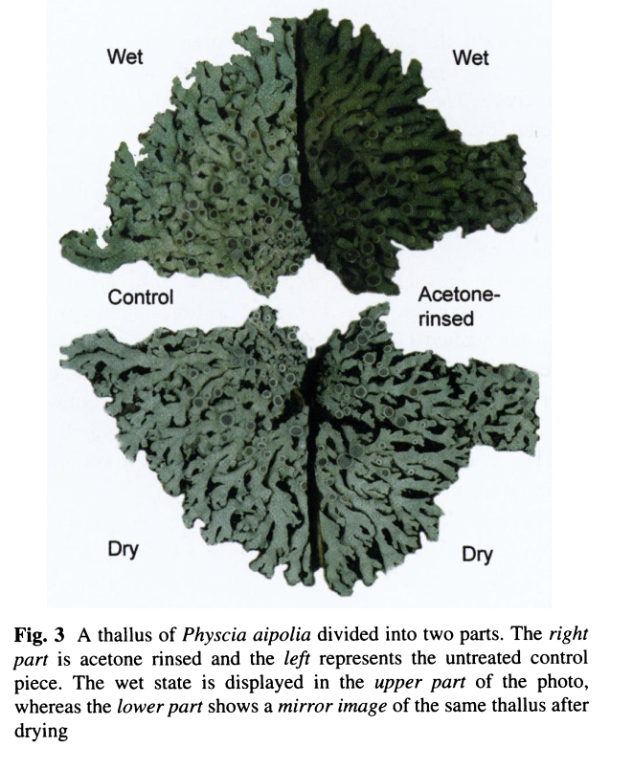
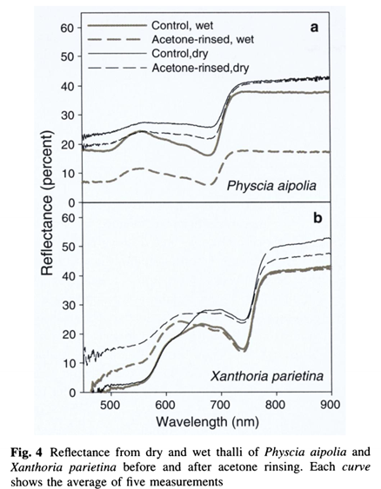
Rinsing reduces reflectance

Slide 35
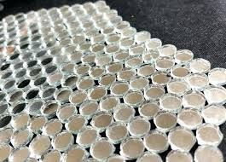
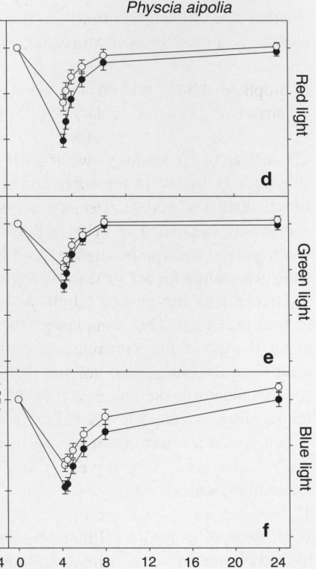
F_{V} / F_{M}
Crystals act as tiny mirrors - net result is that in acetone-rinsed thalli photosynthesis is inhibited more by a high light stress
Solhaug et al. (2001)
Time (h)

Slide 36
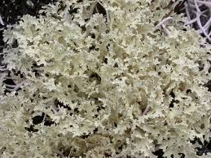
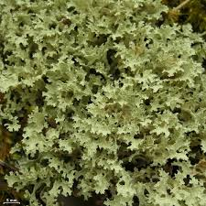
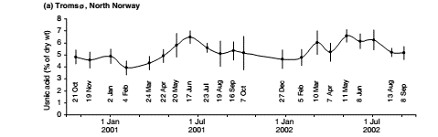
Colorless compounds also show higher levels in summer (Flavocetraria nivalis)

Slide 37
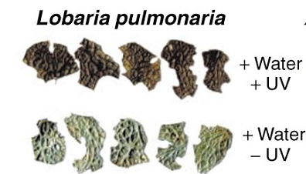
Lichens also produce melanins (fungal cortex, UV stimulates)

Slide 38
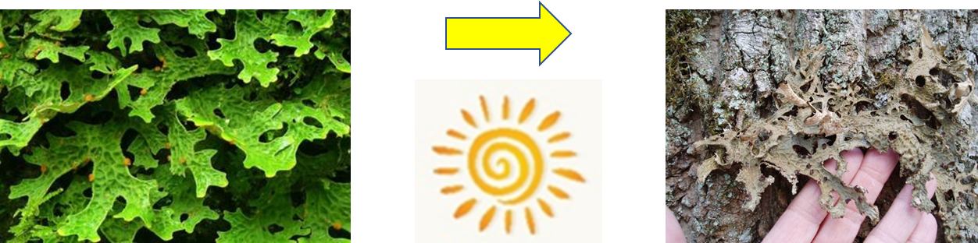
Melanisation ongoing project with Farida Minibayeva, Knut Solhaug and Yngvar Gausala

Slide 39
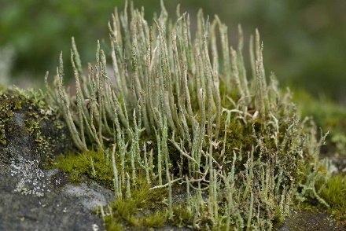
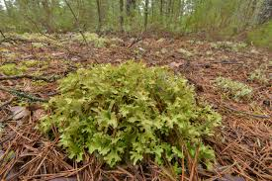
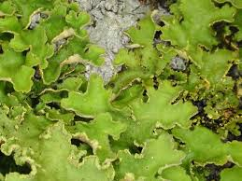





Pseudocyphellaria
Lobaria
Cladonia
Cetraria
Non-Peltigeralean lichens
Peltigeralean lichens

Slide 40


Melanised Cetraria are less photo-inhibited and recover faster than pale
Mafole et al. 2019 Photosynthetica

Slide 41

Improved tolerance to photoinhibition in melanised thalli
Shielding of melanised upper cortex?
Adaptations of algae under melanised cortex?
Test tolerance of algae without upper cortex by removing lower cortex and illuminating from below

Slide 42

Walz “maxi” imaging PAM

Slide 43

Typical image

Slide 44



If lower cortex is removed and algal layer illuminated from below melanised thalli as sensitive as pale
Beckett et al. 2019 Lichenologist
Time (h)

Slide 45
Conclusions
Melanised thalli are more tolerant to photoinhibition than pale
Mostly melanins in the upper cortex protecting photobionts
However, we have found evidence that in some species algae “under a melanised upper cortex” may have more tolerance to high light

Slide 46


Role of constitutively intensely pigmented lower cortex unknown – this may stop light reflection and thus reduce photoinhibition

Slide 47


Cost - melanisation reduces photosynthetic efficiency
Lobaria pulmonaria - below 100 µmol photons m⁻² s⁻¹ of CO₂ fixation reduced by more than 40%
Mafole et al. 2017
Fungal Ecology

Slide 48

Further cost of cost of melanisation is that lichens may get hot!

Slide 49


Example of “cost” of melanisation
One preliminary study (McEvoy, 2007) on Lobaria, carried out with thermocouples, suggest melanised thalli can be up to 3ºC warmer
We will use thermography to compare heating effect in pale and melanised thalli under controlled conditions, and test if the increased temperature is harmful (e.g. on photosynthesis)

Slide 50


Dark of “hair lichens” at top of canopy, light at bottom – screened from the sun, but is there a cost?
NB. Hair lichens are really thin!!!
- Too thin for thermocouples

Slide 51

Cyanobacteria do their own thing…

Slide 52

Cyanobacteria have “orange carotenoid protein” (OCP)- mediated quenching of phycobilisome fluorescence – not studied in lichens
Magdaong & Blankenship (2018)
In addition cyanobacterial Hlips, or small Cab-like proteins (SCPs), are single
helix proteins that bind Chl a, which are ancestors of the LHC superfamily

Slide 53


Ecophysiology needs to catch up with recent research
e.g. back in 1980 Kershaw showed “shade” populations of Peltigera aphthosa more sensitive to photoinhbition than “sun” – can study mechanism

Slide 54



Thanks to Lusanda Matee, Tshepiso Mafole, Kwanele Mkhize, Nqobile Ndhlovu

Slide 55
Signalling in Drought
Increased levels of ABA acting as a signal for stomatal closure, accumulation of metabolites, increasing activity of antioxidant enzymes and expression of genes encoding protective proteins
Challabathula et al. (2018)

Slide 56

“The crystalline structure of lichen compounds implies that absorption spectra of
extracted pigments dissolved in an organic solvent have low ecological relevance
for the in situ screening efficiency” Solhaug & Gauslaa (2012)

Slide 57



But in algae, may need to add cycloheximide as well…..

