Slide 1
LONG-TERM DYNAMICS OF LOBARIA PULMONARIA (L.) HOFFM. РOPULATIONS IN FOREST COMMUNITIES WITH DIFFERENT ANTHROPOGENOUS LOAD (REPUBLIC OF KARELIA) R. V. Ignatenko, V. N. Tarasova
Petrozavodsk State University
Syktyvkar
2019

Slide 2
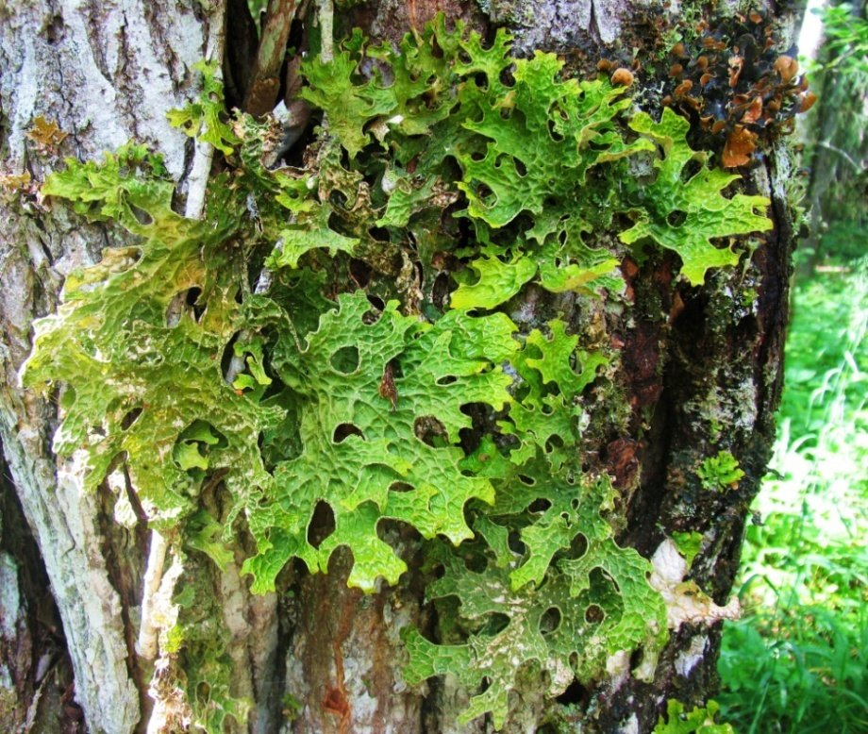
The relevance of research
Lobaria pulmonaria (L.) Hoffm.:
large epiphytic cyanolichen, which widespread in the Holarctic and beyond it;
extremely sensitive to any type of anthropogenic impact;
in temperate climates is related to old-growth forests;
regarded as indicator of ecological continuity of habitat.

Slide 3
The aim:
to study of the long-term dynamics of coenotic populations of Lobaria pulmonaria in forest communities of Karelia with different anthropogenic load.

Slide 4
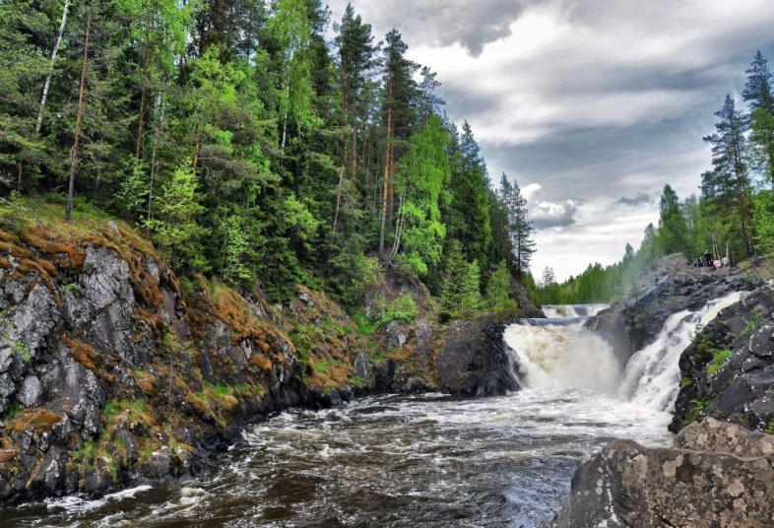
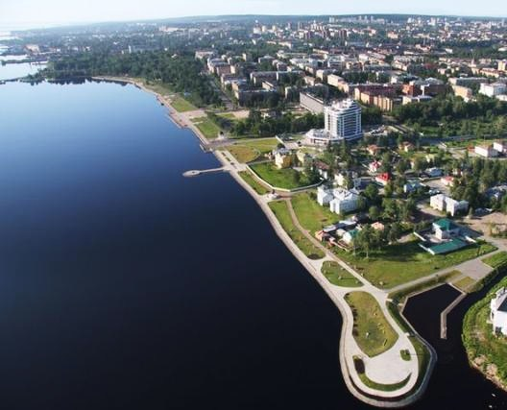
The research areas
«Kivach» reserve
Nature Reserve «Kivach»
Lake Onega
«Zaozersky» reserve
Petrozavodsk
Petrozavodsk city

Slide 5
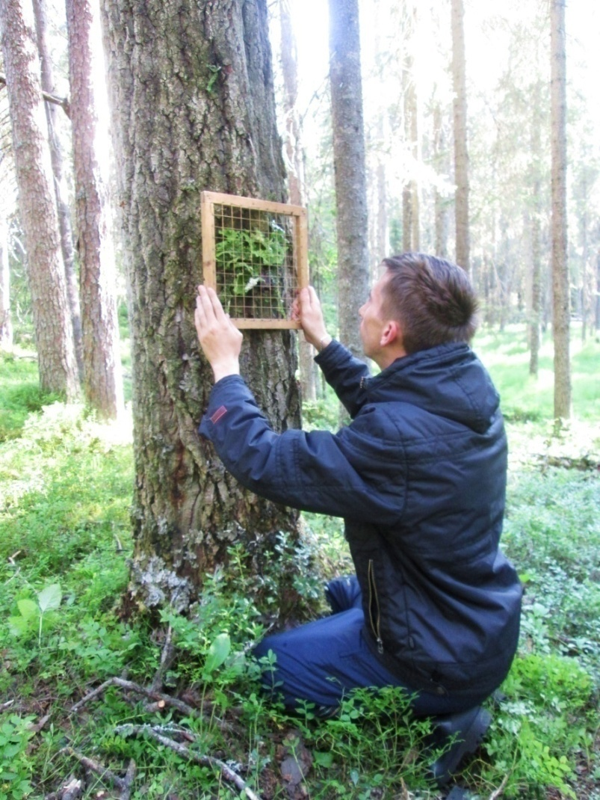
Methods
Research of cenopopulations of the Lobaria pulmonaria were carried out by the route method using express descriptions in the growing periods in 2012 and 2016.
At the habitat of the species, community characteristics (type of forest, crown density, basal area), tree parameters (species, age, height, trunk diameter at the base and at a height of 130 cm) were recorded as well as characteristics of microhabitats (trunk exposure, height above the soil surface, angle of trunk inclination).
For each thallus of Lobaria pulmonaria, using the 25 × 25 cm frame were determinated:
- the total area and area of necrosis (cm²),
- belonging to the functional age group according to the method of I. N. Mikhailova (2005): sterile, hyposorediotic, mesosorediotic, hypersorediotic, fertile, senile, senile.
- functional-age groups were matched to ontogenetic states (Ignatenko, 2018).

Slide 6
Table 1. The main characteristics of the forest communities
Forest type | Stand tree formula | Basal area, m²gа⁻¹ | Share of aspen in the stand, % | Crown density, %
The Petrozavodsk city
Wet spruce forest Vaccinium myrtillus – green mosses type | 4S3A3B | 40 | 29 | 71
Spruce forest Vaccinium myrtillus – green mosses type | 4S4A2B | 21 | 41 | 48
Mixed aspen-spruce forest Calamagrostis arundinacea – Vaccinium myrtillus type | 6A4S | 30 | 55 | 60
The «Zaozersky» reserve
Spruce forest Vaccinium myrtillus – green mosses type | 5S3A1B1P | 23 | 27 | 55
The «Kivach» reserve
Spruce forest Oxalis acetosella– green mosses type | 6S3A1B | 21 | 33 | 65
Wet spruce forest Vaccinium myrtillus – green mosses type | 9S1B | 23 | 4 | 40
Spruce forest Vaccinium myrtillus – green mosses type | 7S2A1B | 24 | 21 | 40
Mixed aspen-spruce forest Calamagrostis arundinacea – Vaccinium myrtillus type | 5S3A1B1W | 14 | 30 | 45

Slide 7
Results Table 2. Substrates of Lobaria pulmonaria in research areas
Substrates | Number of trunks | Number of thalli
 |  | in 2012 | in 2016
Petrozavodsk
Populus tremula (living) | 9 | 14 | 17
«Zaozersky» reserve
Populus tremula (living) | 13 | 50 | 44
Populus tremula (lying deadwood) | 1 | 4 | 4
Salix caprea (living) | 1 | 2 | 3
Sorbus aucuparia (living) | 1 | 8 | 6
«Kivach» reserve
Populus tremula (living) | 7 | 67 | 105
Populus tremula (standing deadwood) | 1 | 21 | 14
Populus tremula (lying deadwood) | 1 | 4 | 4
Salix caprea (living) | 1 | 8 | 8
Salix caprea (lying deadwood) | 1 | 12 | 15

Slide 8
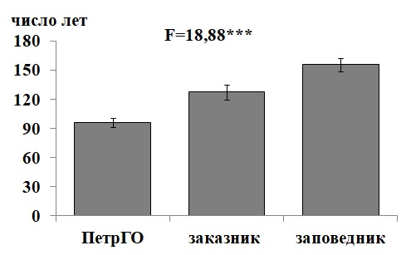
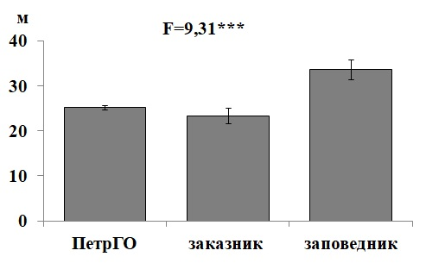
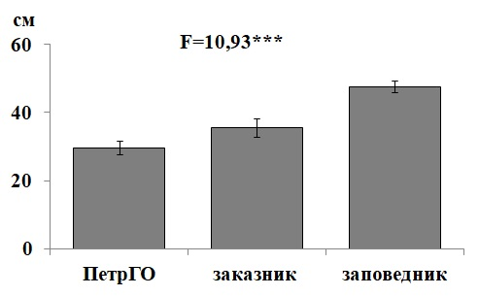
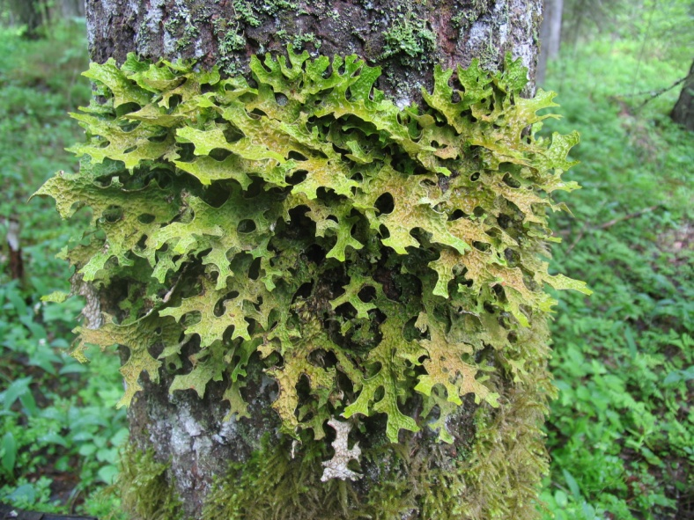
Parameters of Populus tremula trees, colonized by Lobaria pulmonaria in research areas
years
Tree age
Tree height
m
Petrozavodsk Zaozersky Kivach
Petrozavodsk Zaozersky Kivach
Tree diameter
(at a height of 1.3 m above ground level)
cm
Petrozavodsk Zaozersky Kivach

Slide 9
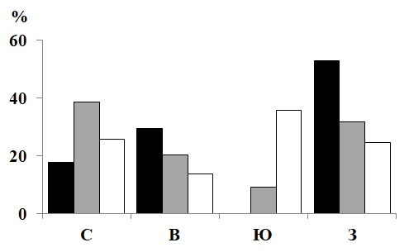
Characteristic of microhabitats
2012
2016
N E S W
N E S W
Exposure of Populus tremula trunk
Note: black column –Petrozavodsk;
gray column –Reserve «Zaozersky»;
white column –Reserve «Kivach»

Slide 10
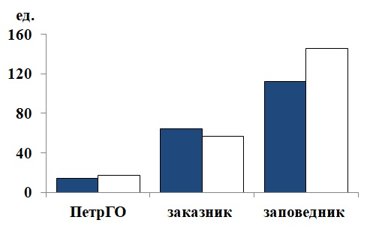
Number of Lobaria pulmonaria thalli in research areas
number of thalli
2016
2012
2012
2016
2012
2016
Petrozavodsk Zaozersky Kivach

Slide 11
Number of Lobaria pulmonaria thalli
number of thalli
new
dead
dead
new
new
dead
Petrozavodsk Zaozersky Kivach

Slide 12
The ontogenetic spectrum of Lobaria pulmonaria coenopopulations in Petrozavodsk
black column – 2012; gray column – 2016
Stages of ontogenesis:
v1 – virgin, v2a – virgin 2a, v2b – virgin 2b, v2c – virgin 2c,
g – generative, ss – sub-senile, s – senile

Slide 13
The ontogenetic spectrum of Lobaria pulmonaria coenopopulations in «Zaozersky» Reserve
black column – 2012; gray column – 2016
Stages of ontogenesis:
v1 – virgin, v2a – virgin 2a, v2b – virgin 2b, v2c – virgin 2c,
g – generative, ss – sub-senile, s – senile

Slide 14
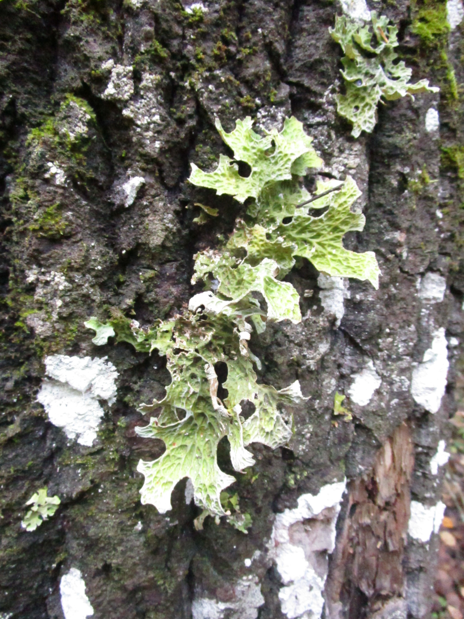
The «Zaozersky» Reserve
2012
2016
virgin 2a thallus
thallus
sub-senile

Slide 15
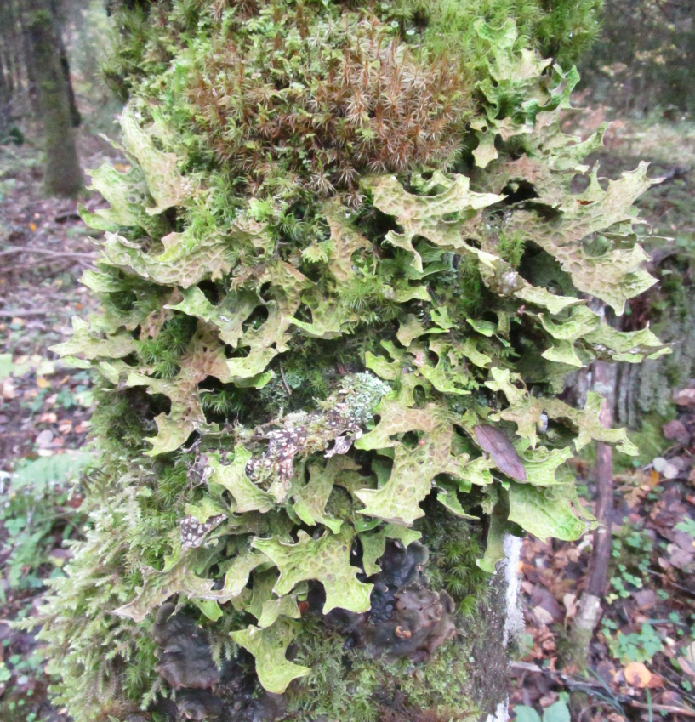
The «Zaozersky» Reserve
2012
2016
sub-senile thallus
generative thallus

Slide 16
The ontogenetic spectrum of Lobaria pulmonaria coenopopulations in «Kivach» Reserve
black column – 2012; gray column – 2016
Stages of ontogenesis:
v1 – virgin, v2a – virgin 2a, v2b – virgin 2b, v2c – virgin 2c,
g – generative, ss – sub-senile, s – senile

Slide 17
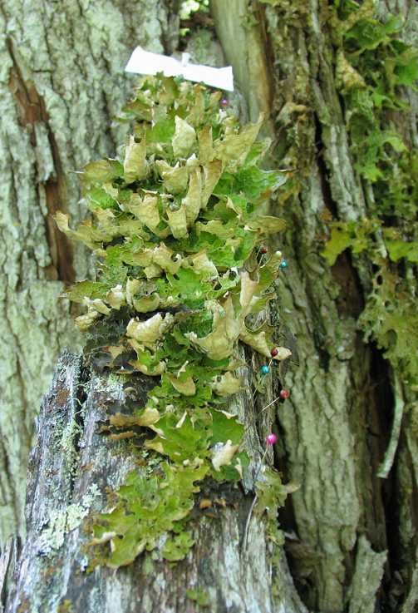
The «Kivach» Reserve
The thalli on trunk of Salix caprea
2012
2016
12 thalli, total area 80 cm²
one functional individual,
total area 338 cm²

Slide 18
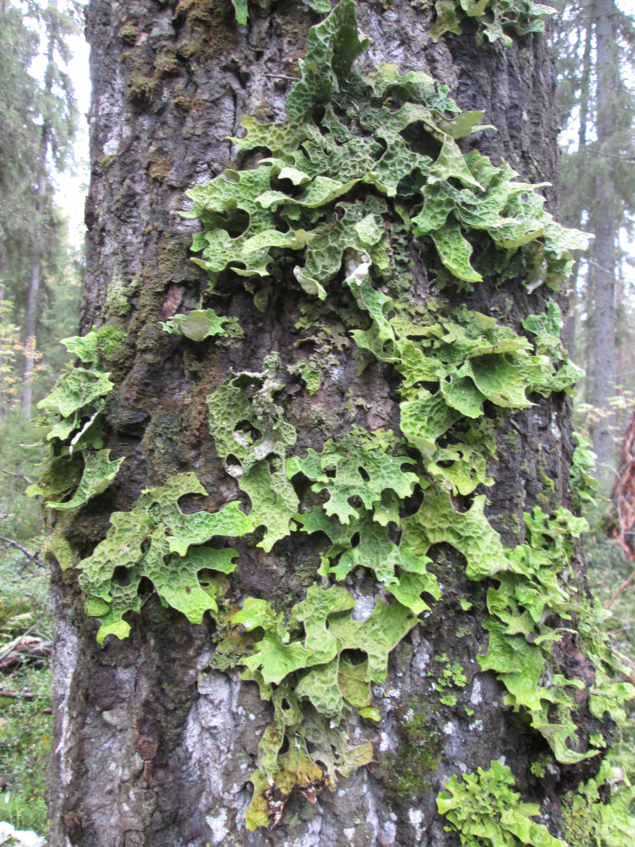
The «Kivach» Reserve
2012
2016
thallus area 587 cm² ; sub-senile
thallus area 806 cm² ; generative

Slide 19
The «Kivach» Reserve
2012
2016
Virgin thalli
dead thalli

Slide 20
The average area of thalli in research areas
cm²
2012
2016
2016
2012
2012
2016
Petrozavodsk Zaozersky Kivach

Slide 21
The area of necrosis of thalli in research areas
cm²
2012
2016
2016
2012
2012
2016
Petrozavodsk Zaozersky Kivach
Note: white column – 2012 (F=13,32***); gray column – 2016 (F=16,41***)

Slide 22
Conclusions
According to results of long-term monitoring (4-yrs) of Lobaria pumonaria coenopopuations are characterized by a high degree of dynamism associated with the processes of growth, development and reproduction;
in undisturbed forest communities («Kivach» Reserve) Lobaria pulmonaria coenopopuations have parameters of normal population (presence of all ontogenetic stages, prevalence of young thalli, appearing high amount of new individuals);
in forest communities with weak anthropogenic load (“Zaozersky” Reserve) Lobaria pulmonaria coenopopuations are getting old (presence of all ontogenetic stages, but proportion of young thalli decrease, more thalli die than appeared);
in the city forest communities with middle level of impact, significant changes in the ontogenetic spectrum of Lobaria pulmonaria coenopopulations were not recorded (regressive, incomplete spectrum, with a predominance of old thalli).

Slide 23
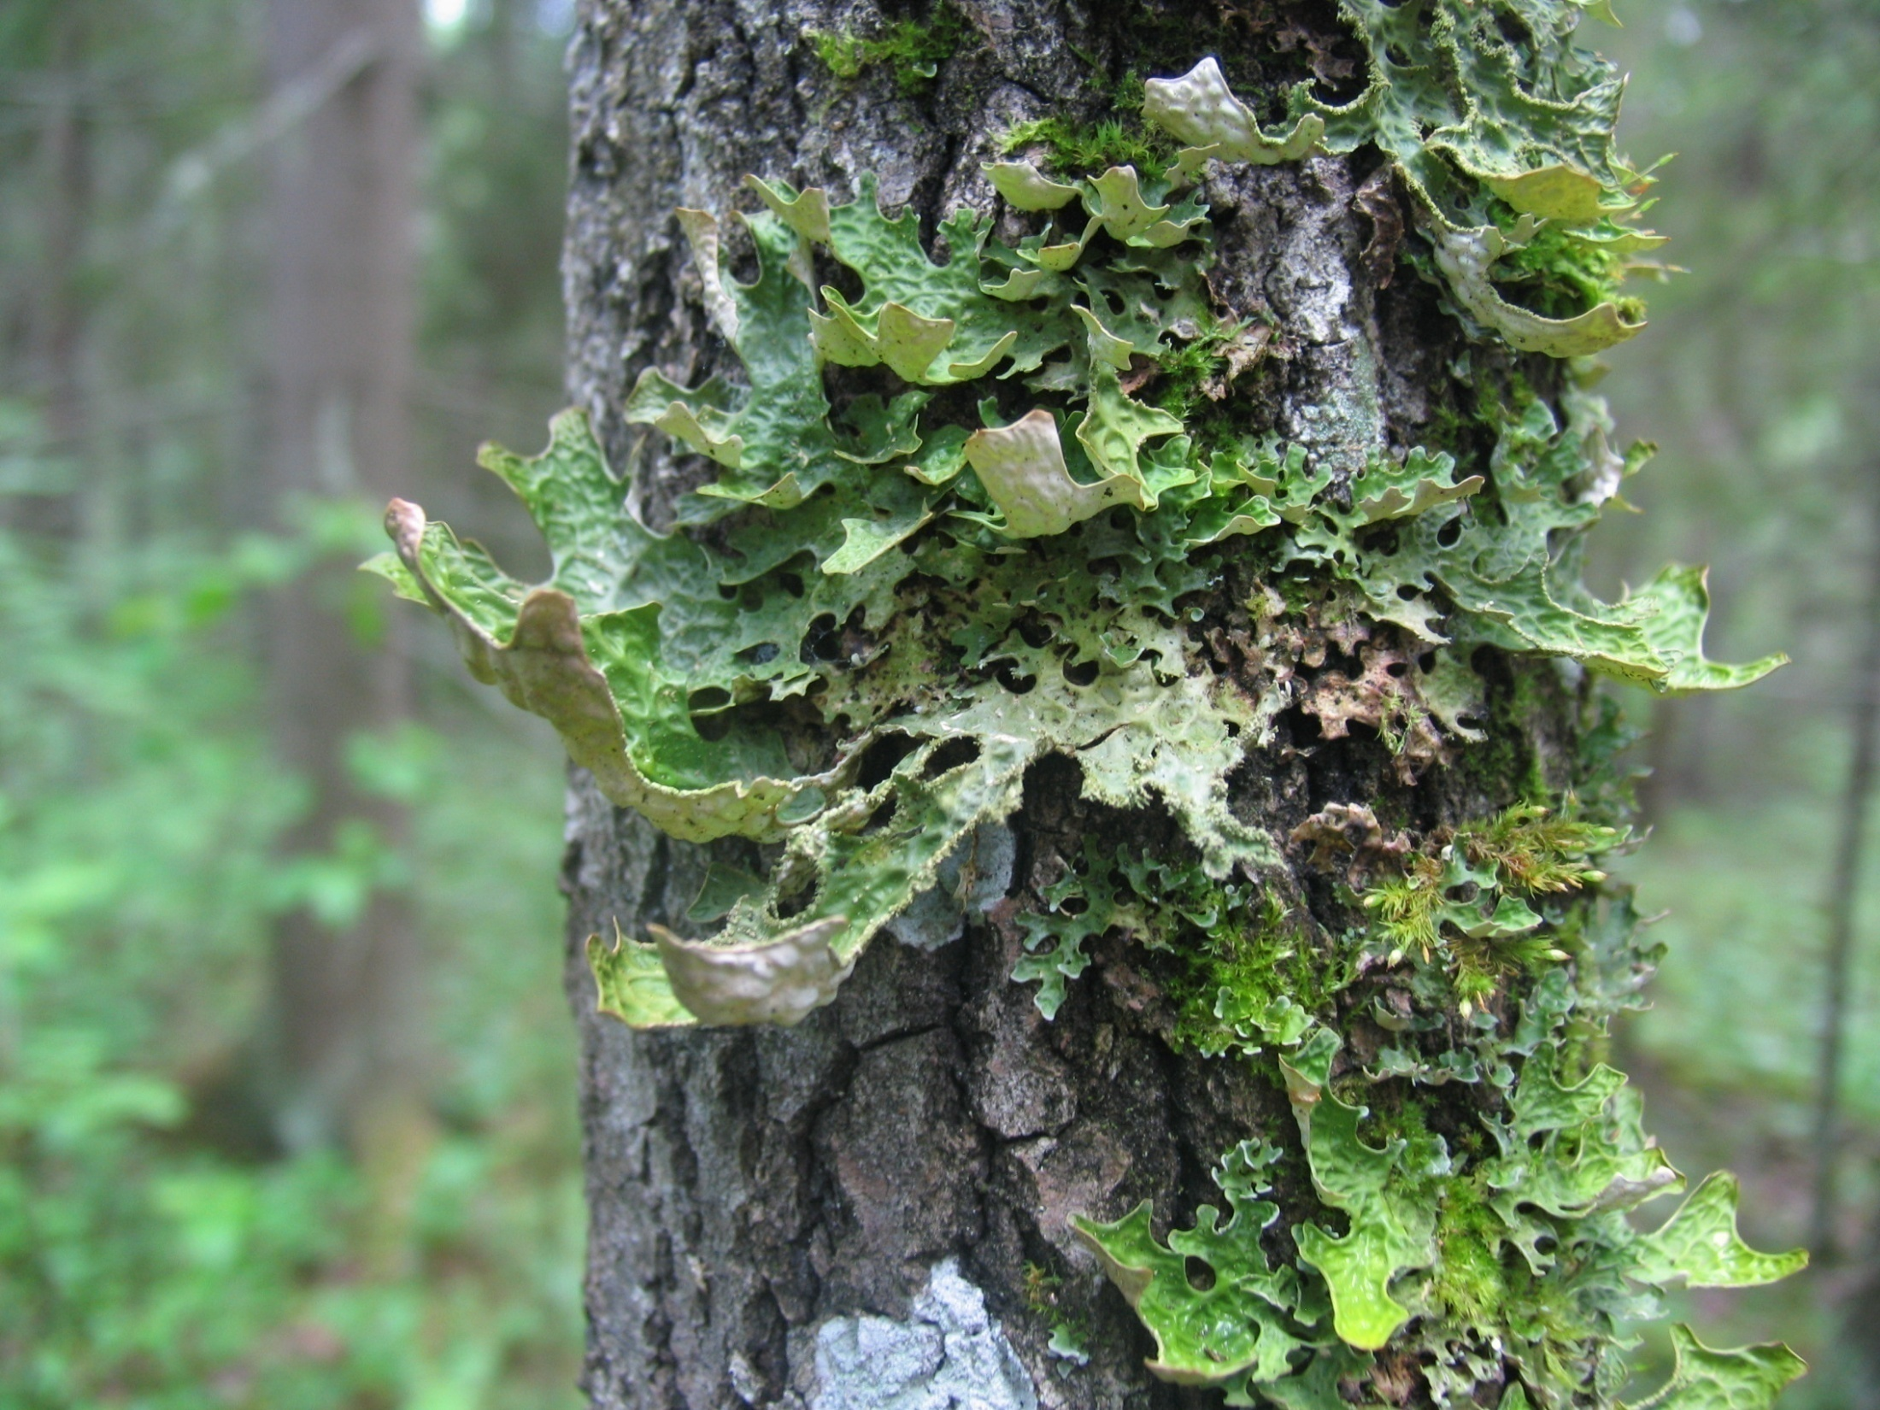
Thanks for attention!

