Slide 1
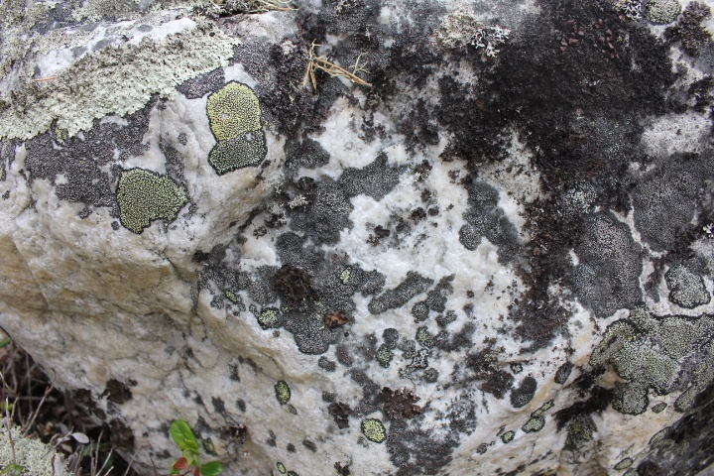
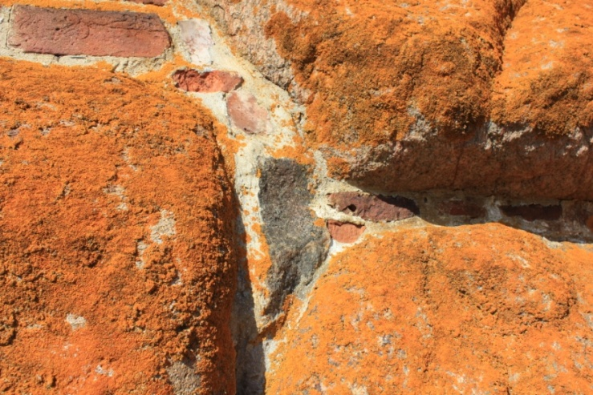
International conference Lichens: from molecules to ecosystems
Round table discussions: lichenology and education
Syktyvkar, 2019

Slide 2
Problems for discussion
Possibilities to involve the course “Lichenology” into educational programs of the different levels (school, higher education, public organizations, lichenology in mass-media).
Studying forms at different levels.

Slide 3
School level
Scientific specialization of teacher.
Invitation of the specialistsPossibilities to involve the course “Lichenology” into educational programs of the different levels (school, higher education, public organizations, lichenology in mass-media).
Studying forms on the different levels.

