Slide 1
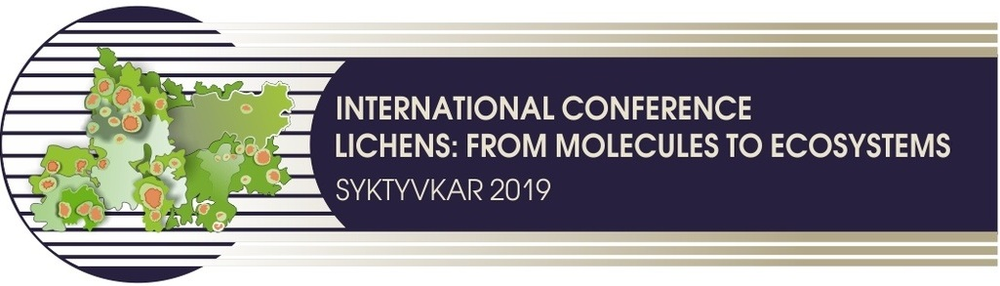
FUNCTIONAL BIOLOGY AND ECOLOGY
OF LICHENS IN THE TAIGA ZONE
OF EUROPIAN NORTH-EAST OF RUSSIA (KOMI REPUBLIC)
Tamara K.Golovko, prof.
E-mail: golovko@ib.komisc.ru
Institute of Biology, Komi Scientific Centre, Ural Branch of RAS,
Laboratory of Ecological Plant Physiology
Syktyvkar, Russia

Slide 2
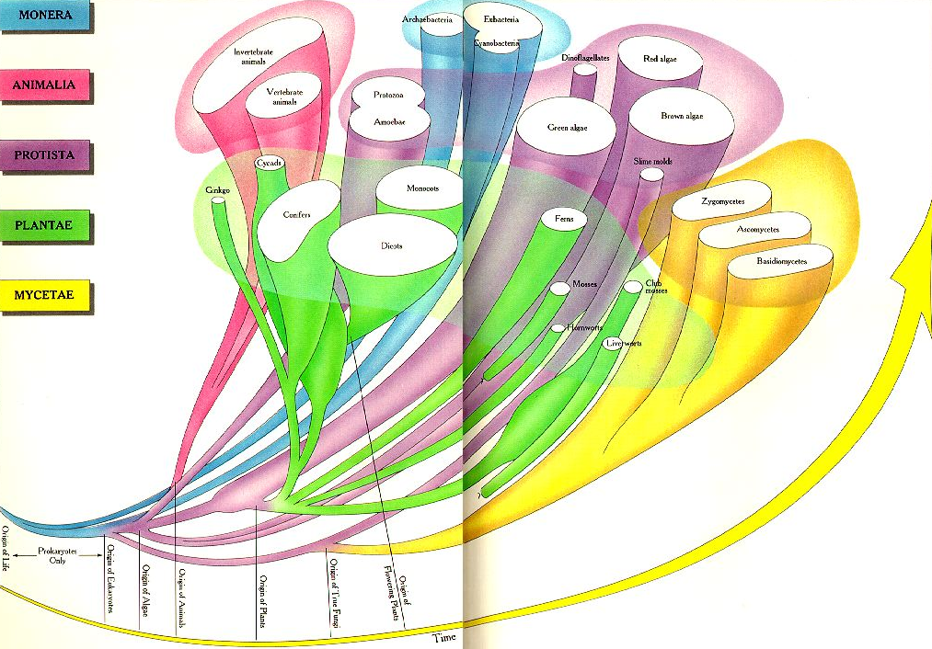

Lichens are ancient symbiotic organisms
Lichens
≈ 400 million years ago

Slide 3
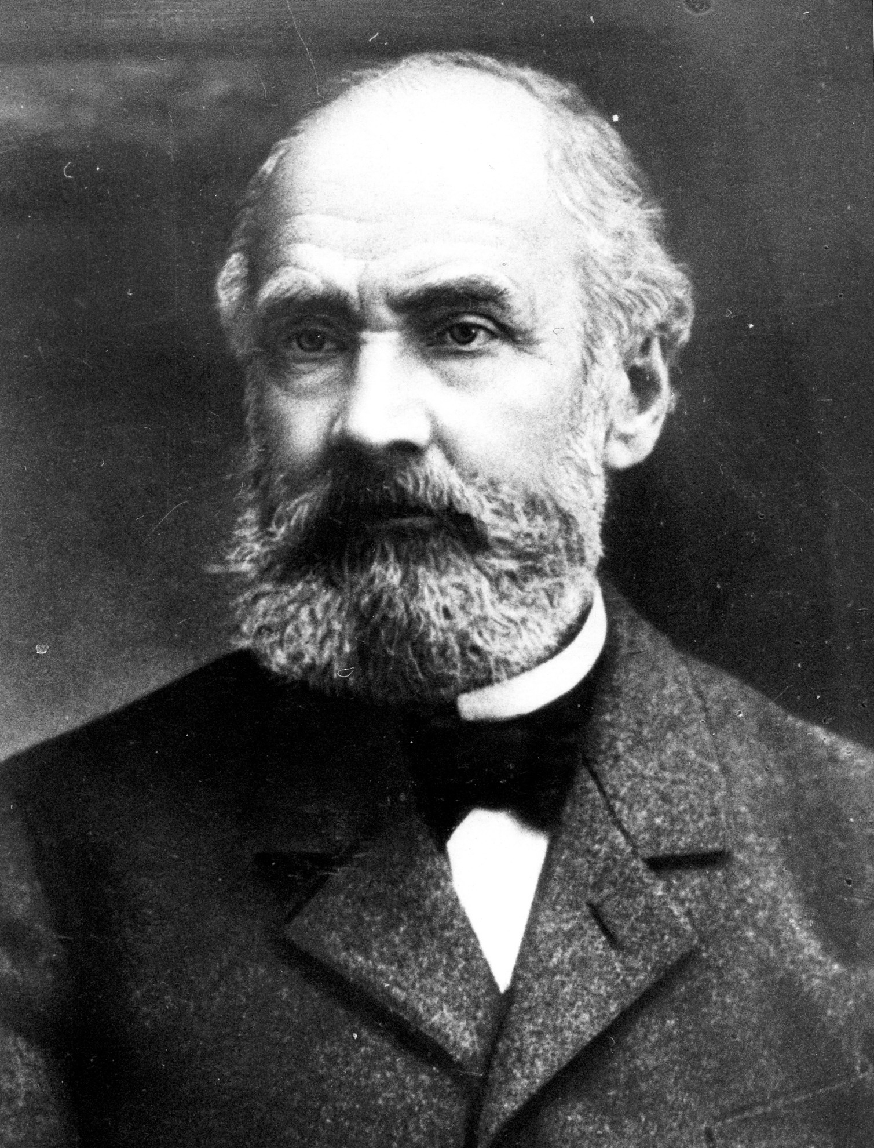
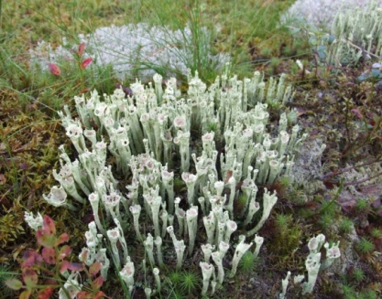
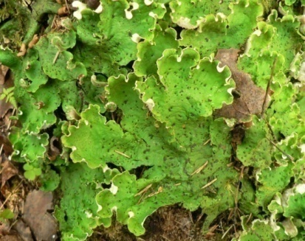
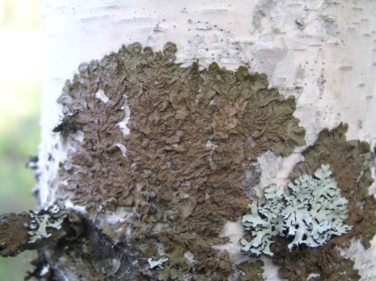
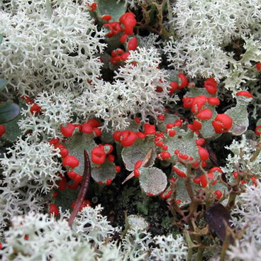
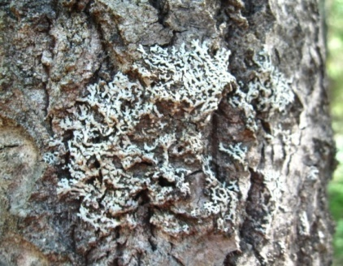
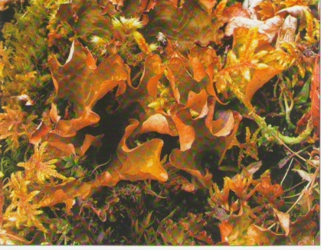
The synthesis of lichens is the first directly observed fact, which proves the origin of more complex forms via combination and interaction of simpler ones. It is the first irrefutable proof of the theory of organisms’ evolution.
А.S. Famintsyn
(1835-1918)

Slide 4
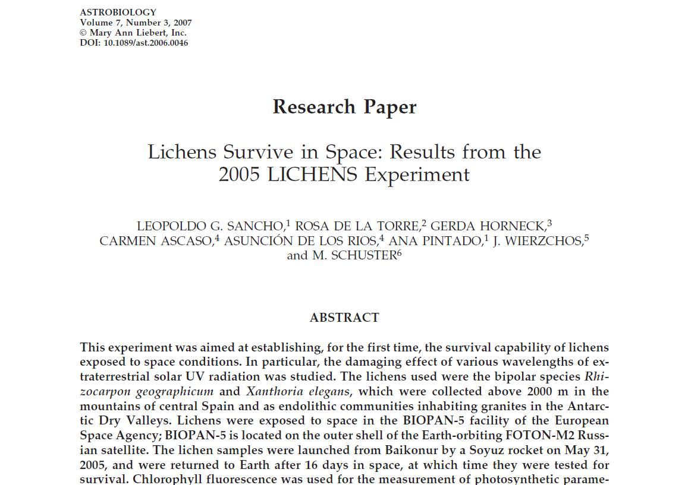
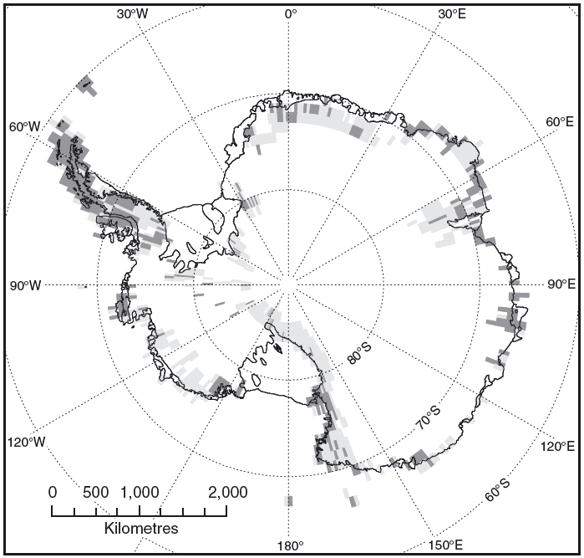
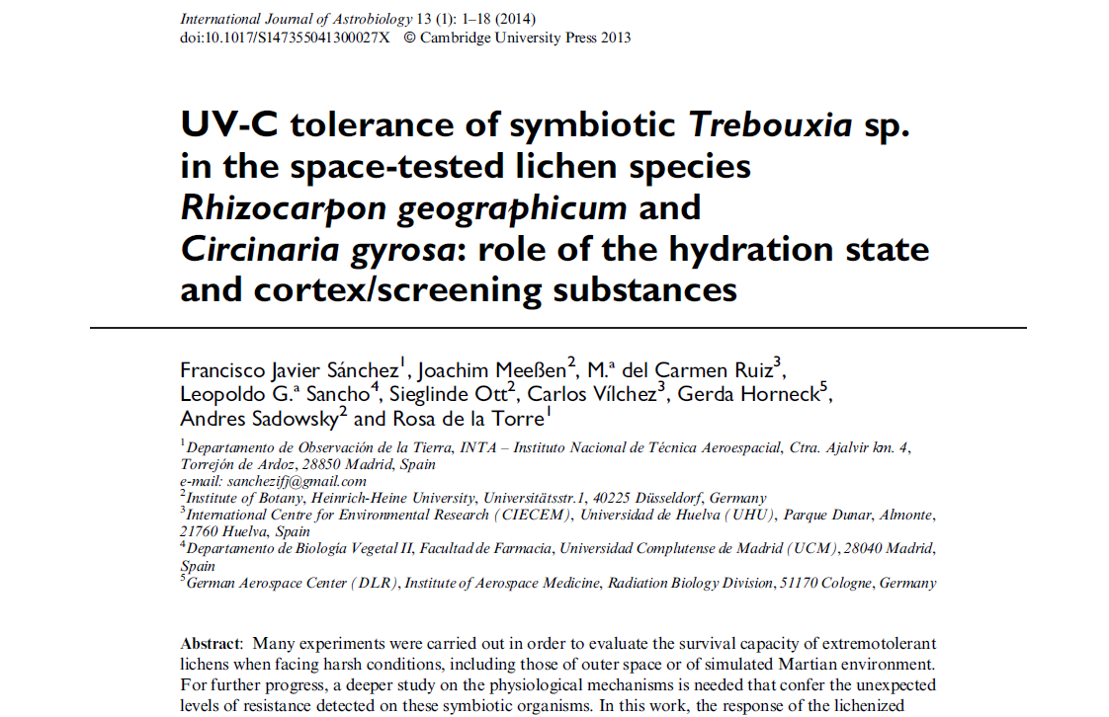
Lichens are poikilohydric photoautotrophs and able
to exist in extreme conditions
Lichens survive after being in outer space
Lichens occupy a dominant position in the flora of Antarctica

Slide 5
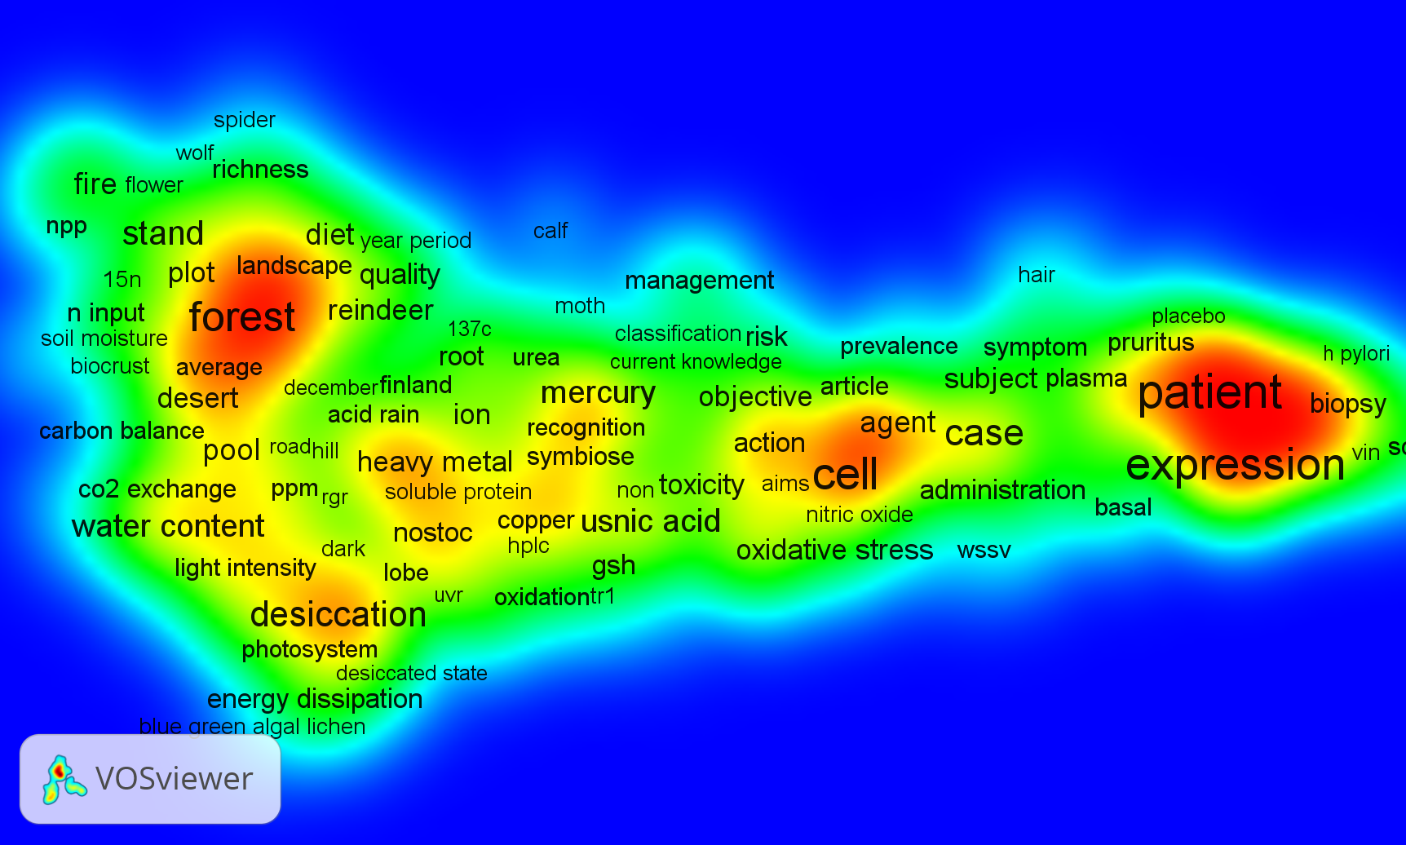
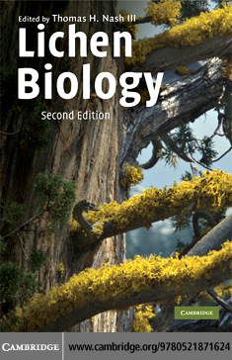
Modern directions in the studies of
lichen biology and ecology
Ecology (lichen-indications)
CO2 -gas exchange
Products of secondary metabolism
Biotechnology
Biomedicine

Slide 6
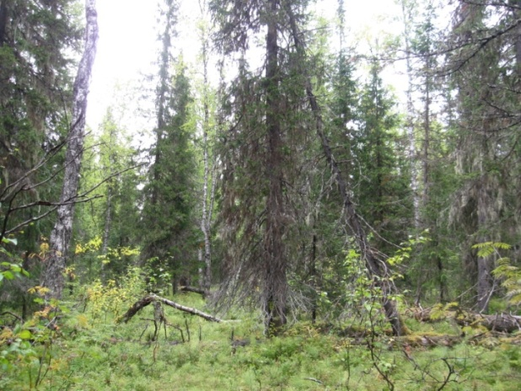
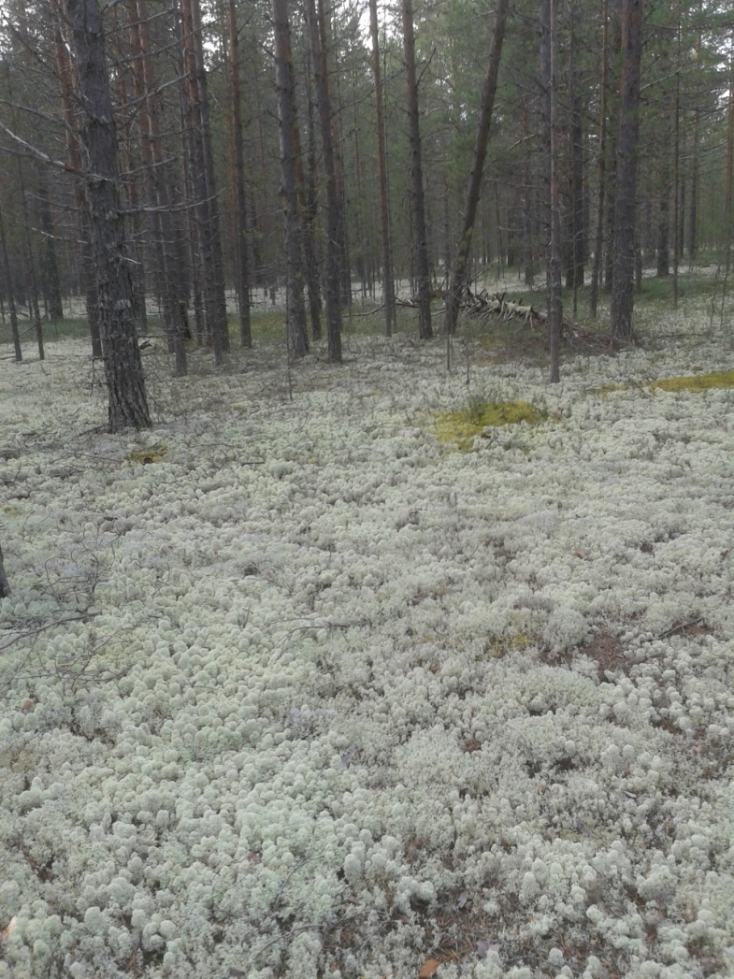
FORESTS OF TAIGA ZONE
The rich lichen flora in taiga forests demonstrates that this habitat has favorable conditions for its life.
Epiphytes dominate in the boreal zone (60% of the total number of species). Amount of lichens living on dead wood is 20%. In pine forests they are part of the moss-lichen layer.

Slide 7
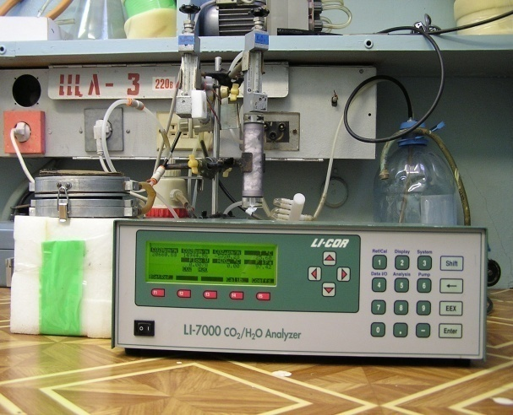
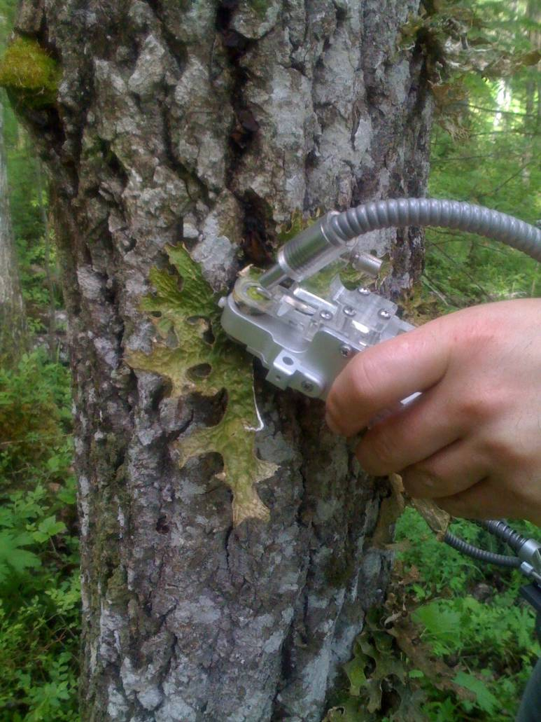
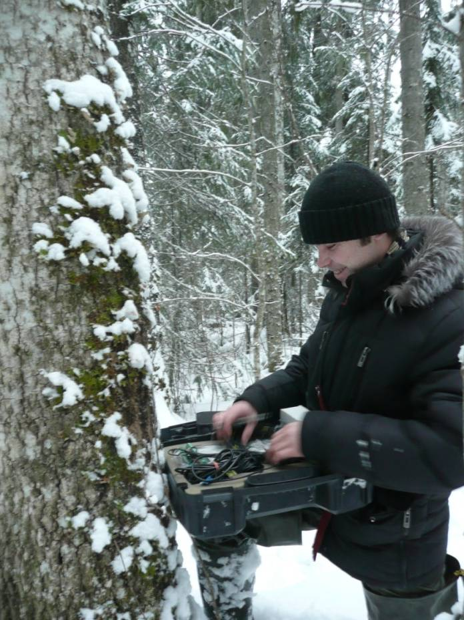
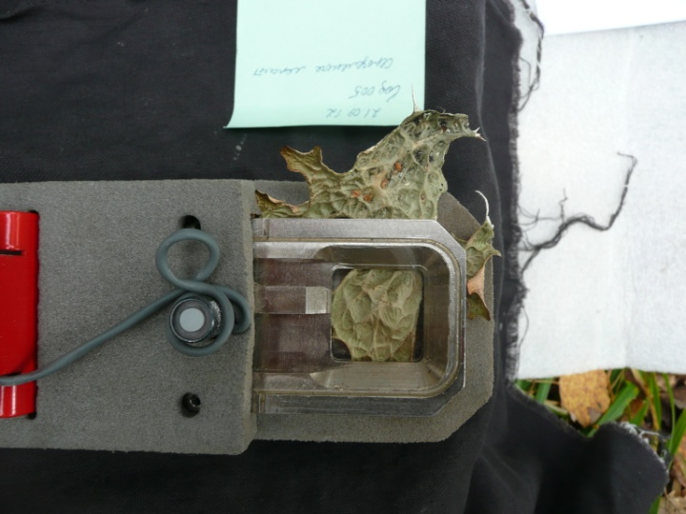
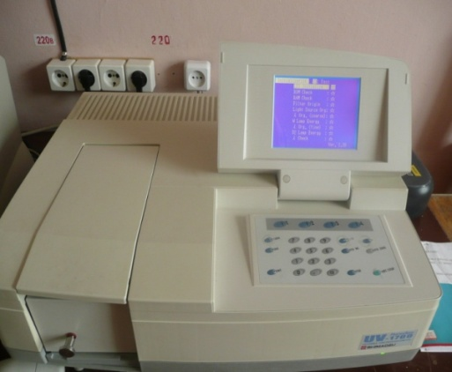
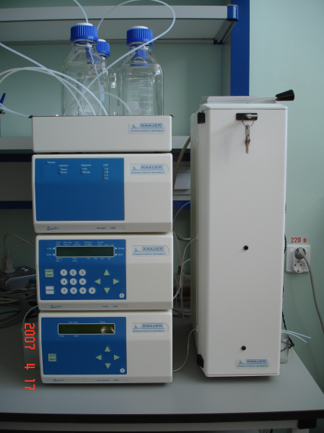
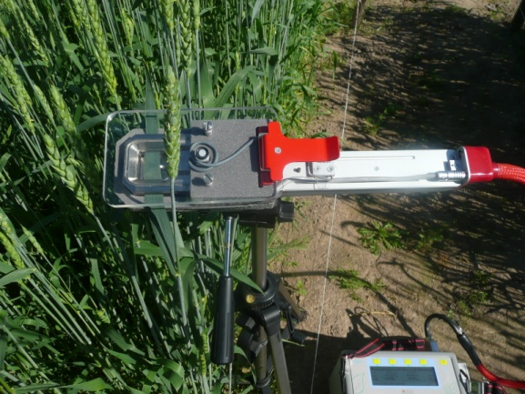
Our main goal was to study the functional activity of lichens, their reactions to light, temperature, humidity, ultraviolet radiation and environmental pollution.
For this purpose we used modern physical and chemical methods and approaches.
We based on the idea that the constitutive mechanisms of the maintain of structural and functional integrity and the inducible mechanisms of damage repair are the basis of high stability of lichens.
We took into account that lichens are an autotrophic association in which the share of photobiont, providing the fungus with organic carbon, make up 5-10% of the thallus biomass.
Much of the data was collected in the field, and the other was generated from laboratory experiments.
LI-7000 (USA)
PAM-2100 (Germany)
LI-1400 (USA)
ADC Lcpro+ (UK)
UV-1700 (Japan)
HLPC

Slide 8
Chlorophyll а content (mg/g DW) in thalli of different lichen species
1 - Cetraria islandica, 2- Cladonia rangiferina, 3 - Cladonia stellaris, 4 - Cladonia sulphuzina, 5 - Evernia mesomorpha, 6 - Hypogimnia physodes, 7 - Lobaria pulmonaria, 8 - Parmelia sulcata, 9 - Peltigera aphthosa, 10 - Peltigera canina, 11 - Peltigera leucophlebia, 12 - Peltigera malacea, 13 - Peltigera membranacea, 14 - Peltigera neopolydactila, 15 - Peltigera ponojensis, 16 - Peltigera praetextata, 17 - Peltigera rufesсens, 18 - Peltigera scarbosa, 19 - Platismatia glauca, 20 - Stereocaulon condensatum, 21 - Usnea hirta

Slide 9
Light dependence of СО₂-exchange rate (µmol/m²s)
in the hydrated thalli of the foliose lichens

Slide 10
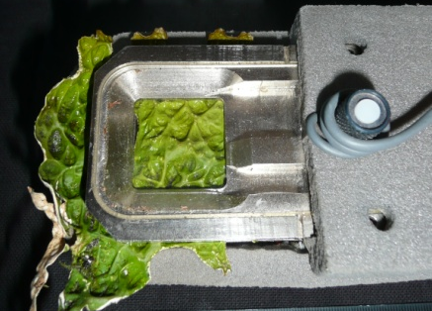
Lobaria pulmonaria СО₂-exchange rate at different light intensities
Lobaria pulmonaria
tg α = 0.046
LCP (СКП)= 20 µmol /m²s (PAR)
IRA(ИРП) = 55-65 µmol /m²s (PAR)
Pn _{IRA} = 2.2 µmol СО₂/ m²s

Slide 11
Light dependence of photochemical (qP) and nonphotochemical quenching (qN) in Lobaria pulmonaria thalli
qN
qP and qN
qP
PAR, µmol /m²s

Slide 12
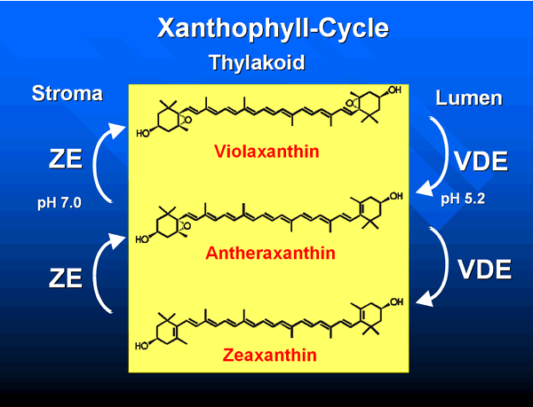
Conversion state of xanthophyll cycle pigments (DEPS,%)
in Lobaria pulmonaria thalli

Slide 13
Response of net –photosynthesis and dark respiration rate of Peltigera aphthosa, P. rufescens and Cladonia stellaris to the relative water content
(data were generated under laboratory conditions)
Peltigera aphthosa
Peltigera rufescens
1.5
1.5
1.0
1.0
0.5
Pn, Rd, mg СО₂/ g DW h
Pn, Rd, mg СО₂/ g DW h
0.5
0
0
20
40
60
80
100
20
40
60
80
100
-0.5
-0.5
-1.0
RWC, %
RWC, %
Сladonia stellaris
RWC= [(M_{FW} -M_{DW})/(M_{FWS} -M_{DW})]· 100%
1.5
1.0
Pn, Rd, mg СО₂/ g DW h
0.5
0
20
40
60
80
100
-0.5
WC, %

Slide 14
Daily СО₂-exchange rate (А) and maximum quantum yield (B) of
Lobaria pulmonaria thalli in its habitat (June)
1 – Net-uptake СО₂, 2 – Dark respiration
1
2

Slide 15
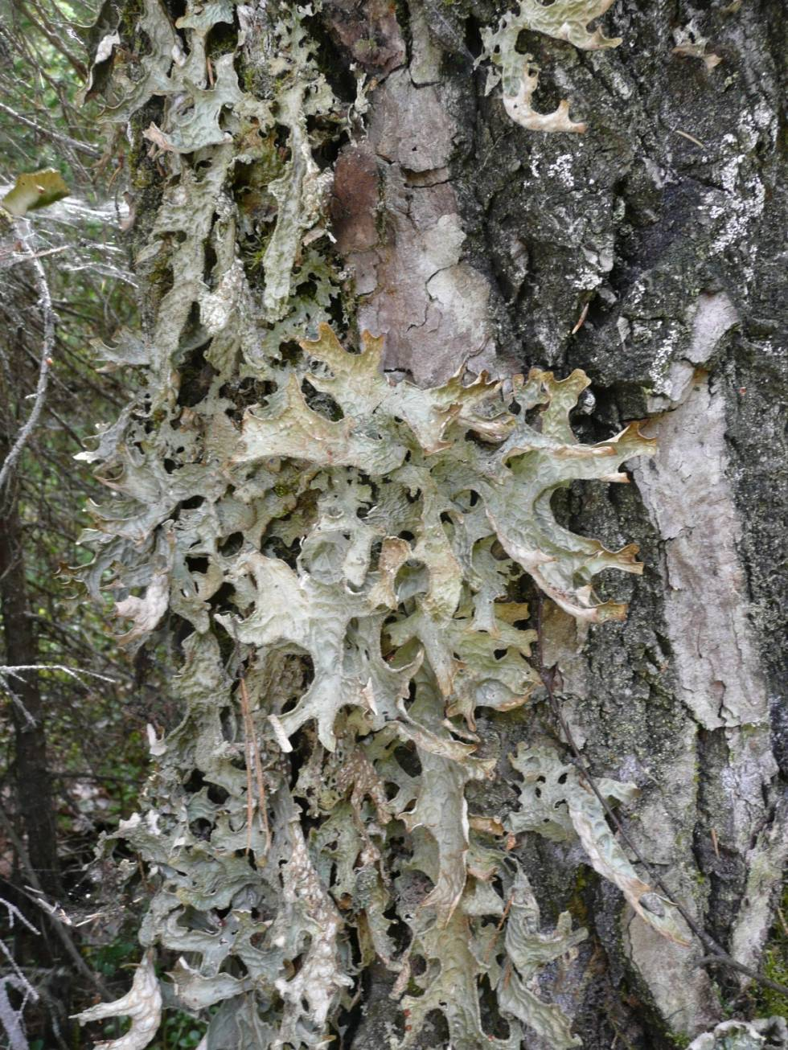
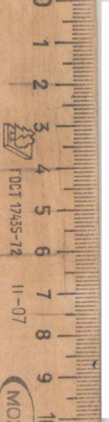
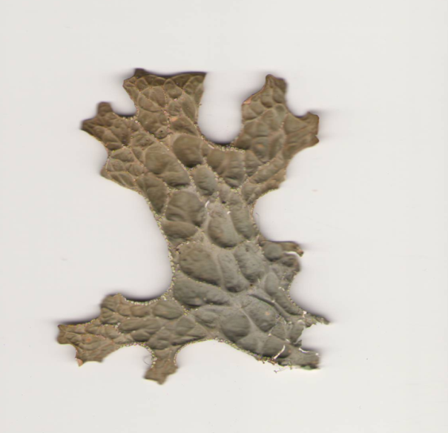
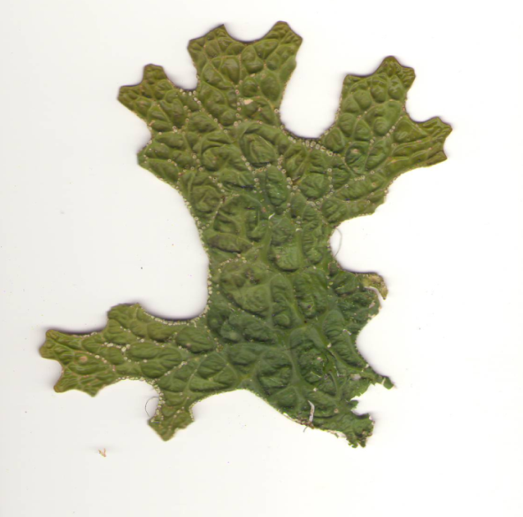
Lobaria pulmonaria thalli in the state of desiccation and hydration
- Н₂О
+ Н₂О
In hydrated thalli upper cortex layer is elastic and provides good light transmission to the algal layer, which gives the thallus a green color.
Desiccation makes the thallus grey in color.

Slide 16
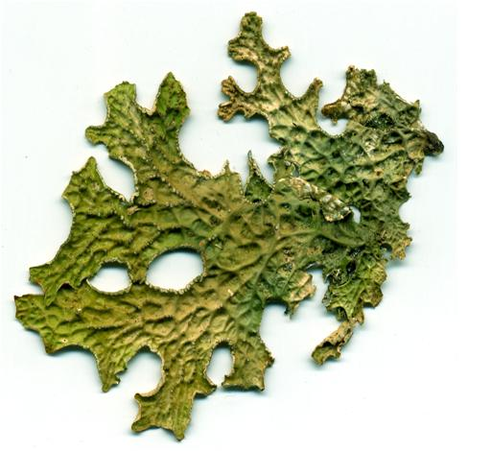
Daily changes of 43 и 40 kDa dehydrines in Lobaria thalli (June)
12 h
12 h
7 h
7 h
22 h
22 h
Day time, h : 7, 12 , 22
Совместно с Н.Е. Коротаевой и
Г.Б. Боровским (СИФИБР)

Slide 17
Season changes of 43 и 40 kDa dehydrines in Lobaria thalli
Jan April Sept June

Slide 18
Chromatogram of trimethylsilyl derivatives of amino acids, carbohydrates and polyols isolated from Peltigera canina
amino acids
glycosides
of sugar alcohols
sugar alcohols
carbohydrates

Slide 19
Low-temperature fluorescence spectra of the short term (10 min) and long term (24 h) hydrated thalli, which were in air-dry state
during 60 days
PSI
PSII

Slide 20
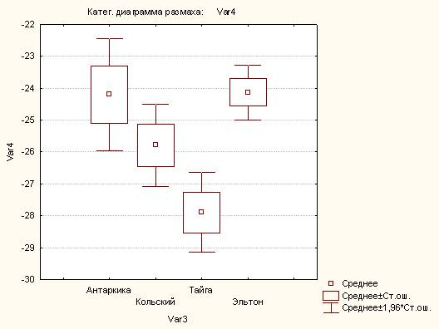
Content of δ¹³С ( ‰ ) in lichens from different regions
The magnitude of isotopic discrimination of carbon (δ13С, ‰) in biomass is a species-specific parameter.
^{The δ13С value depends on:}
^{resistances of} the CO2 diffusion on way to carboxylation centers,
the presence of CO2-concentrating mechanism in photobiont,
^{CO2 source,}
^{environmental conditions.}
Low light intensity affects photosynthesis and reduces δ13С ( it becomes more negative). The lack of moisture inhibits the assimilation and leads to increased δ13С.
The mean δ13C value in lichens of the taiga zone was about -28‰.
Antarctida (n=7)
Tajga zone (n=26)
Kola peninsula (n=10)
Lake El'ton (n=3)

Slide 21
Response of net –photosynthesis and dark respiration of Peltigera aphthosa, P. rufescens and Cladonia stellaris to thalli temperature
(data were generated under laboratory conditions)
0.8
Peltigera aphthosa
Peltigera rufescens
0.8
0.6
0.6
0.4
0.4
Pn, Rd, mg СО₂/ g FW h
0.2
0.2
Pn, Rd, mg СО₂/ g FW h
0
20
30
40
0
10
20
10
30
40
-0.2
-0.2
-0.4
-0.4
-0.6
Temperature, ºC
-0.6
Temperature, ºC
0.8
Сladonia stellaris
0.6
0.4
0.2
Pn, Rd, mg СО₂/ g FW h
0
10
20
30
40
-0.2
-0.4
-0.6
Temperature, ºC

Slide 22
Response of real quantum yield of photobionts of
three lichen species to temperature
1 - Lobaria pulmonaria, 2 - Hypogymnia physodes,
3 - Platismatia glauca
Yield
1 2 3
ºС
Measurements were performed on hydrated thalli under controlled
conditions at PAR intensity of 230 µmol/m²s

Slide 23
Response of net –photosynthesis and dark respiration of Peltigera aphthosa, P. rufescens and Cladonia stellaris to thalli temperature
(data were generated under laboratory conditions)
0.8
Peltigera aphthosa
Peltigera rufescens
0.8
0.6
0.6
0.4
0.4
Pn, Rd, mg СО₂/ g FW h
0.2
0.2
Pn, Rd, mg СО₂/ g FW h
0
20
30
40
0
10
20
10
30
40
-0.2
-0.2
-0.4
-0.4
-0.6
Temperature, ºC
-0.6
Temperature, ºC
0.8
Сladonia stellaris
0.6
0.4
0.2
Pn, Rd, mg СО₂/ g FW h
0
10
20
30
40
-0.2
-0.4
-0.6
Temperature, ºC

Slide 24
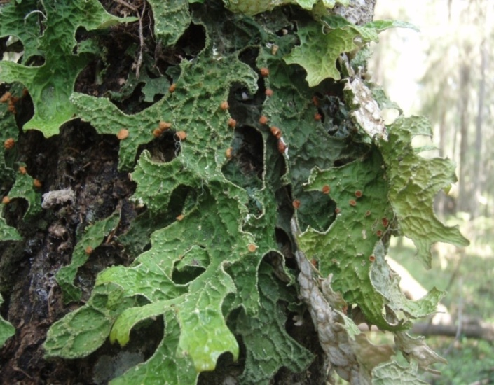
The effect of temperature on the total respiration rate (A) and the respiration pathway ratio (B) in Lobaria pulmonaria thalli
А
1400
1200
1000
nmol О₂ / g DW min.
800
600
400
200
В
0
100
5
10
25
35
45
50
80
Valt
Vres
Temperatura, °С
60
% total respiration
Vcyt
40
20
0
5
10
25
35
45
50
Temperature, °С

Slide 25
Recovery of the maximum photochemical efficiency (Fv/Fm)) and of CO2 net- uptake after the transfer of Lobaria thalli from
the natural habitat to room conditions (January)
A
Б
0,8
200 µmol /m²s
700 µmol /m²s
0,7
0,6
Fv/Fm
0,5
0,4
0,3
0
1
2
4
2
0
1 2 5 24 48
Time of acclimation, h

Slide 26
Maximum quantum yield of PSII (A), total respiration rate (B) and respiration pathway ratio (C) in Lobaria pulmonaria thalli after one-week exposure to low temperature
0.80
a
(А)
0.70
b
c
0.60
Fv/Fm
0.50
0.40
0.30
20
-
16
-
70 °С
(C)
700
a
(B)
100
600
a
80
500
Valt
400
60
Vres
Rd, nmol О₂ / g DW min
% total respiration
Vcyt
300
40
200
b
20
100
0
0
20
-
16
-
70
20
-
16
-
70
Temperature, °С

Slide 27
Season changes of water freezing in Lobaria thalli
(measured calorimetrically)
20.04.12
2.08.12
26.09.12
02.10.12
13.11.12
15.01.13
04.04.13
0
-2
-4
-6
Temperature, °С
-8
-10
-12

Slide 28
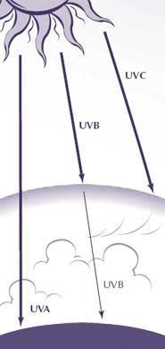
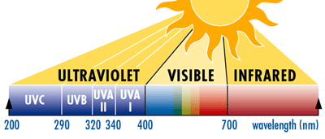
Ультрафиолетовое излучечие (ультрафиолет, УФ, UV) — электромагнитное излучение, занимающее диапазон между фиолетовой границей видимого излучения и рентгеновским излучением

Slide 29
The formation of melanin in the cortical layer of Lobaria lichen under the influence of UV-B radiation
The total dose of two-week UV-B radiation exposure was 62.4 kJ/m²

Slide 30
Maximum quantum yield, СО₂ net-uptake rate and photosynthetic pigment content in Lobaria pulmonaria thalli after two-week exposure to UV-B radiation
The total dose of two-week UV-B radiation exposure was 62.4 kJ/m²
(daily 2 W/ m² during 40 min)
СО₂-exchange, µmol /m²s
Pigments (Chl, Car),
mg/g DW
Fv/Fm
Измерения проведены на увлажненных талломах при интенсивности
ФАР ~ 180 мкмоль/м²с, t = 25 ºC
Control – k, 1 and 2 – UV-В radiation: 1 W/m² during 80 min and
2 W m² during 40 min (cumulative dose for 2 weeks - 62.4 кJ/m² )

Slide 31
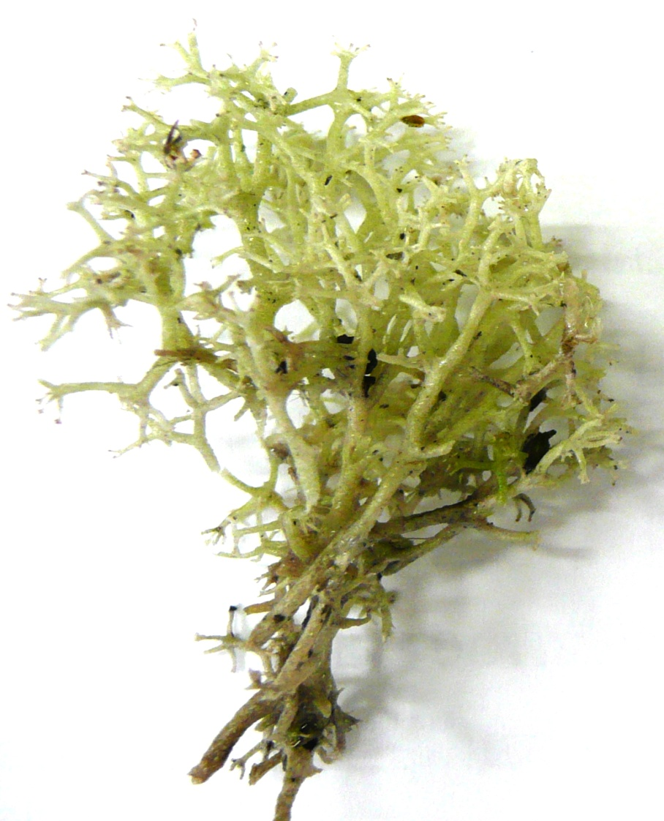
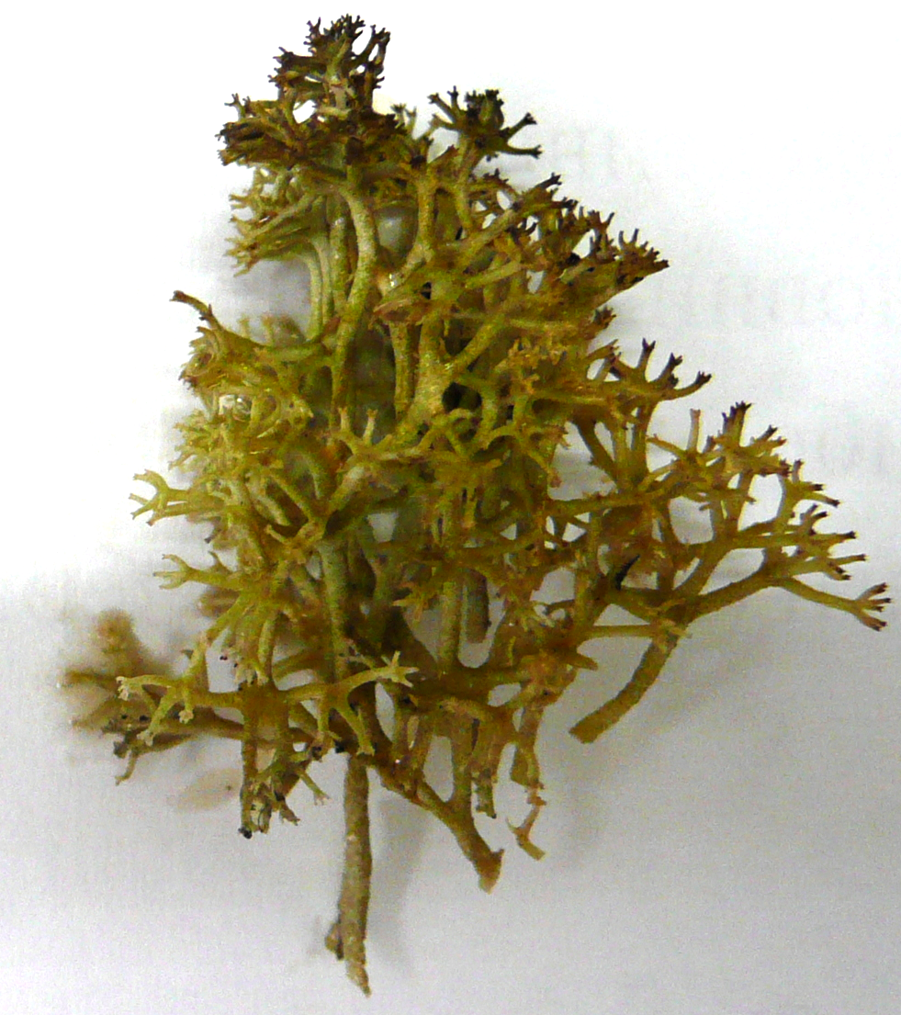
The visual indication of phenolic compounds in Cladonia stellaris thalli, treated with КОН after exposition to UV-B radiation
Control
Total dose UV-B radiation 144 kJ

Slide 32
Effect UV-B radiation on maximum quantum yield(Fv/Fm), minimal (Fo) and maximal (Fm) fluorescence chlorophyll, and non-photochemical quenchion (NPQ) in PS II of Cladonia stellaris photobiont
Fv/Fm
Fo, Fm
NPQ
1 2
3 4 1 2 3 4 1 2 3 4
1 – UV-B (0); 2 –UV-B (43 kJ); 3 –UV-B(144 kJ); 4 – 3 days after treatment

Slide 33
Effects UV-B radiation on the respiratory pathway ratio in Cladonia stellaris thalli
100
80
Valt
60
Vcyt, Valt, Vres,
% total respiration rate
Vres
40
Vcyt
20
0
1
2
3
4
1 – UV-B (0); 2 –UV-B (43 kJ); 3 –UV-B(144 kJ); 4 – 3 days after treatment

Slide 34
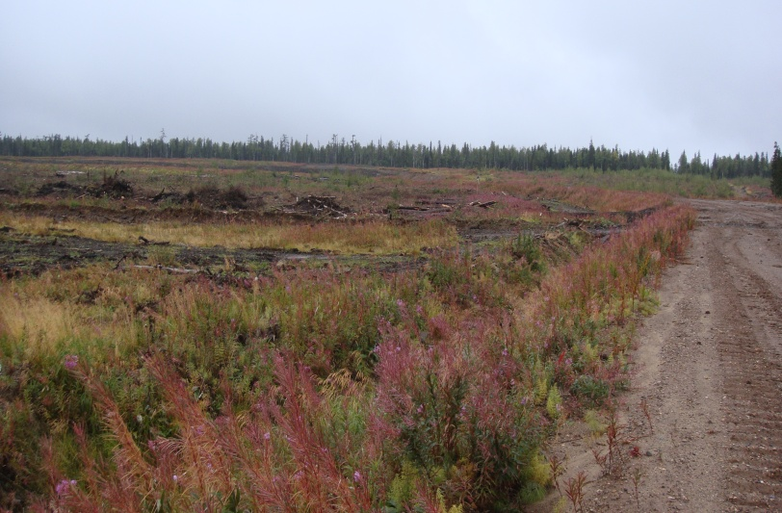
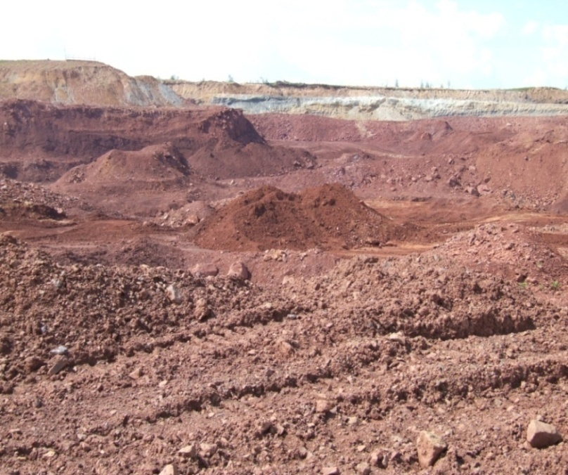
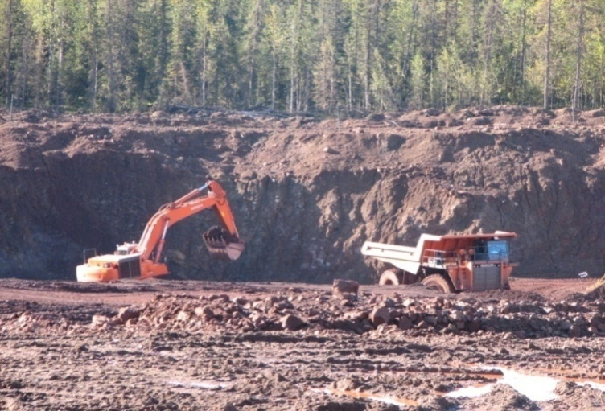
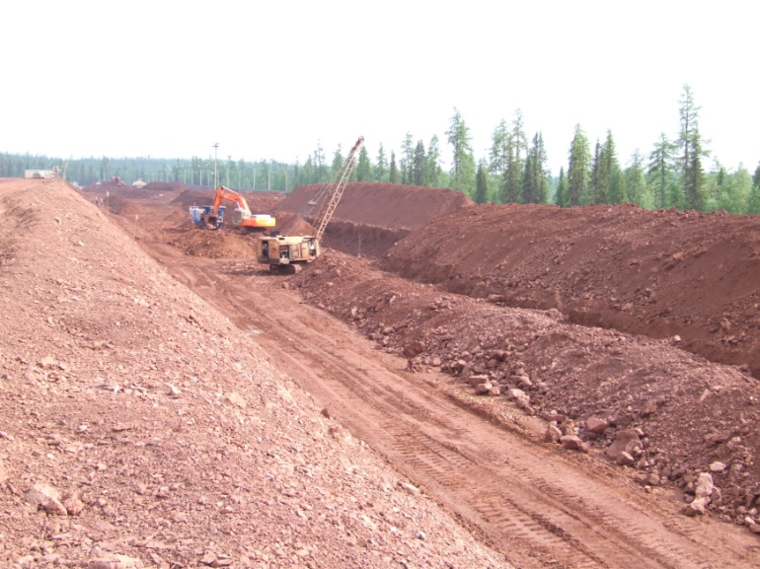
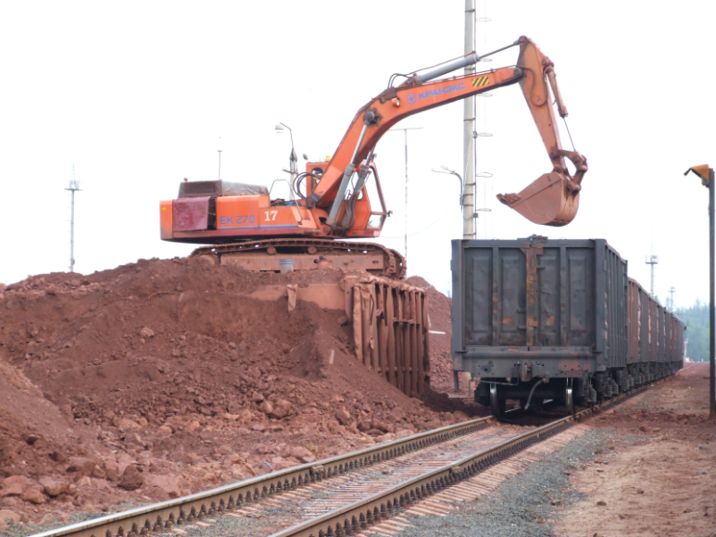
The Middle Timan Bauxite Deposit is the largest in Eurasia. Ore is mined by an open way for more than 20 years. There are oxides of aluminum, iron, silicon, heavy metals in the composition of bauxite dust .

Slide 35
Lipid peroxidation (TBC-RP) and superoxide dismutase (SOD) and guaiacol-peroxidase (GPX) activities in lichen thalli from areas with different levels of pollution by bauxite dust
Species | Site | TBC-RP , nmol/g DW | SOD, U/g protein | GPX, nmol G/ g protein min
Hypogimnia physodes | Relatively clean Low pollution High pollution | 34.95±3.06ª 47.07±4.80ª 73.88±8.79^{b} | 3.29±0.44ª 5.89±0.41^{b} 3.88±0.51^{ab} | 0.041±0.010ª 0.043±0.011ª -
Lobaria pulmonaria | Relatively clean Low pollution High pollution | 50.09±3.21ª 61.61±7.16^{ab} 74.96±6.82^{b} | 7.56±0.26ª 10.88±0.38^{b} 12.63±0.29^{c} | 0.036±0.002ª 0.083±0.002^{b} 0.225±0.005^{c}
Peltigera aphthosa | Relatively clean High pollution | 92.37±7.94ª 164.69±14.37^{b} | 6.24±0.30ª 9.07±0.15^{b} | 0.199±0.031ª 0.256±0.026ª

Slide 36
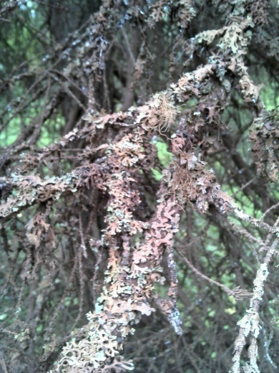
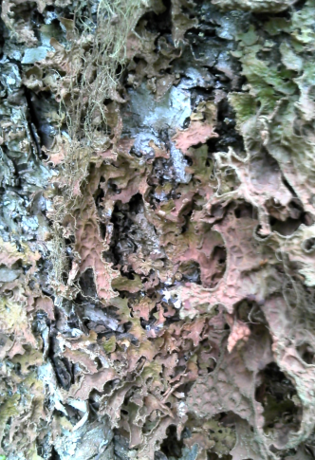
The effect of bauxite dust pollution on the total respiration rate and
respiration pathway ratio in lichens
Lobaria
pulmonaria
3000
c
Hypogymnia
physodes
b
2000
b
a
Rd, nmol О₂ / g DW min
a
a
1000
0
1
2
3
1
2
3
100
80
Valt
60
Vres
% total respiration
Vcyt
40
20
1 – Clean site
0
2 – Low pollution site
1
2
3
1
2
3
3 – High pollution site

Slide 37
CONCLUSION
  1. Lichen is a stable symbiotic association, in which micobiont provides with favorable conditions for photobionts’ functioning.
  2. We obtained data on the main parameters of the functional activity of more than 20 lichen species in the middle taiga zone:
  net CO₂ uptake rate – 1- 5 µmol/m²s
  intensity of photosynthetic activity radiation (PAR) sufficient for photosynthetic saturation of thallus -
  500-600 µmol quantum /m²s
  mean isotopic discrimination value (δ¹³С) - -28‰
  3. The efficiency of the xanthophyll cycle protective mechanism in lichens with green algae photobiont was revealed.
  4. The water content of 45-60% is optimal for CO₂ uptake.
  5. The loss of moisture resulted in an increased dissipation of absorbed light energy as well as decreased net assimilation rate and CO₂ emission in the light.
  6. Temperatures in the range of 15-25 °C are optimal for the photobiont’s activity.
  7. Low negative temperatures observed in natural conditions do not have a significant effect on the photobiont. Pigment-protein complexes in winter are stored in an aggregated state and provided a rapid recovery of functional activity during the transfer of lichens into favorable conditions.
  8. The exposure of lichen thalli to elevated doses of UV-B radiation changed the photobiont’s photochemical efficiency only slightly due to the accumulation of lichen substances and/or increase of the antioxidant enzymes activity .
  9. The pollution by bauxite dust had a drastic effect on the main processes of lichen’s life. The respiration is a sensitive indicator of the thallus’ metabolism state and energy balance of lichens.
  10. Our findings deepen the knowledge concerning adaptive and protective reactions and the ecological-biological properties of lichens in boreal zone.
  11. The study of life processes in lichens significantly enriches the understanding of the diversity and the current state of lichen biota in boreal forests.

Slide 38
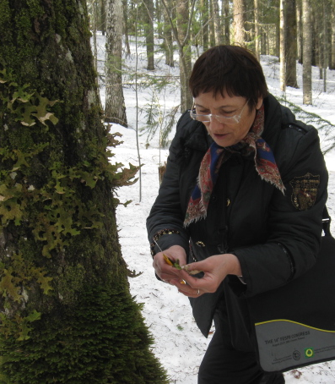
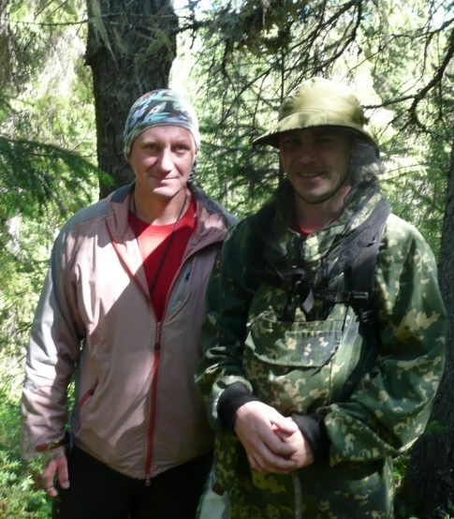

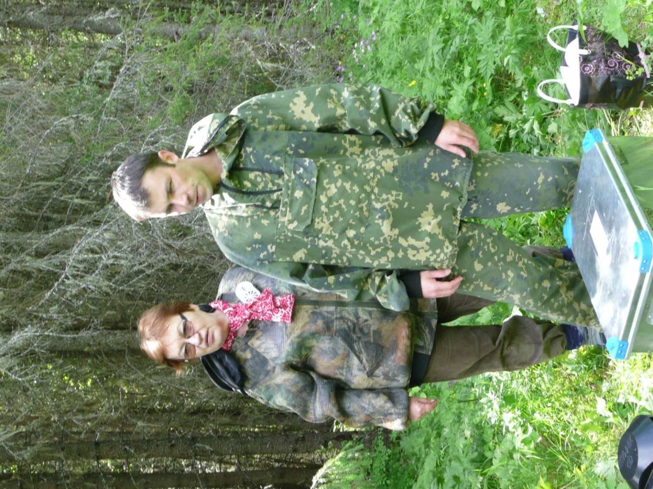

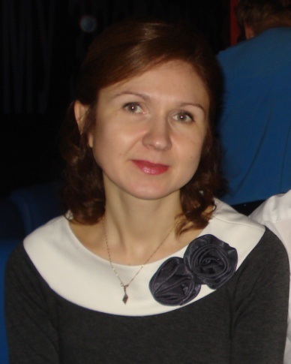
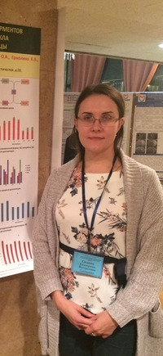
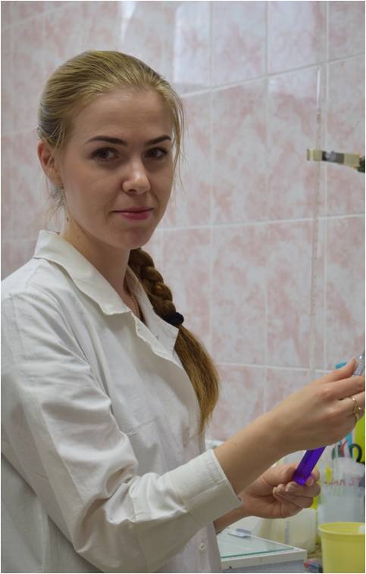
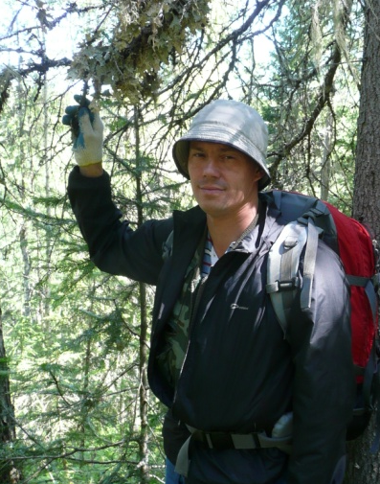
Тamara Golovko
Т.К.Головко
Ilya Zakhozhiy Ruslan Malishev Galina Tabalenkova
Mikhail Shelyakin Igor Dalke Olga Dymova Katya Silina Kseniya Ermolina

Slide 39

  THANK YOU FOR YOUR ATTENTION !
  Финансирование работ осуществлялось по Программе фундаментальных исследований Уральского отделения РАН
  по проектам Лаборатории экологической физиологии растений ИБ Коми НЦ УрО РАН:
  Эколого-биологические свойства и экосистемная роль лишайников таежной зоны европейского северо-востока России ( 2015-2017 гг.)
  Фототрофные организмы как компонент живой природы и индикатор климатических изменений (2018-2020 гг.)

