Slide 1
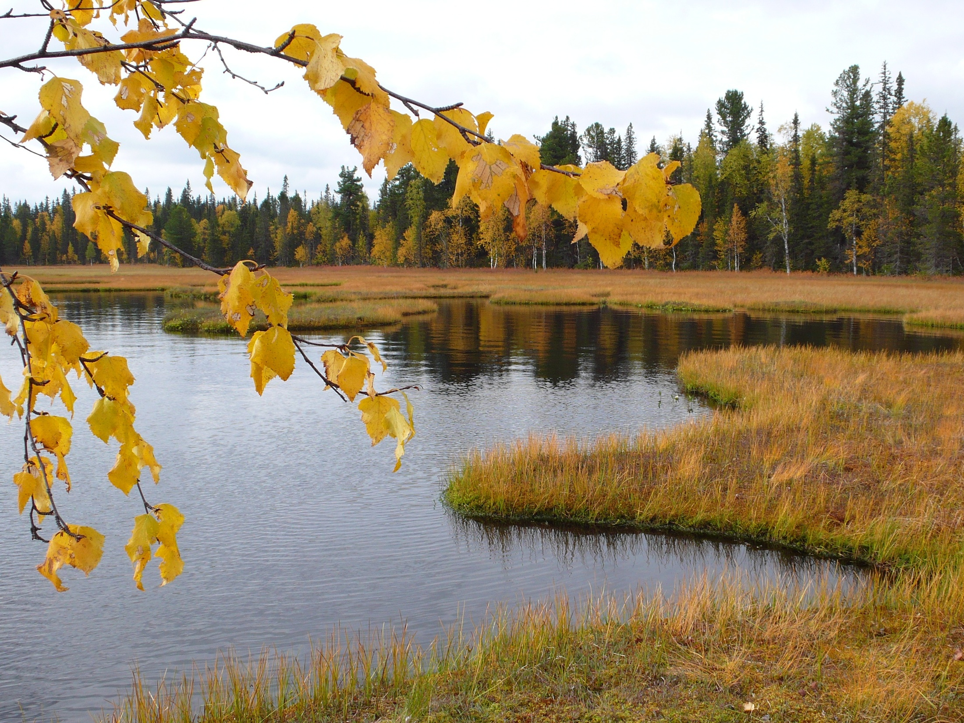
Pystina T.N., Hermansson J. Syktyvkar, Institute of biology Komi SC UrB RAS, Ludvika (Sweden),
LICHENS OF THE KOMI REPUBLIC: RECENT RESULTS AND FUTURE PROSPECTS
Subpolar Urals, «Yugyd va» national park,
Michavad Lake, photo by S.A. Sokolov

Slide 2
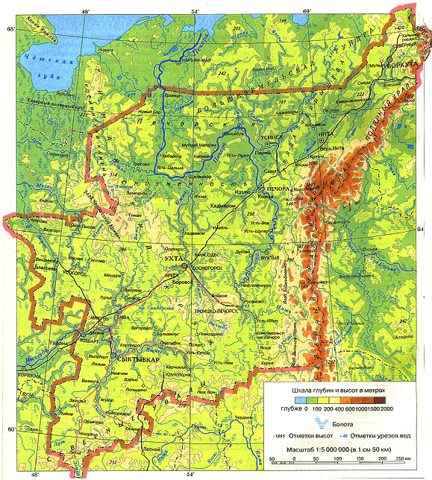
Researches of lichen biota in the Komi Republic
Area of the Komi Republic - 416.8 thousand ha
1994 – the beginning of lichen biota studies
1998 – first species list of lichens of the Komi Republic (Hermansson J., Pystina T.N., Kudryavtseva D.I. Preliminary list of lichens of the Komi Republic. Syktyvkar, 1998. 136p.)
564 species, 60 families, 149 genera
2000-2010 – researches at the protected areas (including the Pechoro-Ilychsky Reserve)
2011-2012 гг. – researches at the areas proposed to protect
Legend: - literature data (1920-е - 80-е) - authors data (1992-2018)
2010-2019 гг. – researches in the national park Yugyd va
-

Slide 3
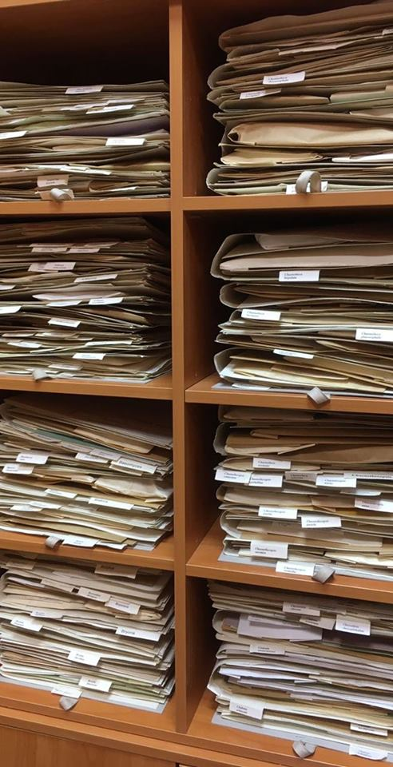
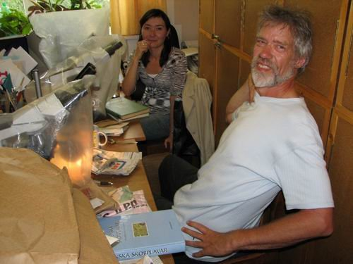
Collection of lichens
Founded in 1994
The main fund – 12 5000 specimens (about 800 species).
Total number of specimens (uncluding unidentified specimens and specimens without labels) – more than 26 000. From different areas of the Komi Republic, European North (Nenets region, Archangelsk, Murmansk and Kirov regions), Krasnodar region, Ukraine, Switzerland, Finland and Sweden.
Samples from the Komi Republic also stored in the Museum of the Evolution of Uppsala University (UPS), the Museum of Natural History of the University of Helsinki (H), the Botanical Museum of the University of Oslo (O), the Komarov Botanical Institute(LE).
Supervisor of the Collection T.N. Pystina
J. Hermansson and N.A. Semenova

Slide 4
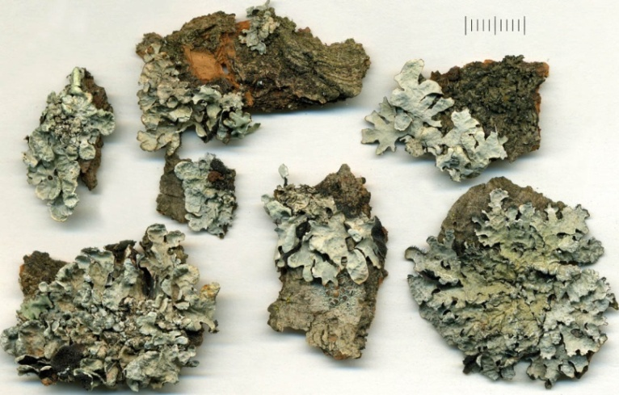
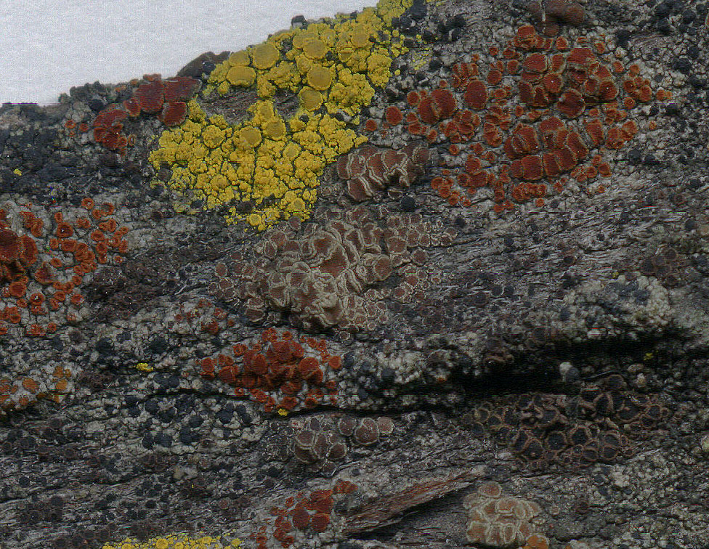
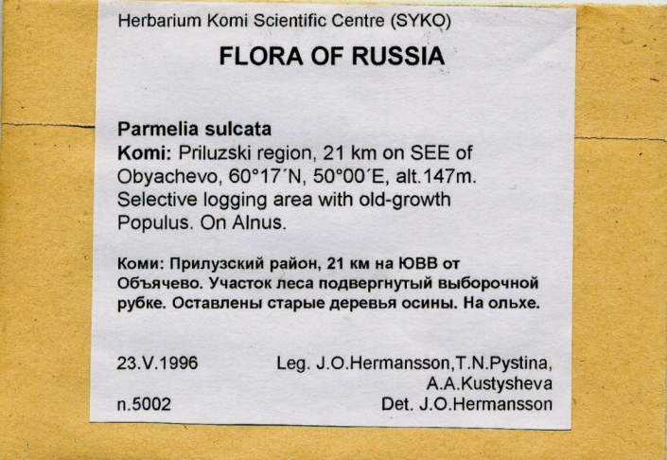
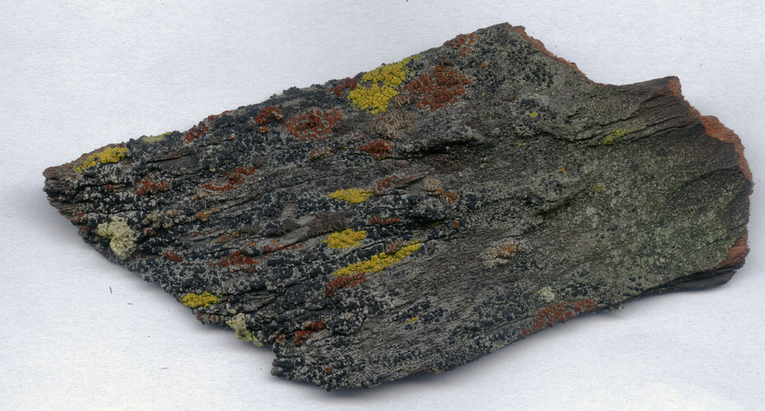
Features of the lichen collection: • alphabetical order of species in the main fund; • bilingual (English and Russian) labeling of samples. Work is underway to create a virtual herbarium of lichens. To date, more than 600 samples of 250 species of 121 genera have been scanned.

Slide 5
Lichen Collection Database :
In the late 1990s, The LICHEN database structure was developed in the Microsoft Access
Since 2017 – data on lichens in the «ADONIS» database, uniting the main botanical collection funds of the Institute of Biology of Komi SC UrB RAS (SYKO).
Entry of information on places of species finds :
- coordinates and location («Location»)
- herbarium specimens («Herbarium labels»).
Currently, we are going to enter the information on the locations of rare species and old specimens.

Slide 6
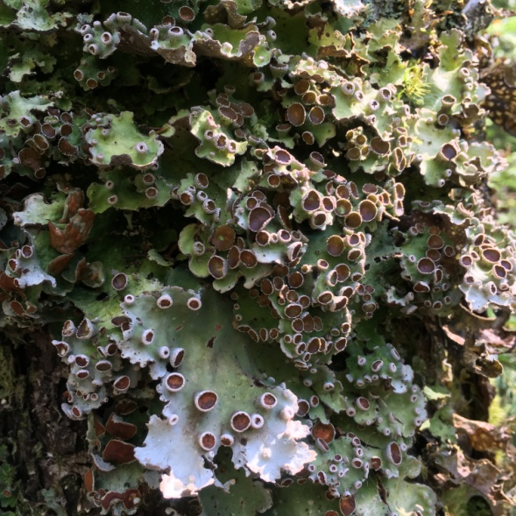
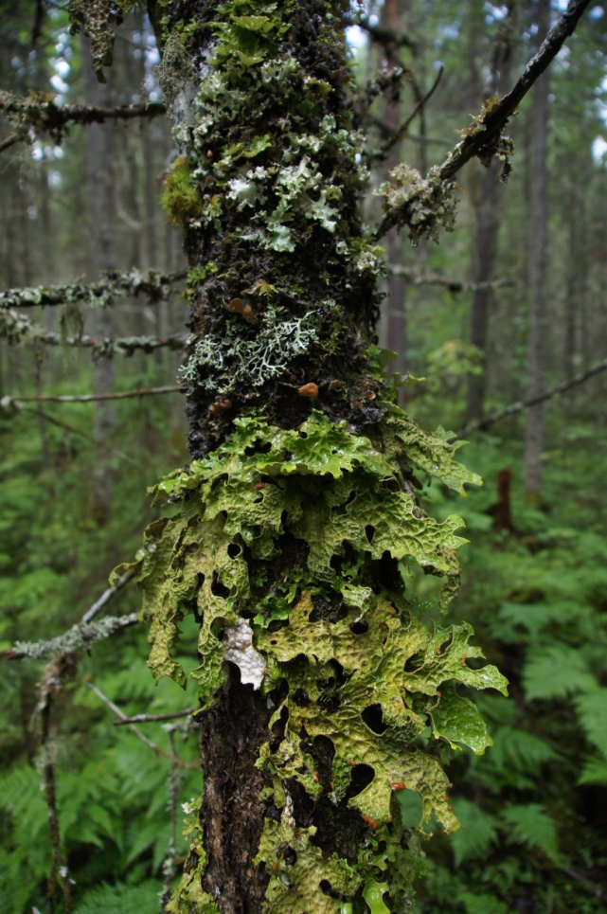
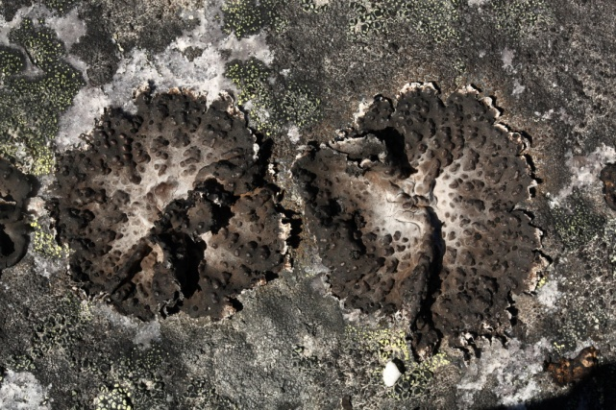
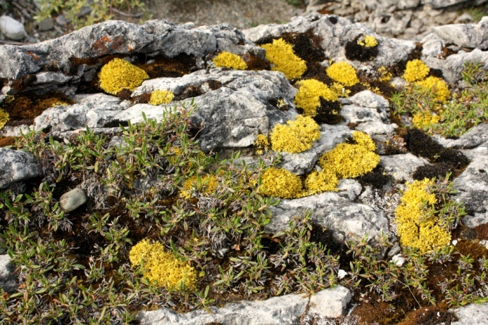
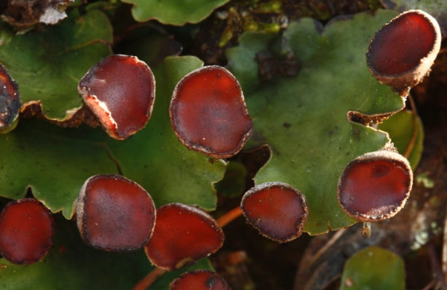
Taxonomical diversity of lichens in the Komi Republic
1101 species of lichens
79 families
296 genera
1247 species of lichens and taxonomically closed fungi
91 families
365 genera

Slide 7
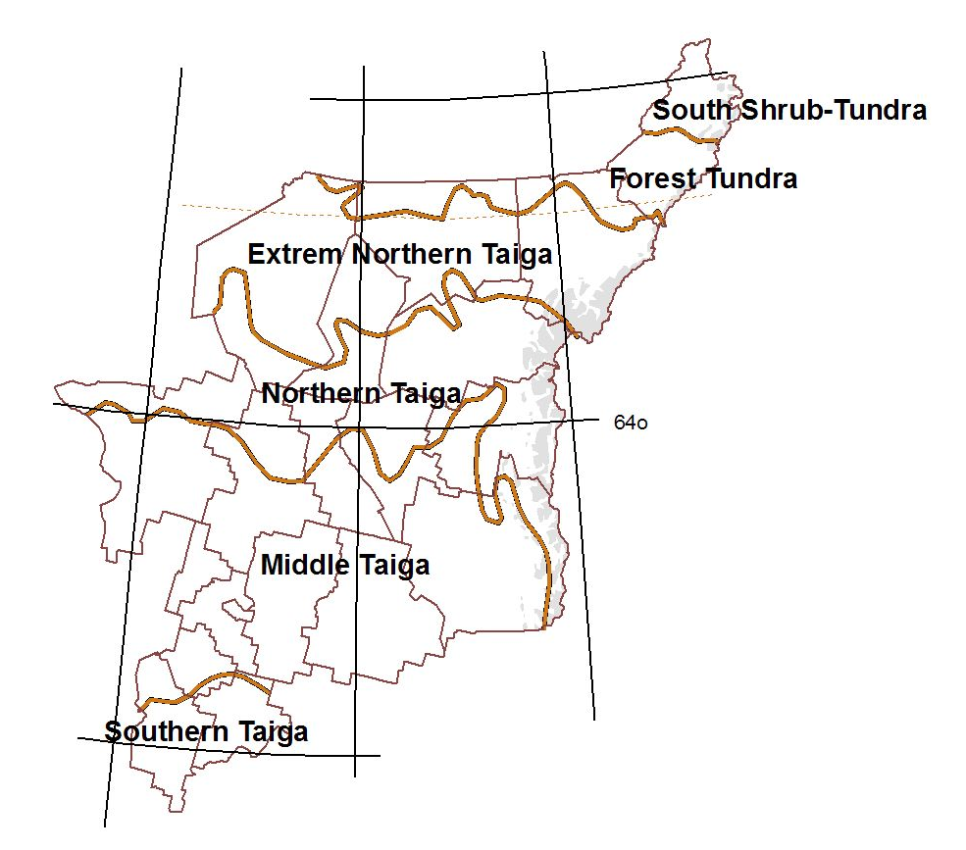
Latitudinal zoning of the vegetation cover of the Komi Republic (Yudin, 1954)
Polar Ural (198)
240
346
443
Subpolar Ural
(686)
469
North Ural
(789)
687
267

Slide 8
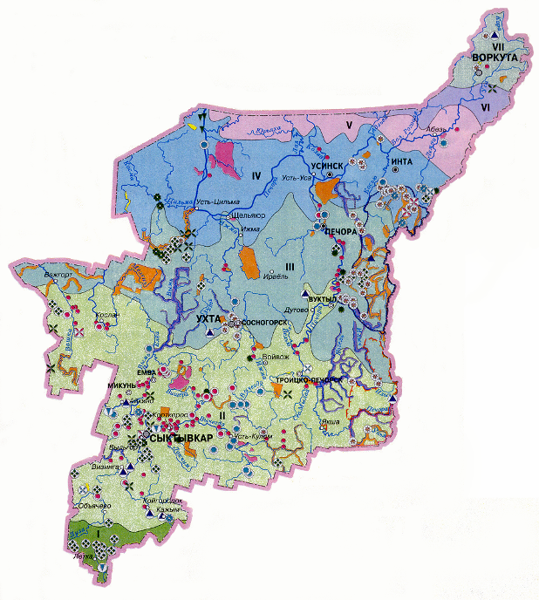
Protected areas of the Komi Republic
236 areas, including:
Reserve (zapovednik)- 1
National park - 1
Nature reserves of regional level – 162 (2,8 million ha)
Nature monuments – 71 (6 000 ha)
Protected nature landscape – 1
Total area 5,4 million ha (13 % of the Komi Republic area)

Slide 9
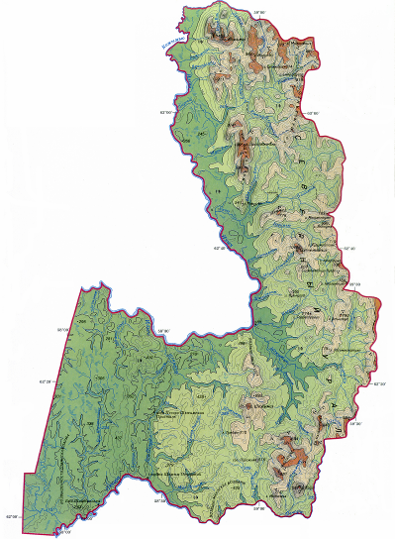
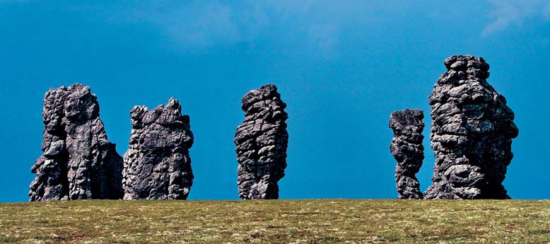
Pechoro-Ilychsky state reserve
Oldes scientific and and environmental institution in the republic (area -721 300 ha). Organized in 1930 for preservation natural complexes in the plain and mountain landscapes of the Northern Urals. Since 1984 – biosphere status.
Since 1995 included in the UNESCO World Heritage List as the object «Virgin forests of Komi»
Manpupuner plateau

Slide 10
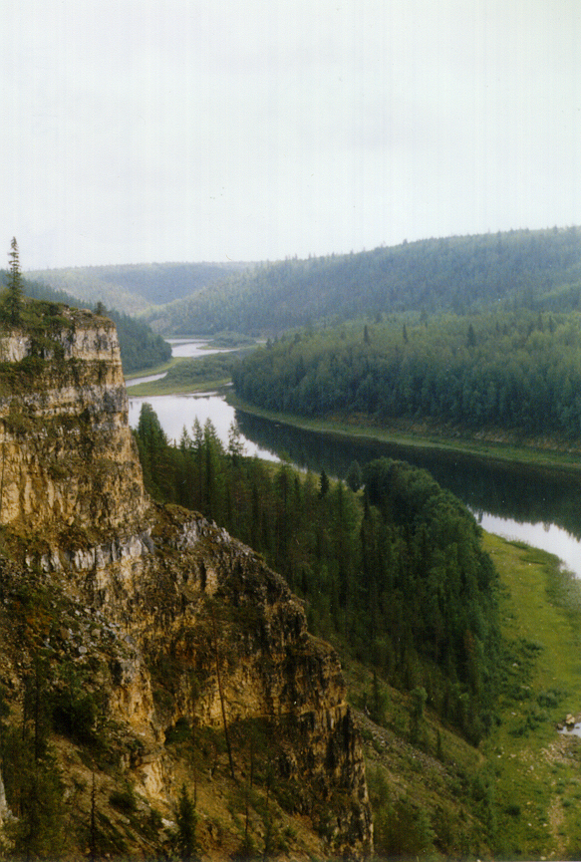
Pechoro-Ilychsky state reserve
814 species of lichens and associated fungi from 68 families and 198 genera
The most diverse families and genera
65% of the lichen biota of the Komi Republic. 284 species were found only in the reserve.
Taxon | Rank | Number of species
Family
Parmeliaceae | 1 | 81
Lecanoraceae | 2 | 70
Cladoniaceae | 3 | 58
Physciaceae | 4 | 51
Bacidiaceae | 5 | 39
Pertusariaceae | 6-7 | 32
Teloschistaceae | 6-7 | 32
Verrucariaceae | 8 | 29
Porpidiaceae | 9 | 27
Lecideaceae | 10 | 24
Genus
Cladonia | 1 | 57
Lecanora | 2 | 48
Caloplaca | 3 | 27
Pertusaria | 4 | 23
Lecidea | 5-7 | 19
Peltigera | 5-7 | 19
Rhizocarpon | 5-7 | 19
Chaenotheca | 8-9 | 16
Stereocaulon | 8-9 | 16
Micarea | 10 | 15
Upper course of the Pechora River

Slide 11
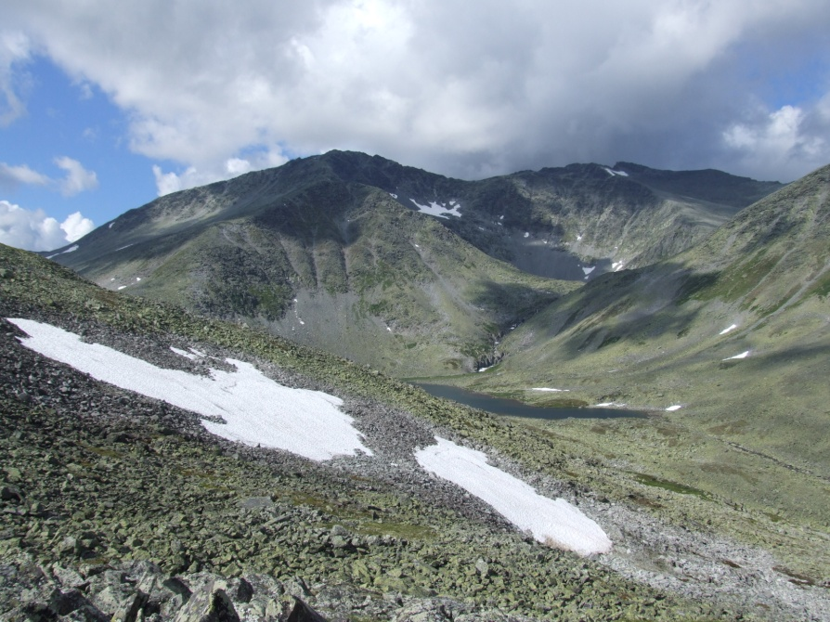
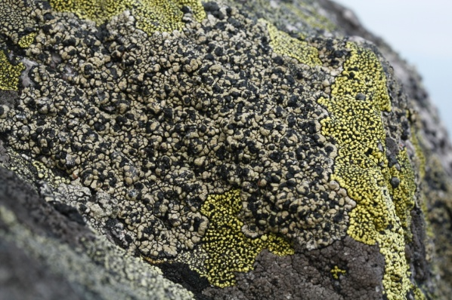
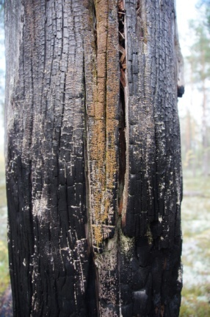
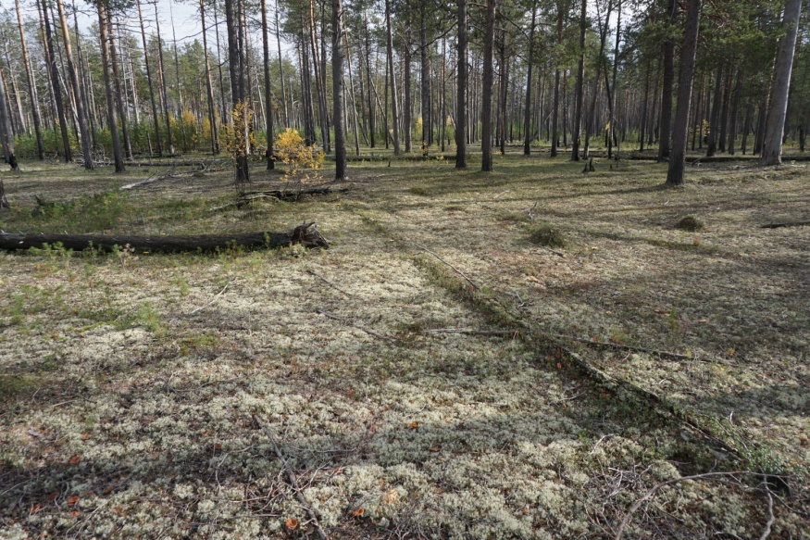
Pechoro-Ilychsky state reserve

Slide 12
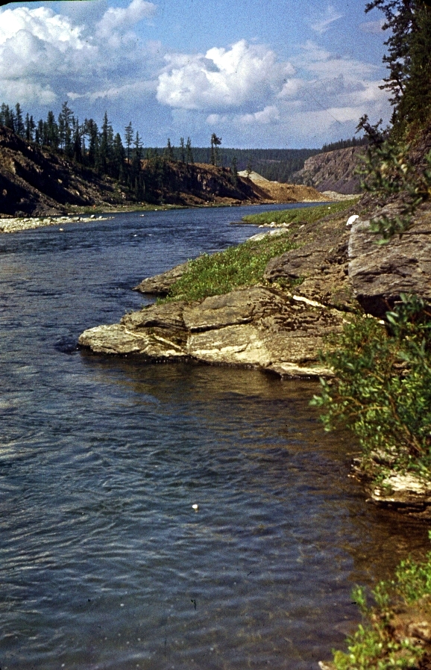
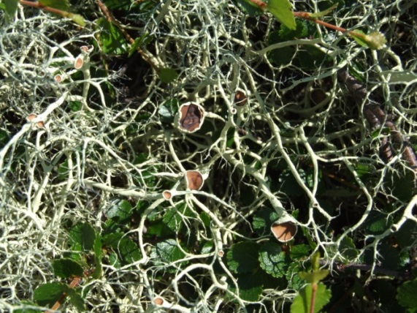
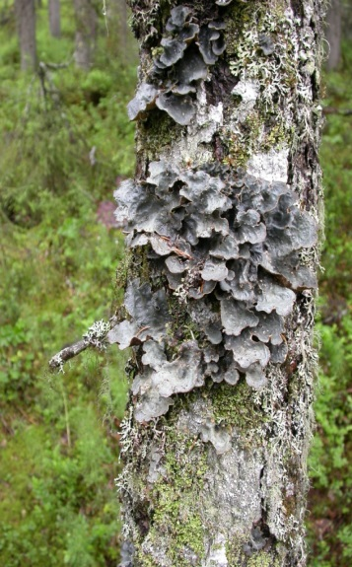
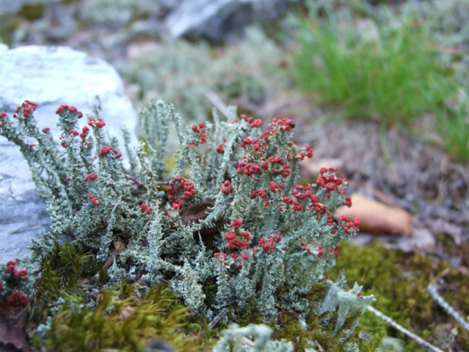
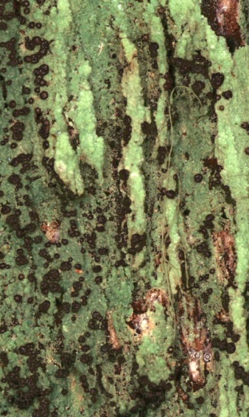
Pechoro-Ilychsky state reserve
Upper course of the Ilych River
Alectoria ochroleuca
Lobaria scrobiculata
Cladonia bellidiflora
Trapeliopsis viridescens

Slide 13
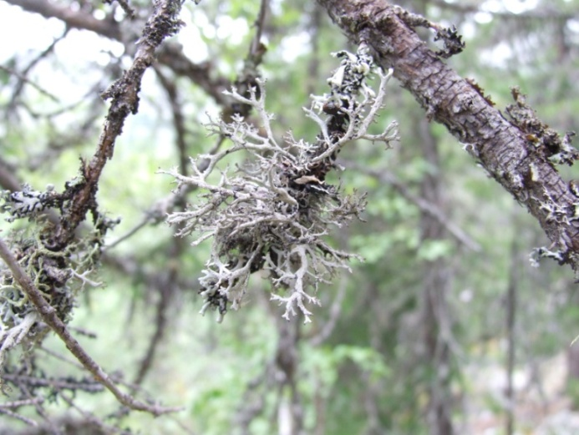
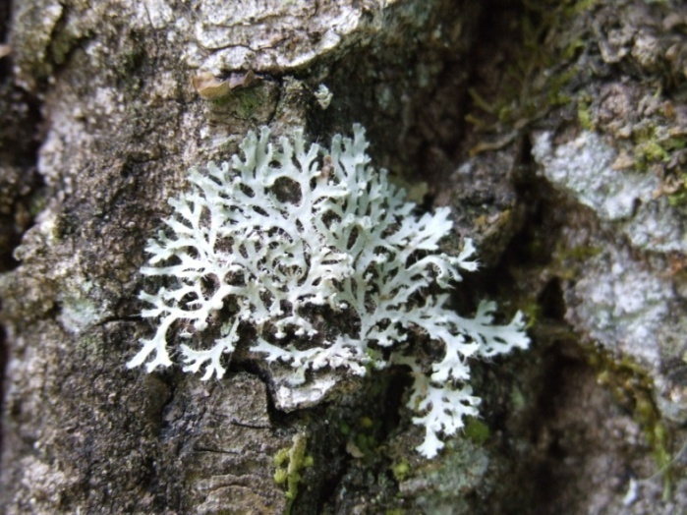
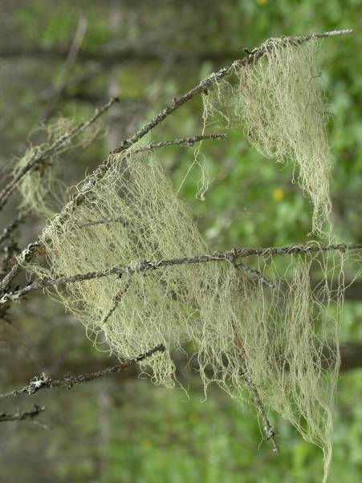
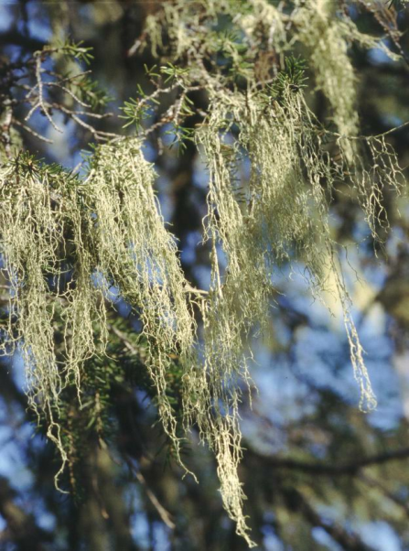
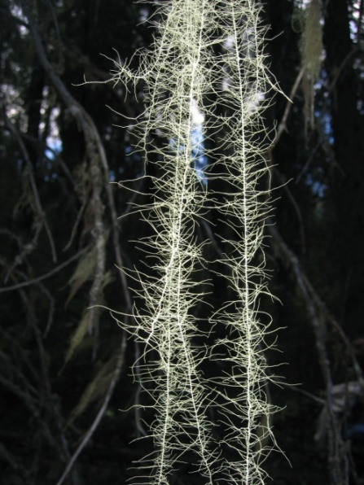
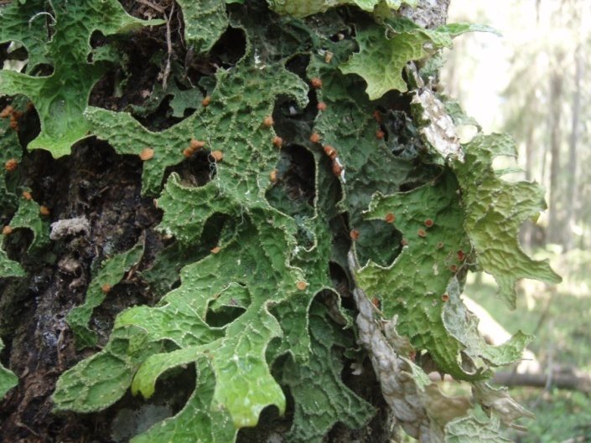
Pechoro-Ilychsky state reserve
In the Reserve and its buffer zone, there are 66 from 85 species of lichens, included in the last edition of the Red Data Book of the Komi Republic
Five species are in the Red Data Book of Russia (2008): Bryoria fremontii (Tuck.) Brodo & D. Hawksw., Leptogium burnetiae Dodge, Lichenomphalina hudsoniana (H.S.Jenn.) Redhead et al., Lobaria pulmonaria (L.) Hoffm., Nephromopsis laureri (Kremp.) Kurok.
15 rare species require monitoring.
Pseudevernia furfuracea (3)
Heterodermia speciosa (1)
Ramalina trausta (monitoring)
Evernia divaricata (monitoring)
Usnea longissima (1)
Lobaria pulmonaria (2, 3)
Pseudevernia furfuracea

Slide 14
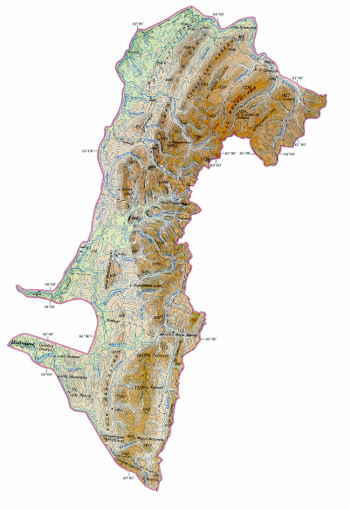
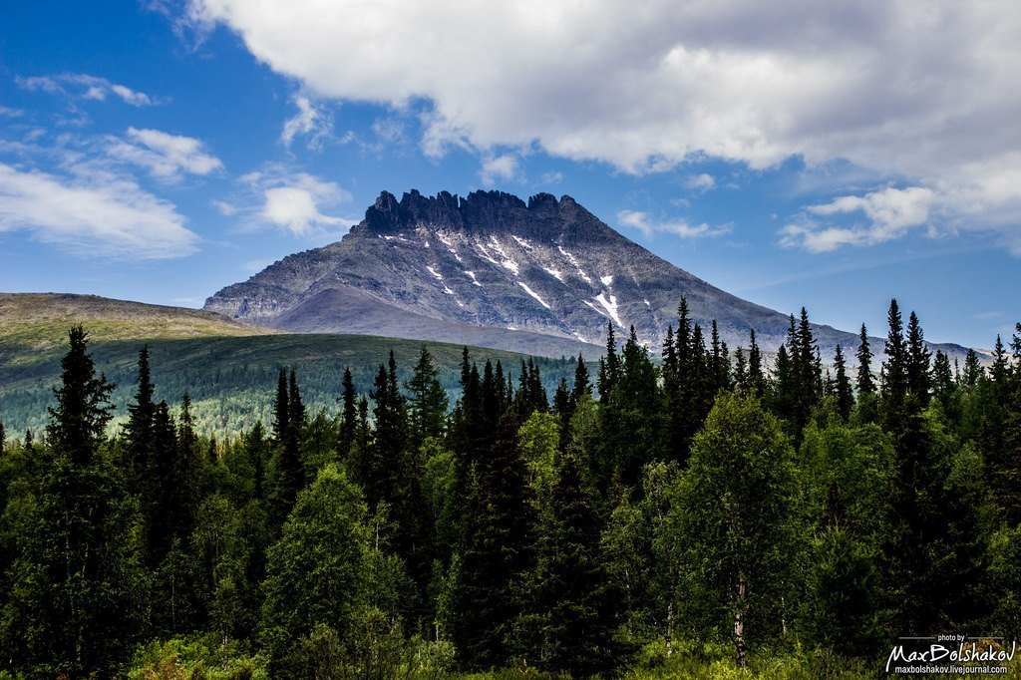
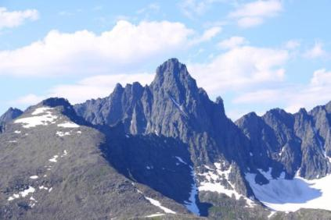
National park «Yugyd va»
National park «Yugyd va» - “fresh water” from the Komi language (1 891 701 ha) is located at the west slopes of the Northern and Subpolar Urals. Created in 1993 for the protection of natural complexes , for the development of tourism and recreation.
Since 1995 included in the UNESCO World Heritage List as the object «Virgin forests of Komi»
Subpolar Urals. Mountain Manaraga (1662 m) and Mountain Sablya (1497 m)

Slide 15
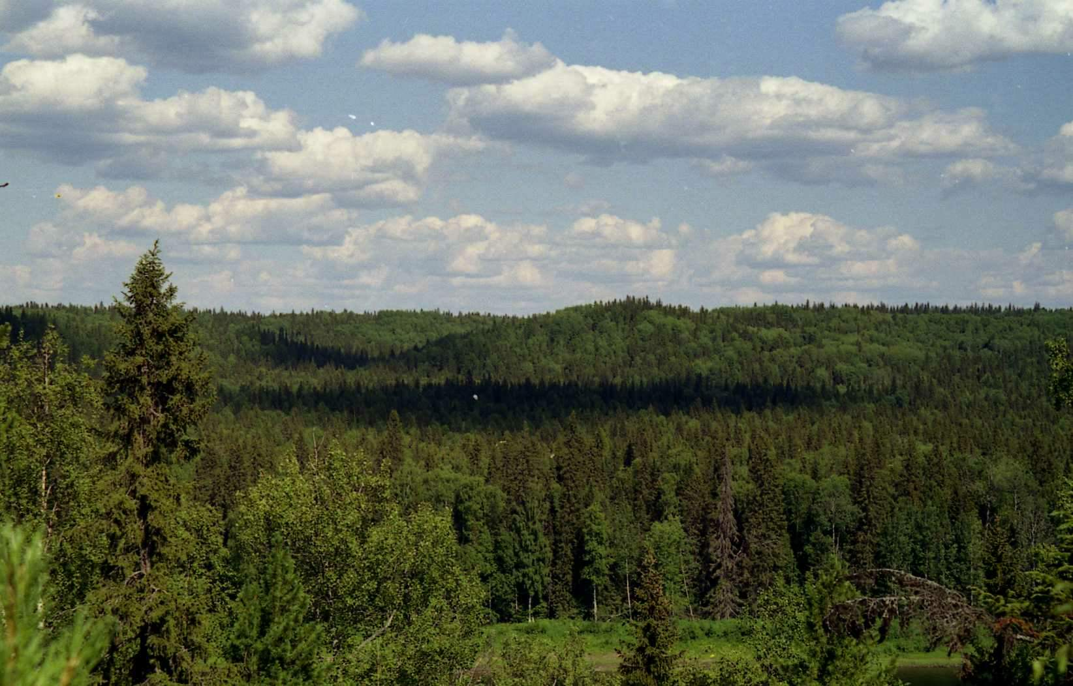
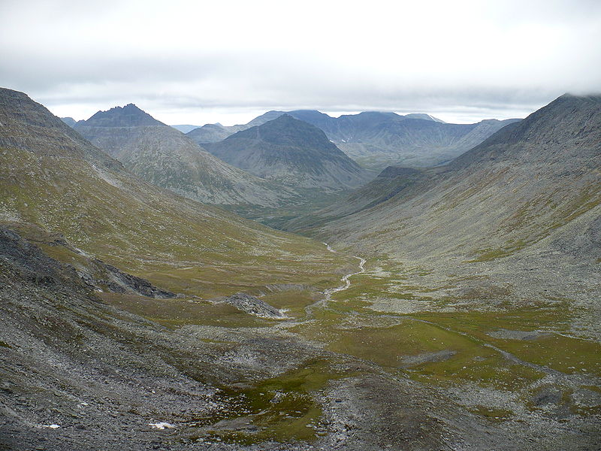
Yugyd va national park
688 species of lichens and closed fungi from 62 families and 193 genera
Most diverse families and genera
Taxon | Rank | Number of species
Family
Parmeliaceae | 1 | 69
Cladoniaceae | 2 | 51
Lecanoraceae | 3 | 36
Physciaceae | 4 | 26
Pertusariaceae | 5 | 21
Bacidiaceae | 6 | 20
Lecideaceae | 7 | 19
Peltigeraceae | 8 | 18
Porpidiaceae | 9-10 | 16
Teloschistaceae | 9-10 | 16
Genus
Cladonia | 1 | 49
Lecanora | 2 | 21
Lecidea | 3-4 | 16
Peltigera | 3-4 | 16
Caloplaca | 5-7 | 13
Pertusaria | 5-7 | 13
Stereocaulon | 5-7 | 13
Melanelia | 8 | 11
Chaenotheca | 9-11 | 10
Bryoria | 9-11 | 10
Umbilicaria | 9-11 | 10
Foothill of the Subpolar Urals. Mertvaya Parma Mountain
View from Manaraga Mountain

Slide 16
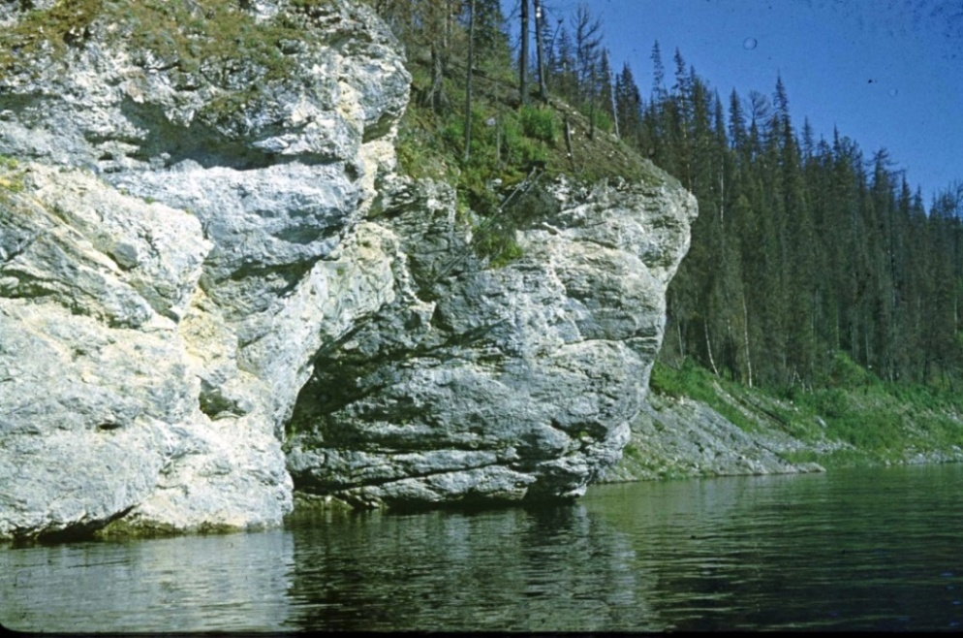
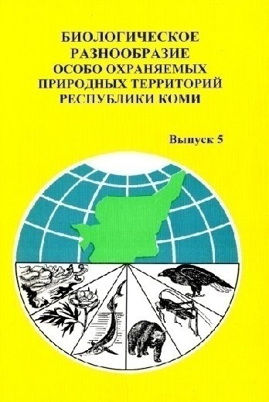
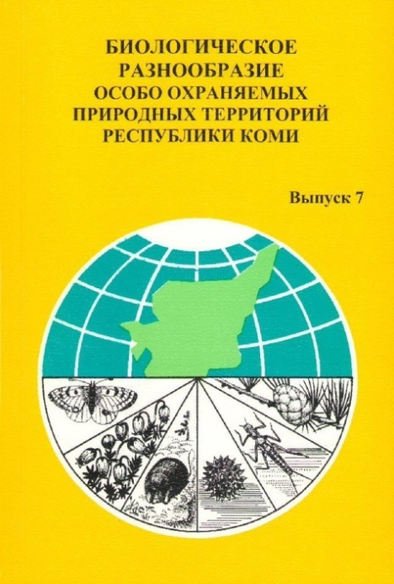
Researches of lichens at the regional protected areas
31 PA, More than 470 species of lichens
 | Protected area | Spe-cies | Gene-ra | Families
1 | Complex reserve «Vazhelyu» | 144 | 55 | 29
2 | Complex reserve «Puchkomskiy» | 128 | 55 | 32
3 | Complex reserve «Khrebtoviy» | 212 | 63 | 34
4 | Complex reserve «Sedyuskiy» | 42 | 23 | 14
5 | Complex reserve «Vegha-Voghskiy» | 97 | 40 | 21
6 | Complex reserve «Belaya Kedva» | 246 | 74 | 37
7 | Complex reserve «Udorskiy» | 170 | 61 | 34
8 | Floristic reserve «Soivinskiy» | 169 | 57 | 35
9 | Biological reserve «Synynskiy» | 205 | 67 | 36
10 | Complex reserve «Sebys» | 215 | 53 | 34
11 | Complex reserve «Beliy» | 139 | 55 | 26
12 | Mire reserve «Don-ty» | 95 | 41 | 25
13 | Complex reserve «Unyinskiy» | 185 | 70 | 38
14 | Complex reserve «Adak» | 187 | 68 | 39
15 | Botanical nature monument «Listvennichnoe» | 117 | 44 | 22
16 | Mire reserve «Ocean» | 145 | 58 | 31
17 | Botanical nature monument «Parnoka-yu» | 74 | 35 | 20
18 | Botanical reserve «Syktyvkarskiy» | 133 | 59 | 34
19 | Forest reserve «Yuil» | 128 | 56 | 31
20 | Floristic reserve «Verkhnetsilemskiy» | 449 | 147 | 65
21 | Complex reserve «Visherskiy» | 83 | 31 | 19
22 | Complex reserve «Madzhskiy» | 64 | 25 | 15
23 | Complex reserve «Ezhugskiy» | 59 | 28 | 18
24 | Complex reserve «Sodzimskiy» | 71 | 35 | 22
Limestones. Reserve «Belaya Kedva»

Slide 17
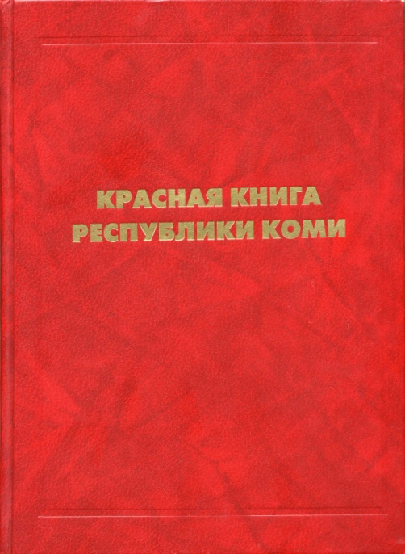
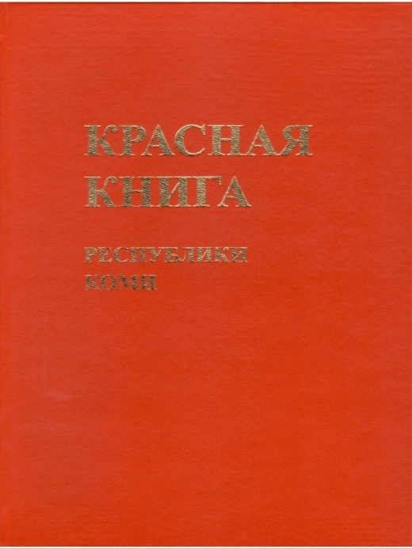
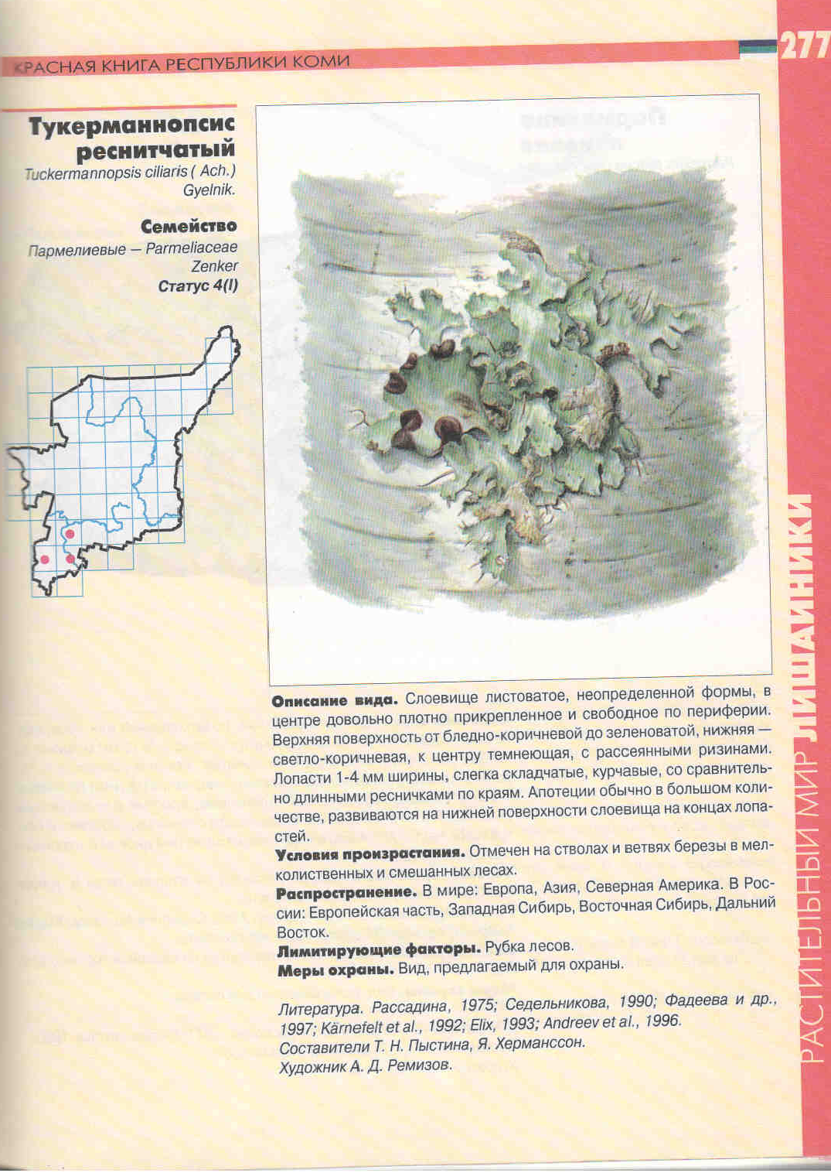
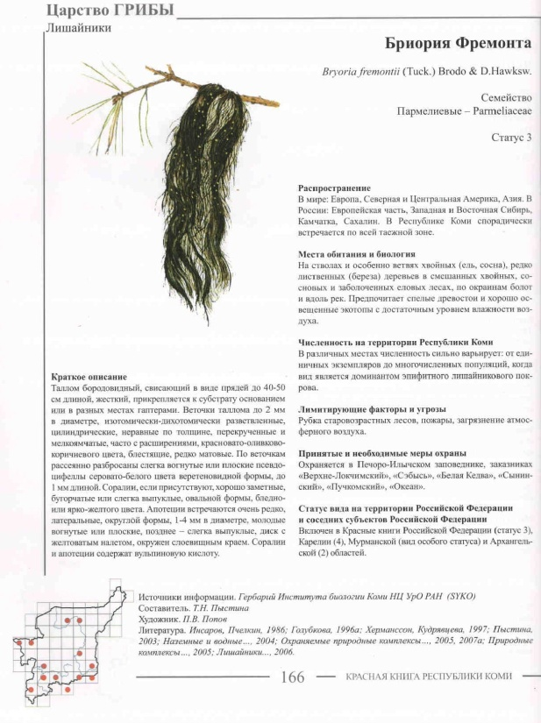
Red Book of the Komi Republic
Red Book of the Komi Republic (1998)
78 species of lichens
Red Book of the Komi Republic (2009) 82 species of lichens

Slide 18
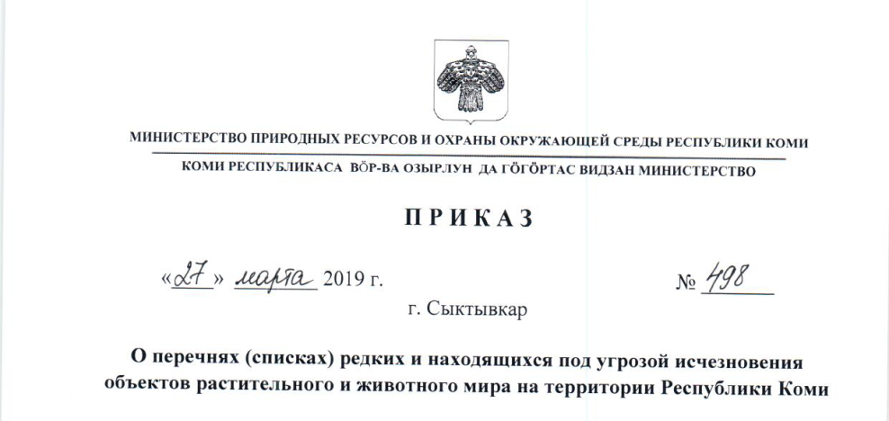
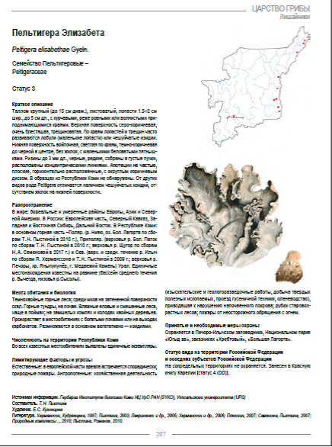
Red Book of the Komi Republic
3rd edition of the Red Book of the Komi Republic will include 85 species of lichens
Year of edition | Protection category |  |  |  |  |  | Total | Monito-ring
 | 0 | 1 | 2 | 3 | 4 | 5
1998 | 0 | 20 | 11 | 16 | 20 | 11 | 78 | 0
2009 | 0 | 16 | 13 | 41 | 12 | 0 | 82 | 16
2019 | 2 | 17 | 12 | 48 | 6 | 0 | 85 | 18
Category 0 (probably disappeared species): Sphinctrina anglica Nyl., Menegazzia terebrata (Hoffm.) A.Massal.

Slide 19
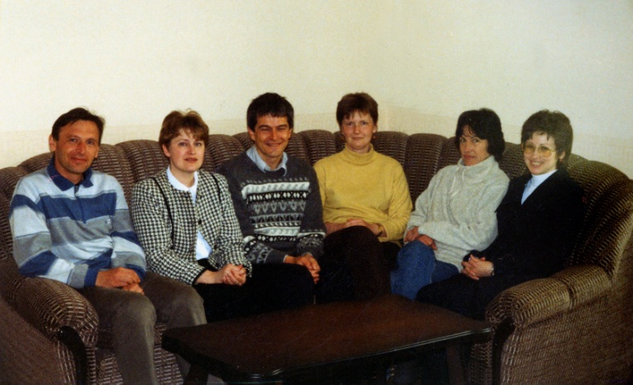
Genetic diversity, population biology and protection status of lichen species Lobaria pulmonaria along the transect from west to east through Eurasia (Scopes 2000-2003)
Participants:
Swiss Federal Institute for Forest and Snow Landscape Research, WSL
Institute of Plant and Animal Ecology, Ural Branch of RAS
Institute of Biology, Komi Scientific Center, Ural Branch of RAS
Sakhalin Botanical Garden
Kholodniy Botanical Institute
Aim ‑ development of new strategies of lichens protection and assessment of the key priorities for the conservation of populations of Lobaria pulmonaria in Eurasia
Objectives:
To determine genetic diversity and specificity within the populations and territories.
To determine ecotypical differrenciation and adaptation of the lichen to different climatic zones.
To develop and verify model for life cycle of epiphitic lichens.
To develop and test the strategies for conservation at the species and environmental levels to make regional conservation more efficient.
To assess the status of Lobaria pulmonaria in the regions in view of different ways of future forestry development.

Slide 20
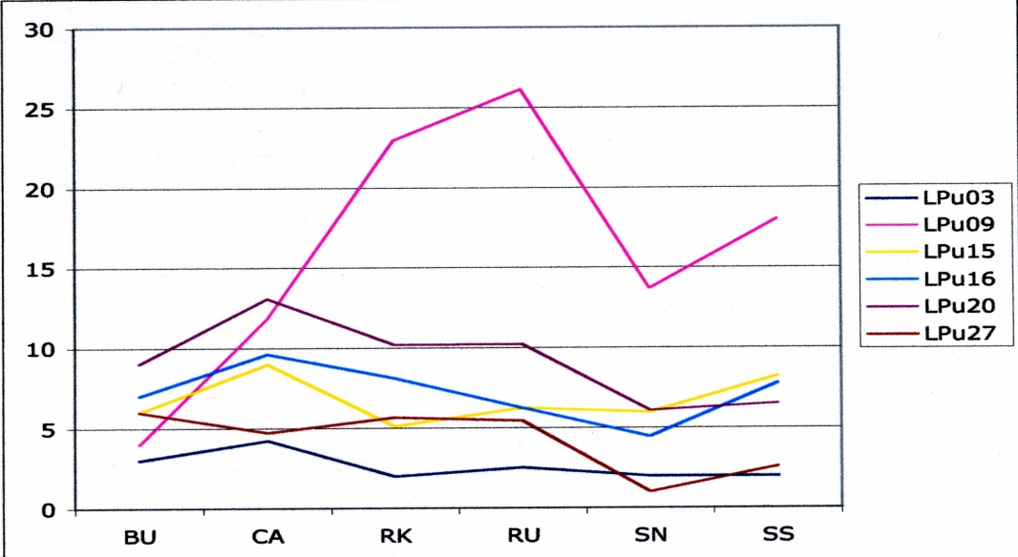
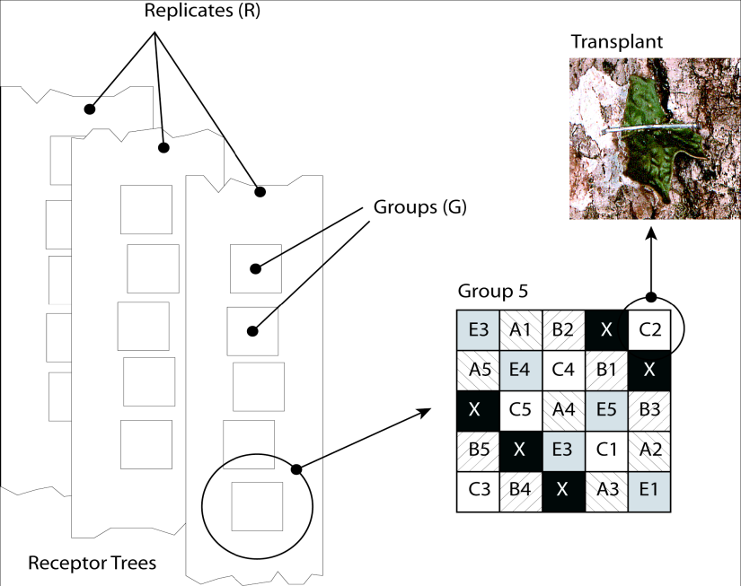
2001
2007
Alleles richness in locus in the studied populations: Bu – Bulgaria, Ca – Carpathians, RK – Komi Republic, RU – Northern Urals, SN – Northern Sakhalin, SS – Southern Sakhalin
Thalli transplantation was made by original approach (Walser & Scheidegger, 2002)
2002
2007
Vitality of thalli of Lobaria pulmonaria in different regionsduring 2nd (2002) 6th (2007) year after the transplantation (Komi Republic)

Slide 21
Studies of habitats with rare lichen species Leptogium rivulare in the southern areas of the Komi Republic, promising for the creation of botanical protected area
Martity Lake. Floodplain willow stand
Leptogium rivulare – fine-leafed lichen, 1-1.5 (2) cm in diameter, dark-ash-grey color.
Common habitats – floodplain stands.
Evty Lake. Floodplain aspen stand

Slide 22
Distribution of Leptogium rivulare in the world and Komi Republic
Findings: five in Sweden, four in Canada, one in Tanzania, Finland, France, Estonia, Lithuania and Belarus. In Russia: Murmansk, Arkhangelsk, Kirov, and Sverdlovsk regions, Mari El Republic.
42 findings in the Komi Republic

Slide 23
Parameters of habitats and local populations of Leptogium rivulare
Administrative area | Kortkeross | Syktyvdin | Ust-Vym
Lake | Martity | Seyty | Evty
Plant community | Calamagrostis-herb willow stand | Herb aspen forest | Herb aspen forest
Area of the lake, km² | 0,098 | 0,6 | 2,6
Area of inventoried territory ,km² | 0,01 | 0,01 | 0,02
Area of the territory where the lichen was found, km² | 0,001 | 0,001 | 0,02
Frequency of occurennce of trees with L. rivulare, % | 45,4 | 42 | 20
Average density of trees with L. rivulare, tree per m² | 0,22 | 0,14 | 0,13
Abundance of L. rivulare | 2,6 | 2,3 | 2,4

Slide 24
Regional reserve “Evtynskiy” to be created
Location: Ust-Vym area of the Komi Republic.
Type – botanical reserve. Area – 360 ha.
By the moment, this area is in the Conception of development of the regional PA system for the period up to 2030

Slide 25
Мониторинг популяций редких видов лишайников
Dendriscosticta wrightii (Tuck.) B. Moncada et Lücking
В 2017 г. на участке леса в бассейне р. Дингуль (левый приток второго порядка р. Лузы), где сохранились ненарушенные леса с крупной популяцией лишайника, наложен мораторий на ведение хозяйственной деятельности. Необходимо детально обследовать прилегающие участки старовозрастных лесов для обоснования организации здесь ООПТ регионального подчинения.

Slide 26
Lichenoindication in the areas affected by Middle-Timan bauxite mine (2002-2013)
Control site
Contaminated site

Slide 27
Methods
Species diversity
2. Monitoring the model species Hypogymnia physodes : abundance, state (size and form of thallus, changes in surface and color, necrosis, pathogenic fungi)
Scale of abundance
3. Chemical analysis (Al, Fe, Mn, Zn, Pb, Ni, Cu)
а
Rank | Number of individuals | Cover, %
0 | 0 | 0
1 | 1-4 | 1-4
2 | 5-24 | 5-49
3 | >25 | 50
б
Lobaria pulmonaria at the tree on the side of trunk faced to the bauxite mine (а) and opposite one (б) (ППН 5).

Slide 28
ППН 4 (control)
ППН 11 (average contamination)
ППН 6 (strong contamination)
Changes in abundance of Hypogymnia physodes (20012)
Damaged thalli of epiphytic lichens under constant bauxite dust contamination (ППН 1, ППН 6)

Slide 29
Accumulation of heavy metals in the thallus of Hypogymnia physodes during 2002-2010
Al > Fe > Mn > Zn > Pb > Cu > Ni

Slide 30
Monitoring of moss-lichen cover in the forests of the reserve «Belyi»
Five stages of degradation of soil-vegetation cover in the pine forests (Malysheva, 1978) :
Stage I – intact forest, projective cover of moss-lichen layer 80-100%, no footpaths;
Stage II – projective cover of moss-lichen layer 65-80%, footpaths up to 10% of area;
Stage III – average damage, projective cover of moss-lichen layer 45-65%, footpaths up to 20-30%;
Stage IV – damaged forest, moss-lichen layer is destroyed, ruderal plants invasion, projective cover of moss-lichen layer 15-45%;
Stage V – degradation of moss-lichen layer (< 15%), dominance of ruderal plants,.
Stage I
Stage II
Stage V

Slide 31
Most of lichen pine forests are at the Stage III. This stage is critical for the ecosystems. At the Stage IV, disturbed forests are stable in time and difficult to return to the initial state. Maybe criteria of forest assessment should be even stricter and recreation to be possible only at the Stages I and II.

Slide 32
Despite the considerable amount of data, the list of lichen species the Komi Republic is far from complete. The current List combines about 75% of expected lichens diversity.
There are few data on the diversity of lichens in the northern territories: forest-tundra and tundra, northern and extreme north taiga.
Ural Mountains, especially Subpolar and Polar Urals, are poorly investigated by lichenologists.
There are scattered information about composition of lichen communities of subalpine woodlands, mountain tundra, and stony placers.
It is necessary to continue research in the protected areas. First of all, this concerns the largest object of the nature reserve fund of the Komi Republic - the Yugyd Va National Park where information on the species diversity of lichens is fragmentary.
Reserves with a rocky limestone outcrops are of special attention due to relic species preserved from the time of the last glaciations. Many new and rare species can be found there.

Slide 33
Thank you for attention!

