Slide 1
Structural and functional features of
Lobaria pulmonaria thalli at different ontogenetic stages
(middle and northern boreal zone)
Androsova Vera
Chirva Olga
Nikerova Ksenya
Ignatenko Roman
Petrozavodsk State University
International conference «Lichens: from molecules to ecosystems»
Syktyvkar, 2019

Slide 2
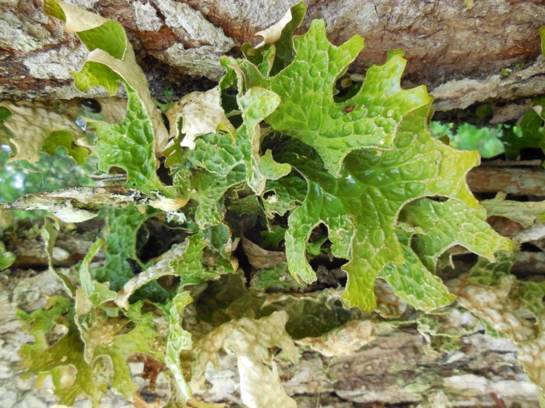
Lobaria pulmonaria (L.) Hoffm.
Lecanoromycetes
Peltigerales
Lobariaceae
Epiphytic foliose lichen
Photobiont- Dictyochloropsis reticulata,
Nostoc sp. (in cephalodias);
Red Data Book of Russian Federation – 2b (vulnerable species);
Red Data Book of Republic of Karelia – 3 (rare species).
regarded as indicator of old growth forest
species sensitivity to habitat condition
Official permission No. 18 for the collection of samples of species listed in the Red Book of the Russian Federation dated 03.03.2016 Rosprirodnadzor.
Lobaria pulmonaria

Slide 3
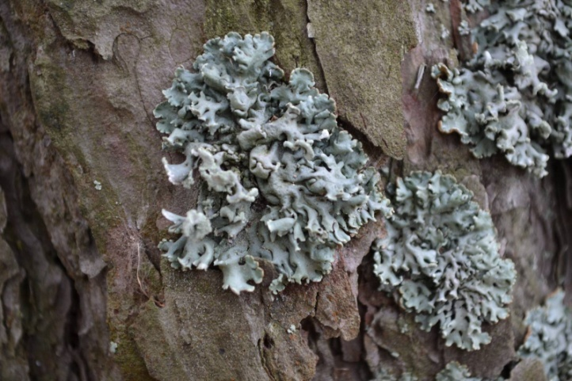
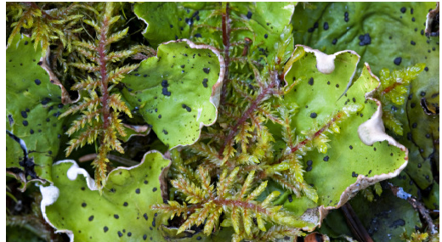
The most popular lichen species in physiological studies
Hypogymnia physodes (L.) Nyl.
Peltigera aphthosa
(L.) Willd.
343*
Lobaria pulmonaria (L.)Hoffm.
111
306
*Number of articles listed in «Recent Literature on Lichens» over the last 50 years

Slide 4
Aim :
to study anatomical and physiological features of Lobaria pulmonaria thalli at different stages of ontogenesis
Objectives :
- to study photosynthetic content and parameters of chlorophyll a fluorescence in L. pulmonaria thalli;
- to study anatomy and water parameters of L. pulmonaria thalli;
to study activity of catalase and superoxide dismutase in Lobaria pulmonaria from forest communities of middle and northern boreal zone

Slide 5
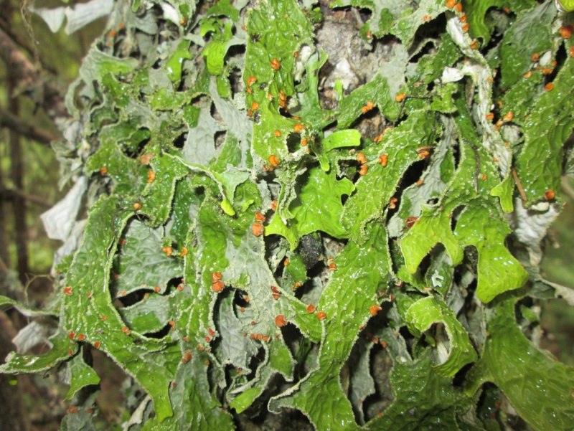
Functional-age group (Mikhailova (2005)
and ontogenetic stages ( Ignatenko, 2018)
Ontogenetic stages | Functional-age group
Immature | sterile (st, im 3)
Virginal | sterile (st, v1) hyposorediate (v2a)
 | mesosorediate (v2b)
 | hypersorediate (v2c)
Generative | fertile (fert, g)
Post-generative | subsenile (s/sen, ss)
 | senile (sen, s)

Slide 6
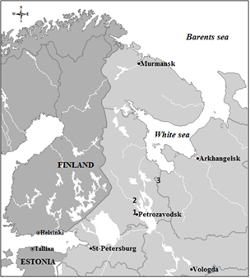
Study area
Sample plots (100 х 100 m)
Zaozersky Sanctuary (61˚50’N, 34˚20’E), Republic of Karelia.
Kivach Strict Nature Reserve (62˚17’N, 34˚00’E,) Republic of Karelia.
Vodlozersky National Park, Arkhangelsk region (63˚30’N, 37˚28’E, 337,600 ha).
Fig.1. Localities of collection sites

Slide 7
Methods
In laboratories of PetrSU and Karelian Research Centre of the Russian Academy of Sciences
Photosynthetic pigments content (Chl a, Chl b, Car) (CФ-2000)
Lobaria pulmonaria thalli
sterile (st, im 3, v 1)
sorediate(sor, v 2)
fertile (fert, g)
subsenile (s/sen, ss)
senile (sen, s)
Parameters of chlorophyll a fluorescence (Fv\Fm, NPQ, Fv, qP, ETR, F0, Fm) (WALTZ JUNIOR PAM)
Statistical analysis
n=98
Anatomical parameters of thalli ( total thickness, thickness of layers ) (AXIO SCOPE, Zeiss)
Water balance parameters (WHC, STM, water saturation, velocity of water saturation and dehydratation)
(OHAUS , Discovery)
Activity of antioxidant enzymes ( SOD, CAT, POD) and protein content
(СФ-2000)

Slide 8
Anatomical parameters: results
Table 1. The average values of the studied anatomical parameters of L. pulmonaria thalli
of different age groups
Functional-age group | Thallus thickness, μm | Upper cortex, μm | Algal layer, μm | Size of algal cell, μm | Proportion of algal layer, % | Thallus area, cm² | STM, mg*cm⁻²
sterile (st, im 3, v1) | 95,8± 18,2 | 12,9± 12,0 | 14,9± 4,56 | 3,1± 0,36 | 15,4 | 3,8 | 7,9
sorediate (v2) | 125,8± 21,2 | 20,2± 2,4 | 20,4± 2,72 | 3,7± 0,93 | 16,3 | 6,0 | 10,9
fertile (fert, g) | 223,4± 48,3 | 25,4± 9,2 | 31,6± 9,02 | 2,9± 0,22 | 14,0 | 6,6 | 11,0
senile (sen, s) | 189,2± 1,5 | 42,2± 15,0 | 27,4± 4,57 | 4,1± 0,52 | 14,2 | 6,0 | 11,6

Slide 9
Photosynthetic pigments content: results
Table 2. Photosynthetic pigments content in L. pulmonaria thalli of different stages (mg g ⁻¹ of dry mass)
Functional-age group | Chl (a+b) | Сarotenoids | Chl a / chl b | Chl (a+b)\car
sterile (st, im 3, v1) | - | - | - | -
sorediate (v2) | 0.246±0.101 | 0.042±0.057 | 1.1 | 6.2
fertile (fert, g) | 0.269±0.205 | 0.044±0.034 | 1.4 | 6.5
senile (sen, s) | 0.198±0.052 | 0.038±0.010 | 1.6 | 5.1
Chl (a+b) mg g -1 dry mass | Chl a / chl b | Сarotenoids | Chl (a+b)\car | Region | Authors
0.38-3.12 | 2.84-4.61 | - | - | Southern Norway | Gauslaa et al., 1996
0.86-2.30 | 2.2-3.9 | 0.28-0.70 | 2.8-4.6 | Komi Republic | Golovko et al., 2014

Slide 10
Photosynthetic pigments content: results
St - sterile (st, im 3, v 1); s - sorediate(sor, v 2); fert - fertile (fert, g); s/sen - subsenile (s/sen, ss); Sen - senile (sen, s)
Fig .2. Photosynthetic pigments content in marginal and basal parts of L. pulmonaria thalli in different functional-age groups

Slide 11
Parameters of chlorophyll a fluorescence: results
Fv/Fm
Y (II)
*
*
St - sterile (st, im 3, v 1); s - sorediate(sor, v 2); fert - fertile (fert, g); s/sen - subsenile (s/sen, ss); Sen - senile (sen, s)
Fig. 3. Parameters of chlorophyll a fluorescence 1:Fv/Fm (1) and 1:Y(II) in marginal, middle and basal parts of L. pulmonaria thalli of different functional-age groups

Slide 12
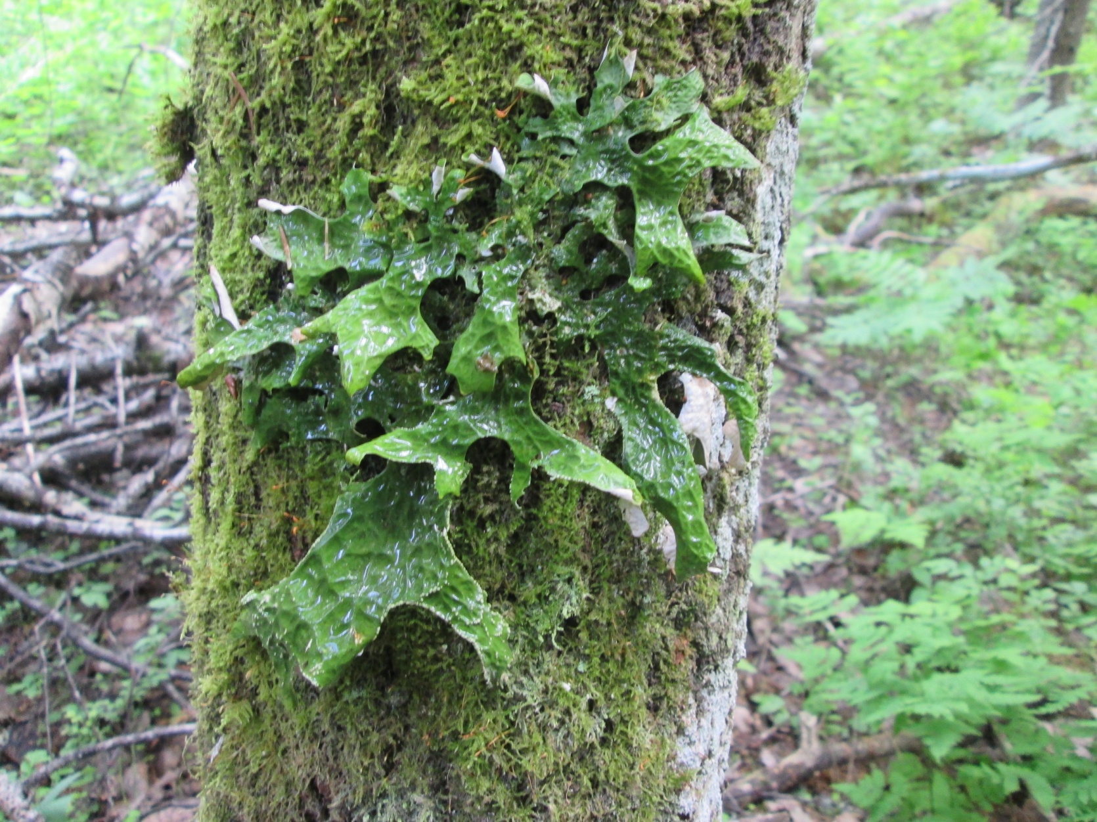
Parameters of water balance: results
Number of thalli
Cover percentage of mosses, %
Fig. 4. Number of L. pulmonaria thalli on Populus tremula with different mosses cover in communities of middle boreal zone.
Fig. L. pulmonaria with mosses

Slide 13
Parameters of water balance: results
WHC – water-holding capacity
was calculated as ratio water mass at full thallus saturation to thallus area
WHC = (Water Mass – Dry mass)/thallus area.
(mg H₂O ∙ cm⁻²)
STM – specific thallus mass was calculated as ratio of dry mass to thallus area
STM = Dry mass/ thallus area
(mg dry mass ∙ cm⁻²)
*
St - sterile (st, im 3, v 1); s – sorediate (sor, v 2); fert - fertile (fert, g); Sen - senile (sen, s)
Fig. 5. WHC and STM of L. pulmonaria thalli of different functional-age groups

Slide 14
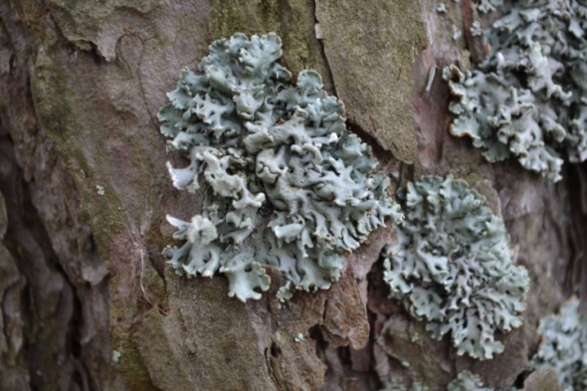
Parameters of water balance: results
Table 3. Parameters - WHC and STM for thalli of Hypogymnia physodes and
Lobaria pulmonaria
 |  | sterile | sorediate
WHC (мг H₂O ∙ см⁻²) | Hypogymnia physodes* | 82,38 | 65,48
 | Lobaria pulmonaria | 11,57 | 14,85
STM (мг сух. веса ∙ см⁻²) | Hypogymnia physodes* | 12,29 | 23,68
 | Lobaria pulmonaria | 7,94 | 10,93
Lobaria pulmonaria (Gauslaa, Coxson, 2011)
WHC 12.7-13.0
STM 8.5-9.4
Note: * Androsova, Suroeva 2018
Hypogymnia physodes Lobaria pulmonaria

Slide 15
Parameters of water balance: results
Fig. 6. WHC (water-holding capacity) of
L. pulmonaria thalli on aspen trunks with different cover percentage of mosses

Slide 16
Parameters of water balance: results
St - sterile (st, im 3, v 1);
s – sorediate (sor, v 2);
fert - fertile (fert, g);
Sen - senile (sen, s)
Fig. 7. Maximal water saturation of L. pulmonaria thalli of different functional-age groups

Slide 17
Parameters of water balance: results
1
2
Fig.8. Velocity of water saturation of L. pulmonaria thalli with different cover percentage of soredia

Slide 18
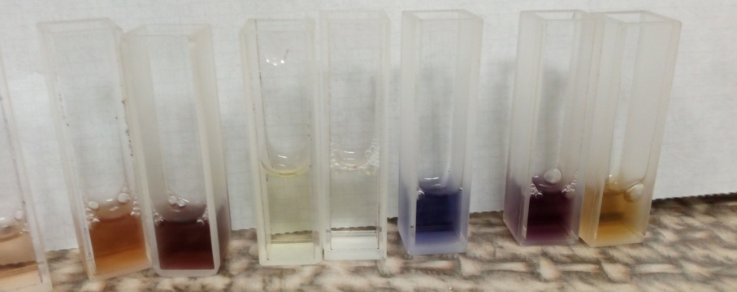
Estimation of enzymatic activity : methods
Ontogenetic stages:
juvenile (virginil 1, virginil 2a, 2b, 2c)
mature (senile, subsenile)
Phorophyte – aspen (Populus tremula)
Activity of catalase (µmol H₂O₂/mg of protein)
was determined by the enzymatic decomposition of hydrogen peroxide (at 240 nm).
Localities of samles collection:
Middle boreal subzone
Zaozersky Sanctuary (61˚50’N, 34˚20’E)
Kivach Strict Nature Reserve (62˚17’N, 34˚00’E)
Northern boreal subzone
Vodlozersky National Park (63˚30’N, 37˚28’E, Arkhangelsk region )
Activity of superoxide dismutase (U/mg of protein)
was determined on the inhibition of photo recovery of nitro blue tetrazolium ( at 560 nm).
Activity of peroxidase (µmol TG/mg of protein)
was determined based on the using guaiacol as a hydrogen donor and hydrogen peroxide - as a substrate (at 470 nm)
Protein content
was determined by Bradford method and expressed in mg of protein per g of tissue (mg/g).

Slide 19
Estimation of enzymatic activity : resullts
Table. 4. Protein content and enzymes activity in juvenile and mature thalli of Lobaria pulmonaria in middle and northern boreal communities.
Параметры | Northern boreal communities |  | Middle boreal communities
 | Juvenile | Mature | Juvenile | Mature
Protein content, mg/g | 3.64±0,28 | 3.79±0,34 | 3.55±0,11 | 3.32±0,10
SOD activity, U/mg of protein | 6.22±0,26 | 4.85±0,48 | 5.22±0,32 | 5.66±0,27
CAT activity, µmol H₂O₂/mg of protein | 187±49,02 | 522±70,57 | 441±73,49 | 578±64,06
Superoxide dismutase activity, U/mg of protein:
7,56±0,26
(Golovko et al., 2018, L. pulmonaria)
3,29±0,44
(Golovko et al., 2018, Hypogymnia physodes)
Catalase activity, µmol H₂O₂/mg of protein:
217±27
(Silberstein et al., 1996, Xanthoria parietina)

Slide 20
Estimation of enzymatic activity : results
Superoxide dismutase
Catalase
Fig. 9. Activity of superoxide dismutase and catalase in L. pulmonaria thalli from communities of middle and northern boreal subzones

Slide 21
Estimation of enzymatic activity : results
Superoxide dismutase
Catalase
Fig. 10. Activity of superoxide dismutase and catalase in juvenile thalli of L. pulmonaria from communities of middle and northern boreal subzones

Slide 22
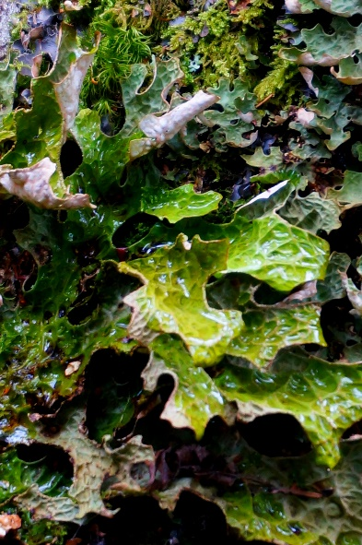
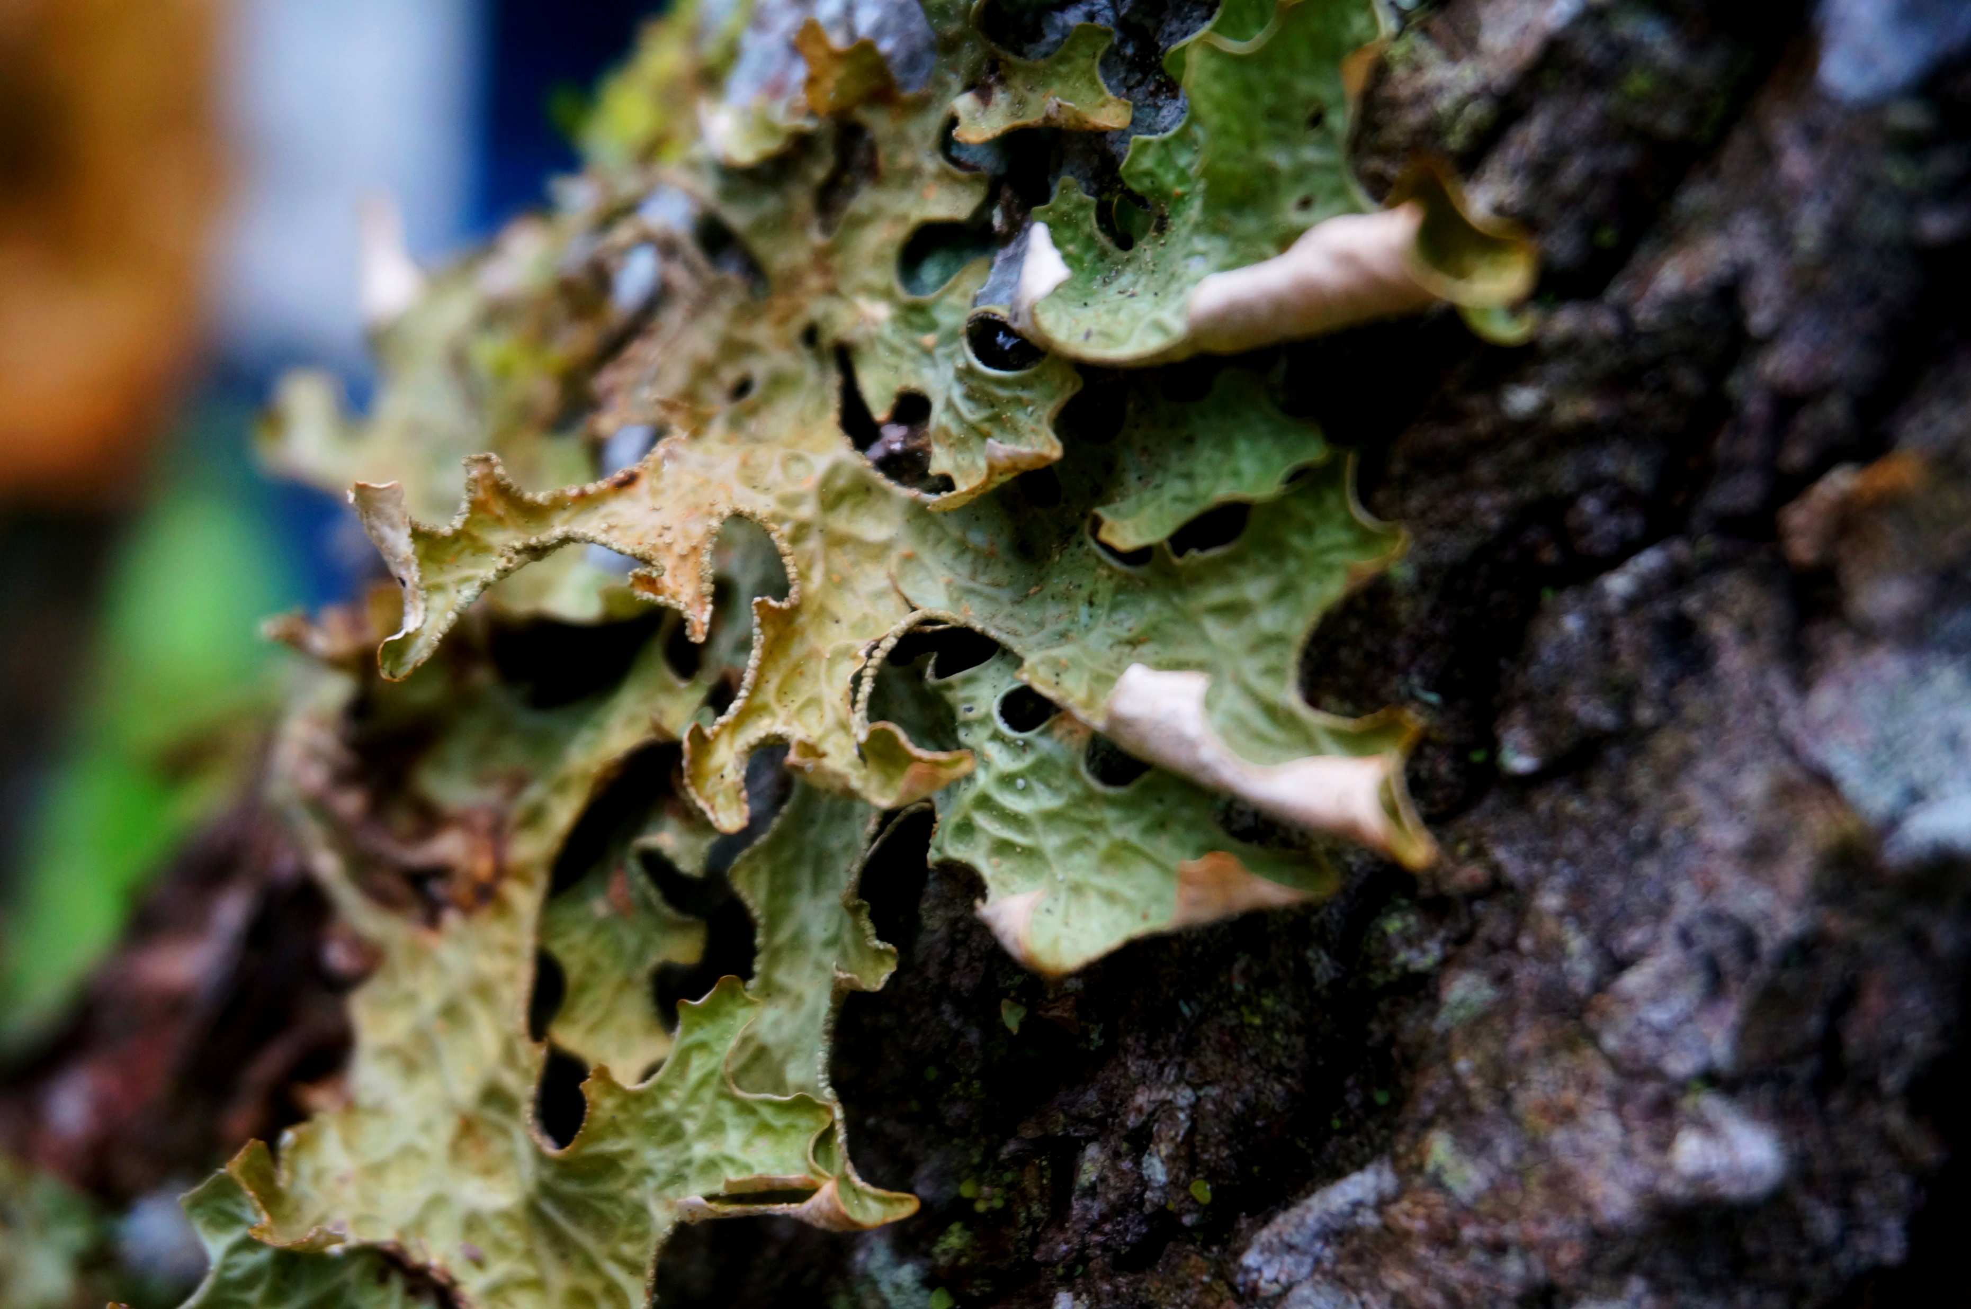
Conclusion
The study revealed differences between the Lobaria pulmonaria thalli of different ontogenetic stages.
The specify features were found for young immature and virginil thalli (without reproductive structures):
- low stability of the photosynthetic apparatus functioning;
- low specific thallus area, low velocity of water absorption rate and low water holding capacity;
- studies of antioxidant enzymes have also revealed sensitivity in the early stages of L. pulmonaria thallus development.

Slide 23
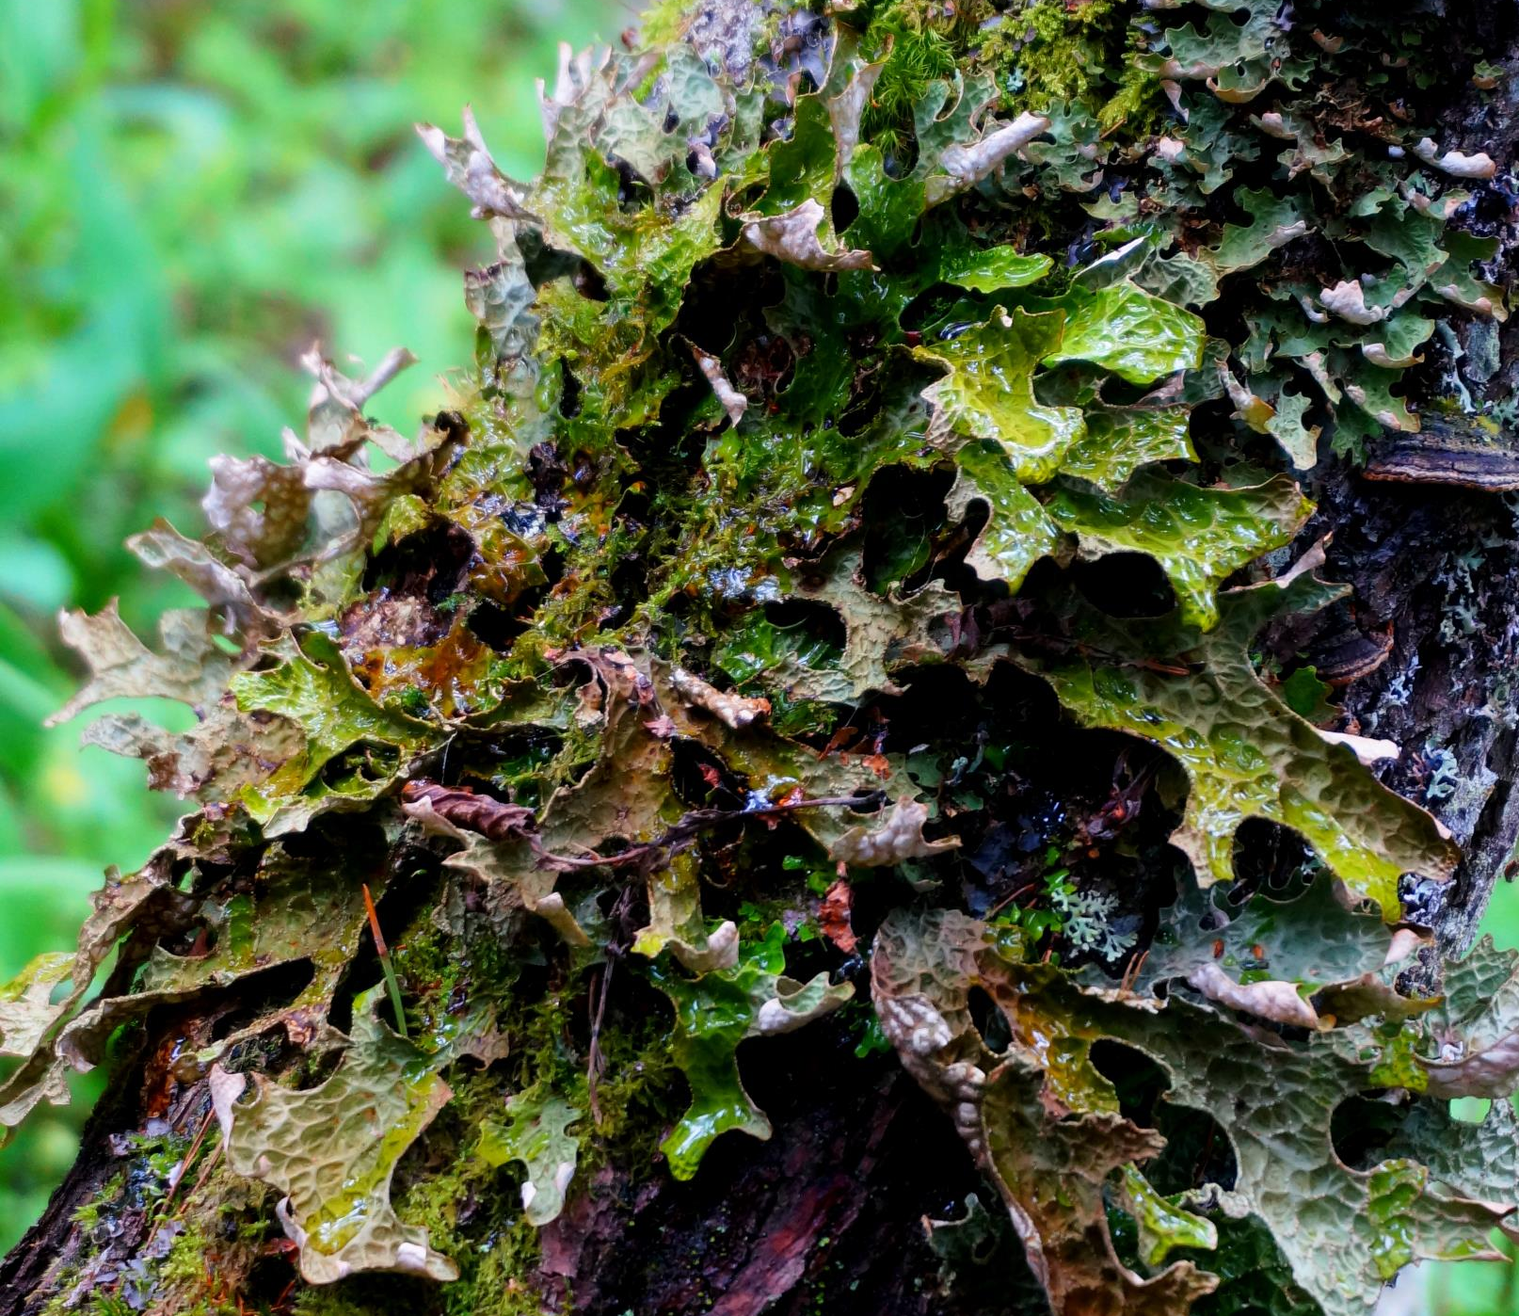
Thanks for attention!

