Slide 1
Recovery of lichens after disturbances in boreal forests: species diversity, cover, populations
International Conference «Lichens: from molecules to ecosystems»
Syktyvkar, September 9-12, 2019
Viktoria Tarasova¹, Vera Androsova¹, Vadim Gorshkov^{2,3},
Roman Ignatenko⁴, Lyubov Kalacheva¹, Viktoria Shvetzova¹, Irina Zhulai¹, Roman Obabko⁶
¹Petrozavodsk State University, Petrozavodsk, Republic of Karelia, Russia
²Komarov Botanical Institute RAS, St. Petersburg, Russia
³St. Petersburg State Forest Technical University, St. Petersburg, Russia
⁴Institute of Biology of Karelian Research Centre RAS, Petrozavodsk, Russia
⁵The Arctic University of Norway, Tromsø, Norway
⁶Forest Research Institute of Karelian Research Centre RAS, Petrozavodsk, Russia

Slide 2
The importance…
The modern boreal forests are highly disturbed;
the decrease in biological diversity of boreal vegetation;
the impact of climate change on boreal ecosystems.
The study of the potential of forest ecosystems and their individual components for recovering is the most important task of modern ecology.

Slide 3
Lichens as component of forest communities:
sensitive to environmental disturbances;
predominance of epiphytic lichens;
ephemeral, unstable habitats (living trees);
The dynamics of the epiphytic cover depends on the dynamics of communities, tree stand, and individual trees.

Slide 4
Problems:
The dynamics of recovering of the lichen component in boreal forest communities after disturbances is poorly studied;
ignoring by Russian lichenologists the ecological approach in researches;
low level of environmental knowledge: the basics of geobotany and phytocenology, forest typology.

Slide 5
Traditionally, the succession of lichens are being actively studied in Europe, especially in the Scandinavian and Baltic countries, as well as in the USA and Canada, but:
often there are no data about exactly time-since-disturbance;
no continuous succession series of communities, belonging to the same forest habitats: often only two categories of forests are compared: «managed forests» and «old-growth forests»;
forests in Europe, that have not yet completed their recovery cycle after disturbance, are often regarded as old growth forests;
Problems:
difficult to identify the potential of lichen component to recover from disturbances and to determine the stages and duration of this process.

Slide 6
On the other hand the recovering dynamics of taiga ecosystems after disturbance has been fairly well studied, at least in Northwest Russia, but:
in these researches the lichen component is often ignored, because
geobotanists do not know the methods of lichen identification.
Problems:
The solution to this problem could be comprehensive work carried out by different specialists at the same sample plots.

Slide 7
The main approaches for the study of successional forest dynamics:
Approaches | Core | Advantages | Disadvantages
Direct observation | Description of stationary sample plots after a certain time | High accuracy of assessment of recorded indicators | Limited observation time
The method of constructing of ecological-dynamic series | Selection and description of communities with different time-after disturbances growing in similar habitats | A wide range of time –after disturbances | Errors in determining community growing in the same habitats

Slide 8
Hypothesis
Since lichens are components of ecosystems, general principles of recovering dynamics of communities are applicable to them.

Slide 9
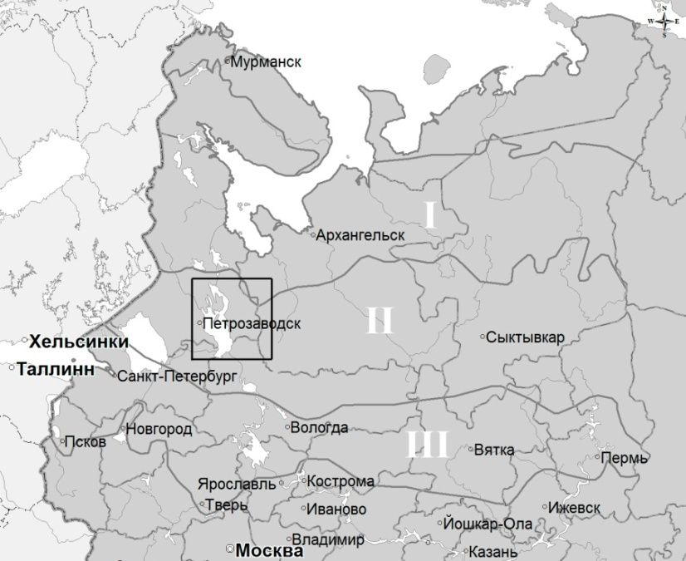
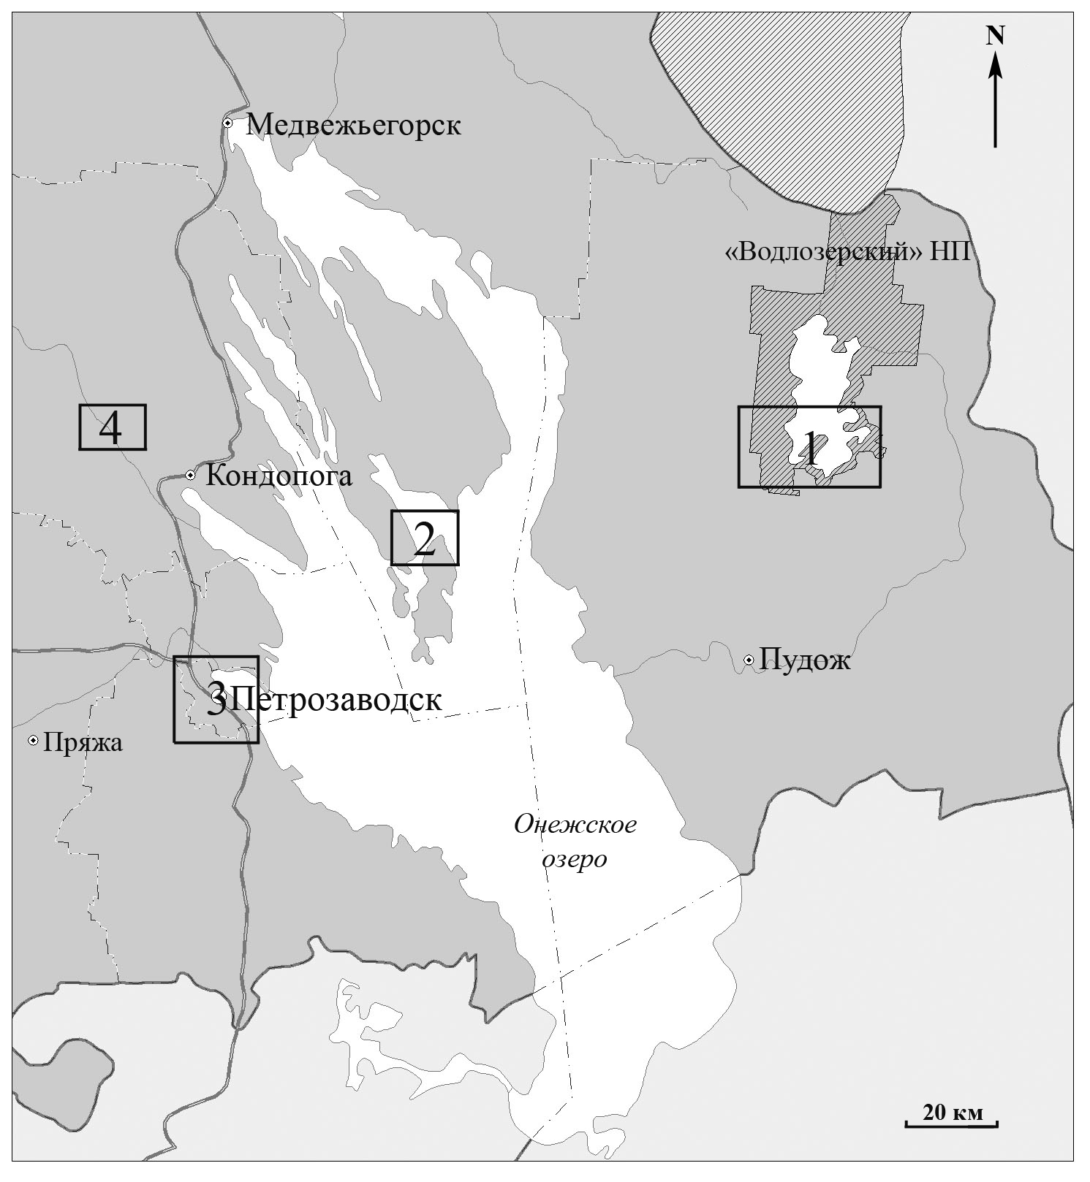
Research areas
N
3
1
5
2
4
Subzones of taiga:
I – northern;
II – middle;
III – southern.
1 – Vodlozersky National Park;
2 – Kizhsky Reserve;
3 – Kivach Reserve;
4 – Petrozavodsk city;
5 – Vodlynsky forestry
Fig. 1. Location of research areas on the map of the Republic of Karelia.

Slide 10
Objects of study ecological-dynamic series of communities in drained habitats:
1. Green-moss pine forests on fluvioglacial deposits (sand), the time-after-disturbance is 4-206 years.
2. Green-spruce spruce trees recovering through aspen forests, on loamy moraine, the time-after-disturbance is 20-450 years.
3. Green-spruce spruce trees recovering through birch forests, on sandy loam and loamy moraine, the time-after-disturbance is 64-377 years.

Slide 11
а) The method of direct observation at stationary sample plots
Green-moss pine forests of different time after last fire
4 years
(1998)
11 years
(2005)
15 years
(2009)
19 years
(2013)
Fig. 2. Pine forest (SP№29а, Kivach) with different time after last fire

Slide 12
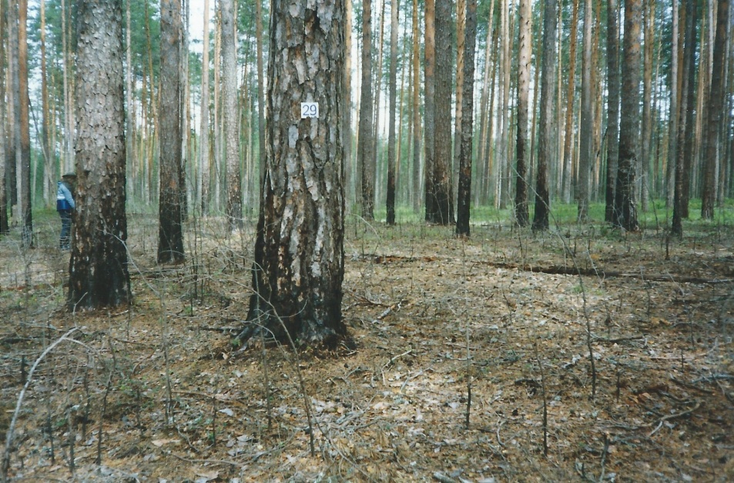
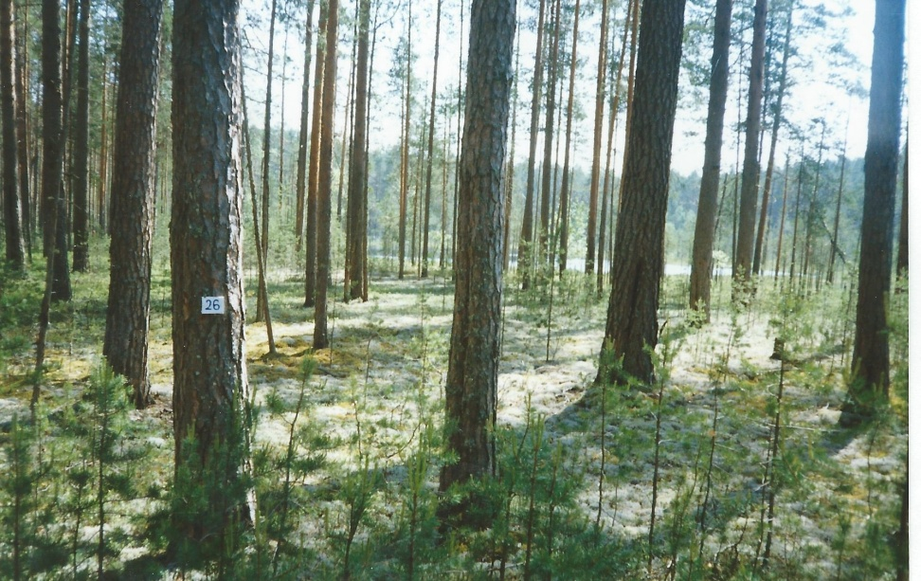
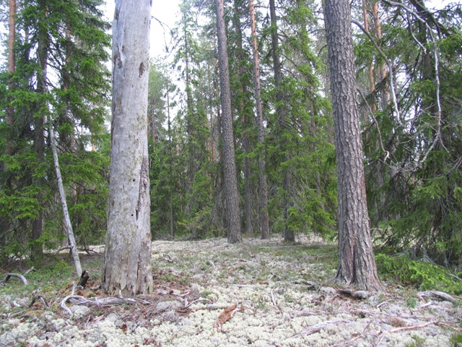
б) The method of constructing ecological-dynamic series
Green-moss pine forests of different time after last fire
4
years
52
years
70
years
180
years
Fig.3. Pine forests with different time after last fire

Slide 13
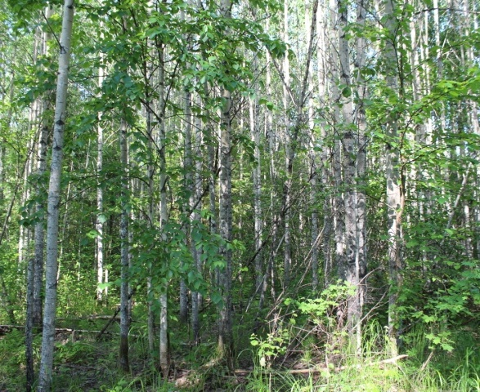
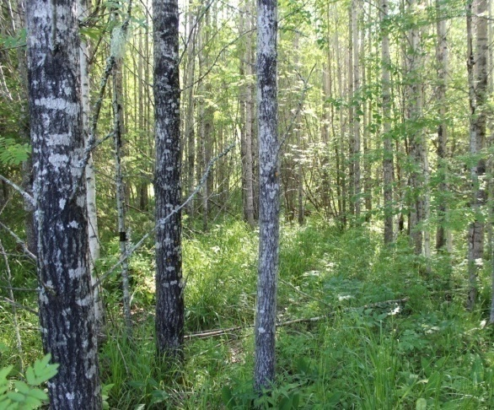
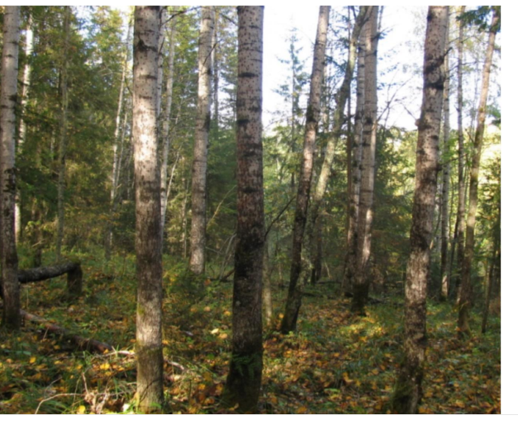
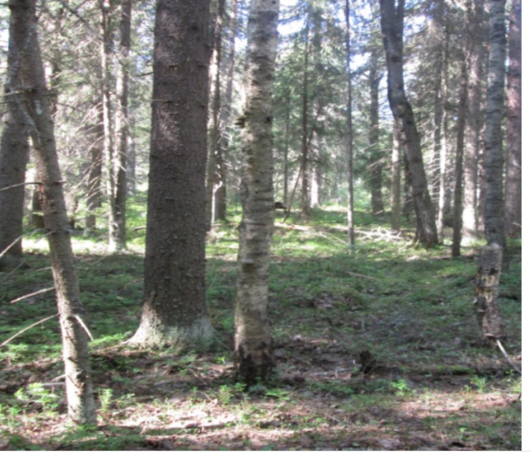
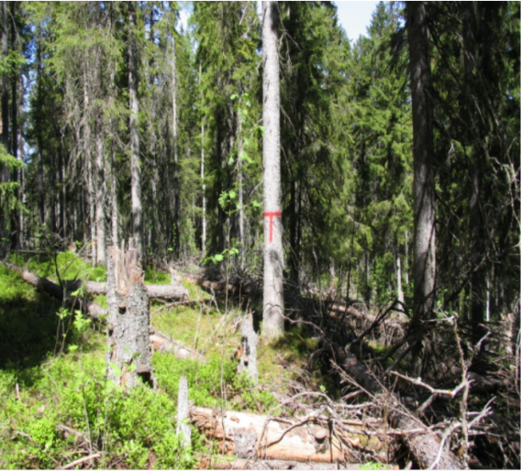
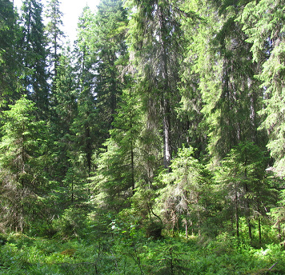
3. Spruce forests (throw aspen forests stage)
The method of constructing ecological-dynamic series
Aspen herb
Mixed spruce-aspen forest
Vaccinium myrtillus- green moss spruce forest
20
years
40
years
80
years
140
years
260
years
450
years
Fig. 4. Ecological-dynamic series of spruce forests
13

Slide 14
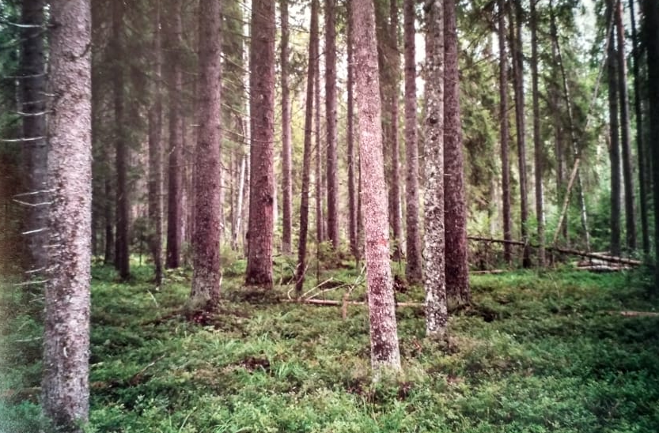
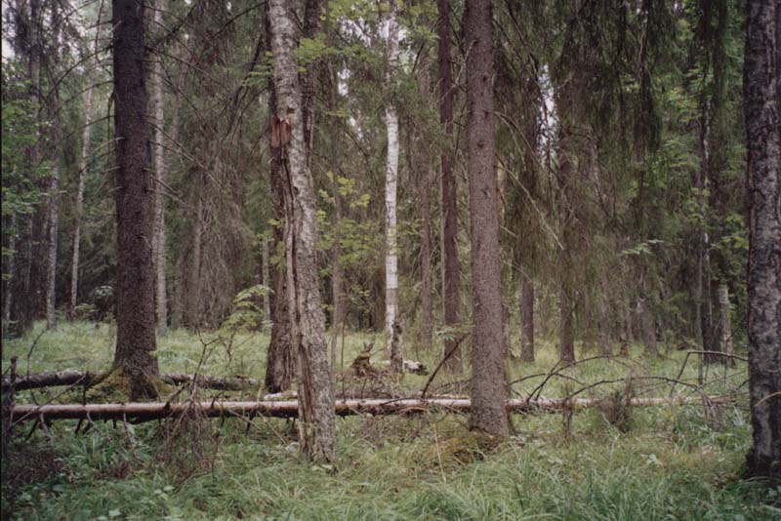
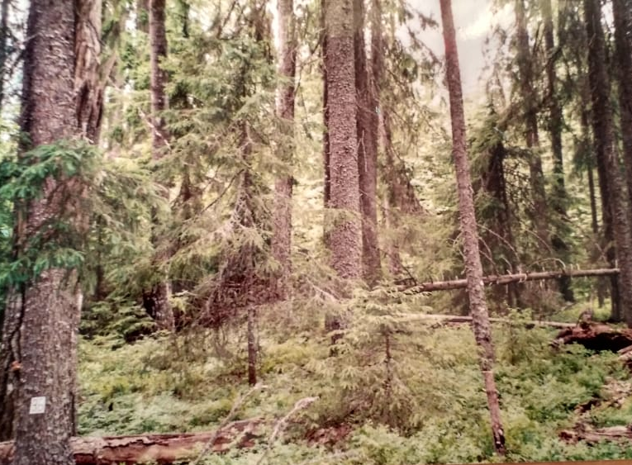
The method of constructing ecological-dynamic series
3. Spruce forests (throw birch forests stage)
74 years
94 years
185 years
282 years
Fig. 5. Ecological-dynamic series of spruce forests

Slide 15
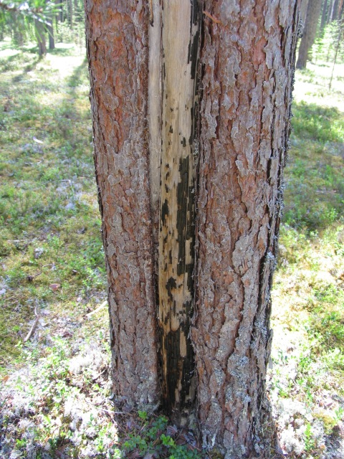
Methods. Determination of the time after disturbance
Spruce forests
Pine forests
a) Studying the population structure of spruce trees: construction of histograms of frequency distributions by age, diameter and wood supply;
b) analysis of the maximum age of trees;
c) analysis of the age of the stand and undergrowth, renewing on the dead wood.
(а)
(б)
Fig. 6. A post-fire scar on a pine trunk with traces of two fires - 132 and 98 years ago, ZP “Kivach”.
Fig. 7. Histograms of the frequency distribution of the number of spruce trees depending on its age: a – old-growth spruce forest (NP "Vodlozersky", 410 years), b – herb aspen forest (ZP "Kivach", 80 years ).

Slide 16
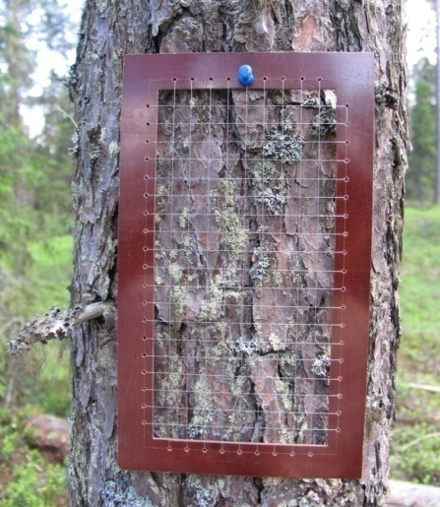
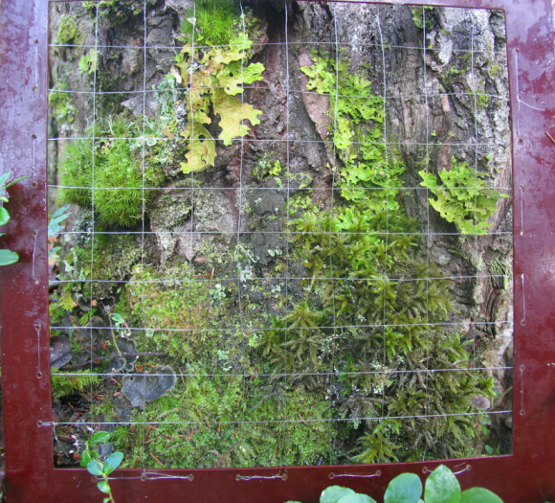
Methods. Study of epiphytic cover
In pine forests– pine (Pinus sylvestris L.)
In spruce (birch series) forests – spruce (Picea abies (L.) Karst.)
In spruce (aspen series) forests – aspen (Populus tremula L.)
8 -25 trees selected on sample plot
Characteristics of trees (height, age, diameter)
Description of epiphytic lichen cover:
(а)
8 per trunk tree:
- by use frame 10х20 cm (pine, spruce), 25х25 cm (aspen);
- at the height 0 and 1,3 m above ground level;
- form four sides (north, east, south, west).
(b)
Characteristics of the epiphytic cover:
- species diversity;
- cover percentage of lichens and mosses.
Fig. 8. Description of the epiphytic cover on the trunks using a frames
of 10x20 (a) and 25x25 cm (b).

Slide 17
Sample size
Type of data | Pine forests | Spruce forests (aspen series) | Spruce forests (birch series)
Number of sample plots | 35 | 28 | 40
Number of trees | 500 | 227 | 600
Number of descriptions | 5600 | 1791 | 4800
Number of specimen determinations | ~ 850 | 3447 | ~ 1150

Slide 18
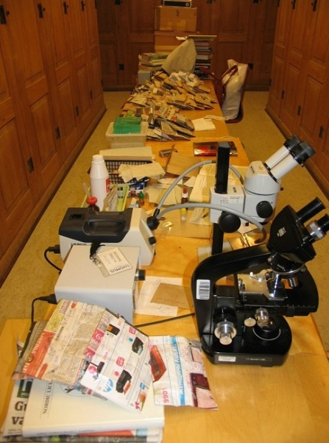
Methods. Total lichen species diversity
was studied on different substrates (on all tree species, soil, standing and lying dead wood) within the sample plot;
only in spruce forests (aspen series).
Fig. 9. Identification of lichens in herbarium of University of Helsinki

Slide 19
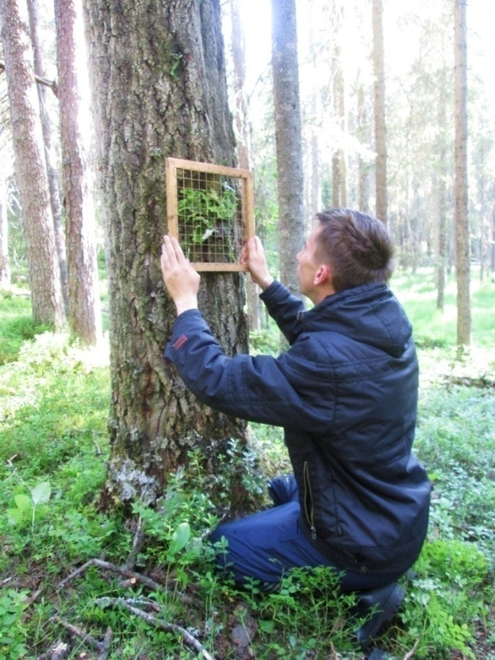
Methods. Population structure of Lobaria pulmonaria
In spruce forests (aspen series).
By the method of total recording of all thalli on all substrates at the height from 0 to 2 m above ground level.
The total area and ontogenetic stage were described for each thallus.
Type of data | n
Number of sample plots | 25
Number of trees | 556
Number of description of thalli | 2811
Fig. 10. The measurement of thallus area

Slide 20
Results
The total lichen species diversity
in spruce forests (aspen series)

Slide 21
Total species diversity
Number of species per ha
Time-after-disturbance, years

Slide 22
Total species on Picea spp.
Total species on Populus tremula
Number of species per ha
Time-after-disturbance, years

Slide 23
Total species on Alnus incana
Total species on Betula spp.
Number of species per ha
Total species on Sorbus aucuparia
Total species on deadwood
Time-after-disturbance, years

Slide 24
Number of species – indicators of old-growth forests
Number of species per ha
Time-after-disturbance, years
Handbook for identifying valuable forest types in northwestern Russia
(Konechnaja et al., 2009)

Slide 25
Number of cyanolichen species
Number of Caliciales species
Number of species per ha
Time-after-disturbance, years

Slide 26
Results
Total epiphytic lichen species diversity
in pine forests

Slide 27
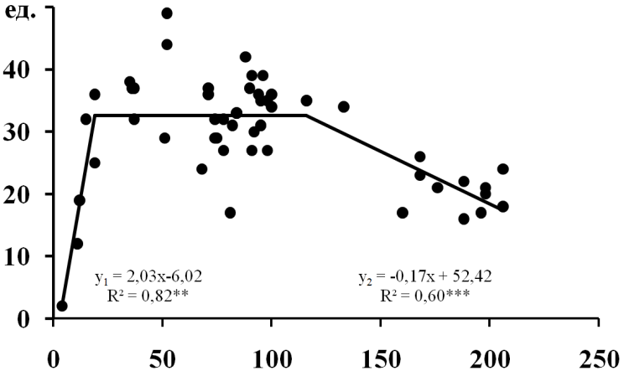
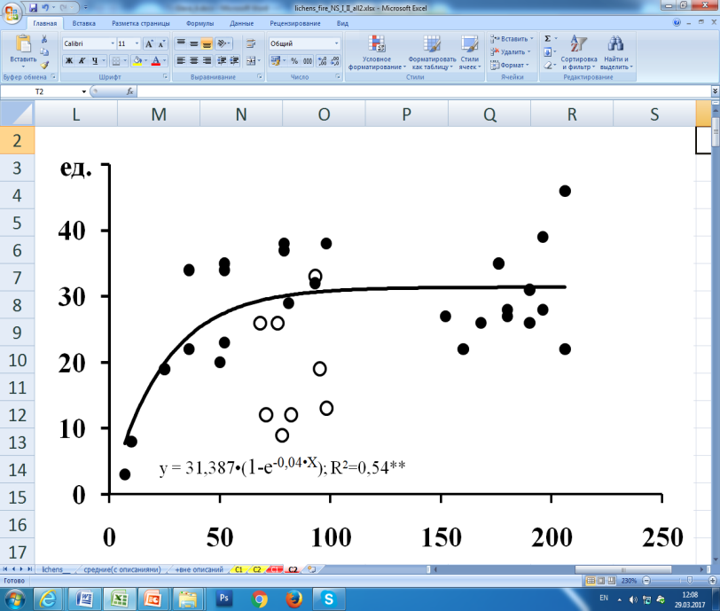
Total number of epiphytic lichen species, n
pre-fire
generation
of trees
post-fire generation
of trees
The time-after-last fire, years
Notes: white circles - communities with insignificant damage (5–20%) of tree stand by last fire.

Slide 28
Results
Cover of epiphytic lichens in pine forests

Slide 29
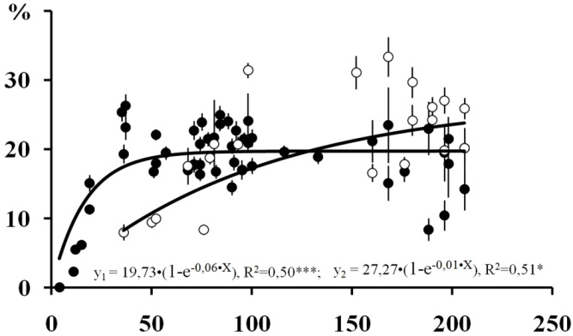
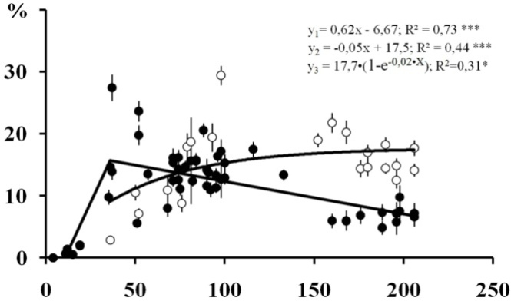
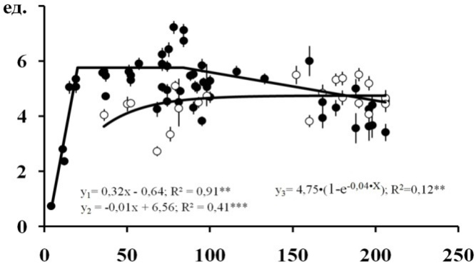
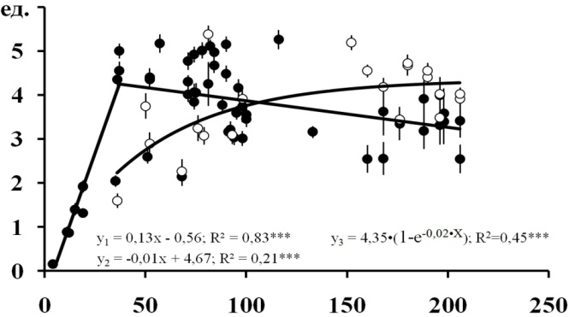
Epiphytic cover in pine forests on tree trunks
of pre- (black circles) and post-fire (white circles) generations
height 0-20 сm
height 130-150 сm
Total cover, %
Average number of species in description, n
Time after last fire, years

Slide 30
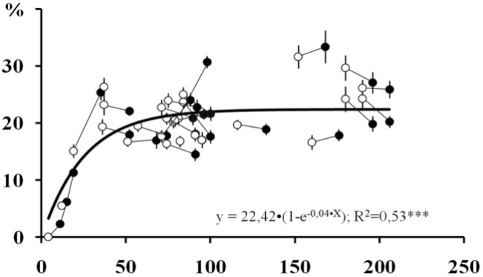
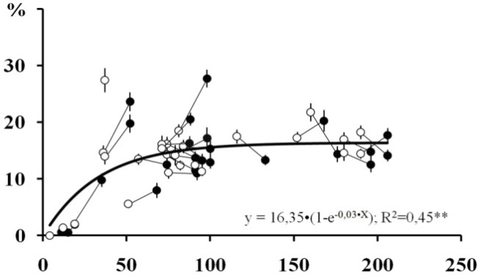
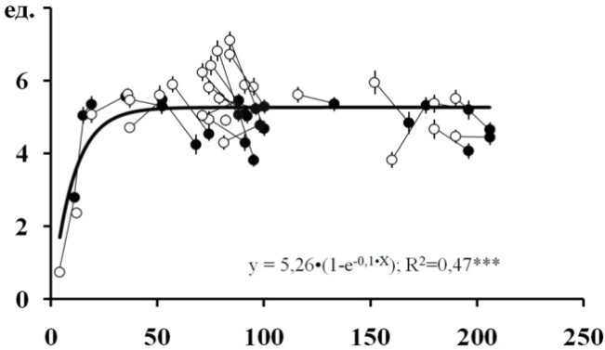
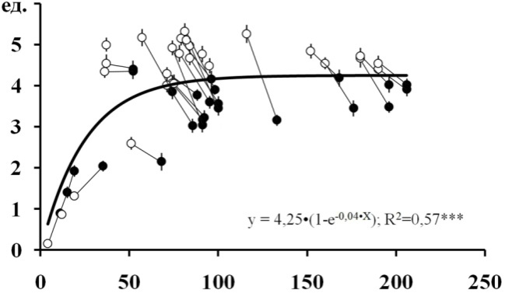
Epiphytic cover in pine forests on tree trunks of two generations
height 0-20 сm
Total cover, %
height 130-150 сm
Average number of species in description, n
Time after last fire, years
Notes. The same sample plots connected by lines: black circles – observed in 1997-99, white circles – in 2014-15.

Slide 31
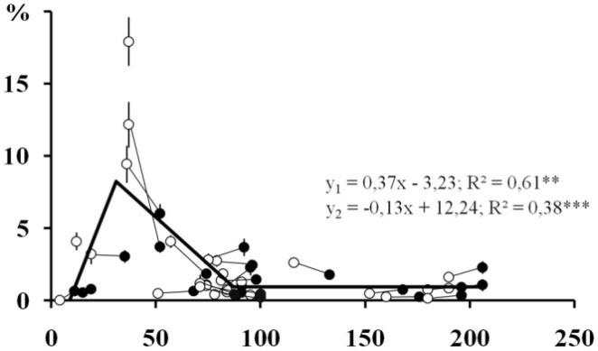
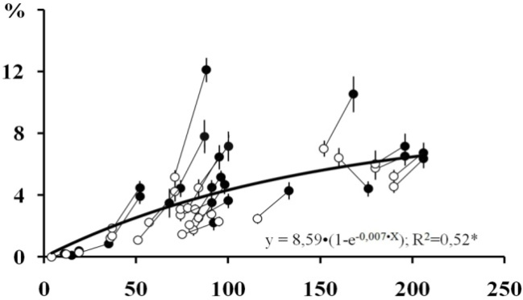
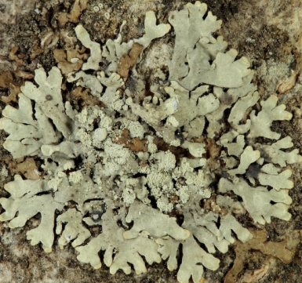
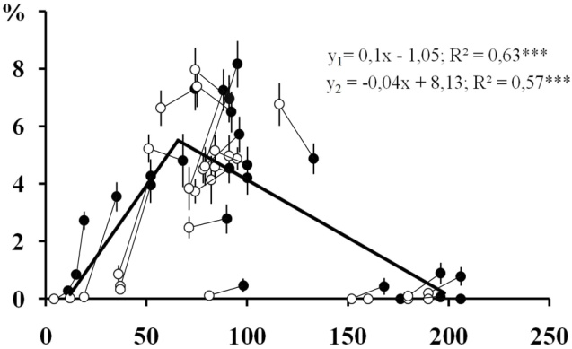
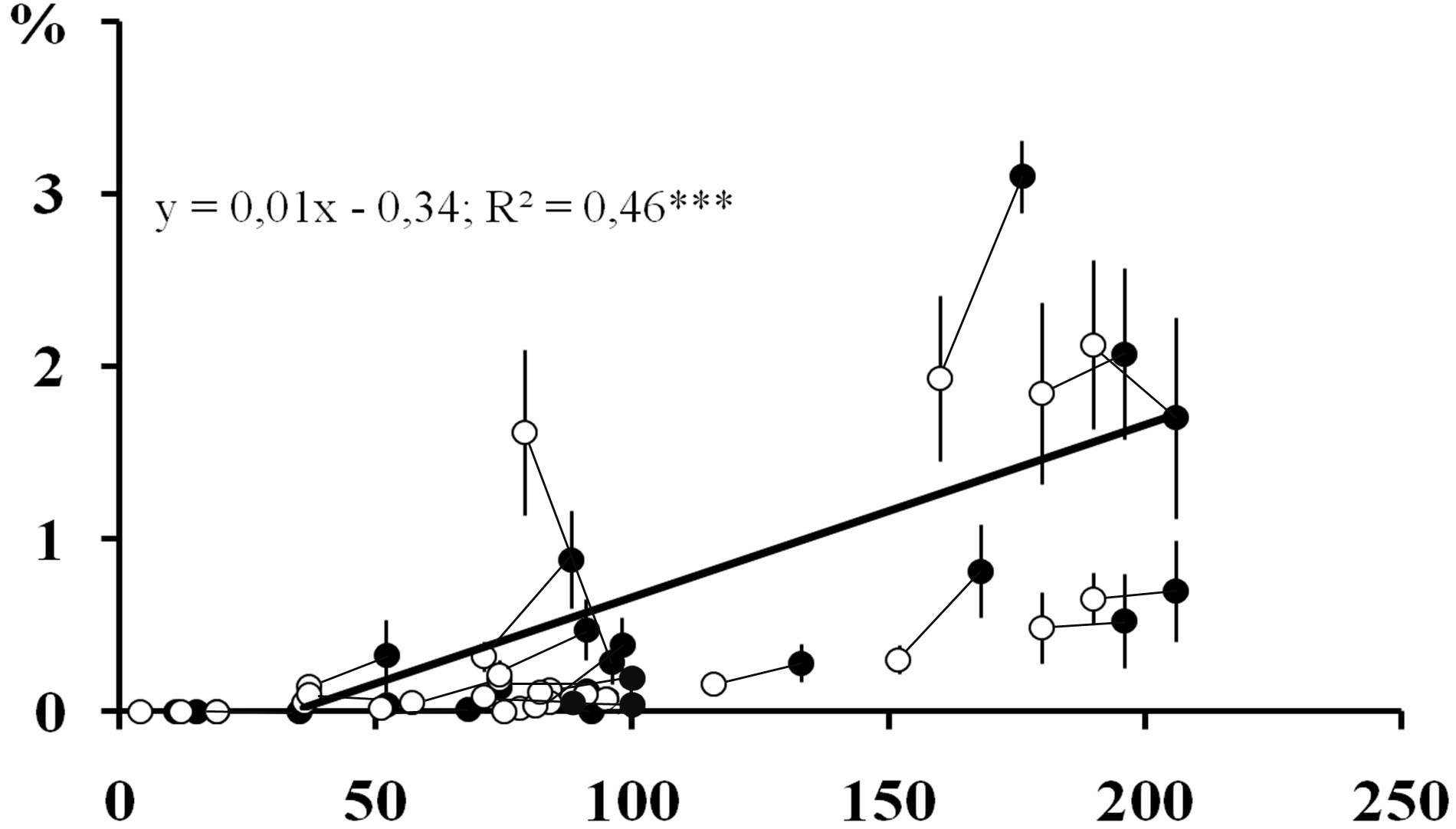
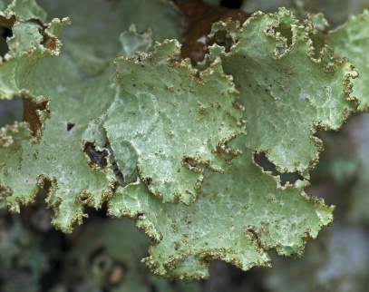
height 0-20 сm
height 130-150 сm
Hypogymnia physodes
Parmeliopsis ambigua
Hypocenomyce scalaris
Platismatia glauca
Time after last fire, years

Slide 32
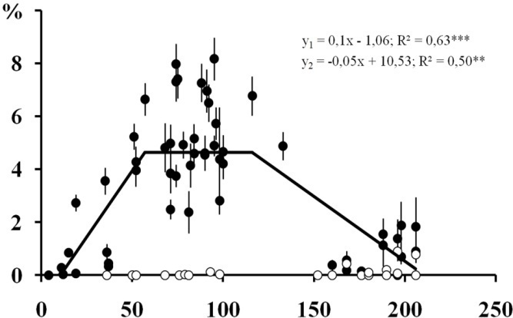
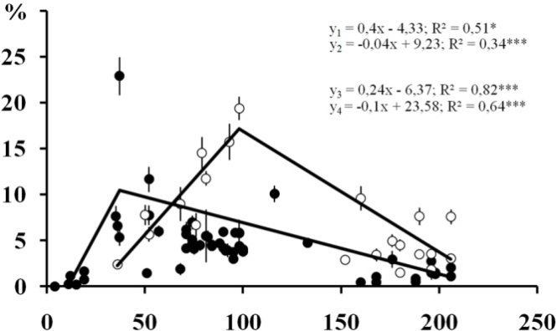
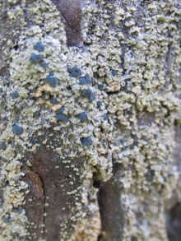
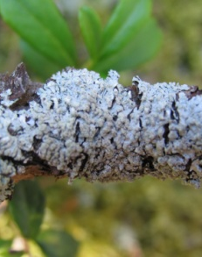
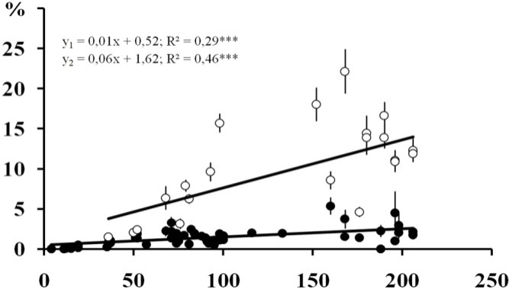
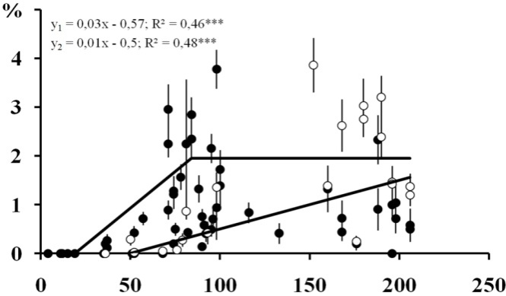
height 0-20 сm
height 130-150 сm
Hypocenomyce scalaris
Hypogymnia physodes
Parmeliopsis hyperopta
Bryoria spp.
Time after last fire, years

Slide 33
Results
Cover of epiphytic lichens on spruce trunks in spruce forests (birch series)

Slide 34
height 0-20 сm
height 130-150 сm
Total cover, %
Average number of species in description, n
Time after disturbance, years

Slide 35
height 0-20 сm
height 130-150 сm
Cladonia spp.
Hypogymnia physodes
Parmeliopsis hyperopta
Parmeliopsis ambiqua
Cover percentage, %
Lepraria spp.
Platismatia glauca
Time after disturbance, years

Slide 36
Results
Cover of epiphytic lichens on aspen trunks
in spruce forests (aspen series)

Slide 37
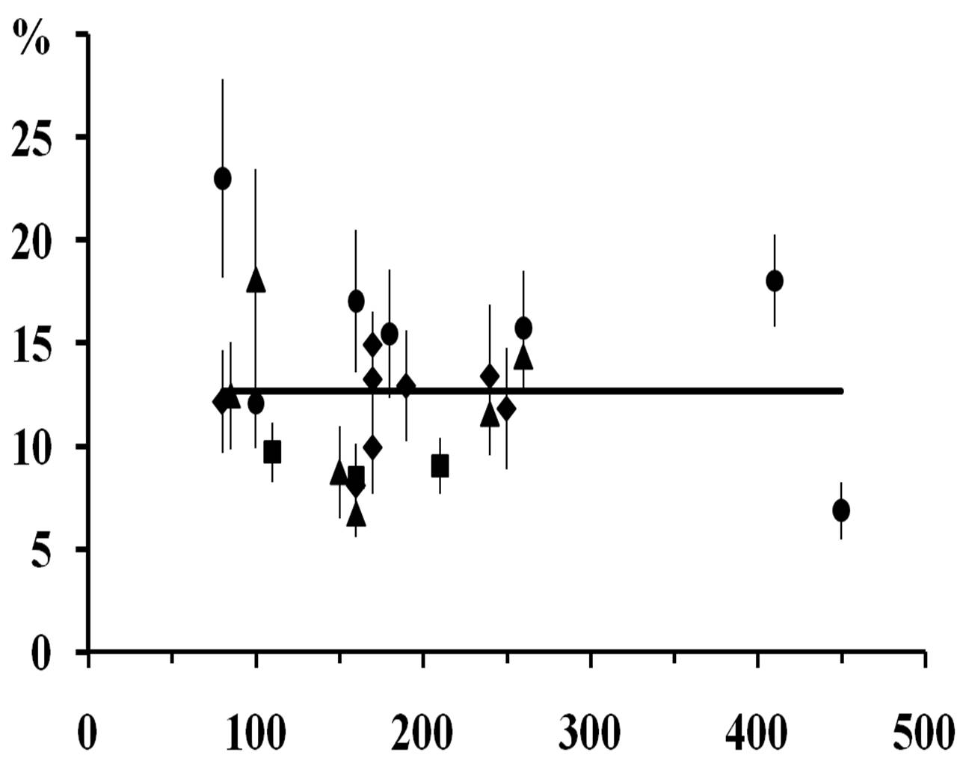
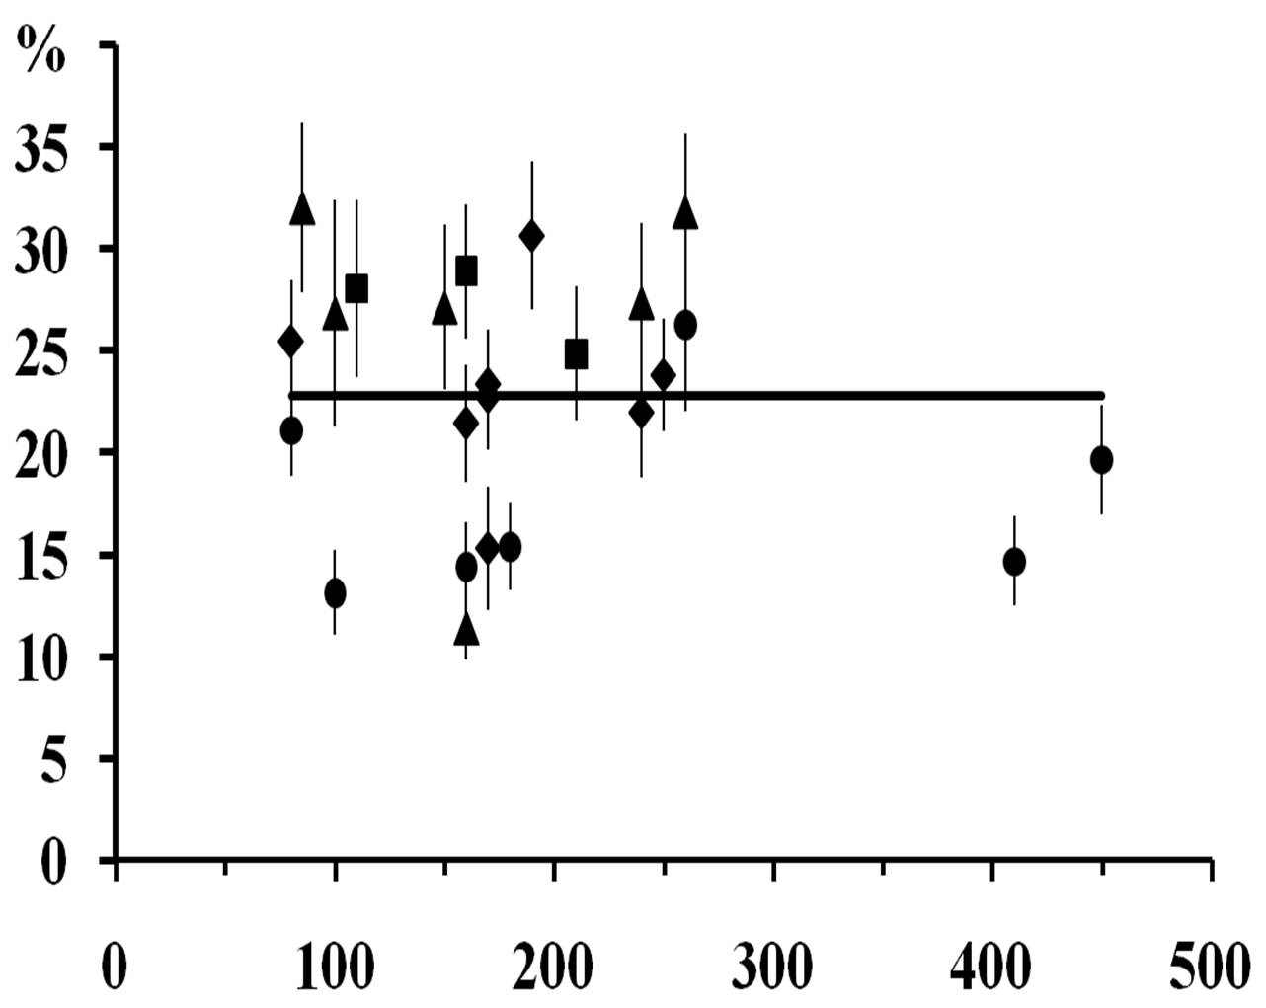
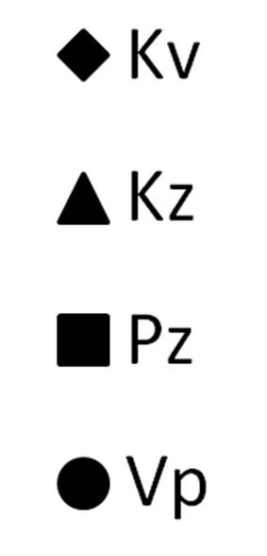
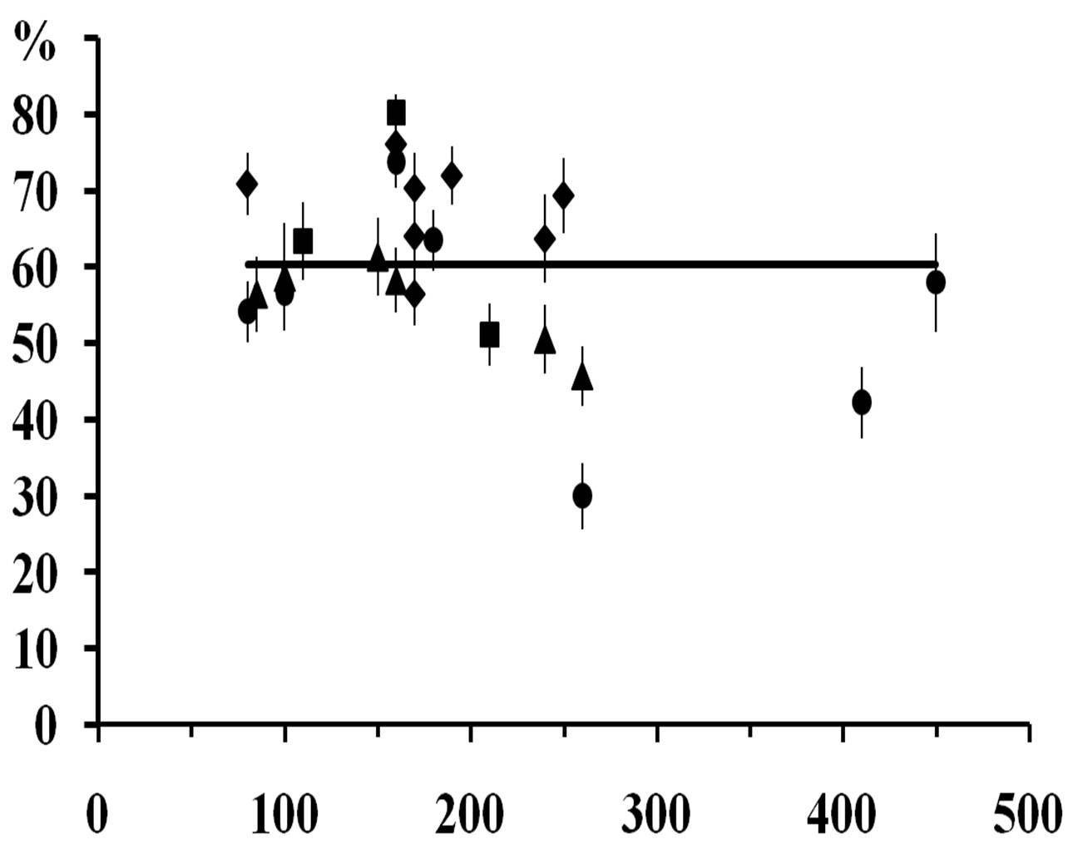
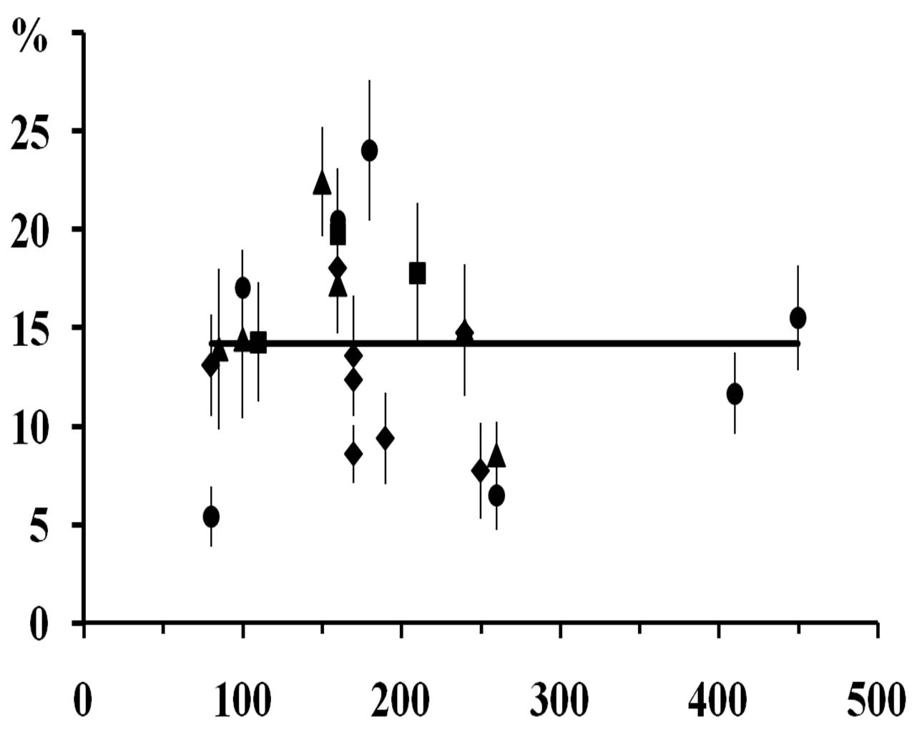
height 0-20 сm
height 130-150 сm
Total lichen cover, %
Areas:
Total moss cover, %
Time after disturbance, years

Slide 38
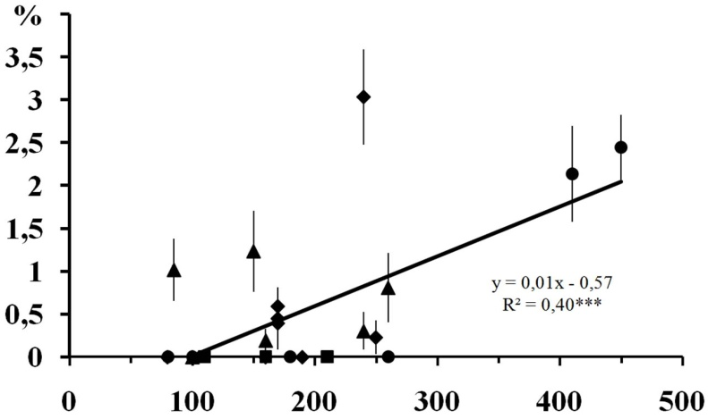
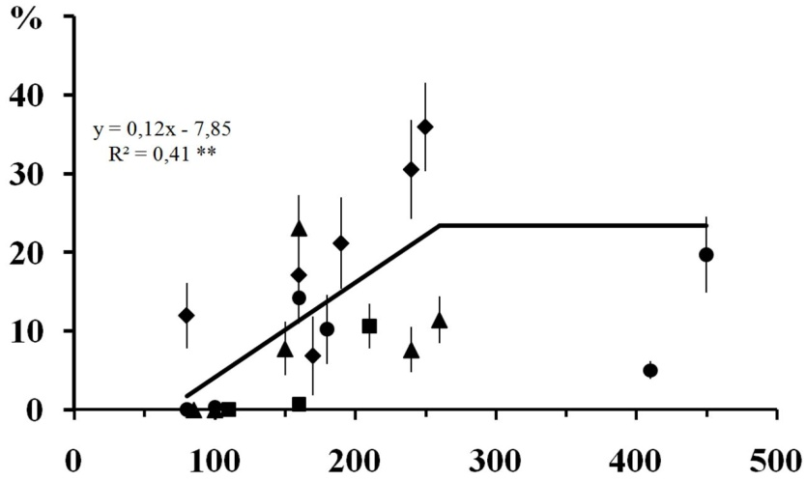
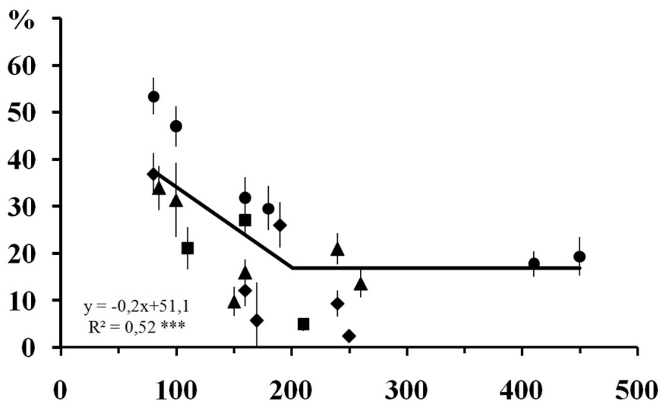
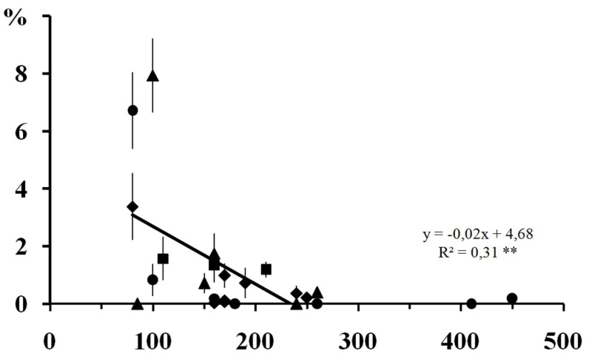
height 0-20 сm
Nephroma spp.
Rhytidiadelphus triquetrus
Mycobilimbia epixanthoides
Brachythecium spp.
Time after disturbance, years

Slide 39
height 130-150 сm
Parmelia sulcata
Lecanora spp.
Physciaceae
Phlyctis argena
Time after disturbance, years

Slide 40
Results
Population structure of Lobaria pulmonaria
in spruce forests (aspen series)

Slide 41
Total number of thalli, n
Number of substrate units, n
Time after disturbance, years

Slide 42
Number of thalli on living P. trеmulа
Number of thalli on standing deadwood of P. trеmulа
Number of thalli on living Picea abies
Time after disturbance, years

Slide 43
Average of thallus area, cm²
Total thalli area, cm²/ha
Percentage of virgin 2a thalli, %
Percentage of subsenile thalli, %
Time after disturbance, years

Slide 44
Spatial structure of coenopopulatioan of Lobaria pulmonaria Middle age aspen forest, age 80 years
Radius, m
Fig. 10. Ripleyʼs function score g (r) for individuals of trees with different number of L. pulmonaria thalli.
20 m
Substrates with L. pulmonaria randomly distributed

Slide 45
Spatial structure of coenopopulatioan of Lobaria pulmonaria Mixed aspen - spruce forest, age 175 years
Radius, m
20 m
Substrates with L. pulmonaria group distributed: grouped at a distance of 2.5 -4 m

Slide 46
Spatial structure of coenopopulatioan of Lobaria pulmonaria Old-growth spruce forest, age 410 years
Radius, m
20 m
Substrates with L. pulmonaria group distributed: grouped at a distance of 1 -16 m

Slide 47
Conclusion
It was found, that the basic characteristics of lichen cover, such as: species diversity, coverage (indirect biomass indicator), species structure (proportion of species cover), as well as the population structure of individual lichen species, are determined by the time since the last disturbance (position of the community in the succession series), species and age structure of the stand, the proportion of trees before- and after- fire generations.
The relative stabilization (recovering) of most of the studied lichen characteristics in the spruce forests is registered at 250 years after the disturbance, and pine (depending on the saving of the tree stand after last fire) - at 50–150 years. Among the studied lichens, groups of early, middle, and late succession species were identified that can be used as indicators of certain stages of forest development.

Slide 48
the study was supported by the Ministry of Education and Science of the Russian Federation, project No 5.8740.2017/k “Comprehensive assessment of the recovering potential of moss and lichen cover during secondary autogenous successions in boreal ecosystems of the North-West of Russia”
ГОРШКОВ Вадим Викторович д. б. н., профессор кафедры Общей экологии и физиологии растений ГЛТУ , заведующий Лаборатории Экологии растительных сообществ БИН РАН
In locality of Usnea longissima
in Arkhangelsk region

Slide 49
Thank you for attention!
Old-growth flooded spruce forest near Ileksa river (Vodlozero National Park)

